Slide 2

Azure Service Bus Messaging - The Good, The Bad, and The Ugly Sean Feldman

Slide 3
Notes:
Meet the good, the bad, and the ugly.
In this session, they will help us to navigate through some of the features of ASB.
With their help we’ll learn how to better use this messaging service in Azure applications.

Slide 4
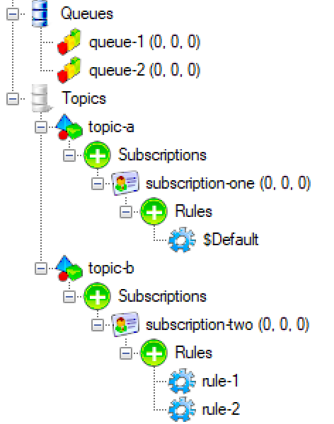
Building Blocks
Remote Service
Entities
Queues
Topics
Subscriptions
Rules
Client (WindowsAzure.ServiceBus)
Notes:
Azure Service Bus service (which I will call the broker) is represented by the store and the gateway.
The entities are used to store and operate on messages on the broker side.
- Queues
- Topics
- Subscriptions
And rules
To access the brokers and the entities, a client is required. For this talk, I’ll be using WindowsAzure.ServiceBus client

Slide 5
Receive Modes
ReceiveAndDelete
PeekLock
PeekLock is at-least-once delivery
ReceiveAndDelete is at-most-once delivery
Use ReceiveAndDelete with caution
Notes:
A message can be receive in one of two modes
ReceiveAndDelete – At-most-once delivery. Message received and removed from the broker in one operation. No second chances. Possible regrets. No the mode to mishandle a $1 million message.
PeekLock – At-least-once delivery, Two phased receive. Message is received, but is not removed. Broker requires confirmation for the message to be removed. If no confirmation is received within time called LockDuration, message becomes visible to other competing consumers.

Slide 6
PeekLock Disposition Operations
Receive
Complete
Abandon
Defer
Deadletter
Lock timeout expired X MaxDeliveryCount
Abandon is not Defer
Deferred messages can only be retrieved by their SequenceNumber
Message can be dead-lettered explicitely
Message marked as completed and removed from the queue.
Message becomes visible on the queue and can be received again.
Message remains on the queue and can be received later using SequenceNumber
Message is moved to deadletter sub-queue and can be received from that queue.
Message is moved to deadletter sub-queue and can be received from that queue.

Slide 7
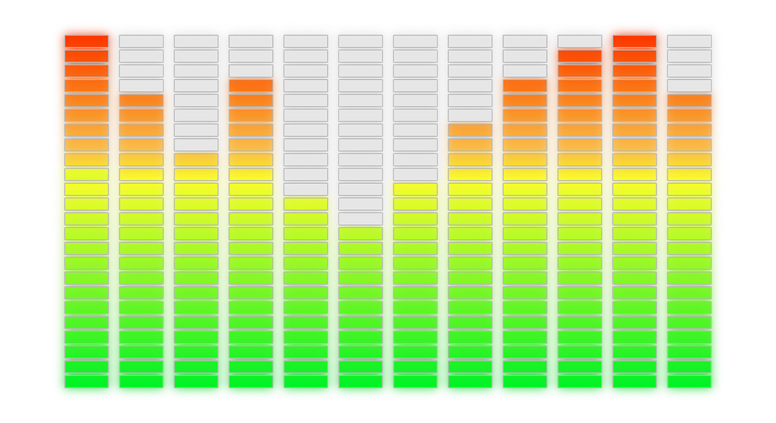
Performance Counters
ASB Performance counters can help with troubleshooting and diagnostics of your messaging related code
WindowsAzure.ServiceBus.PerformanceCounters
Notes:
Bad: lack of documentation

Slide 8
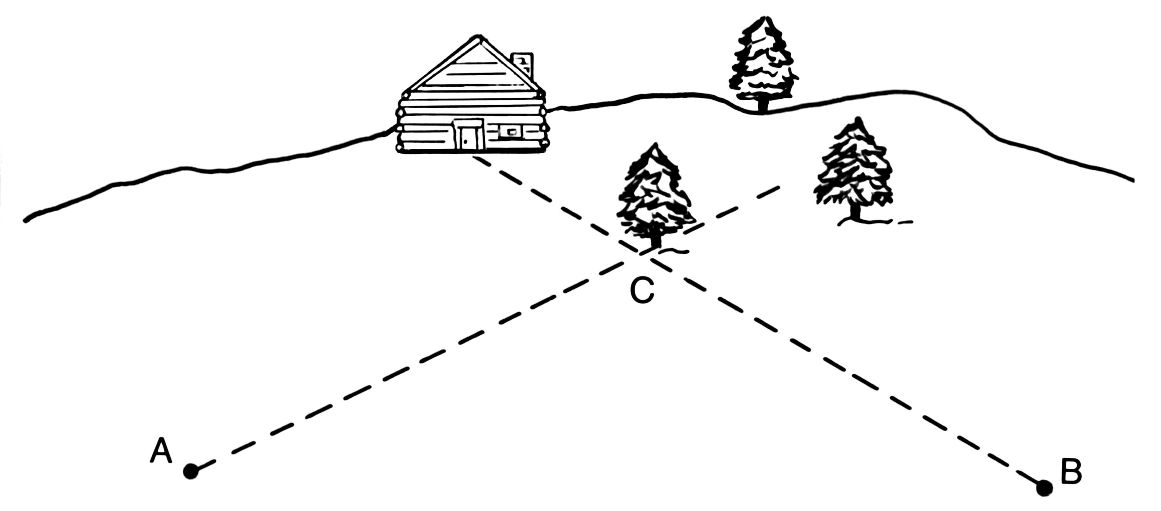
Connectivity Management
If a single factory produces a connection, how many connections can it create?
Factory is a connection
Factory per client for an extreme throughput
Factories are not cheap

Slide 9
Sending and Receiving
QueueClient
QueueClient
MessageSender
MessageReceiver
MessageSender and MessageReceiver for code that doesn’t care about entity type
TopicClient
SubscriptionClient

Slide 10

Message Pump
OnMessage API implements message pump
OnMessageOptions for parallelism, lock extension, and completion
OnMessageOptions.ExceptionReceived
Complete Abandon
Defer Deadletter
Notes:
OnMessageOptions (AutoComplete , AutoRenewTimeout, MaxConcurrentCalls)
OnMessageOptions.ExceptionReceived
MessageReceivier.OnMessageAsync

Slide 11



Forwarding
Forwarding happens on the broker
Maximum 3 hops
queue1
queue2
Notes:
The rule of 3

Slide 12

Dead-Lettering
Dead-lettering happens for a reason, DeadLetterReason
Forwarded DLQed messages have a source, DeadLetterSource
DLQed message are not always forwarded
117051215727656
Notes:
Centralized Dead-lettering and DeadLetterSource

Slide 13
Pub/Sub
Topic: mytopic
Subscription: mysub1
sys.Label LIKE ‘%rush%’ OR Amount >= 100
Broadcasting w/o knowing the recipients
Messages headers can be mutated
Enables different levels of processing
Rules
Filter
HighPriority
SET Priority=‘high’
Action
Subscription: mysub1
Rules
(Amount < 100) AND (sys.Label NOT LIKE '%rush%')
Filter
NormalPriority
Action
SET Priority=‘normal’
Notes:
Broadcasting, various priorities of processing, message manipulations (headers)
Perhaps combine with forwarding?
Benefits are:
1. Native chaining
2. Single receiving client
3. No need to worry about subscriptions

Slide 14
Multiple rules
Topic: mytopic
Subscription: mysub
sys.Label LIKE '%rush%'
Rules
Rules evaluated using OR logic
Filter
Rule1
Action
Filter
Amount >= 100
Rule2
Action
When headers mutated, duplicates created
Notes:
Rules evaluated using OR logic, but when action is added, a copy of message is evaluated, not the original message

Slide 15
Batching
Atomic operation
Destination A
100 or less messages
Total size is limited
Notes:
Good: atomic
Bad: 100 or message size

Slide 16
Transactions - Atomic Sends
Messages can be sent one at a time
Transaction scope to complete or abort
Destination A
100 or less messages
Total size is limited
Notes:
Good: Multiple messages to the same destination
Good: can send and abort
The Bad: same as with batching

Slide 17
Transactions - Atomic Sends with Receive
Incoming and outgoing messages participate in transaction
Multiple outgoing destinations
Destination A
Source
Destination B
Destination C
Possible ghosts scenario
No cross-namespace support
AMQP not supported yet (SBMP is)
Notes:
Transaction with send-via to span multiple destinations
Multiple destination, atomic operation
Mandatory tx.commit
The Bad: Ghosts scenario
The Bad: no support for transactions and send-via when using AMQP
The Bad: no cross namespace support

Slide 18
There’s more to queues than meets the eye
Non-delivered message was not lost
queue/$DeadLetterQueue
queue/$Transfer
queue/$Transfer/$DeadLetterQueue
Transaction succeeds
Another DLQ to monitor
Notes:
Ugly: Messages participating in a transaction that end up in TDLQ do not raise any exceptions (transaction completed, messages are gone, but not found in destination).
Possible reasons: queue is disabled / exceeds maximum size

Slide 19

Native de-duplication
Deduplication on message ID
Deduplication time period specified per entity
Time based
(Idempotency in code can be safer)
Notes:
Bad: time based
Bad: accidental setting change will introduce duplicates
Bad: Remember duplicated messages with subscription rules and actions? Guess what will happen if de-dup in on? :D

Slide 20
Message Session
Ordered processing is guaranteed
FIFO
#3
#2
#1
Max concurrency is 1
Single consumer only

Slide 21
HA with paired namespaces
Client App
Primary namespace
Secondary namespace
ASB client
Path: Primary/x-servicebus-transfer/
testing
0
1
N Backlog queues
…
N-1
Message pumps

Slide 22
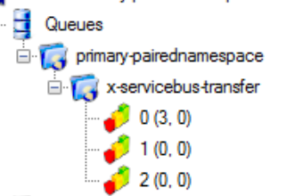
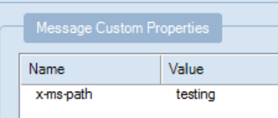
HA with paired namespaces
Bad design
High cost
Notes:
The Bad: Design
The Ugly: Cost
could be a success story

Slide 23
Microsoft.Azure.ServiceBus
.NET Standard 1.3 & Full Framework support
Rapidly catching up with the current client
Next generation Azure Service Bus .NET Standard client library
Notes:
Currently targets .NET Standard 1.3 and .NET Framework

Slide 24
Takeaways
Powerful messaging service
Abundance of features
Sometimes don’t work as expected
And always remember that every coin has
Two sides
And an edge!

Slide 25
Thank you
Sean Feldman, Solutions Architect @ Particular Software
@sfeldman
http://weblogs.asp.net/sfeldman

