Slide 1


Slide 2

NServiceBus in Azure - a Right Tool for the (web)job? Sean Feldman

Slide 3
NServiceBus
Messaging and workflow framework for distributed systems that are
Scalable
Reliable
Easy to work with and extend

Slide 4
NServiceBus Concepts
Messages
Commands
Events
Endpoint (logical)
Endpoint instances (physical)
Host
Transport
Handlers
Sagas
Notes:
Endpoint is a logical entity that communicates with other Endpoints
Endpoint instances allow scale-out
Host environment where endpoints are running
Transport an abstraction of the underlying technology to provide messaging capabilities
Handler unit of code to operate on a messages. Stateless.
Saga handle long running processes. Stateful. Usually represent workflows and coordinate of for handlers.

Slide 5

There’s moar…

Slide 6


Notes:
Conventional on-premises deployment: endpoints are deployed to physical machines or VMs.
Endpoints can be either self-hosted or hosted using NServiceBus.Host which provides a convenient way to run an endpoint as windows service in production or as a console application during development and debugging stage.
To scale out, endpoint instances are deployed to multiple machines/VMs

Slide 7

Notes:
For web applications, a self-hosted model is used where NServiceBus endpoints are bootstrapped at the time web application is starting.
Web-based endpoints can be send-only endpoints.

Slide 8

Here comes the cloud
Notes:
Let’s have a look at the services NServiceBus can help with by enhancing developers productivity.

Slide 9
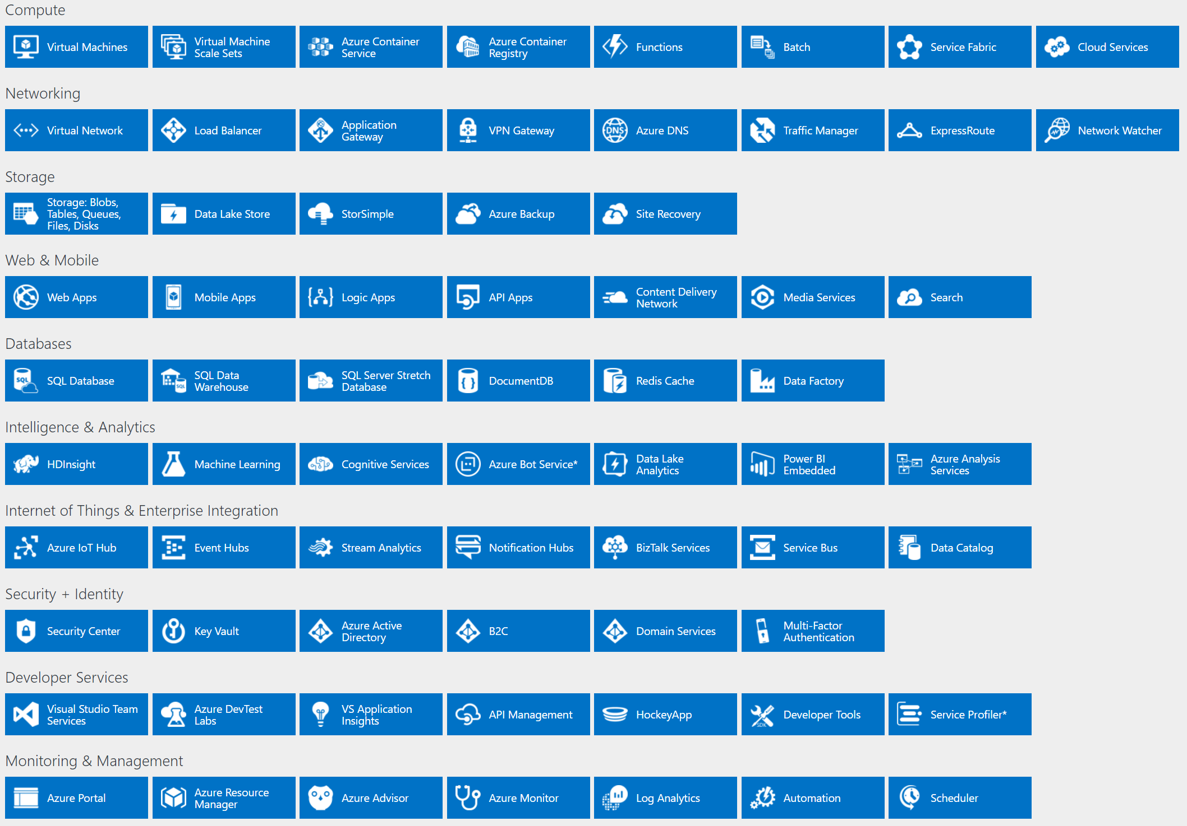
Notes:
Compute and Web&Mobile are two strong options for NServiceBus hosting.
Communication cannot be synchronous when running at the scale such as Azure. Connect Storage Queues and Service Bus.

Slide 10

IaaS: VMs
Notes:
NServiceBus runs easily on Azure VMs or VMSS.
Pros: familiar to on-premises
Cons: still a pet to take care of

Slide 11

From IaaS to PaaS
Notes:
PaaS services bring the convenience of delegating the infrastructure responsibility.
How NServiceBus plays along with those? Quite nicely!
There are a few things that need to be considered.

Slide 12


MSMQ is out
Notes:
Historically, NSB was defaulting to the MSMQ for communication infrastructure.
On Azure, where data centers are bigger than a soccer field, MSMQ is not the right technology to use (latency of 2PC, disk availability, etc).
Instead, ASQ and ASB provide the needed services to implement queueing and messaging required for communication.

Slide 13

Local file system is out
Notes:
For many services, local file system does not exist any more.
Instead, Storage Service provides Blobs mechanism used to store data.

Slide 14

PaaS: Cloud Services
Notes:
CS is very good at scaling out and handling load.
NSB runs on CSes
Provides substantial benefits when running at a significant scale-out, which CSes were designed for.

Slide 15


Deploy to any role type
Notes:
Provide a brief description what is what.
Web Roles – intended to host web type of application with IIS component installed on the underlaying VMs.
Worker Roles – intended to host windows service type of application.

Slide 16


PaaS, Costly PaaS
Notes:
The problem is especially around worker roles, where the design model allows a single project per worker (assuming windows service).
When multiple services are involved, each by default gets a different worker role. No shared/pooled option unless implemented as a custom solution.

Slide 17
Multi-hosting
Notes:
NSB allows to use a single worker as a host for multiple endpoints.f
Benefits are:
Endpoints can be updated w/o downtime
Deployment is fast (literally copying a zip package to a storage account).

Slide 18
Compute savings are real
Notes:
Normal deployment a la MSFT: 4 endpoints = 4 workers. Scaled to 3 instances each = 12 VMs in total.
NSB multi-host: 4 endpoints = 1 worker. Scaled out to 3 instances each = 3 VMs. 75% cost savings
Not to mention amount of mental health saved by not spending time on lengthy CS deployments.

Slide 19

PaaS-ish:
Service Fabric
Notes:
SF as a technology is not new. MSFT has been building on it for years and has opened it up to spread the love and make some money.
Current issues with SF on Azure (ASF) is that it’s still very much IaaS-y and required a strong IT knowledge to maintain in production.
SF should be perceived as a “resource pool” to which microservices-based applications are deployed.
Warning: before jumping into SF, first allow yourself some extensive experimentation to understand the beast better.

Slide 20


Reliable Service
Stateless
Reliable Service
Stateful
Guest Executable
Supported programming models
Notes:
Reliable services: Stateless and Stateful
Guest executables
For reliable Stateful services, NSB provides
- Native persistence based on reliable collections (for Sagas and Outbox)
- Partition aware routing https://docs.particular.net/samples/azure/azure-service-fabric-routing/

Slide 21
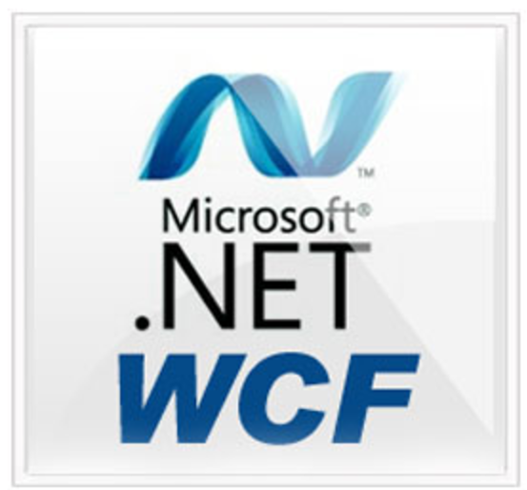
Partition aware routing sample https://docs.particular.net/samples/azure/azure-service-fabric-routing/
Inter process and out of cluster communication
Notes:
NSB replaces WCF and RPC based communication with proper ASB or ASQ based implementation of transports.
When working with stateful services, where messages need to target the appropriate partitions and not just handled by replicas (instances) on any partition.

Slide 22

PaaS Serverless
Notes:
Still a PaaS. No matter how it’s called.
Functions are intended to execute small units of work as a result of a trigger and be short lived and stateless.
Especially when using under consumption plan, execution is limited to 5 mins.
As of today, NSB doesn’t provide any value on top of Functions. In the future, depending where functions will evolve, things might change.

Slide 23

PaaS: App Service
Notes:
Azure App Service offers simplicity and elegance for small to medium size applications.
NSB supports App Service.

Slide 24

WebApp
Notes:
WebApps – develop and deploy w/o concerns for the infrastructure.

Slide 25

WebJobs for
Backend Processing
Notes:
WebJobs – an answer to Windows Services replacement in the Azure App Services

Slide 26





WebJobs nuances
Craving for more details on Azure Service Bus?
Azure Service Bus Messaging - The Good, The Bad, and The Ugly
tomorrow at 8:45AM @ room 6
Poisonous Queues
Retries
Connectivity
Receive Mode
Error
Notes:
Poisonous queue Per-queue and inconsistent (DLQ for ServiceBusTrigger) – contrast with NSB’s centralized error queue
Retries Immediate only – contrast with NSB recoverability (immediate and delayed retries)
Connectivity – no control besides Max Concurrency level, ServiceBusTrigger is using a single client per entity – all messages from the same queue go through the same connection / channel.
ASB receive mode PeekLock mode only. NSB allows more granular control over receiving mode.

Slide 27

Azure VMs
Cloud Services
App Service
Service Fabric
Service ?
Notes:
Already today NServiceBus helps developers to run on Azure VMs, CSes, App Service, and Service Fabric, shielding them from the unnecessary need to worry for the middleware and messaging.
Tomorrow the list might be extended with whatever a new services that joins the options of hosting your code in Azure.

Slide 28

6
Notes:
What’s exciting about NSB 6 and Azure?
Quite a few things actually.

Slide 29


NServiceBus
Ingredients:
Notes:
Asynchronous bottom-up. Improved throughput, hardware utilization, and overall performance

Slide 30

IMessageSession (IWantToRunWhenEndpointStartsAndStops)
NServiceBus
Context Flow
IIncomingPhysicalMessageContext
IMessageHandlerContext
MutateIncomingTransportMessageContext
ErrorContext
FeatureConfigurationContext
IOutgoingLogicalMessageContext
IIncomingLogicalMessageContext
Notes:
Clarity of what operations are possible with context that is flown rather than reliance on “magical” dependencies injected into your code.

Slide 31





Can saturate storage account
NServiceBus
Azure Storage Queues
Throughput
Multi Account
Secured
Custom Envelope
Notes:
Throughput: achieved with concurrency, number of parallel receivers, and batching. Up-to 20K msg/s, can saturate storage account
Multiple storage accounts NSB can run endpoints that utilize different storage accounts to communicate with each other.
Secured connection strings logs and messages can use aliases instead of actual storage account connection strings
Custom envelope unwrapper to support message headers that natively are not provided.

Slide 32





NServiceBus
Azure Service Bus
Throughput
New Topology
Secured
Transactions*
Lock Renewal
Multi NS
Smart Batching
Intelligent Retries
Sanitization
Notes:
Increased throughput thanks to async, batching, and connections management
New topology – NSB runs more efficiently and aligned with the best practices of the ASB (decoupled publishers and subscribers, overflow protection, reduced number of connections to broker)
Secured connection strings logs and messages to use aliases instead of actual storage account connection strings
SendAtomicWithReceive transaction mode – NSB utilizes send-via with transactions feature of the native ASB
Auto lock renewal
Multi namespace support to allow endpoints to use multiple namespaces to talk to each other (HA, overcoming resources utilization limits)
Smart batching (> 100 msg & max size limitation) – NSB will chunk up messages and send out
Immediate and delayed retries tied to the delivery counter to avoid unnecessary message dead-lettering
Custom Sanitization – NSB allows developers to specify what to do with entities that do not comply with ASB naming rules

Slide 33

NServiceBus
Azure Storage Persistence
ẼあЫ
Complex Types
No full table scans
Notes:
Why storage is required? To augment features that are not found in the native services. Sagas for example, require state to be stored.
Complex types NSB, unlike Storage tables, can store any type and not just the primitives
No full table scans – NSB is using secondary indices to speed up data access (finding sagas by correlation property)
Down the road could be replaced by CosmosDB with Table API

Slide 34


NServiceBus
Azure Blob Storage DataBus
Message Size
Automated Cleanup
Notes:
NServiceBus allows to overcome the message size limitation on Azure by implementing seamlessly the claim check pattern.
Automated cleanup to ensure that attachments for no longer needed messages are cleaned up.

Slide 35
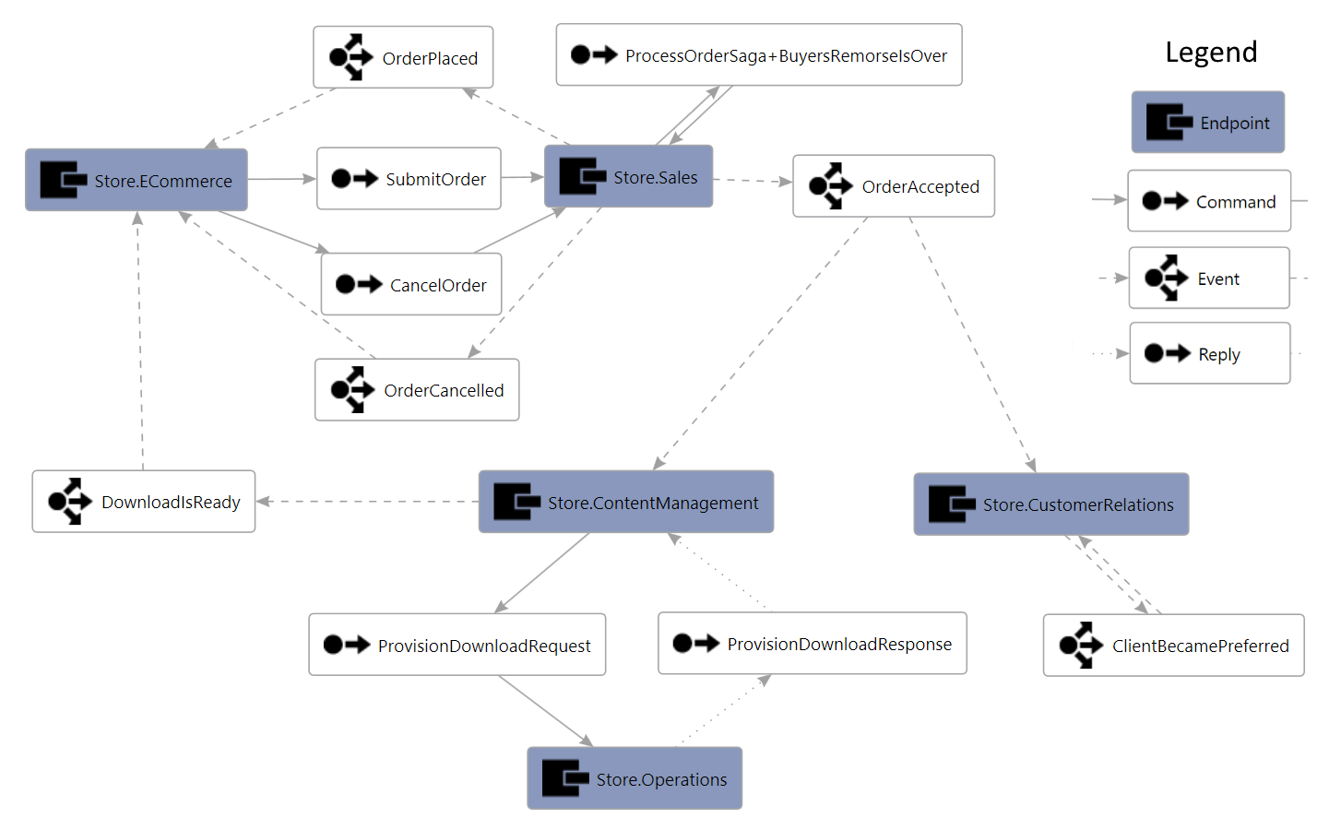
Demo
Online Store Application
Notes:
5 endpoints – web application and 4 backend processes
Sales – coordinates order execution with the rest of the services. It’s a workflow that allows customers to cancel prior to fulfilling it.
ContentManagement
Operations
CustomerRelations
Diagram source: https://particular.net/blog/what-does-your-particular-system-look-like
DL Routing Visualization tool from Particular Labs: https://github.com/ParticularLabs/RoutingVisualization

Slide 36
What would it take to convert an application?
Demo of on-premises application converted to WebJobs

Slide 37
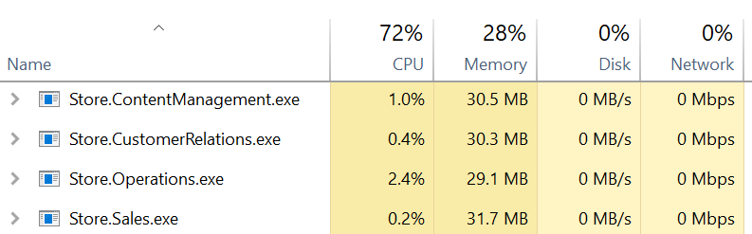
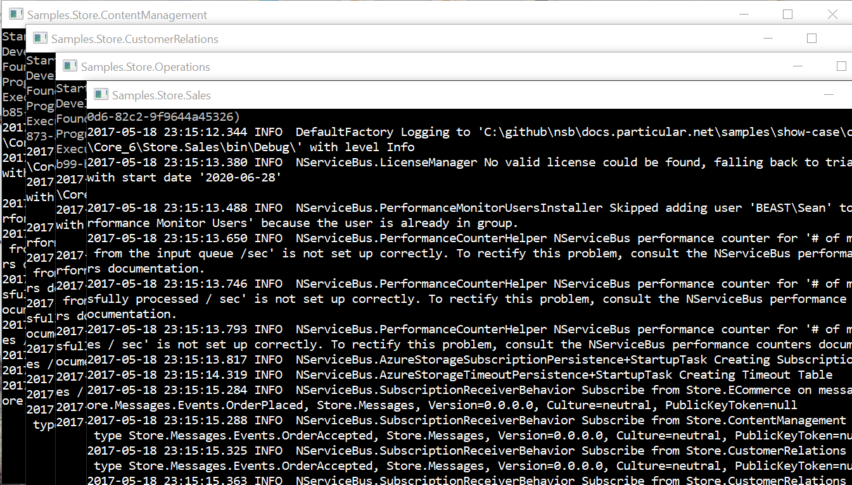

Slide 38
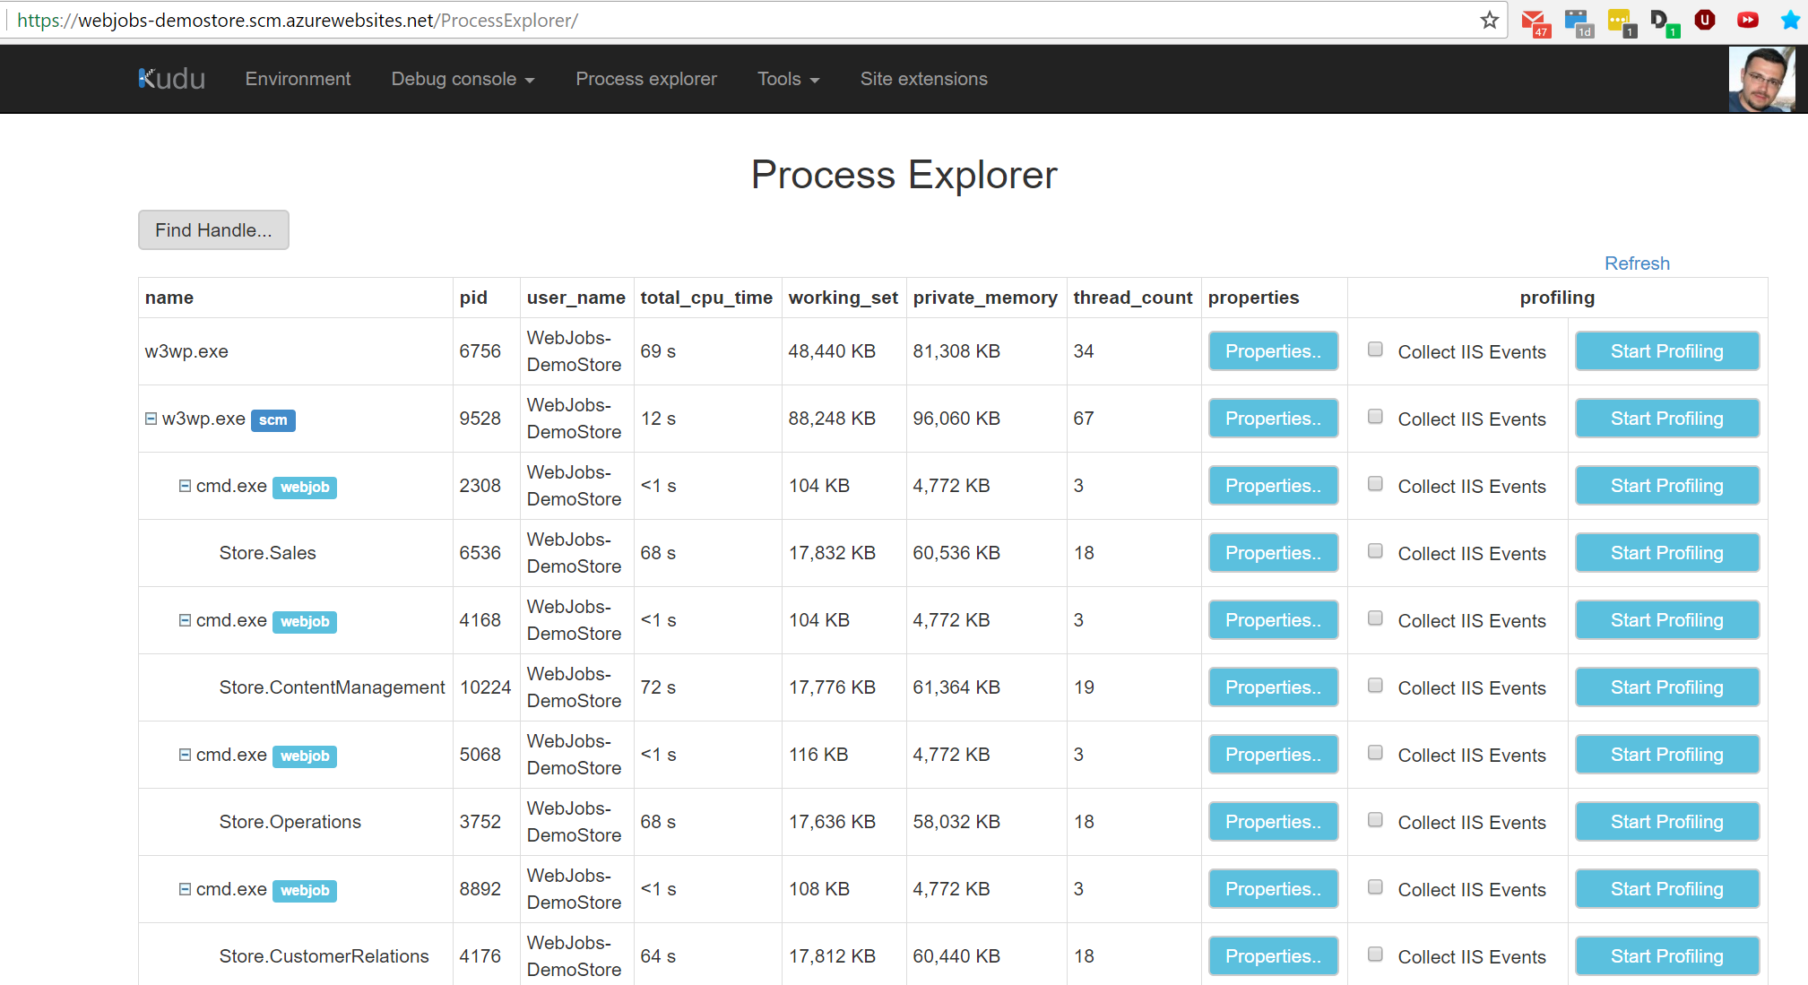

Slide 39
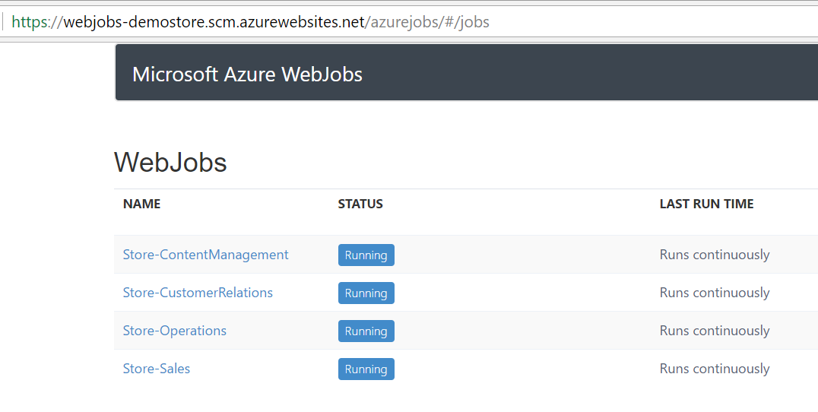

Slide 40
Summary
NServiceBus runs on Azure
Highly
Simplifies middleware/messaging/queueing
Lets you focus on what really matters
optimized
for asynchronous
work

Slide 41

Don’t forget about Fallacies of Distributed Computing
Get access to the Advanced Distributed Systems Design videos on the Fallacies of Distributed Computing to tackle the monster in the cloud
http://go.particular.net/fallacies
Hurry up!
The magic works for 2 weeks only (till midnight)

Slide 42
Thank you
Sean Feldman, Solutions Architect @ Particular Software
@sfeldman
http://weblogs.asp.net/sfeldman

Slide 43








