Slide 1


Rock-paper-scissors-lizard-Spock
Mini-Project 1

Slide 2
Agenda
1
The RPSx Game
2
Payoff Matrix & Interactive Game
3
Game Strategy
4
Python Code

Slide 3
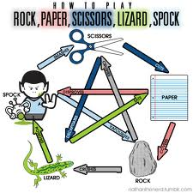
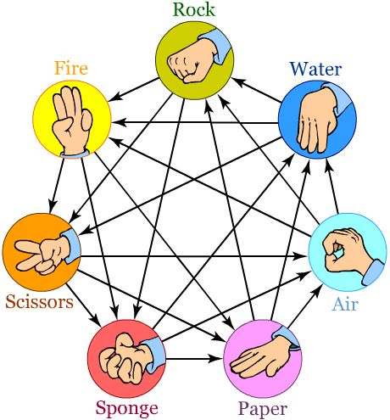
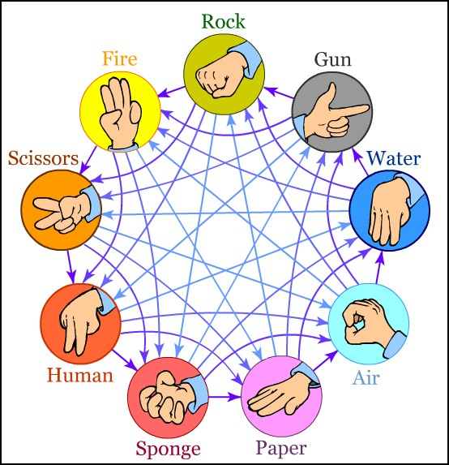
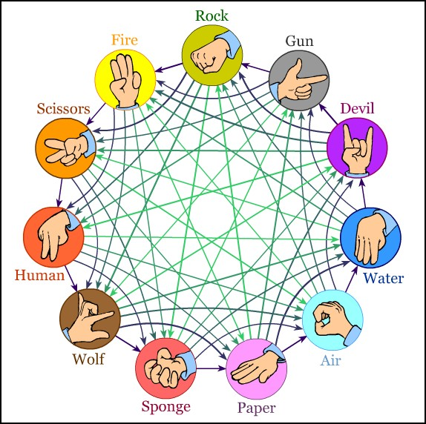
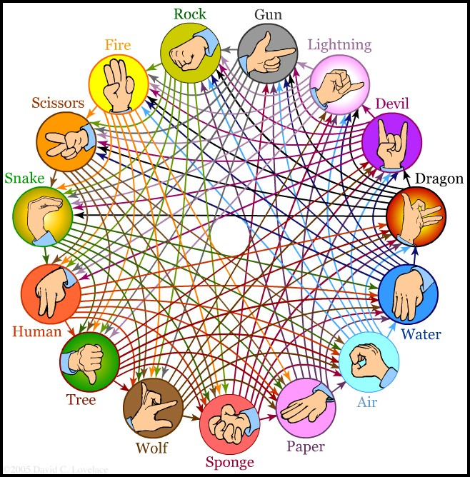
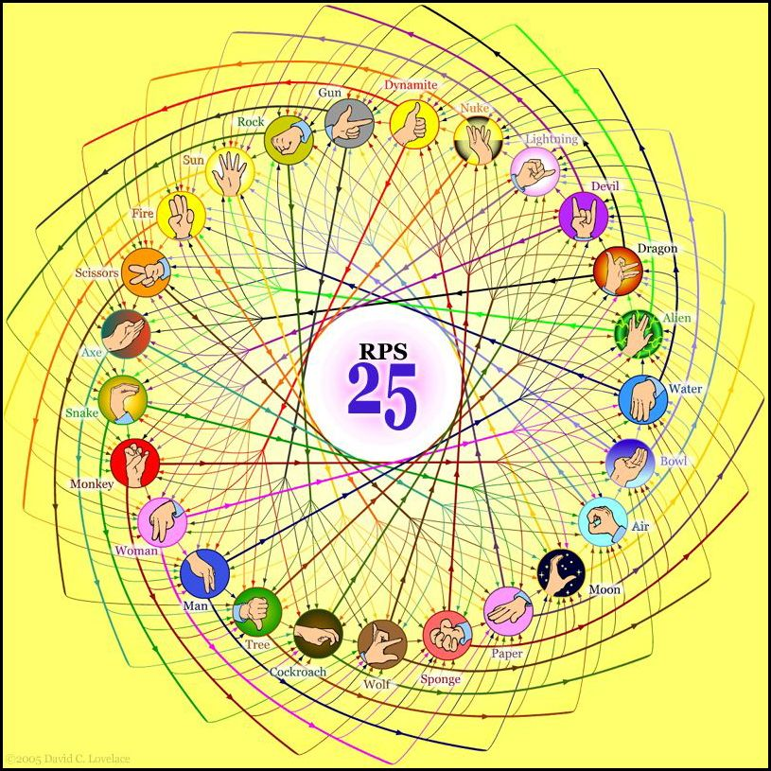
RPS-x
http://www.umop.com/rps.htm

Slide 4
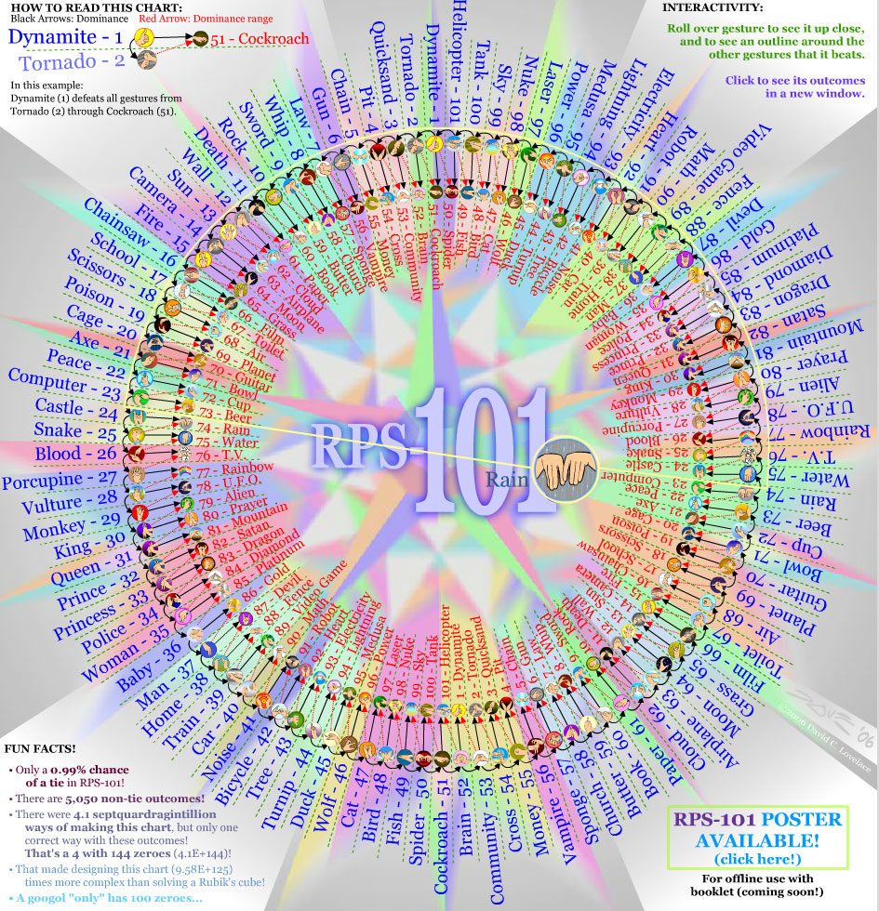
Amazing! RPS-101
http://www.umop.com/rps.htm

Slide 5
Additional weapons, RPS-x
More
Weapons
As long as the number of moves is an odd number
and that each move defeats exactly half of the
other moves while being defeated by the other
half, any combination of moves will function as
a game. For example, 5-, 7-, 9-, 11-, 15-, 25-,
and 101 weapon versions exist.
Prob.
Of Tie
Adding new gestures has the effect of reducing
the odds of a tie, while increasing the complexity
of the game. The probability of a tie in an
odd-number-of-weapons game can be calculated based
on the number of weapons n as 1/n, so the probability
of a tie is 1/3 in RPS, 1/5 in RPSLS and 1/101 in
RPS101.

Slide 6
Rock-paper-scissors From Wikipedia
Asian origin
the game dated back to the time of the Chinese Han
Dynasty (206 BC – 220 AD).The first known mention of the
game was in the book Wuzazu by the Chinese Ming Dynasty
writer Xie Zhaozhi (fl. ca. 1600)
In Japanese history,the people often played sansukumi-ken
By the early 20th century,rock-paper-scissors had spread
beyond Asia,especially through increased Japanese contact
with the west.
real-life
Instances of use in real-life scenarios
Tournaments
World Rock Paper Scissors Society sanctioned tournaments
UK Rock Paper Scissors Championships
USARPS Tournaments
Team Olimpik Rock Paper Scissors Championships 2012
http://en.wikipedia.org/wiki/Rock-paper-scissors

Slide 7
Agenda
1
The RPSx Game
2
Payoff Matrix & Interactive Game
3
Game Strategy
4
Python Code

Slide 8
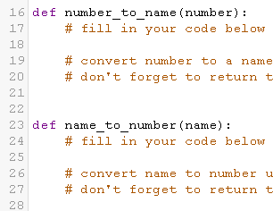
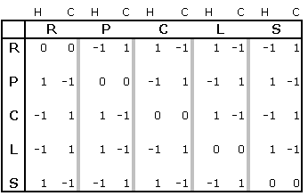
Payoff Matrix & Faster Data Access
Computer
Read/Write Memory Faster than if …elif…
R for Rock
P for Paper
C for Scissors
L for Lizard
S for Spock
Human
vs
Human
Payoff
Computer
Payoff
Read/Write memory is faster than call function and if ... elif statements
We can set any payoff value to evaluate game
Applied Game Theory

Slide 9
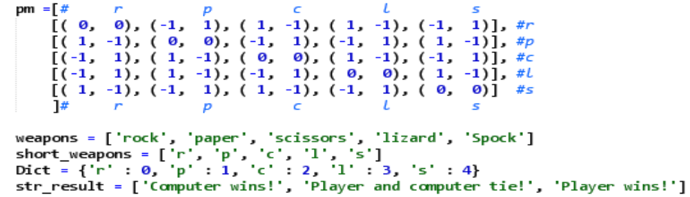
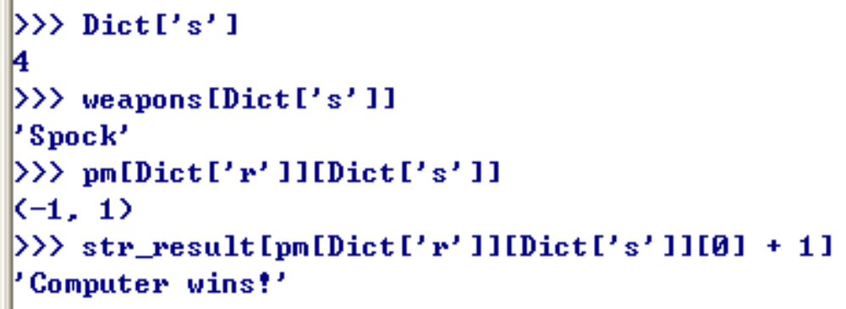
Set and List for array and matrix
+1
r
0
rock
p
1
paper
Dict
c
2
scissors
l
Dictionary
(Set datatype)
3
lizard
s
4
Spock
Notes:
Python knows a number of compound data types, used to group together other values. The most versatile is the list, which can be written as a list of comma-separated values (items) between square brackets. List items need not all have the same type.
http://docs.python.org/2/tutorial/introduction.html#lists
Python also includes a data type for sets. A set is an unordered collection with no duplicate elements. Basic uses include membership testing and eliminating duplicate entries. Set objects also support mathematical operations like union, intersection, difference, and symmetric difference.
http://docs.python.org/2/tutorial/datastructures.html#sets

Slide 10
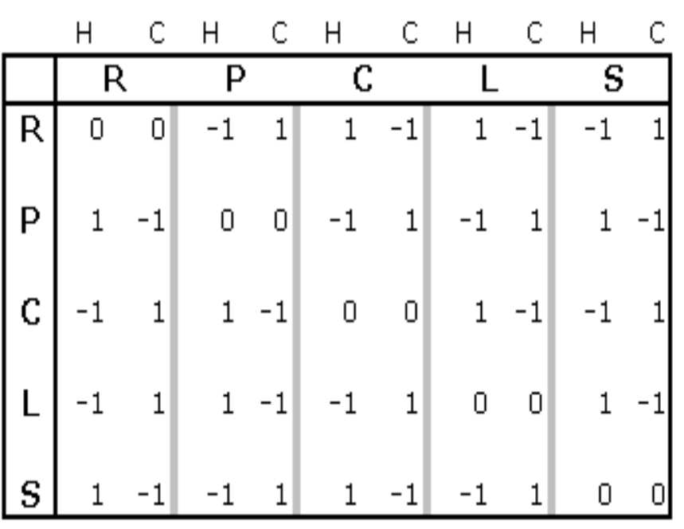
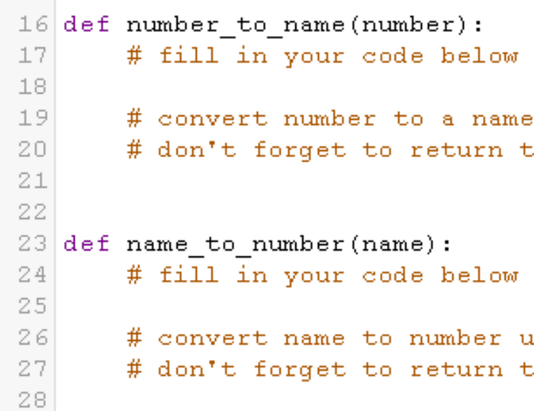
Integrate Logic & Matrix
If we want play RPS-101, I do not want and CAN NOT write a 101 x 101 payoff matrix without error.
But, we can call name_to_number function to generate the 101 x 101 matrix by if … elif statements before play game.
So, we integrated the power of logic and matrix.
Generate
101 x 101 matrix
Automatically

Slide 11
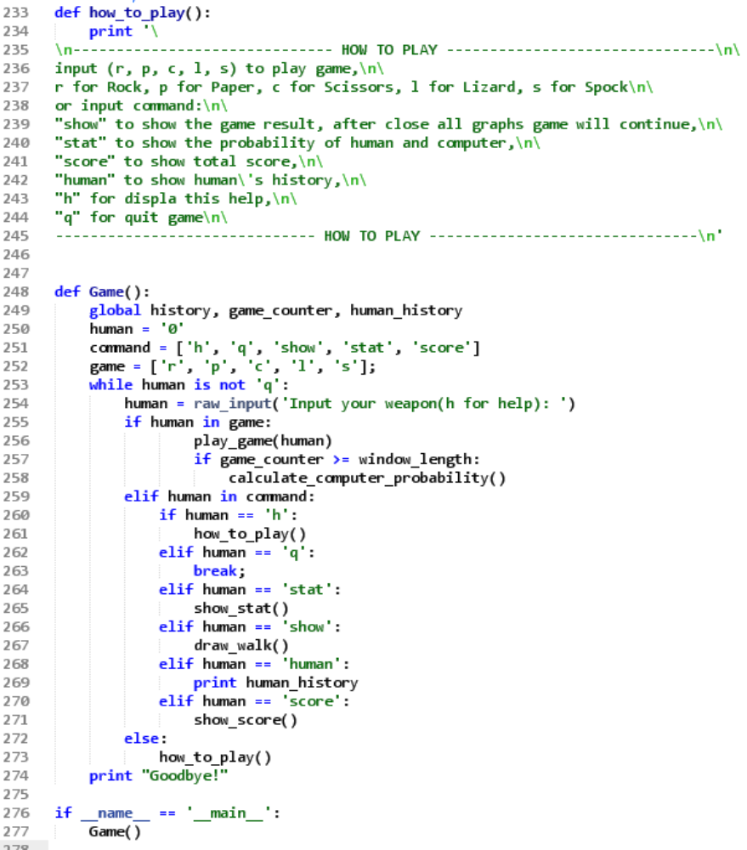
Interactive Game For FUN!
Help Information
Player chooses Weapon
Computer chooses Weapon
Computer adjust strategy
Game
Loop
Show Information
Show Statistics
Draw Graph for each game
Show Score

Slide 12
Agenda
1
The RPSx Game
2
Payoff Matrix & Interactive Game
3
Game Strategy
4
Python Code

Slide 13
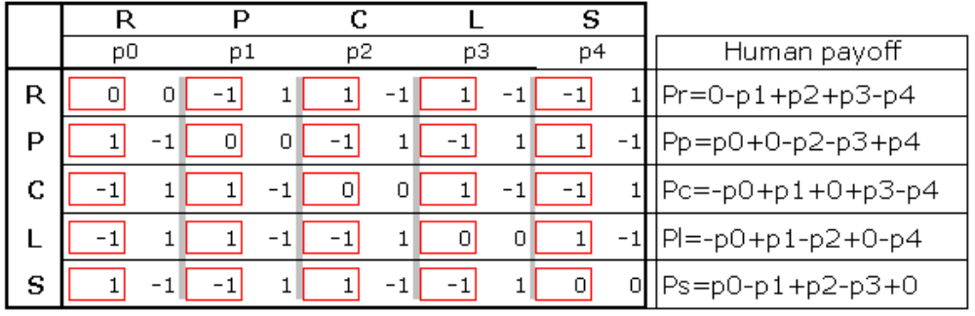

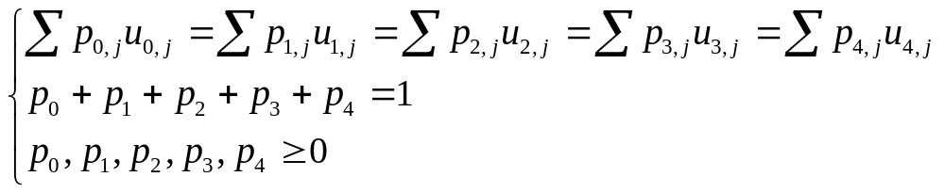
Random guess, Game Theory-Mixed Nash Equilibria
Bad idea: It would be a pretty bad idea to play any deterministic strategy (pure strategy: only one action is played with positive probability)
Good Idea: confuse the opponent by playing randomly (mixed strategy: more than one action is played with positive probability)
Strategy: must randomize to make opponent indifferent payoff with any weapon.
But Human has pattern

Slide 14
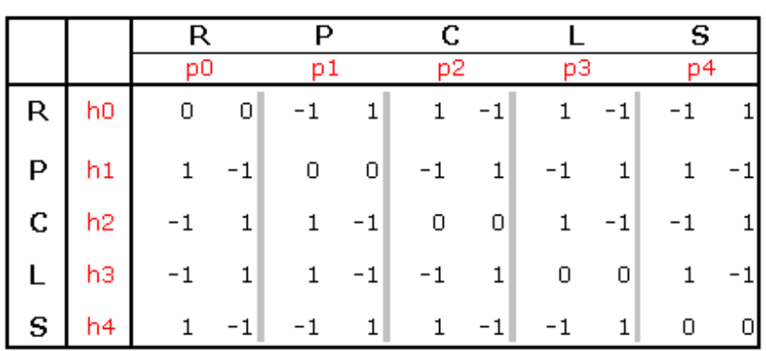
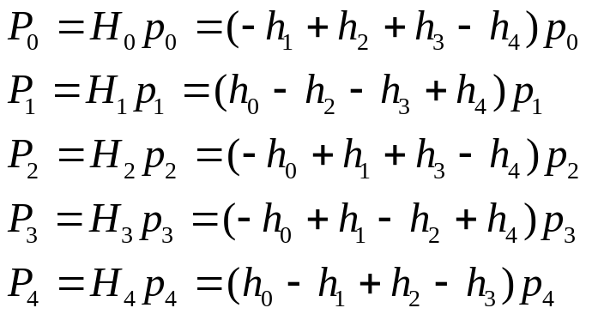





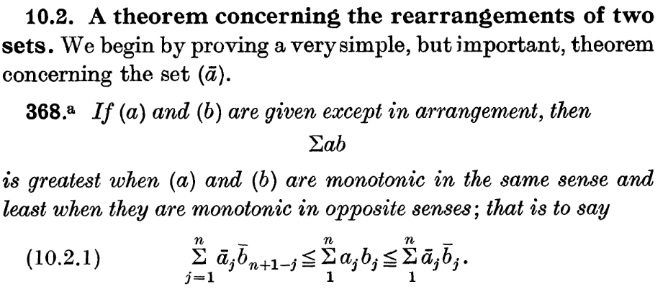
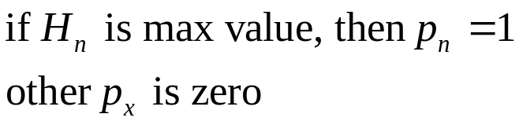
Frequency analysis - If people play game with probability h0,h1,… what is my strategy?
Payoff
Find Max Payoff
Rearrangement inequality [Hardy Inequalities]
http://en.wikipedia.org/wiki/Rearrangement_inequality

Slide 15
History pattern matching
Sequence
The history of game is a string sequence.
Pattern
The RPSLS-RPSLS-… sequence has equivalent Frequency, but
it is no a stochastic process.
Simple
algorithm
looks for a sequence in the past matching the last few moves.
For example, if in the last three moves, the predictor will
look for times in the past when the same three moves occurred.
(In fact, it looks for the longest match to recent history;
a repeat of the last 30 moves is considered better than just
the last 3 moves.)
Once such a repeat is located, the history matcher examines
the move our opponent made afterwards, and assumes they will
make it again.
http://ofb.net/~egnor/iocaine.html , the winner of 1st Roshambo competition

Slide 16
Agenda
1
The RPSx Game
2
Payoff Matrix & Interactive Game
3
Game Strategy
4
Python Code

Slide 17
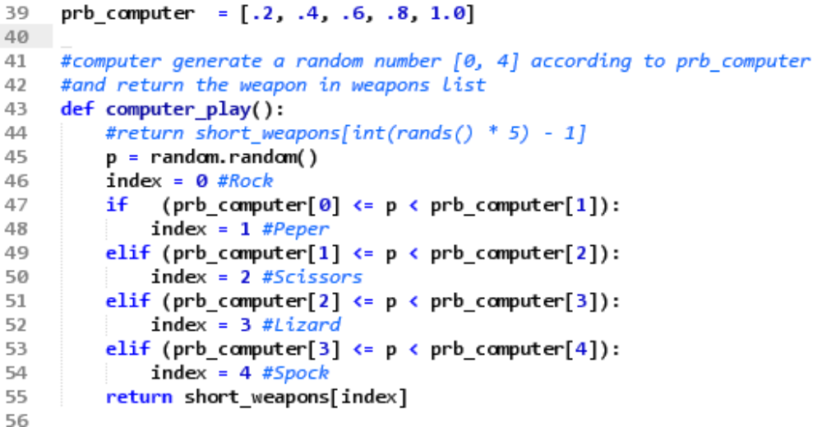
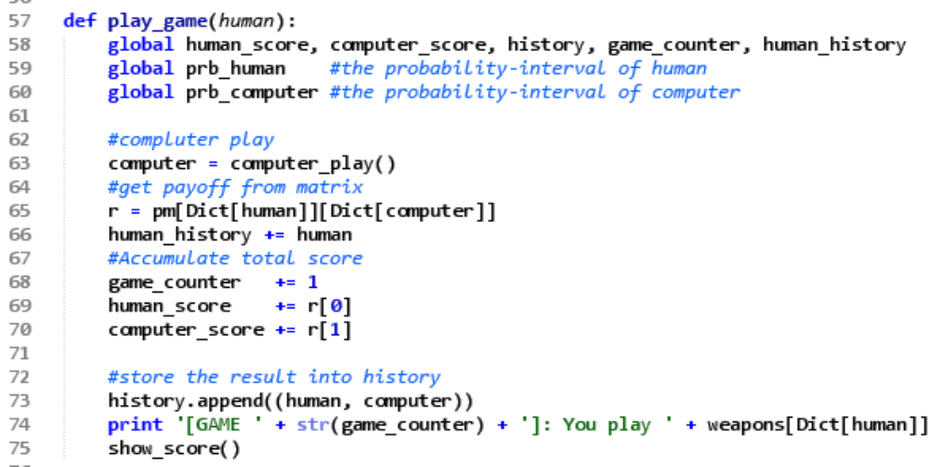
Computer’s random probability
0
p0
p1
p2
p3
1
p4
rock
paper
scissors
lizard
Spock

Slide 18

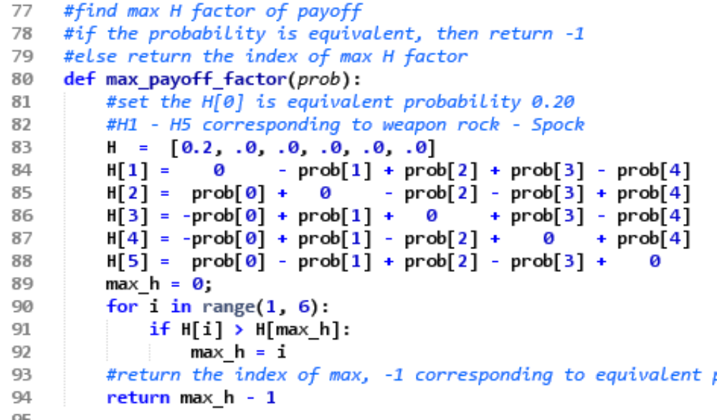
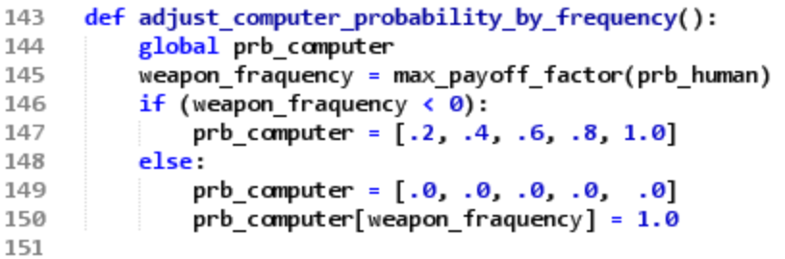
Find max payoff by human’s probability
Adjust computer probability by
frequency
Find Max Value

Slide 19
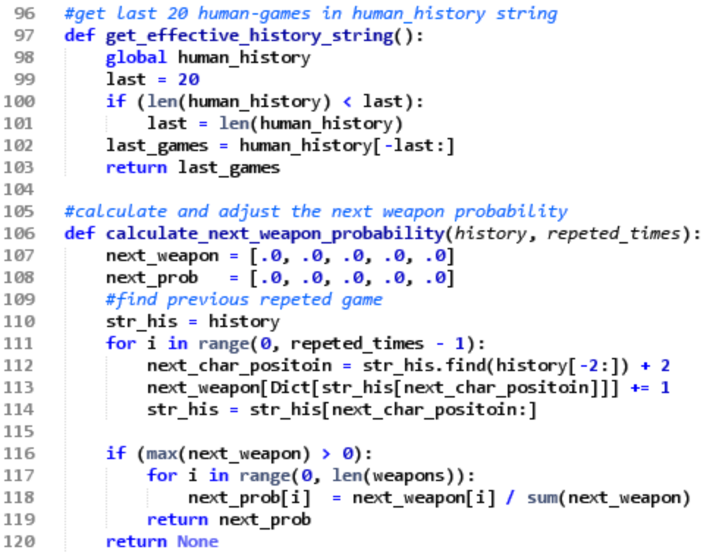
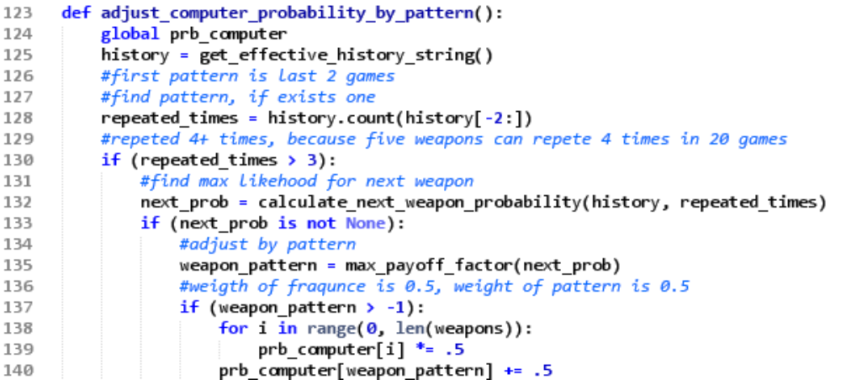
Adjust strategy by human’s pattern
Analyze Last 20 game
Find repeated times
Prob = 0.5 * prob_frequency
+ 0.5 * prob_pattern

Slide 20
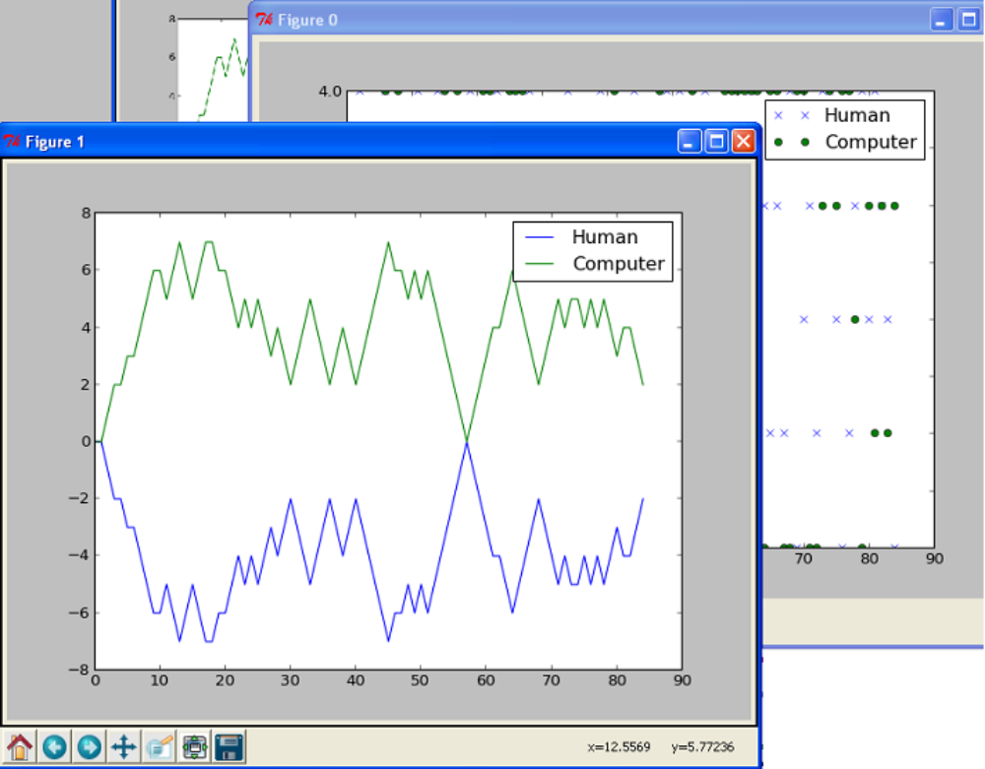
Runtime…
Computer’s
Strategy
Computer’s
Score
Human’s pattern
Human’s
Score

Slide 21
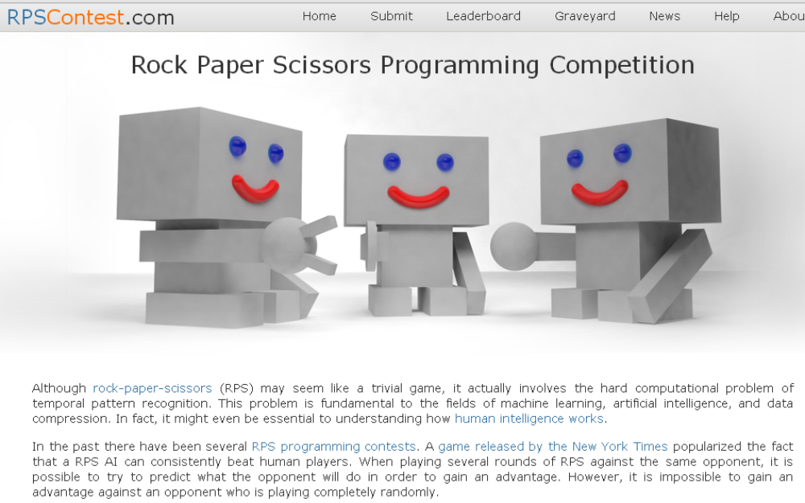

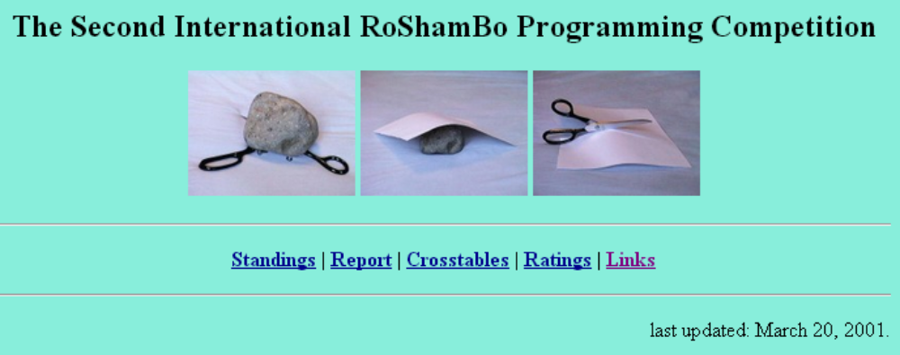
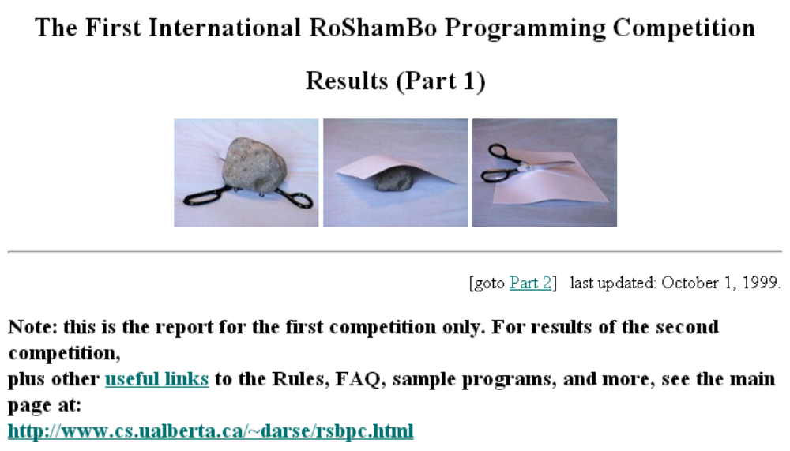
Programming Competition
http://www.rpscontest.com/
http://webdocs.cs.ualberta.ca/~darse/rsb-results1.html
http://webdocs.cs.ualberta.ca/~darse/rsbpc.html

Slide 22
To be continued …
Thank You !

