Slide 1
Factors that statistically affect MPG or Cost
Sean Hastings

Slide 2
Business Objective
Analyze raw data and statistically test factors that may affect MPG or annual cost, helping customers make informed decisions.

Slide 3
Information
FuelEconomy.gov Explanation of Data set and column titles
raw fuel costs data is available here Data Set

Slide 4

Hypothesis #1 Save or Spend Newer vs Older
$$H_{0 }μ_{1}=μ_{2}$$
The average save or spend over 5 years will be the same for gasoline powered model years before 2000 and after.
$$H_{a }μ≠μ_{}$$
The average save or spend over 5 years will not be the same for gasoline powered model years before 2000 and after.

Slide 5
Hypothesis #1 t-Test

Slide 6

Hypothesis #1 (Results)
Reject $H_{0 }μ_{1}=μ_{2 },$the difference of means is statistically significant with a p-value < .001 and a 95% confidence interval of $−185.62±54.31$

Slide 7
Hypothesis #1 (Results) Comparing Means : Newer vs. Older
 | mean | standard error | M.O.E
After 2000 | -3062.86 | 18.31986882 | 35.91
Before 2000 | -3248.48 | 20.78802943 | 40.75

Slide 8
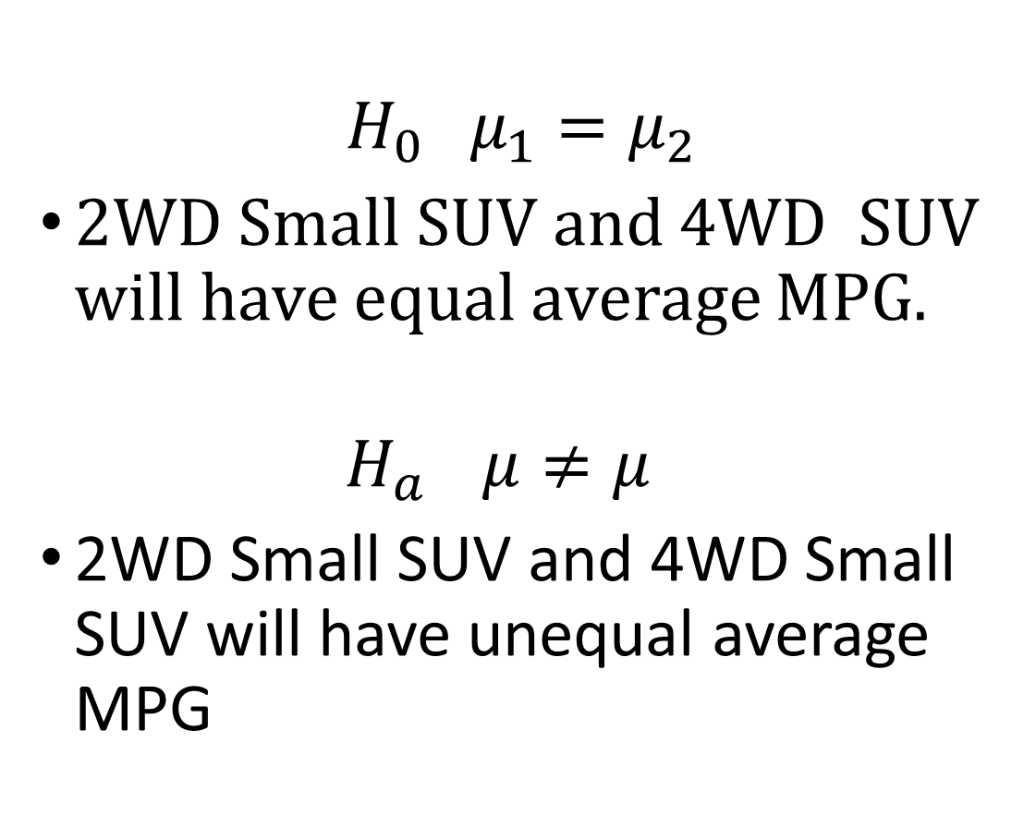
Hypothesis # 2 2WD vs. 4WD
$$H_{0 }μ_{1}=μ_{2}$$
2WD Small SUV and 4WD SUV will have equal average MPG.
$$H_{a }μ≠μ_{}$$
2WD Small SUV and 4WD Small SUV will have unequal average MPG

Slide 9
Hypothesis #2 t-Test

Slide 10

Hypothesis #2 (Results)
Reject the null hypothesis, and the difference of means is statistically significant with a p-value < 0.001 and a 95% confidence interval of $1.56±0.39$

Slide 11
Hypothesis #2 (Results) Comparing Means : 2WD vs. 4WD
 | mean | standard of difference | M.O.E
Small SUV 2WD | 23.81 | 0.145528115 | 0.29
Small SUV 4WD | 22.25 | 0.135210022 | 0.27

Slide 12
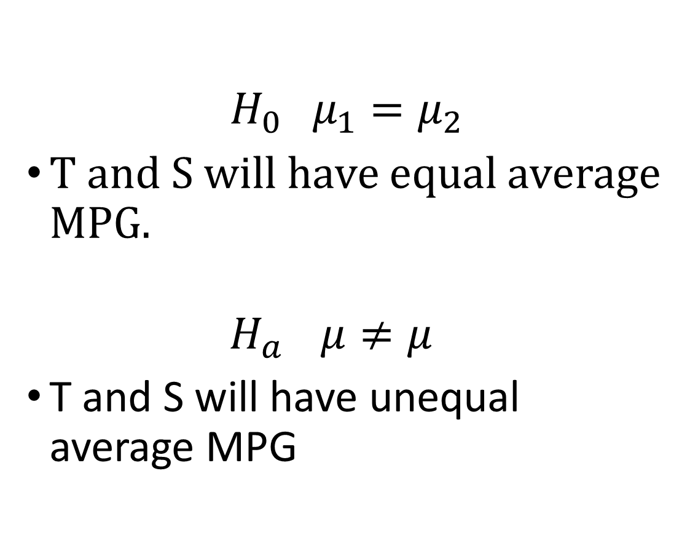
Hypothesis #3 Turbo-charger vs. Super-charger
$$H_{0 }μ_{1}=μ_{2}$$
T and S will have equal average MPG.
$$H_{a }μ≠μ_{}$$
T and S will have unequal average MPG

Slide 13
Hypothesis #3 t-Test

Slide 14

Hypothesis #3 (Results)
Reject the null hypothesis, and the difference of means is statistically significant with a p-value < 0.001 and a 95% confidence interval of $3.07±0.28$

Slide 15
Hypothesis #3 (Results) Comparing Means: T vs S
 | mean | standard error | m.o.e
Turbo charged | 21.32 | 0.06160396 | 0.121
Super charged | 18.26 | 0.130536888 | 0.256

Slide 16
Conclusion
3 statistically significant recommendations for website
Buying a model year after 2000, will save you between $130.00 and $240.00 (5 years) vs. before 2000.
2WD Small SUV Average 1-2 MPG better then 4WD Small SUV.
Turbo-charged engines average about 3 MPG more then Super-charged engines.

