Slide 1
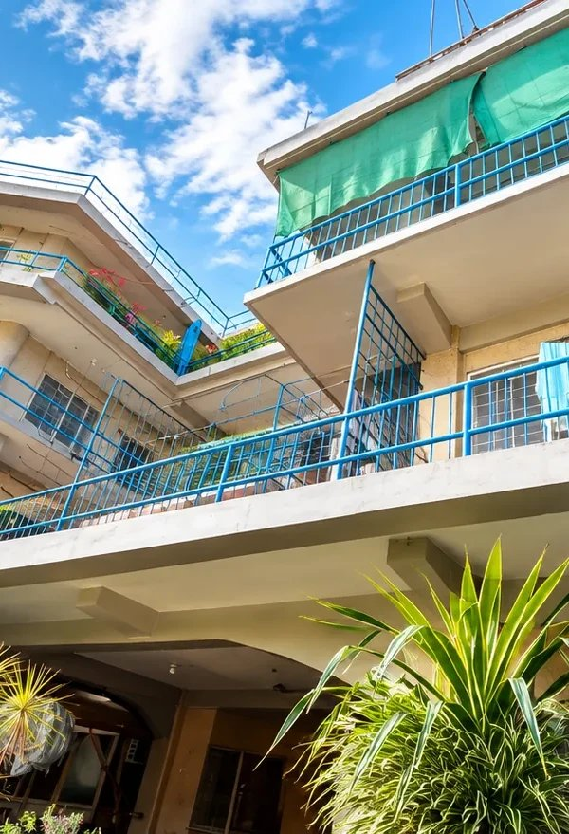

Hivelet
PROGRESS REPORT
A Web-Based Apartment Management System for Fe Galang Da Silva Boarding House
Status as of 2 October 2026
IT 124 Capstone Project 2 · Bicol University College of Science
Notes:
LLOYD (0:25)
[Stand centre. Wait for the room to settle.]
Good morning, Ma'am, Sir, and classmates. We are the Hivelet team, and this is our progress report as of the second of October. Hivelet is our web-based apartment management system for the Fe Galang Da Silva Boarding House. I am John Lloyd Cuario, the team's database administrator and data analyst, and each of us will present one part of today's report.

Slide 2
The team and today's order
PRESENTER Lloyd
1
2
3
4
5
John Lloyd M. Cuario
Sean Jerve Ll. Rebancos
Victor Noel A. Napay
Kiel Hedrix V. Relos
Eljohn Paulo C. Loterte
Database Administrator / Data Analyst
System Architect / Full-Stack Developer
Backend Developer / Integration Engineer
Frontend Developer / UI/UX Designer
Quality Assurance / Systems Analyst
Introduction, project recap, manuscript progress
System architecture and module status
System features (owner, tenant, public)
Interface progress and tenant acceptance testing
Test results, defects fixed, next steps, closing
Slides 1–4
Slides 5–6
Slides 7–8
Slides 9–10
Slides 11–13
Notes:
LLOYD (0:30)
[Gesture to each member as you name them.]
Here is the team, in the order we will speak. After me, Sean, our system architect, will walk through the architecture and the modules. Vince, our backend and integration engineer, will present the features. Kiel, our UI/UX designer, will show the interface work and how the tenants did in testing. And Eljohn, our quality assurance and systems analyst, will close with the test results and our next steps.

Slide 3


Where the project stands
PRESENTER Lloyd
Before
Paper receipt book and Excel workbooks. Payments, water, expenses and repair requests scattered across paper, spreadsheets, SMS and Messenger.
33
32 / 33
units in 5 clusters
across 3 floors
units occupied
today
With Hivelet
One live system for the owner, her tenants and the public, running on her real records today, not a prototype.
937
1,327
income rows moved
from her workbook
expense allocations
moved from her workbook
Notes:
LLOYD (0:40)
[Point to the four numbers as you say them.]
A quick recap of the problem. Mrs. Da Silva runs thirty-three units, in five clusters across three floors, from a paper receipt book and Excel workbooks. Payments, water bills, expenses and repair requests were spread across paper, spreadsheets, text messages and Messenger. Hivelet puts all of it in one place. And it is no longer a prototype. Her records are already inside the live system: nine hundred thirty-seven income rows and one thousand three hundred twenty-seven expense allocations, transferred from her own workbook, with thirty-two of the thirty-three units occupied today.

Slide 4
Manuscript progress
PRESENTER Lloyd
Chapters 1–3
Corrections against the built system (33 units, PostgreSQL 17.6 on Supabase, Vue 3 + Express in TypeScript, Vercel)
Partial
Ch. 4 §4.1
Existing practices and requirements; one owner question left (Table 5)
Partial
Ch. 4 §4.2
Development of the six modules; screenshots for Figures 4–8 left
Partial
Ch. 4 §4.3
Pilot testing: Tables 8, 10, 11, 11A–11D filled from real results
Completed
Ch. 4 §4.4
ISO/IEC 25010 evaluation (Tables 12–22): survey with IT evaluators on 3 Oct
Pending
Ch. 4 §4.5
Deployment plan: hosting and record transfer done; hand-over in progress
Partial
Chapter 5
Summary, conclusions, recommendations drafted; final after survey
Partial
Appendices
User manual (App. K), consent form, test cases and forms
Completed
Notes:
LLOYD (0:50)
[Walk the rows top to bottom. Hand over to Sean at the end.]
Now the manuscript. For Chapters 1 to 3, we checked every page against the system we actually built and wrote paste-ready corrections: thirty-three units instead of thirty-two, PostgreSQL on Supabase instead of MySQL, Vue and Express in TypeScript, and Vercel as the host. Those corrections are being applied now. Chapter 4 is drafted, and its development and pilot-testing sections are already filled with real results from our testing day on September thirtieth. What remains are the ISO 25010 evaluation tables, which wait on the survey, and the screenshots for Figures 4 to 8. Chapter 5 is drafted and will be finalized from the survey results. I will now pass it to Sean.

Slide 5


System architecture
PRESENTER Sean
Hosted on Vercel · every approved change deploys automatically
Users
Owner
Tenants
Public visitors
Vue 3 + TypeScript
Progressive Web App: installable on a phone, works offline read-only
Express API + TS
All rules and money math on the server; 55 routes each declare a permission
PostgreSQL 17.6
Hosted on Supabase; row-level security on all 22 operational tables
Installs from the browser: no app store
75 numbered migrations
Backup before every data change
Audit trail the app cannot edit
Adyen + GCash
Optional online payment
Notes:
SEAN (1:05)
[Trace the diagram left to right.]
Thank you, Lloyd. Hivelet is built in three layers. The front end is a Vue 3 application in TypeScript, delivered as a Progressive Web App, so the owner and tenants can install it on a phone without an app store. It talks to an Express API, also in TypeScript, where every business rule and every calculation runs on the server, not in the browser. Underneath is PostgreSQL 17.6, hosted on Supabase. Security is enforced twice: each of the fifty-five admin and tenant routes declares the permission it needs, and the database itself has row-level security on all twenty-two operational tables. Online payments go through Adyen with GCash, and the whole system runs on Vercel, where every approved change goes live automatically. Every change to the database is a numbered migration, and we take a backup before touching any data, because these are the owner's real financial records.

Slide 6





Module status
PRESENTER Sean
Authentication & Access Control
Tenant & Room Management
Still open
Own starting passwords, login IDs, lockout, RLS
33 units, tenancies, rate history by trigger
ISO/IEC 25010 evaluation
Survey with IT evaluators, 3 October
Training and hand-over
Owner and tenants; user manual handed over
Neither is code. Both need people.
Booking & Enquiries
Financial Tracking & Payments
Public catalogue, enquiry inbox, private reply link
Bills, receipts, GCash verification, Excel
Maintenance & Notifications
Progressive Web App
Repairs with photos, threads, in-app alerts
Installable; offline copy of essentials
All six modules: Completed and running on live data
Notes:
SEAN (0:55)
[Point to the six green tiles, then to the 'Still open' box.]
These are the six modules and where each one stands. Authentication and role-based access control is complete. Since September twenty-ninth, every tenant has their own starting password and must choose a new one at first sign-in, and since October first, tenants sign in with a personal login ID. Tenant and room management, booking and enquiries, financial tracking and payment recording, and maintenance with notifications are all complete and running on live data. The Progressive Web App layer is complete too, and this week it gained a read-only offline copy of each person's essential figures. What is still open is not code: the ISO 25010 evaluation, which needs the survey, and the final training and hand-over to the owner. Now Vince will show you the features inside these modules.

Slide 7



Features: the owner's side
PRESENTER Vince
Monthly Income & Monthly Expenses
Bills: rent + water
Named after her two workbook sheets and laid out the same way. Income is filed under the month the rent is for.
Water = occupants × ₱200 (rate editable in settings), computed, never typed. Linda units kept out of grand totals, as in her book.
Receipts & GCash verification
Excel downloads
Cash recorded with her acknowledgement receipt; the same receipt is refused twice. GCash waits in Pending Verification until she approves.
Both ledgers export in her own format. New this week: download one month, a whole year, or everything.
Notes:
VINCE (1:00)
[Use the four cards as your outline.]
Thank you, Sean. Let me start with the owner's side. Her two most important screens are named after her own workbook sheets, Monthly Income and Monthly Expenses, and they keep the same layout, so she does not have to learn a new way of keeping her books. Each bill carries rent and water separately. Water is computed from the number of occupants at two hundred pesos per head, so it is never typed by hand. Cash payments are recorded with her acknowledgement receipt, and the system refuses the same receipt twice. Online GCash payments wait in Pending Verification until she approves them, so nothing reaches the ledger without her. Both ledgers export to Excel in her format, and as of this week she can download a single month, a whole year, or everything.

Slide 8

Features: tenants and the public
PRESENTER Vince
Tenant portal
Public website
Rent month by month, with one sentence on how far payments reach
Repair requests with a photo, followed in a thread
Notifications when a payment or repair changes
Pay through GCash
All 33 units with live rates
Never shows a tenant's name (checked every run)
Enquire about a unit with no account
Private link and reference code to read the owner's reply
What a tenant sees: the last 12 months
Paid
Due
Not entered
N
D
J
F
M
A
M
J
J
A
S
O
Illustration only, not a real tenant's record
Notes:
VINCE (0:55)
[Left column first, then right. Hand over to Kiel.]
On the tenant side, each tenant sees their rent month by month: one sentence that says how far their payments reach, and a bar for each of the last twelve months marked Paid, Due, Not entered, or Not due yet. They can send a repair request with a photo, follow it in a conversation thread, receive notifications, and pay through GCash. For the public, the site lists all thirty-three units with live rates, and it never shows a tenant's name. A visitor can send an enquiry about a specific unit without creating an account, and receives a private link and a reference code to read the owner's reply. Next, Kiel will show how all of this looks, and how the tenants found it.

Slide 9





Interface progress
PRESENTER Kiel
Rebuilt for phones
Cards instead of wide tables, no overlapping toolbars, every dialog has a way out
Hivelet
Full dark mode
Switch in the account menu; sun/moon on public pages
Pull-to-refresh
In the installed app, like a native one
Filters and sorting
On eight list screens
Offline essentials
Last-loaded figures readable with no signal; paying and recording stay online
Tables become cards on a phone
Notes:
KIEL (0:50)
[If a phone is available, hold it up showing the installed app.]
Thank you, Vince. When we first reviewed the system on a real phone, the screens were messy, so we rebuilt the mobile experience screen by screen. Tables on a computer now become cards on a phone, toolbars no longer overlap, and every dialog has a clear way out. This week we added a full dark mode, pull-to-refresh in the installed app, filters and sorting on eight list screens, and a green hexagon loader on the first visit. The installed app can now show each person's last-loaded figures with no connection, under a notice that says when they were saved. Paying and recording still need the internet, so offline use can never create conflicting records.

Slide 10
Testing day: tenant acceptance
PRESENTER Kiel
91%
of 34 tenant task attempts completed without help (30 Sep)
31
without help
3
with help
0
not completed
Public site checks: 9 of 9 passed. Help was needed only at first sign-in and finding the balance.
Notes:
KIEL (0:50)
[Point to the 91% callout, then the chart. Hand over to Eljohn.]
On September thirtieth we held our testing day with the owner and the tenants at the boarding house. Tenants were given real tasks: signing in for the first time, finding their rent and balance, sending a repair request with a photo, and opening the GCash payment. Across thirty-four task attempts, ninety-one percent were completed without any help, three needed help, and none failed. The only tasks that needed help were the first sign-in and finding the balance, which tells us exactly where the guidance should improve. All nine public-site checks passed. One tenant also told us they want even more features, which goes straight into our recommendations. Eljohn will now present the rest of the test results.

Slide 11





System test results
PRESENTER Eljohn
≈ 3 s
85–88
A+ × 3
slowest page load timed, laptop and phone (most under 2.5 s)
PageSpeed performance on mobile; 100 for accessibility, best practices, SEO
Mozilla Observatory, SecurityHeaders, SSL Labs
0 errors
78 / 78
490 / 490
12 simultaneous users, 1,085 requests in 60 s on the live site
endpoint and access-control checks passed
exported reports reconciled against the database
Notes:
ELJOHN (0:40)
[Read the big numbers; do not read every label.]
Thank you, Kiel. Beyond the users, we measured the system itself. Every page we timed loaded within about three seconds on both a laptop and a phone. Google PageSpeed scored the live site eighty-five to eighty-eight for performance, and one hundred for accessibility, best practices and SEO. Three independent security scanners, Mozilla Observatory, SecurityHeaders and SSL Labs, all gave an A-plus. Twelve simultaneous users sent over a thousand requests with zero errors. And in our automated checks, all seventy-eight endpoint and access tests and all four hundred ninety report reconciliations passed.

Slide 12

Defects fixed and next steps
PRESENTER Eljohn
Found in testing, then fixed
Next
Offline Overview showed ₱0
Now shows a dash, never a false zero
1
3 Oct ISO/IEC 25010 survey with IT evaluators
2
Compute Tables 12–22 from the responses
Late save warning on one Android phone
Fixed in code; re-test on the same phone
3
Screenshots for Figures 4–8
4
Owner's last question (Table 5)
Security & accessibility audit, 2 Oct
Four fixes shipped the same day
5
Training and hand-over to the owner
6
Finalize Chapter 5 and the abstract
Notes:
ELJOHN (0:50)
[Left column, then the timeline on the right.]
Testing also found real defects, and we fixed them. With the internet cut, the Overview showed zero pesos instead of a dash. That is fixed. On one Android phone, the warning for a save that stops answering came late. That is fixed in code, and we will re-test it on the same phone. A security and accessibility audit on October second led to four more fixes. Here is what is next. Tomorrow, October third, our IT evaluators answer the ISO 25010 survey, which fills Tables 12 to 22. Then we capture the screenshots for Figures 4 to 8, confirm the last question with the owner, finish training and hand-over, and finalize Chapter 5 from the results.

Slide 13
Thank you
John Lloyd M. Cuario
Sean Jerve Ll. Rebancos
Victor Noel A. Napay
Kiel Hedrix V. Relos
Eljohn Paulo C. Loterte
Questions are welcome. All five of us will answer.
Hivelet · hivelet.vercel.app
Notes:
ELJOHN (0:15)
[All five step forward for questions.]
That concludes our progress report. Hivelet is built, tested with its real users, and now in its evaluation stage. Thank you for listening. We are happy to answer your questions.

