Slide 1

Attack-a the Akka!
http://bit.do/SK_Akka_June2016
A Brief Intro to Akka.NET

Slide 2
What We’ll Cover
History / Overview
Concepts &
Benefits
Demos

Slide 3

Akka-knowledgments: Thanks, Roger!
Twitter: @rogeralsing
Github: rogeralsing
Email: Roger@nethouse.se
Web: http://rogeralsing.com
http://akka.nethouse.se

Slide 4

Akka-knowledgments: Thanks, Petabridge!
Twitter: @petabridge
@aaronontheweb
@skotzko
Web: http://petabridge.com
Notes:
You may know Aaron from one of his many rants, including “.NET Core is boiling the ocean”
Fun fact: he sounds exactly like Seth Macfarlane from family guy. True story.
Met these guys during their 8 hour workshop at .NET Fringe last year (Fringe is coming up again in July!)

Slide 5
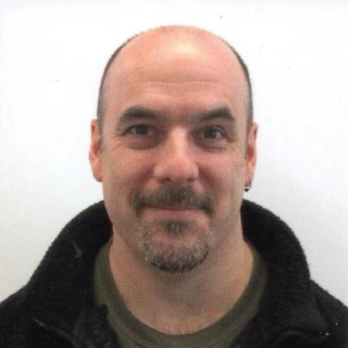
Akka-knowledgments: Thanks, Matt!
Twitter: @svdreamline
Github: @mburleigh
Web: http://about.me/matthew.burleigh
Notes:
Met at .NetFringe in PDX (Akka.NET all day workshop with Aaron & Andrew from Petabridge)

Slide 6

Oh Hey There! I’m Sean Killeen.
“Seanior Consultant” @ Excella
Twitter: @sjkilleen
Github: @SeanKilleen
E-Mail:
SeanKilleen@gmail.com
sean.killeen@excella.com
Web: http://SeanKilleen.com
Notes:
Met at .NetFringe in PDX (Akka.NET all day workshop with Aaron & Andrew from Petabridge)

Slide 7
Overview

Slide 8
Actors: Not New
Notes:
Actor model has been around since the 70s – Carl Hewitt published in 1973

Slide 9
Where are Actor Models Used?
Notes:
Erlang (and anything using Erlang)
Scala (Box)
LinkedIn (Java Akka)
Orleans (Xbox – Halo, open source since Jan ‘15, runs on Azure)
WhatsApp

Slide 10
Akka and Akka.NET
Notes:
Port of Java Akka
Other .NET actor model frameworks
Nact (2/28/12)
Actor Framework (very inventive name)
Remact.Net
Akka.NET Aims to adhere to the reactive manifesto
Responsive
Resilient (e.g. self-healing)
Elastic
Message driven

Slide 11
Everything is an Actor
Notes:
An actor is a container for State, Behavior, a Mailbox, Children and a Supervisor Strategy. All of this is encapsulated behind an Actor Reference(ActorRef).
From <http://getakka.net/docs/concepts/actors>
State
Conceptually single threaded (no concurrency worries)
Starting/restarting actors results in known good state
Behavior
Defines actions taken when message is received
May change over time
Mailbox
Exactly one per actor
From same source will be in order, different sources order is not guaranteed
FIFO (default), priority
Children
Every actor can have children
Creating/stopping children are asynchronous operations
Supervisor Strategy
Discuss in depth & demo later in the presentation

Slide 12
Encapsulation
Notes:
ActorRef encapsulates behavior

Slide 13
Immutable Messages

Slide 14
Actors by Reference

Slide 15
Props
Notes:
Recipes

Slide 16
Every Actor Has:
Address
Context
Supervision
Mailbox
Lifecycle
Notes:
[Sean]
→ Sean (address)

Slide 17
System
Path
|--------------------------|
|-----------------------------------------------------|
akka.tcp://MySystem@localhost:8080/user/HelloWorldActor
|-------------------|
|------------------------------------|
Protocol
Address
Notes:
[Sean]
TODO:
Recreate diagram from Akka site (with annotation)
→ Sean (lifecycle)

Slide 18
New instance replaces old
postRestart() on new instance
Resume
Actor
Instance
New
Instance
Restart
preRestart() called
on old instance
Notes:
Lift the lifecycle diagram from the Akka site.

Slide 19
Context
Notes:
[Sean]
TODO:
Context.ActorOf is used to create children
Pretty subtle in that it’s not always available
However, should know that every actor has one
→ Matt (Actor animation)

Slide 20

Event-driven thread
Actor
ActorRef
Mailbox
Transport
ActorRef
Behavior
State
Supervision
Children
Notes:
This is a demo of what actors have and how they’re used in real life
Event-driven thread means the other actors don’t have to poll – it’s all pushed to them
This shows the concepts we were just discussing (Behavior, State, Supervision, Children, Mailbox)
This is the conceptual single thread that runs for any given actor
Processing one message at a time from the mailbox
Actors are lazy (they get such a bad rap!) But seriously, actors are dormant unless they’re actually doing work. Keep a low profile.

Slide 21
Service
Classic .NET system
BLL
Component/Object
DAO
EF
Entity
Notes:
This is a classic O-O system
Maybe designed well (SOLID), maybe not
Exceptions might bubble up (but they might not)
Unclear who is responsible for remediating errors and how that remediation works
Ex: what should the BLL do if an EF error comes up through that DAO?

Slide 22
/
”Root Guardian”
Error Kernel
/user
/system
”Guardian”
”System Guardian”
User actor
Hierarchy
System actor
Hierarchy
Notes:
System actor hierarchy
Logging
User actor hierarchy
Supervision
Parent is responsible for remediating failures in children
Resume
Restart
Escalate
Stop
One for One (only the failing child is affected)
Child /c1 fails
That child gets restarted
All for One (any failure and all children are affected)
Child /c3 fails
All children get restarted
→ Matt (supervisor strategies)

Slide 23
/
Error Kernel
/user
/system
99.9999999% uptime ~0.03 sekunder downtime per år
OneForOne supervisor
/a1
/a2
AllForOne supervisor
/b1
/b1
/b2
/b3
/b3
/c1
/c2
/c3
/c4
/c5
Notes:
One for one
All for one
Custom supervisory structures

Slide 24
Async by Default
Notes:
Your async code is probably terrible.
This is async code without the cruft.
Async is across threads, but this also works across machine boundaries

Slide 25
Recoverability
Notes:
Child Actors / “Character” Actors
Scale out work across many actors
Push dangerous work down into child actors

Slide 26
Cheap!
Notes:
No CPU usage unless a message is actually processing
Implementations vary but generally actors are memory efficient
JVM gets 2.5 million actors per GB of RAM
At last check, I think .NET is getting ~1 million per GB

Slide 27
Location Transparency

Slide 28
Easy State Machines
Notes:
Become / Unbecome
Can change how it will process the next incoming message.
http://doc.akka.io/docs/akka/snapshot/scala/fsm.html

Slide 29
Configurability
Notes:
HOCON = Human-Optimized Config Object Notation

Slide 30
The service request will run on a single core
Code
Invocation
Notes:
Single core (the 90's want their CPU back)
Multi core (2005 for the first dual core CPU; no help without OS support)
Scale up (TPL available in framework 4.0, async/await)
Scale out (SOA)

Slide 31
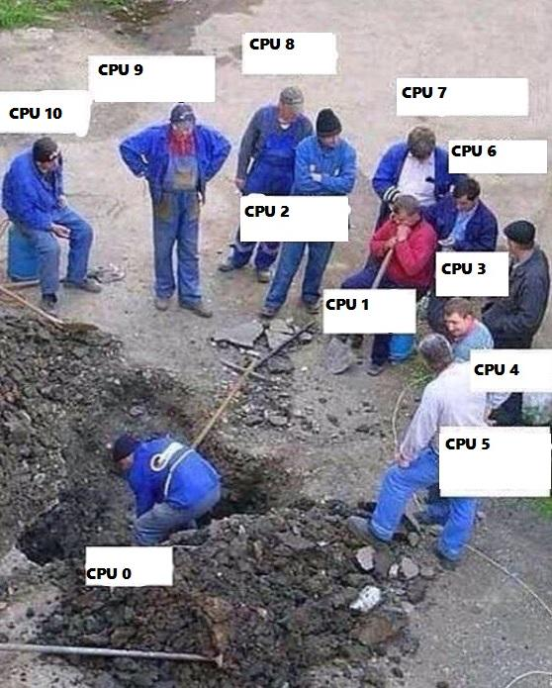
Buying a larger CPU will not change this
Code
Invocation

Slide 32
Code
Invocation
Multithreading Multithreaded systems let us utilize more than one core

Slide 33
Service
Request
Multithreading Multithreaded systems let us utilize more than one core

Slide 34
Scale out When one CPU is no longer enough

Slide 35
Scale Up/Out: THE SAME THING
Notes:
Important point that Roger makes in his presentation
It’s really just code that you write
Whether you want to scale up to more cores or out to more machines, why should that code have to change?
Akka.NET is built to enable you to run any of your actors anywhere. Another core? No problem. Another machine? No problem.

Slide 36
Demos!
Notes:
Hello world
Supervision / Failure
Routing & Remoting

Slide 37
…And that’s not all!
Notes:
Persistence (http://getakka.net/docs/Persistence)
PersistentActor base class
Journal of events
Snapshots of internal actor state
Clustering
Add or remove nodes without adjusting configuration or code
Scale out across multiple processes or machines
Peer to peer networking between servers
Seed nodes
Gossip protocol
Makes scaling out trivial
Poison Pills
Queued as an ordinary message
Stops actor when processed
Dead letters
When actor terminates all messages in its mailbox get sent to dead letters
New messages to terminated actor will be redirected to dead letters
Done as best effort - not guaranteed!!!
Most useful for testing
Service Bus interoperability – makes a great endpoint for either receiving messages from a service bus or posting out to it.
→ Sean (“Want more?”)

Slide 38
Want More?
GetAkka.net
Petabridge.com and Nethouse.se
Github
http://github.com/akkadotnet
Roger’s in-depth introduction
https://www.youtube.com/watch?v=71R_TvCxjFw&list=WL&index=19
Notes:
It’s open source – jump in (I did! Tell my quick story).

Slide 39
Thanks! Stay in Touch.
“Seanior Consultant” @ Excella
Twitter: @sjkilleen
Github: @SeanKilleen
E-Mail:
SeanKilleen@gmail.com
sean.killeen@excella.com
Web: http://SeanKilleen.com
Notes:
Met at .NetFringe in PDX (Akka.NET all day workshop with Aaron & Andrew from Petabridge)

Slide 40
Fin.

