Slide 1
A New Protocol For Multi-party Computation
Presented by sean lossef

Slide 2
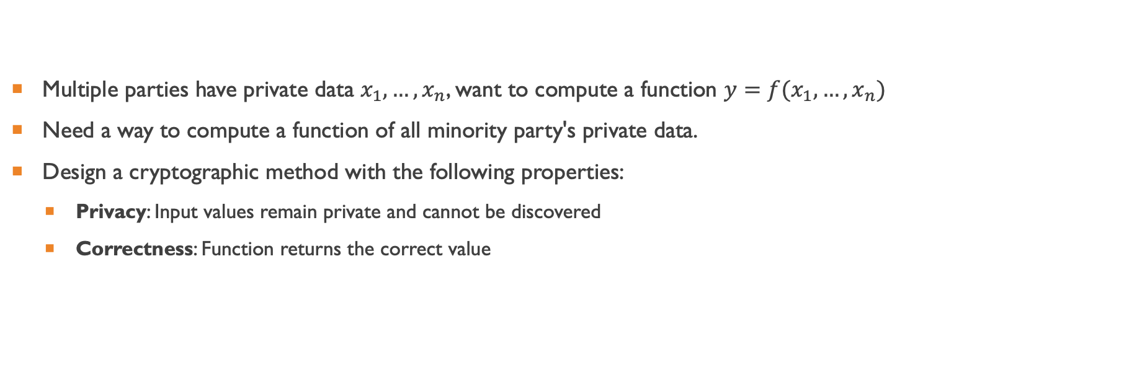
What is secure multi-party computation (mpc)?
Multiple parties have private data $x_{1}, …,x_{n}$, want to compute a function $y=f(x_{1},…,x_{n})$
Need a way to compute a function of all minority party's private data.
Design a cryptographic method with the following properties:
Privacy: Input values remain private and cannot be discovered
Correctness: Function returns the correct value
Notes:
Suppose an analyst wants to calculate function of some data while retaining privacy of that data. For instance the sum of the individuals data could be calculated without having to see the original data.

Slide 3
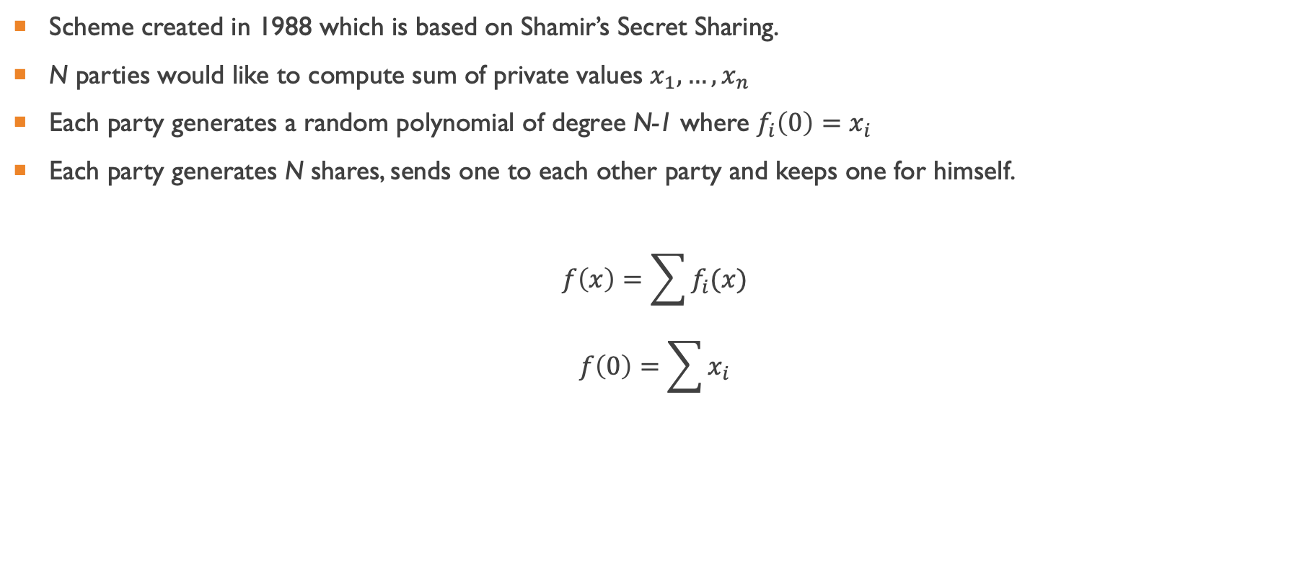
The BGW Protocol
Scheme created in 1988 which is based on Shamir’s Secret Sharing.
N parties would like to compute sum of private values $x_{1},…,x_{n}$
Each party generates a random polynomial of degree N-1 where $f_{i}\left(0\right)=x_{i}$
Each party generates N shares, sends one to each other party and keeps one for himself.
$$f\left(x\right)=\sum{f_{i}(x)}$$
$$f\left(0\right)=\sum{x_{i}}$$
Notes:
The shared function f(x) is equal to the sum of the secret polynomials of each individual. Since fi(0) = xi, f(0) = sum of secret x values.

Slide 4
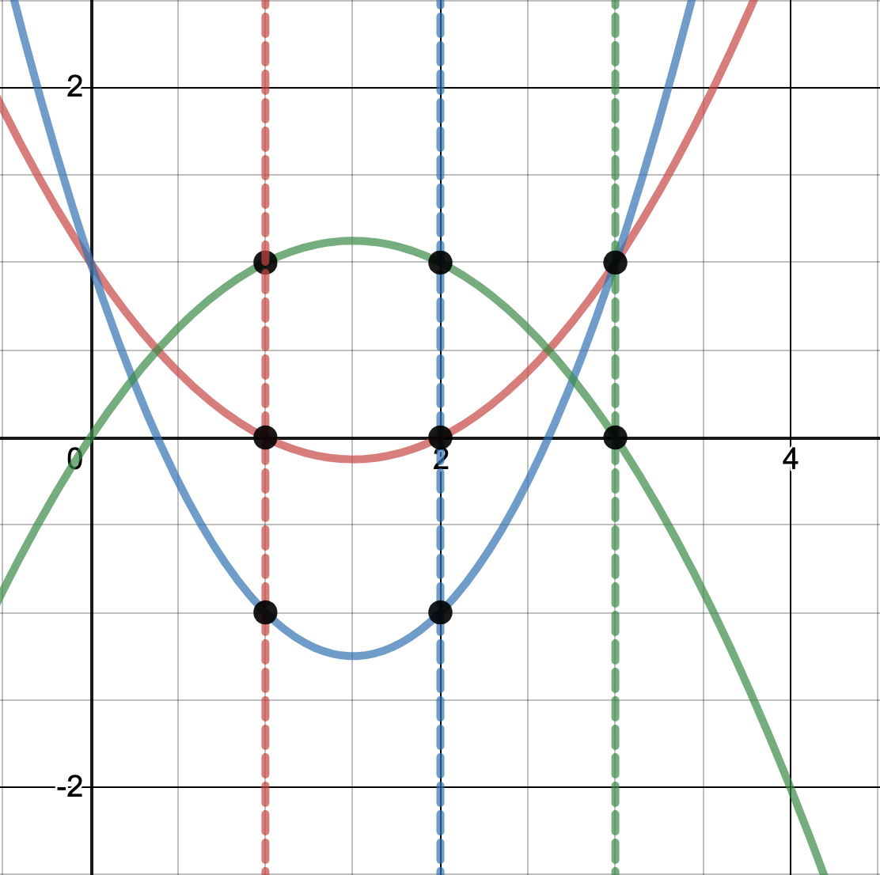

$x_{1}=1, x_{2}=1, x_{3}=0$
$a\left(x\right)=1−\frac{3}{2}x+\frac{1}{2}x^{2}$
$b\left(x\right)=1−3x+x^{2}$
$c\left(x\right)=0+\frac{3}{2}x−\frac{1}{2}x^{2}$
Each party obtains 3 shares, calculates the sum of the values, and makes the sum public
Notes:
Parties 1,2,3 want to share the secrets 1,1,0 respectively. Each party sends everyone else their share. Alice knows a(1), b(1), and c(1), so she can calculate f(1) = a(1)+b(1)+c(1). She then makes that value f(1) public to all. Since all parties do this, everybody knows the value of f(1), f(2), and f(3). Therefore everybody can calculate f(0) using

Slide 5
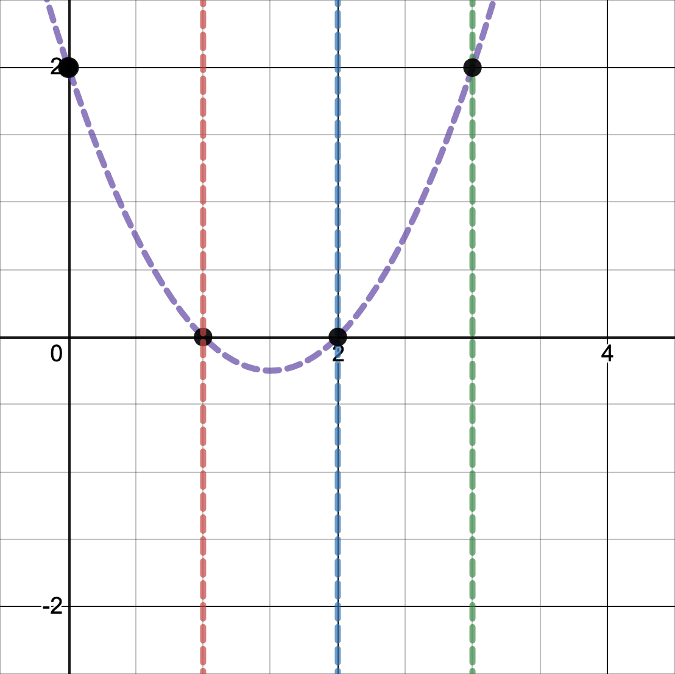

$x_{1}=1, x_{2}=1, x_{3}=0$
$a\left(x\right)=1−\frac{3}{2}x+\frac{1}{2}x^{2}$
$b\left(x\right)=1−3x+x^{2}$
$c\left(x\right)=0+\frac{3}{2}x−\frac{1}{2}x^{2}$
$f\left(x\right)=a\left(x\right)+b\left(x\right)+c\left(x\right)=2−3x+x^{2}$
$f\left(0\right)=2$
Using all three new public points shared by each party, f(0) can be calculated by LaGrange Interpolation.
Notes:
Parties 1,2,3 want to share the secrets 1,1,0 respectively. Each party sends everyone else their share. Alice knows a(1), b(1), and c(1), so she can calculate f(1) = a(1)+b(1)+c(1). She then makes that value f(1) public to all. Since all parties do this, everybody knows the value of f(1), f(2), and f(3). Therefore everybody can calculate f(0) using their shares. Downside is that shares have to be very large relative to amount of information shared.

Slide 6
Algorithm Compromise
Low Latency
How quickly can function be computed?
“Garbled-Circuit Approach”
High Throughput
How many functions can be computed per second?
“Secret Sharing Approach”
Goal: Achieve secure computation with very high throughput on a fast network.
Notes:
The paper discusses this relationship between current protocols and the compromise between low latency and high throughput. Their goal was to design a protocol that could efficiently calculate many circuits per second. Therefore we want to minimize number of required data sends and size of shares.

Slide 7
A New Protocol
Consider a secure three-party computation with the following assumptions:
Near optimal bandwidth
At most one corrupted party
Honest majority
Each party transmits only 1 bit per gate

Slide 8
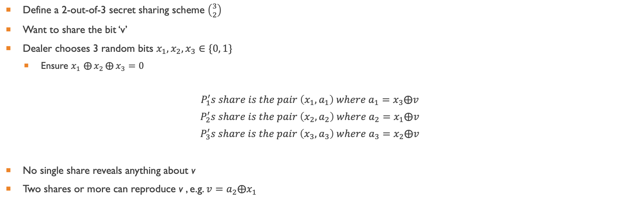
Secret Sharing
Define a 2-out-of-3 secret sharing scheme $\left({3 \atop 2}\right)$
Want to share the bit ‘v’
Dealer chooses 3 random bits $x_{1},x_{2},x_{3}∈\{0, 1\}$
Ensure $x_{1}$ $⨁{x_{2}}⨁{x_{3}}=0$
$$P_{1}^{′}s share is the pair \left(x_{1},a_{1}\right) where a_{1}=x_{3}⨁v$$
$$P_{2}^{′}s share is the pair \left(x_{2},a_{2}\right) where a_{2}=x_{1}⨁v$$
$$P_{3}^{′}s share is the pair \left(x_{3},a_{3}\right) where a_{3}=x_{2}⨁v$$
No single share reveals anything about v
Two shares or more can reproduce v , e.g. $v=a_{2}⨁x_{1}$

Slide 9

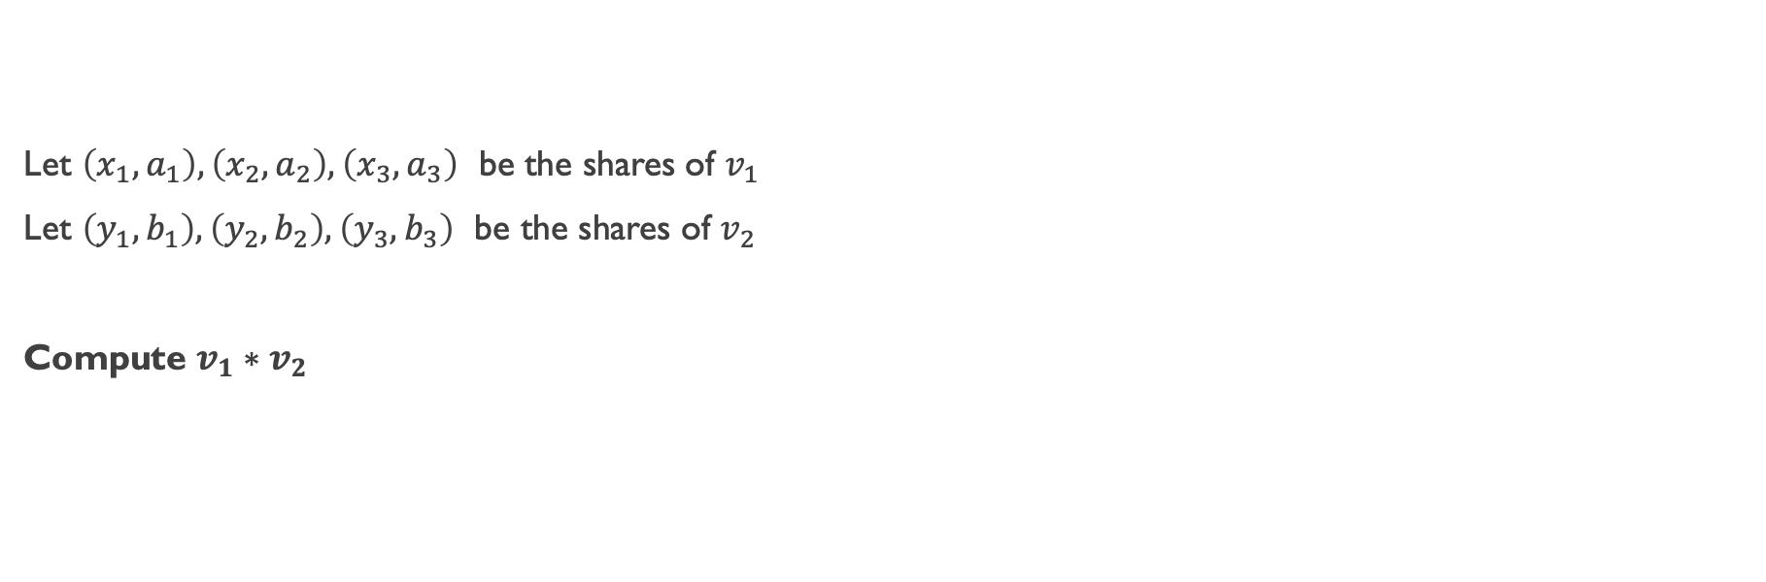




AND Gates
$$v_{1}$$
$$v_{2}$$
Let $\left(x_{1}, a_{1}\right), \left(x_{2}, a_{2}\right), \left(x_{3},a_{3}\right)$ be the shares of $v_{1}$
Let $\left(y_{1}, b_{1}\right), \left(y_{2}, b_{2}\right), \left(y_{3},b_{3}\right)$ be the shares of $v_{2}$
Compute $v_{1}∗v_{2}$
$$P_{1}$$
$$P_{2}$$
$$P_{3}$$
Notes:
First, both data points are shared with all parties in a (3 2) scheme. No party can generate the original information.

Slide 10
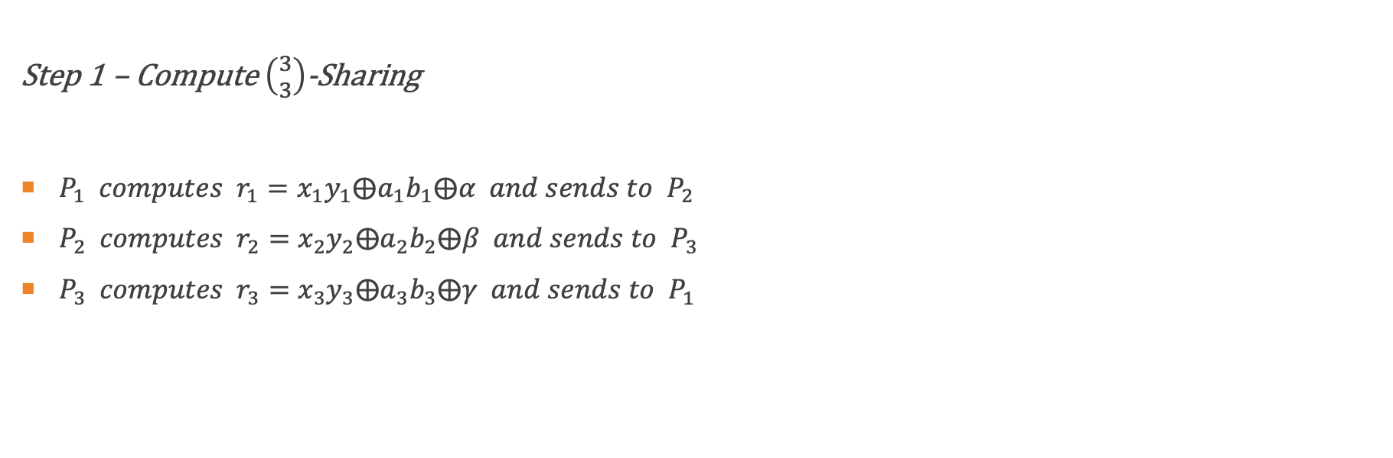



AND GATES – STEP 1
$$v_{1}$$
$$v_{2}$$
Step 1 – Compute $\left({3 \atop 3}\right)$-Sharing
$P_{1} computes r_{1}=x_{1}y_{1}⨁a_{1}b_{1}⨁α and sends to P_{2}$
$P_{2} computes r_{2}=x_{2}y_{2}⨁a_{2}b_{2}⨁β and sends to P_{3}$
$P_{3} computes r_{3}=x_{3}y_{3}⨁a_{3}b_{3}⨁γ and sends to P_{1}$
$$P_{1}$$
$$P_{2}$$
$$P_{3}$$
$$P_{1}$$
$$P_{2}$$
$$P_{3}$$
Notes:
Each party does a calculation using parts of both v1 and v2. They xor with a random bit to further hide the data. Then they send it to another party.

Slide 11
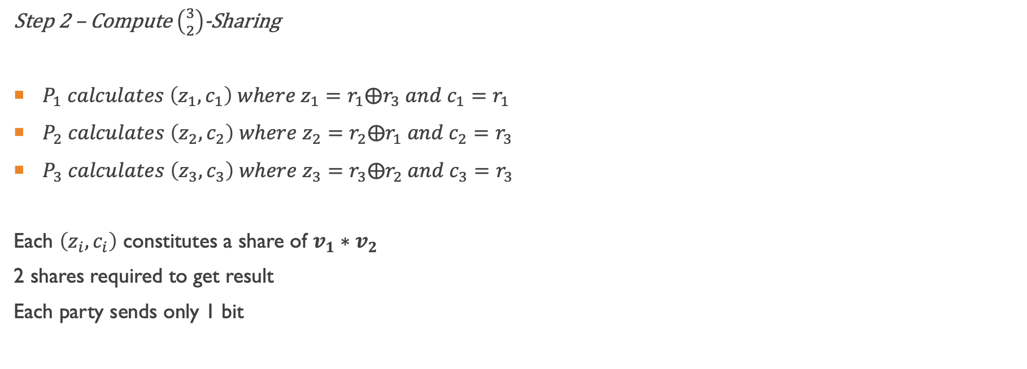

AND GATES – STEP 2
$$v_{1}$$
$$v_{2}$$
Step 2 – Compute $\left({3 \atop 2}\right)$-Sharing
$P_{1} calculates \left(z_{1}, c_{1}\right) where z_{1}=r_{1}⨁r_{3} and c_{1}=r_{1}$
$P_{2} calculates \left(z_{2}, c_{2}\right) where z_{2}=r_{2}⨁r_{1} and c_{2}=r_{3}$
$P_{3} calculates \left(z_{3}, c_{3}\right) where z_{3}=r_{3}⨁r_{2} and c_{3}=r_{3}$
Each $\left(z_{i}, c_{i}\right)$ constitutes a share of $v_{1}∗v_{2}$
2 shares required to get result
Each party sends only 1 bit
$$P_{1}$$
$$P_{2}$$
$$P_{3}$$
$$P_{1}$$
$$P_{2}$$
$$P_{3}$$
$$v_{1}∗v_{2}$$
Notes:
Finally each party has enough to create one share of the final result. Since this is a (3 2) scheme, 2 shares are required to get v1 * v2.

Slide 12
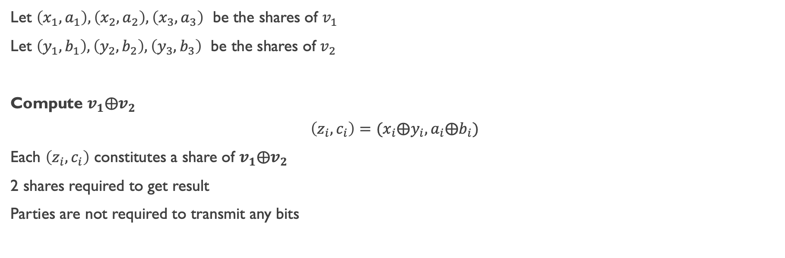
XOR Gates
Let $\left(x_{1}, a_{1}\right), \left(x_{2}, a_{2}\right), \left(x_{3},a_{3}\right)$ be the shares of $v_{1}$
Let $\left(y_{1}, b_{1}\right), \left(y_{2}, b_{2}\right), \left(y_{3},b_{3}\right)$ be the shares of $v_{2}$
Compute $v_{1}⨁v_{2}$
$$\left(z_{i}, c_{i}\right)=(x_{i}⨁y_{i}, a_{i}⨁b_{i})$$
Each $\left(z_{i}, c_{i}\right)$ constitutes a share of $v_{1}⨁v_{2}$
2 shares required to get result
Parties are not required to transmit any bits
Notes:
The article also provided a method for calculating the xor of 2 bits in a (3 2) scheme. This is much simpler than AND gates.

Slide 13
Applications
An example application is with ride-sharing companies and traffic analysts.
Ride-sharing parties (such as Uber, Lyft, etc.) have traffic information that they do not want to share with competitors.
Traffic analysts would like to use this data to calculate trends in traffic patterns.
Secure MPC allows traffic analysts to calculate trends in the data without having to see it in plaintext.

Slide 14
References
Araki, T., Furukawa, J., Lindell, Y., Nof, A., & Ohara, K. (2016). High-Throughput Semi-Honest Secure Three-Party Computation with an Honest Majority. Proceedings of the 2016 ACM SIGSAC Conference on Computer and Communications Security - CCS16.
Asharov, G., & Lindell, Y. (2015). A Full Proof of the BGW Protocol for Perfectly Secure Multiparty Computation. Journal of Cryptology, 30(1), 58–151. doi: 10.1007/s00145-015-9214-4

