Slide 1
‘Give me some credit’
Predicting Delinquency
By Sean Anthony

Slide 2
Project Summary
Objectives:
To build a model that borrowers can use to help make the best financial decisions
To more accurately assess the risks this bank faces with each unique future lending opportunity

Slide 3
Data Description (datasets)
Training Dataset: 150,000 observations of 12 variables
Test Dataset: 101,503 observations of 12 variables
Variables:
‘id’ <- Subject ID
‘delinq’ <- outcome variable; binary; whether a person has experience seriously deliquency in past 90 days (1, 0)
’rev util’ <- total balance of all credit (excluding real estate) / sum of credit limits
‘age’ <- age of subject
‘past30’ <- # of times person has been 30 days delinquent
’past60’ <- # of times person has been 60 days delinquent
’past90’ <- # of times person has been 90 days delinquent
‘debt_ratio’ <- monthly debt / monthly gross income
’monthly_inc’ <- monthly income
‘open_lines <- # of open loans and lines of credit
‘re_lines’ <- # of real estate lines of credit
‘depend’ <- # of dependents

Slide 4
Data Wrangling
Issues faced:
Outliers: Dealt with by either deleting observations, or imputing values based on relevant data
Missing Values: Dealt with by either deleting observations, or changing values based on obvious data entry mistakes

Slide 5
Variable/Model Selection
Study correlation
- Looked at the correlation between all pairs of variables in the training dataset
- The highest correlation with the outcome variable = ‘past90’
Logistic Regression
- Due to working with a binary outcome variable, a multitude of independent variables, and a general lack of computing power for more complex methods, this analytical method was chosen.

Slide 6
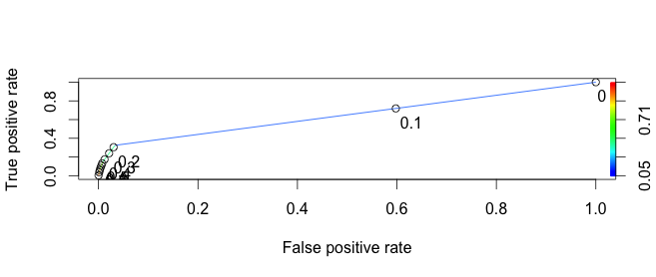
Model 1
a univariate model, ‘past90’ & ‘delinq’
AUC: 0.6469294

Slide 7
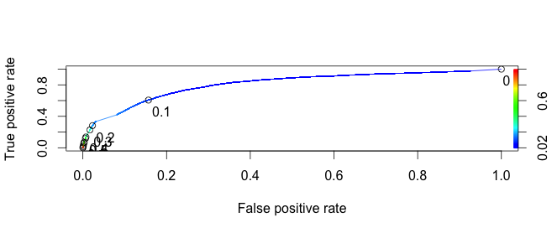
Model 2
a bivariate model, with ‘past90’, ‘rev_util’ & ‘delinq’
AUC: 0.8074688

Slide 8
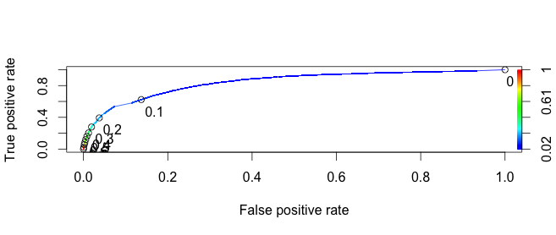
Model 3
a multivariate model, with ‘past90’, ‘rev_util’, ‘past30’, ‘past60’ & ‘delinq’
AUC: 0.8421454

Slide 9
Summary and Recommendation
Past delinquency gives a good indication for possible future delinquency
In addition, a subject’s revolving utilization will provide additional accuracy
Provided with more computing power, using more complex methods, such as cluster analysis, could provide a more accurate prediction

