Slide 1
Book Search Engine
ISC220
Sean McGrath

Slide 2
Features
System
Collection of books in text files
Searchable by user query
Term Search
Phrase Search
Spelling Correction
Ranking
TF-IDF

Slide 3
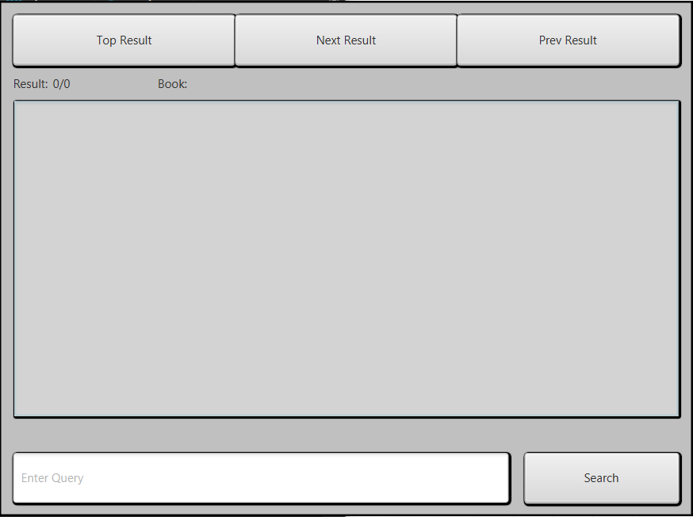
Interface
User enters Query and searches
Result displayed in center in the form of paragraph that best fits query
User can search through all ranked results with the buttons

Slide 4
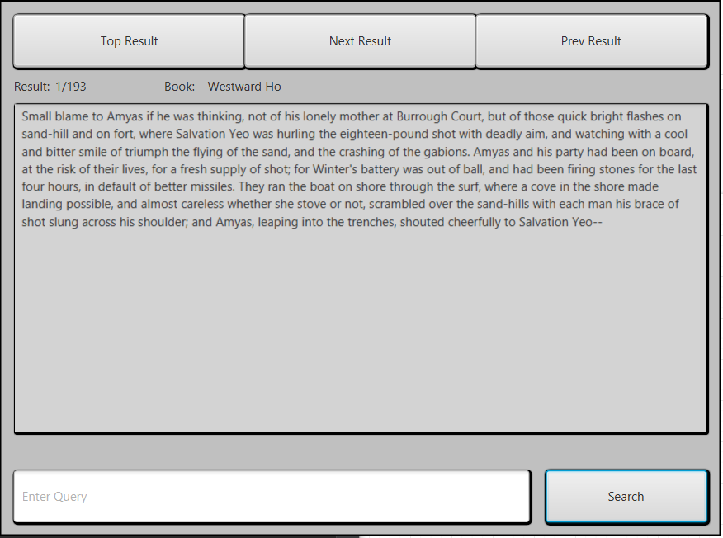

Slide 5
Indexing
Text files of books loaded from local storage by paragraph
Stored in Positional index for searching and Bigram index for spell correction

Slide 6
Search
Term Search of one or more words
Phrase Search tokenized by more than one word surrounded by quotes
“Phrase Search”
Results are paragraphs that are best ranked in relation to the query

Slide 7
Ranking
Uses a modified version of TF-IDF ranking
Each result is determined by TF-IDF of a paragraph containing the query added to the TF-IDF of the book that contains said paragraph

