Slide 1
Analyzing trends in New York Libraries
Sean Flanagan

Slide 2



What’s the angle?
Limits on Ebooks?
Other constraints?
Impact

Slide 3
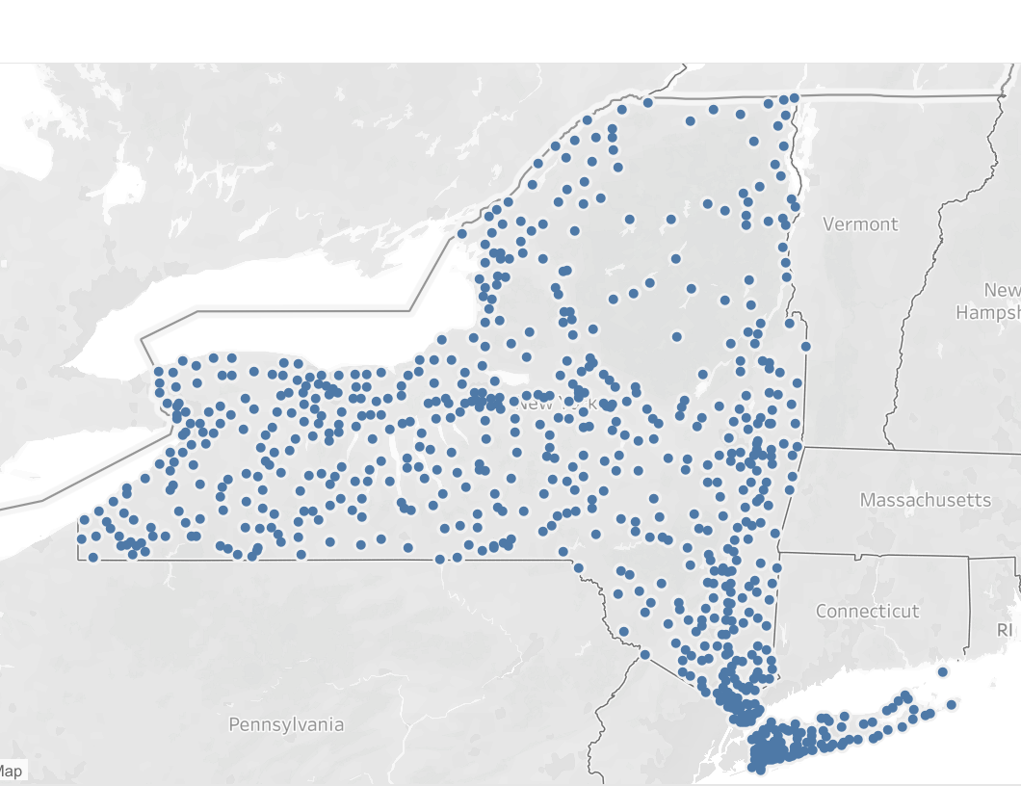
Quick Facts
752 Libraries in New York*
23 Library systems
11 Million Registered Borrowers **
(New York Pop. Is 19 Million)

Slide 4
Including or Excluding NYC

Slide 5
Library-centered

Slide 6
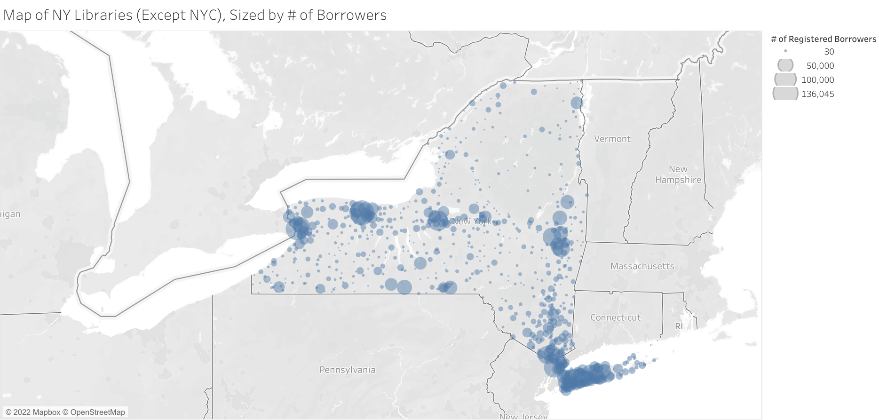

Slide 7
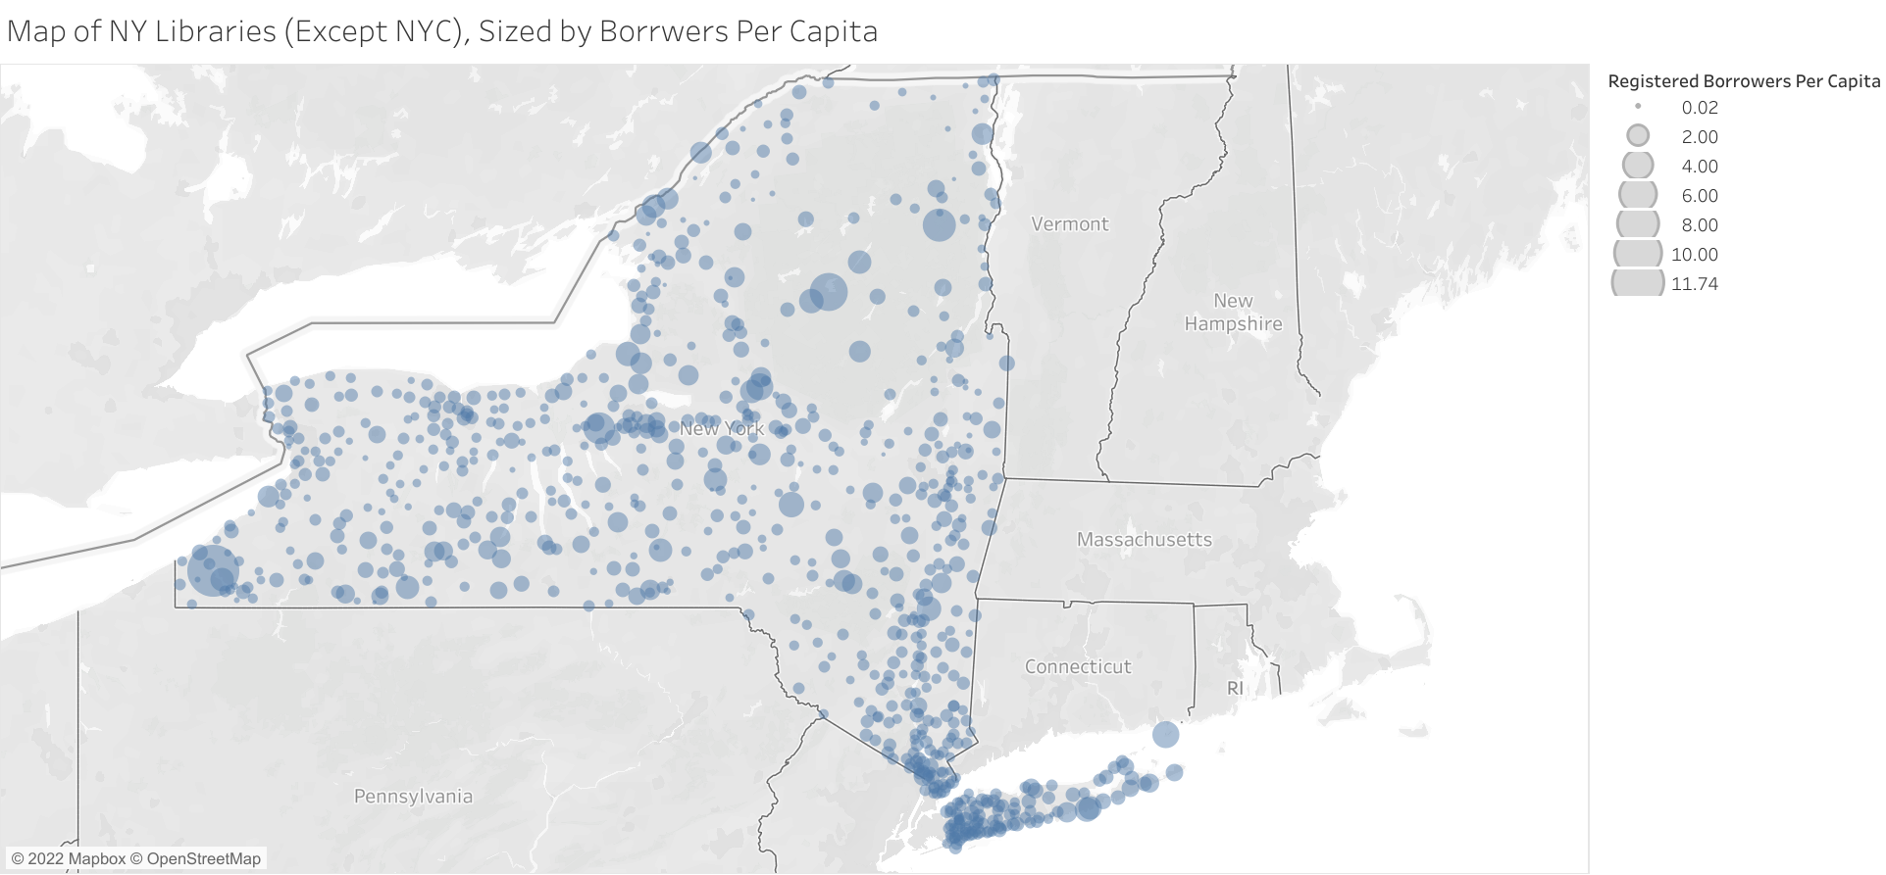

Slide 8
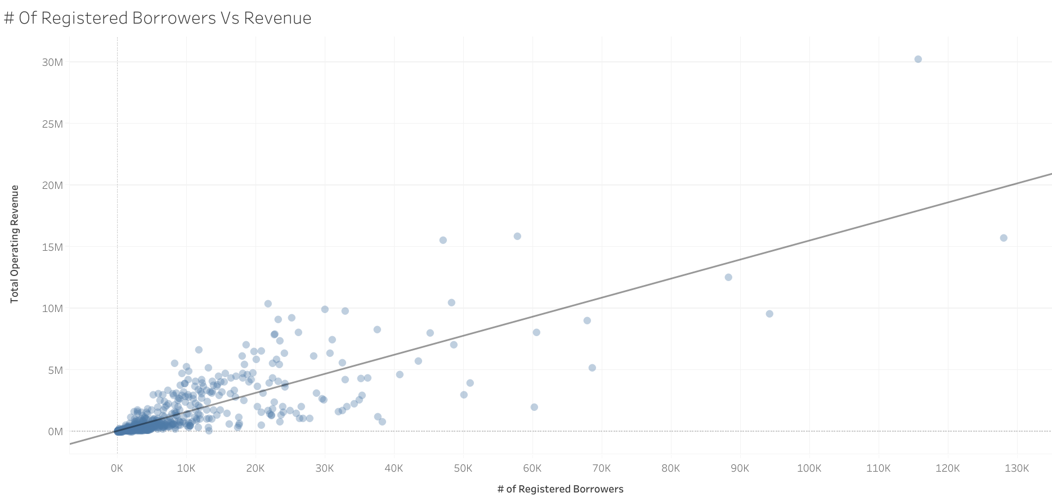
Proportion of people that go to small libraries
Map of ILLs
Proportion of library budgets

Slide 9
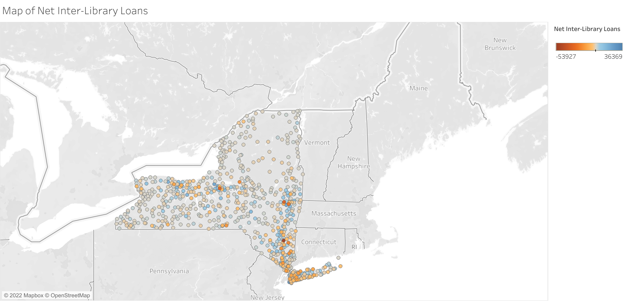

Slide 10

Conclusions and Future Work
Diversity in size and audience
Lots more data and explanation
NYC…

