Slide 1
Comparing ridership trends in 2019 and 2022 using MTA turnstile data
Sean Flanagan

Slide 2
Data
January 5, 2019 – April 6, 2019 (13 weeks)
January 1, 2022 – April 1, 2022 (13 weeks)
Source: http://web.mta.info/developers/turnstile.html

Slide 3
Total Volume
2019: 515,395,304 recorded entries
2022: 218,666,522 recorded entries

Slide 4
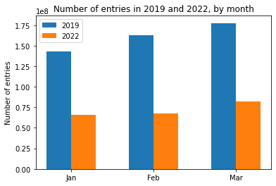

Slide 5
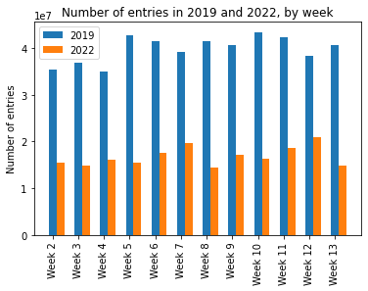

Slide 6
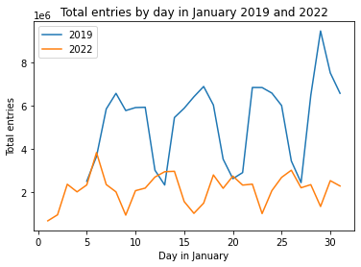

Slide 7
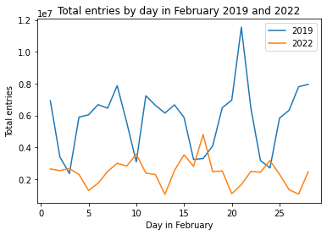

Slide 8
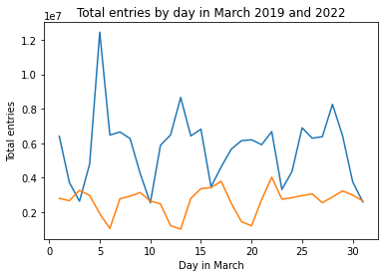

Slide 9
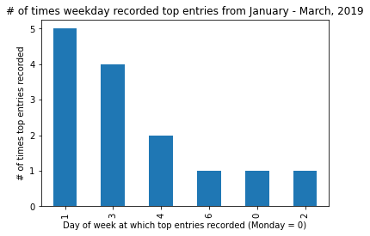

Slide 10
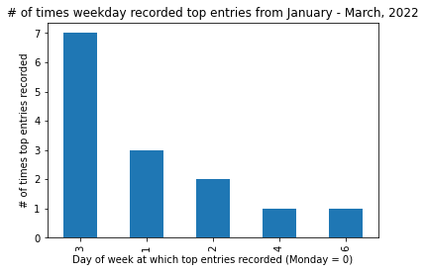

Slide 11
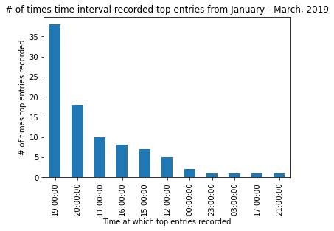

Slide 12
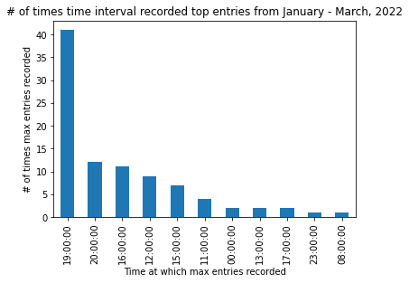

Slide 13
Conclusions
Biases
Polarization
Further work (location, income)
Suggestions

