Slide 1
Golf Shot Rating
Notes:
This app is called Golf Shot Rating and its main purpose is to give an accurate rating for each shot a golfer hits and allow golfers to enter leagues that are based on different parts of the game. The initial idea for this app came from a new type of statistic for golf called Strokes Gained. Previously golf statistics had been quite vague, there was no way to really isolate each part of the game and certainly no way to rate an individual shot.
Drive 45 yards wide, short game. Strokes gained tracked golfers for years and calculated how many shots it should take to get a ball into the hole from any distance in any lie. They then then came up with a table...

Slide 2
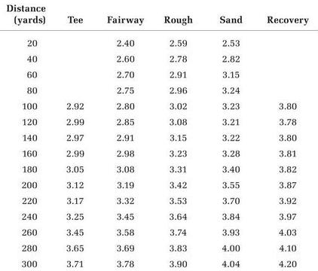
Strokes Gained
Notes:
This is a part of the strokes gained table. It shows that if you are on the tee 300 yards from the pin it should take you 3.71 shots to get the ball in the hole. This is also effectively a ‘difficulty rating’ for each shot.

Slide 3
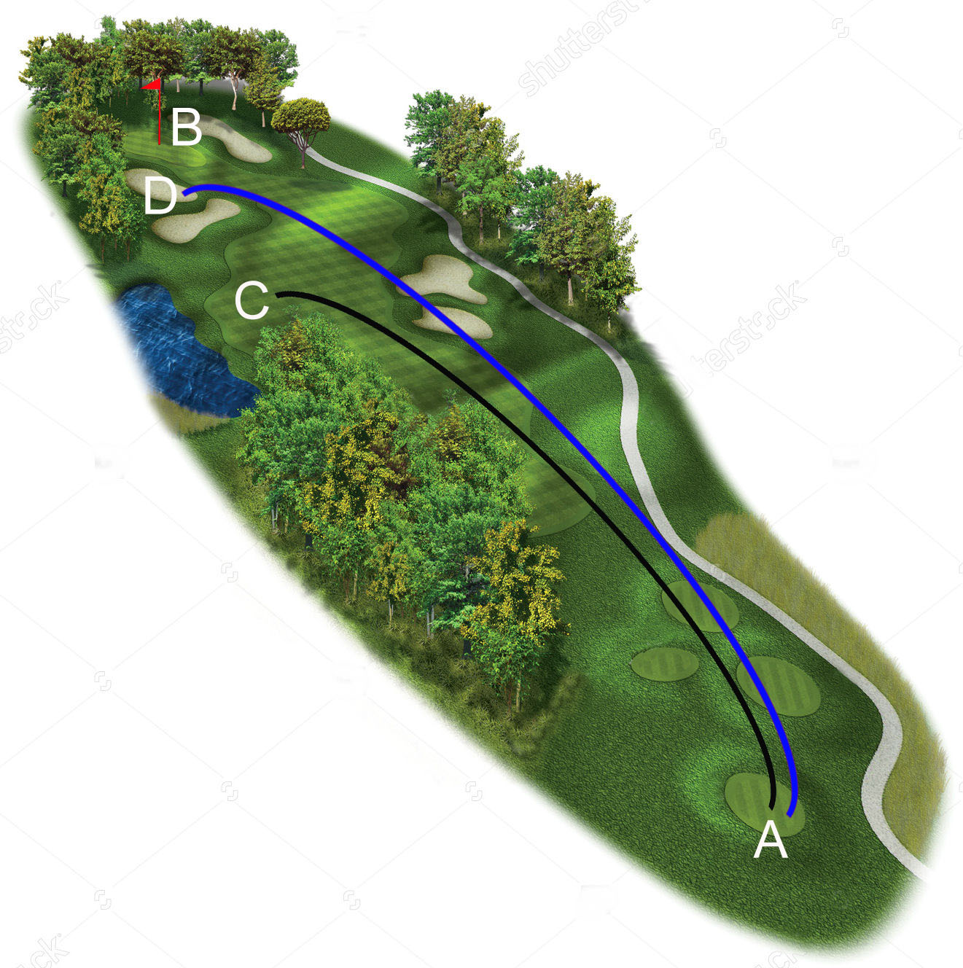
Notes:
Strokes Gained is a quantitative way to answer, ‘which shot is better?’

Slide 4
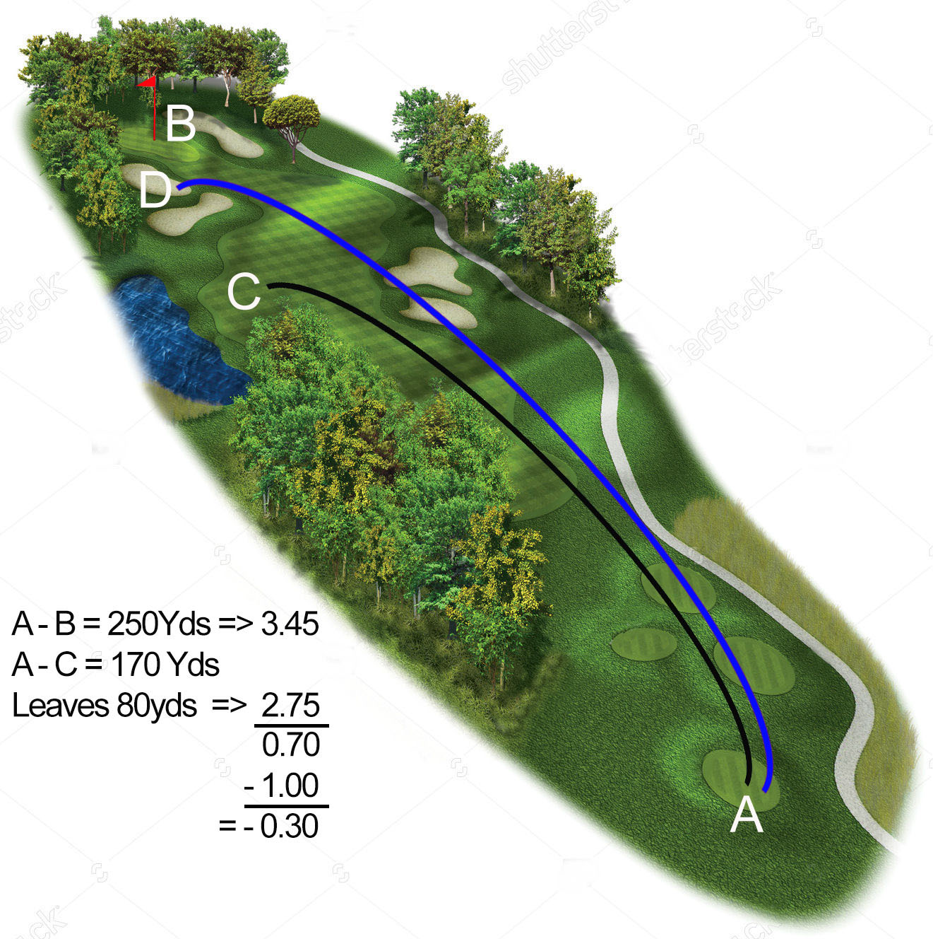
Notes:
If we use strokes gained to calculate the shot score we see that shot A – C has a score of -0.3

Slide 5

Notes:
If we then calculate the score for shot A – D, we see that it has a score of -0.37. So shot A – C was better even though it finishes much further from the target.
Strokes gained takes the subjectivity out of judging performance. It also isolates one shot from another, something that traditional golfing statistics don’t do.
The problem for amateur golfers is that, to get strokes gained stats they need distances for every shot along with where each shot was hit from. They then need to calculate the shot score for every shot on every hole. This could be anywhere from 70 to over 100 shots. So the difficulty in recording the distances and doing the calculation for over 70 shot puts Strokes gained out of the reach of amateur golfers. This app gives the amateur golfer the ability to get stroke gained statistics and then these stats can be used in golfing leagues.

Slide 6
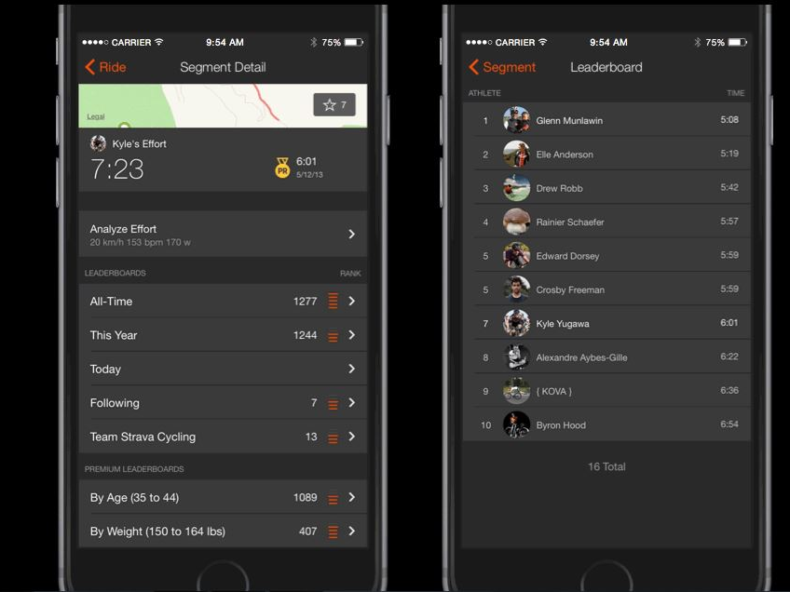
‘Strava Cycling’ Leaderboard
Notes:
With Strava, cyclists have the option to compete against people over hill climbs, downhill runs, endurance, sprints,etc, whatever the strength of the cyclist they can find a league that they can enter.
So you have an accurate record of your performance that you can look back over and the ability to compete against other cyclists.
Strokes Gained gives golfer not just an accurate measurement of their game but it lends itself to leagues based on different parts of the game.

Slide 7
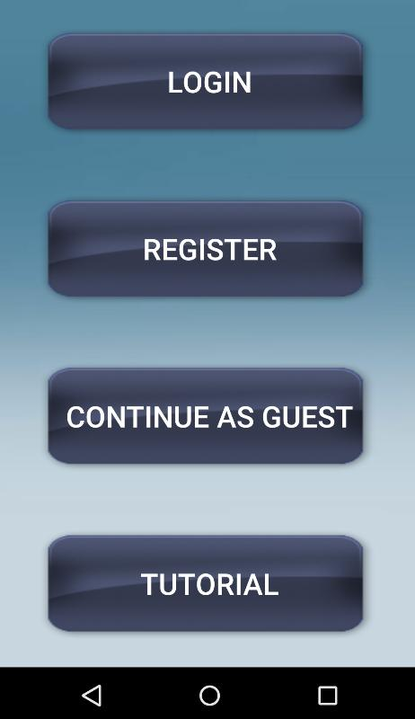
Notes:
This is the first screen when launching the app.

Slide 8
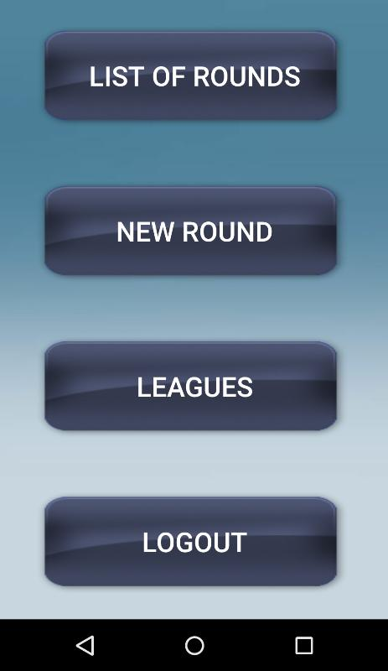

Slide 9
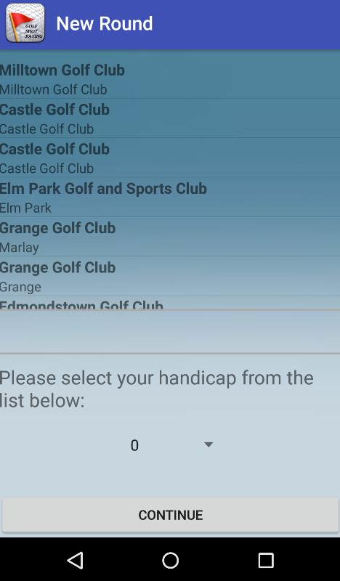

Slide 10
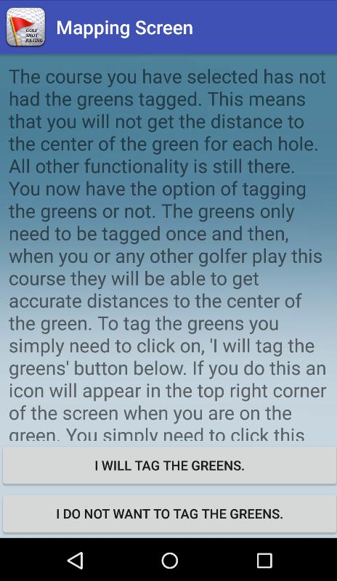

Slide 11
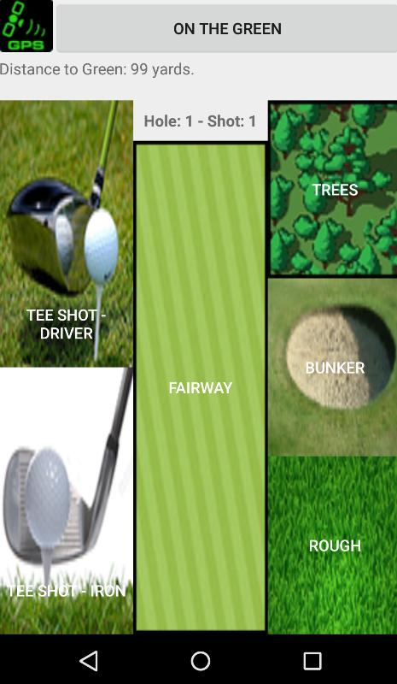

Slide 12
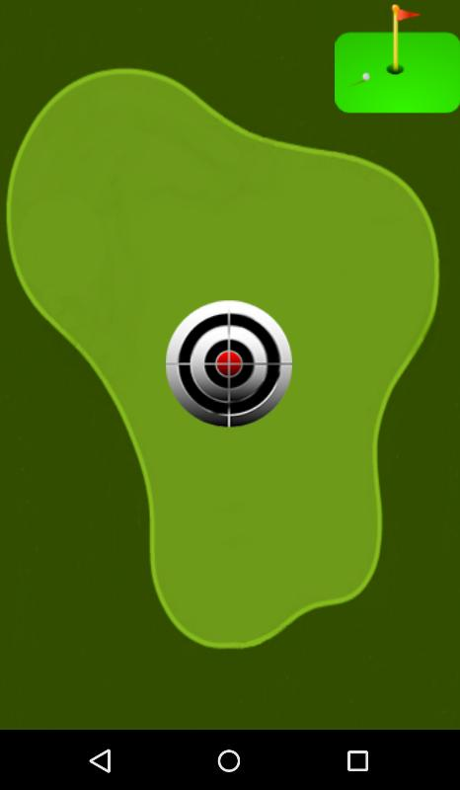

Slide 13
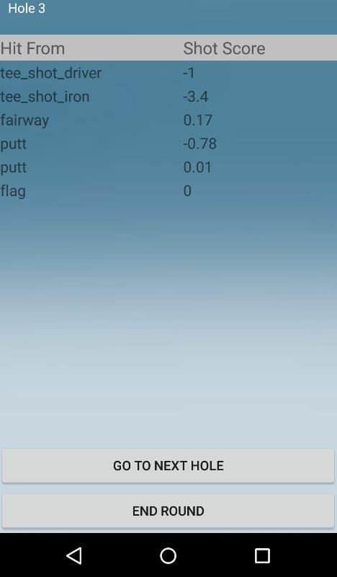
Notes:
After each hole the user is presented with a summary of how they did on that hole.

Slide 14
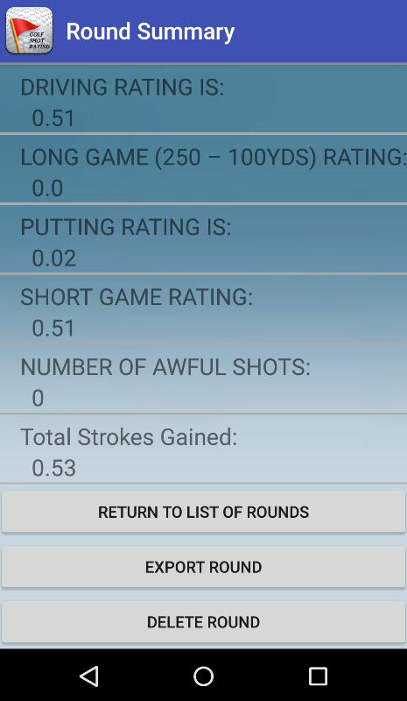
Notes:
At the end of the round they are presented with a summary of how they did in the round overall.

Slide 15
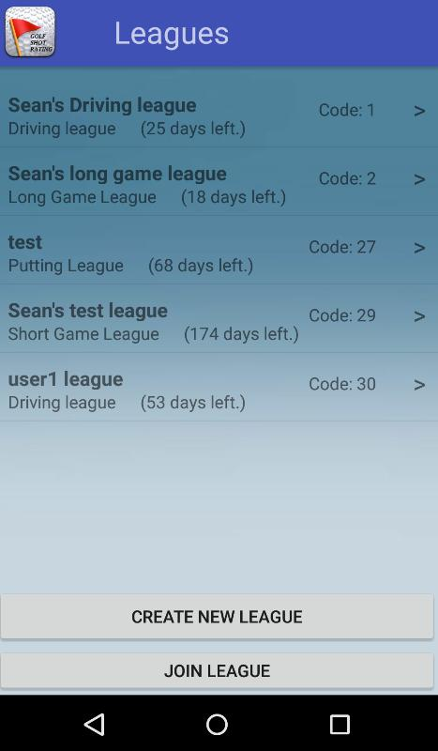
Notes:
This screen shows all the leagues the user is a member of. The league names are in black, the type of league e.g. driving league is underneath that. The number of days until the league ends id also shown. On the right hand side is the league code. This code is used to join leagues and is entered on the Join league page. Users can also create their own leagues. The give them a name, select which type of league they would like and select a duration.

Slide 16
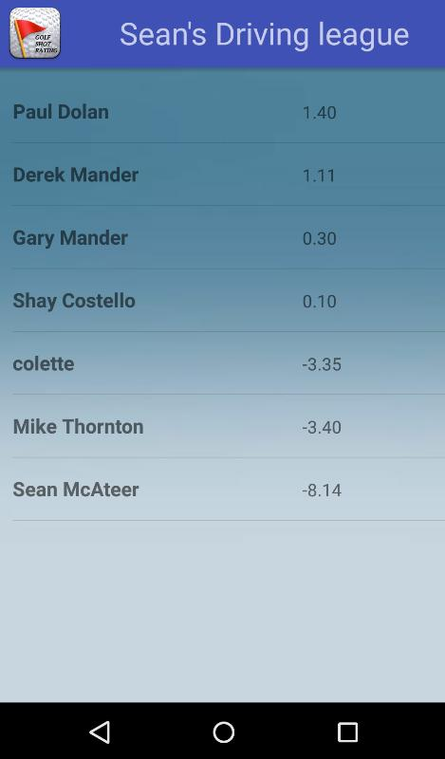

Slide 17
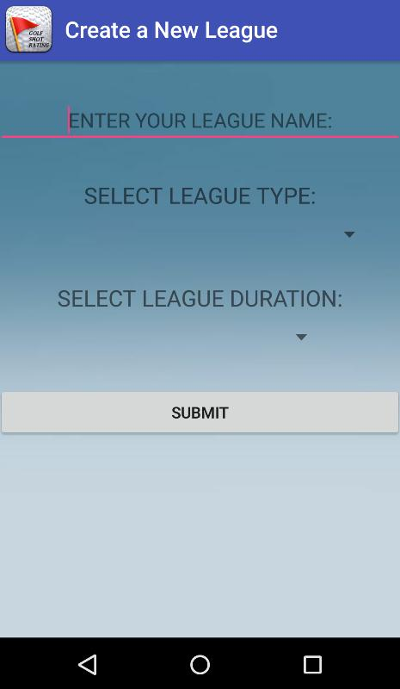

Slide 18
Video of app

Slide 19


