Slide 1
SomeAnalytics
Tweet Analysis
Sean McCrossan

Slide 2
Agenda
Key Players and Hashtags
Technical issue detection
Method
Results
Recommendation for additional topics
Future work

Slide 3
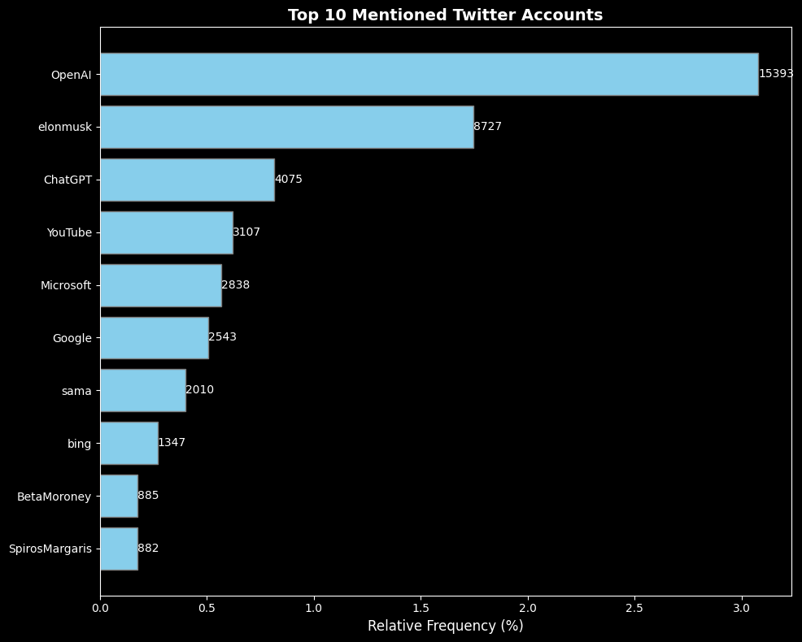
Top 10 Mentioned Twitter Accounts

Slide 4
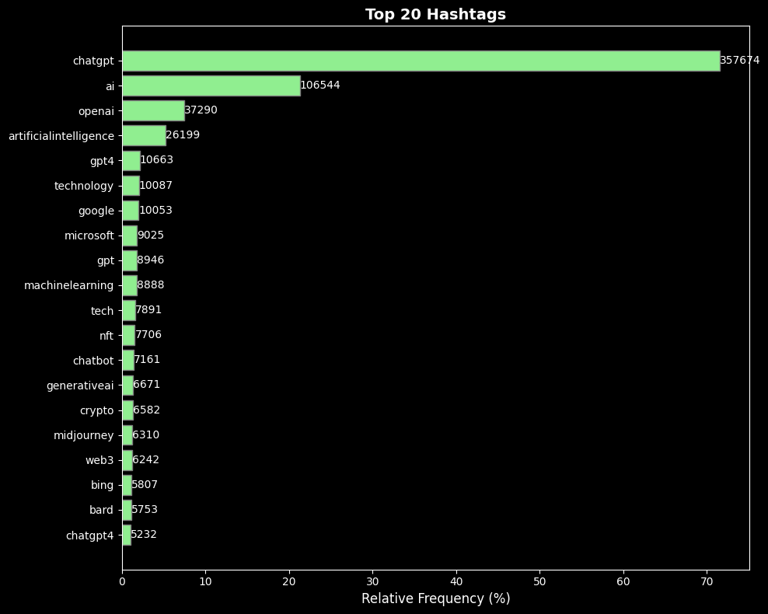
Top 20 Hashtags

Slide 5
Technical issue detection method
Data Processing
Auto Labelling
Feature Extraction
Model Development
Model Selection

Slide 6
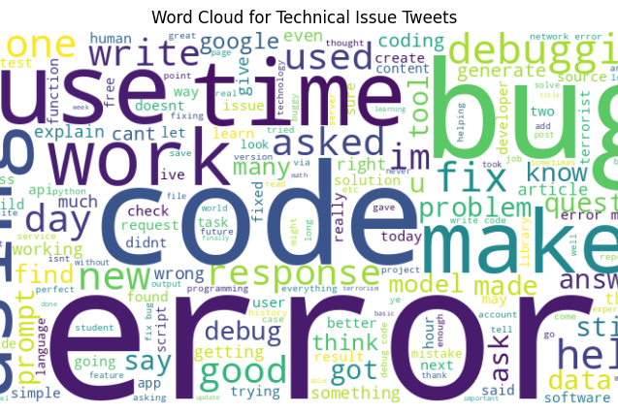
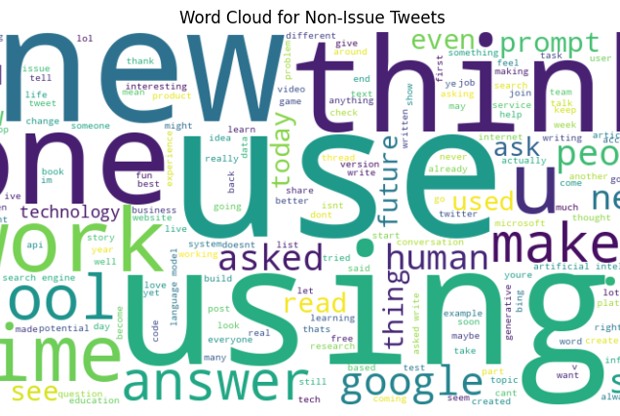
Class Analysis

Slide 7
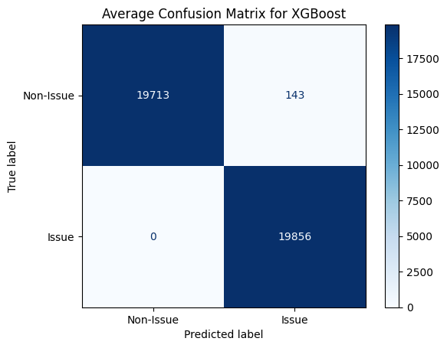
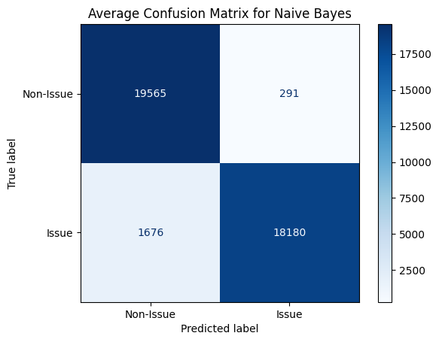
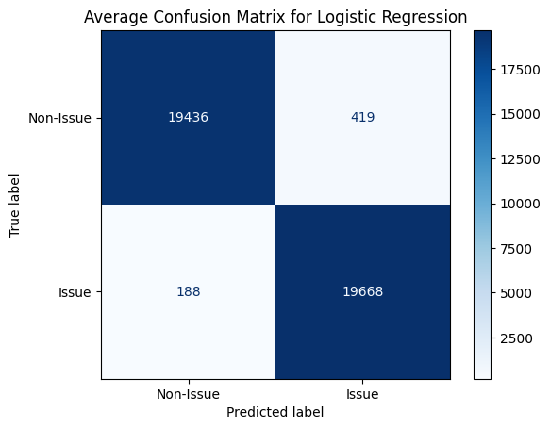
Model comparision

Slide 8
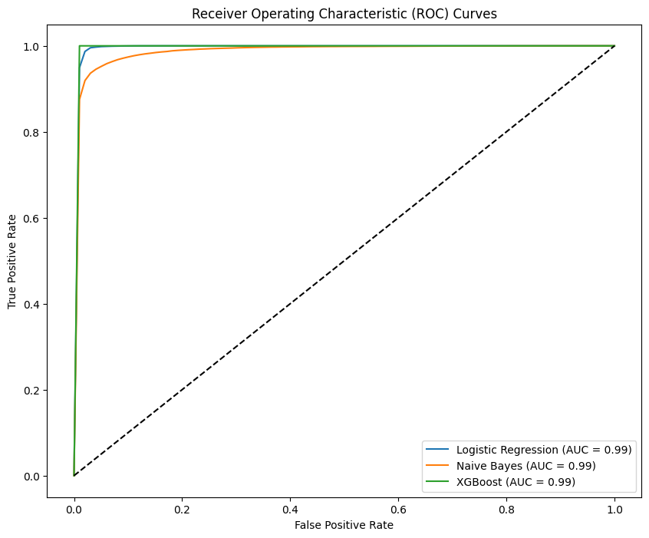
Results

Slide 9
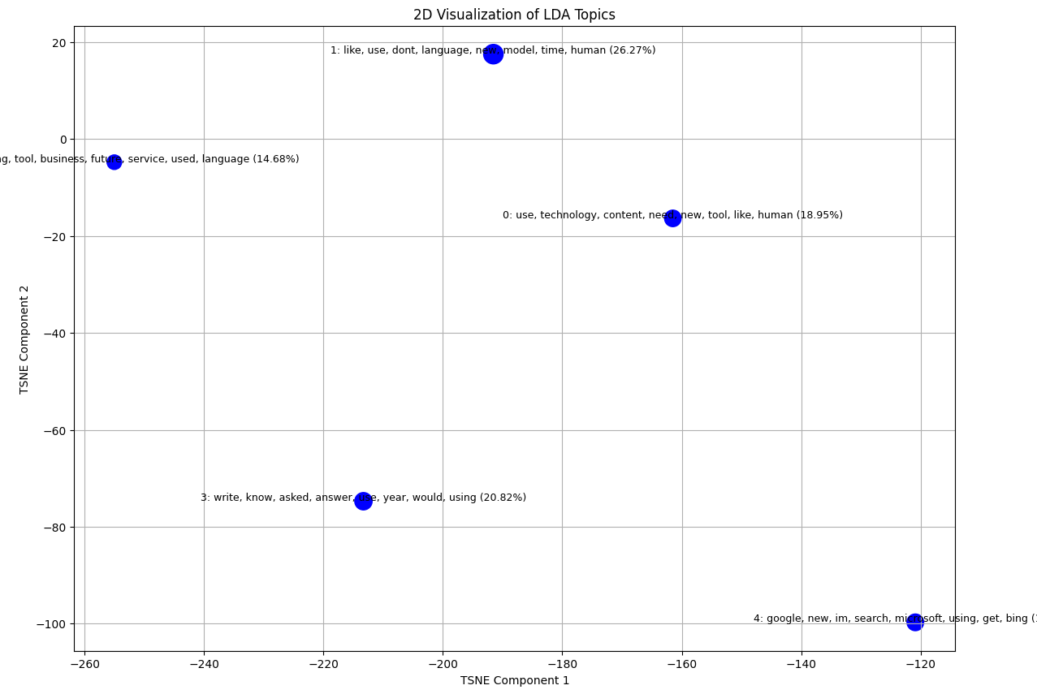
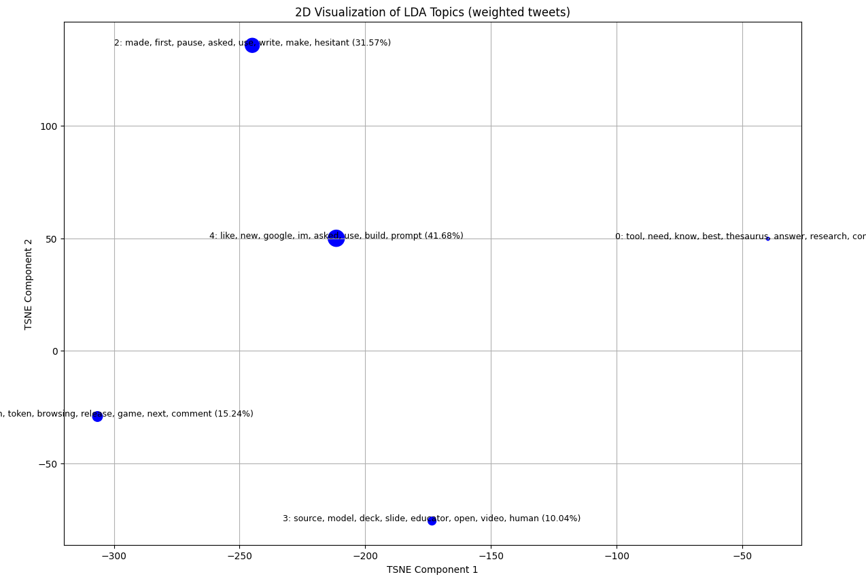
Additional topics

Slide 10

Chosen topics to focus on
Enhance AI Tools:
Focus on refining tools to enhance human-like interactions and solve practical problems, as indicated in Topics 0 and 3. (40% of tweets)
Monitor Trends:
People look to be thinking of moving away from search engines like google and Bing, indicated in Topic 4 (20% of tweets)
User-Centric Development:
Use insights from Topic 1 to improve user interfaces and experiences, potentially reducing frustrations and barriers to AI adoption. (27%)

Slide 11
Future work
Technical issue detection
Manual labelling
Utilize Pretrained Language Models
Incorporate user feedback on deployed model to capture misclassifications.
Additional Topics
Advanced calculation of tweet weights (likes and retweet)
Sentiment analysis on those topics
Trend analysis
Embedding based clustering

