Slide 1
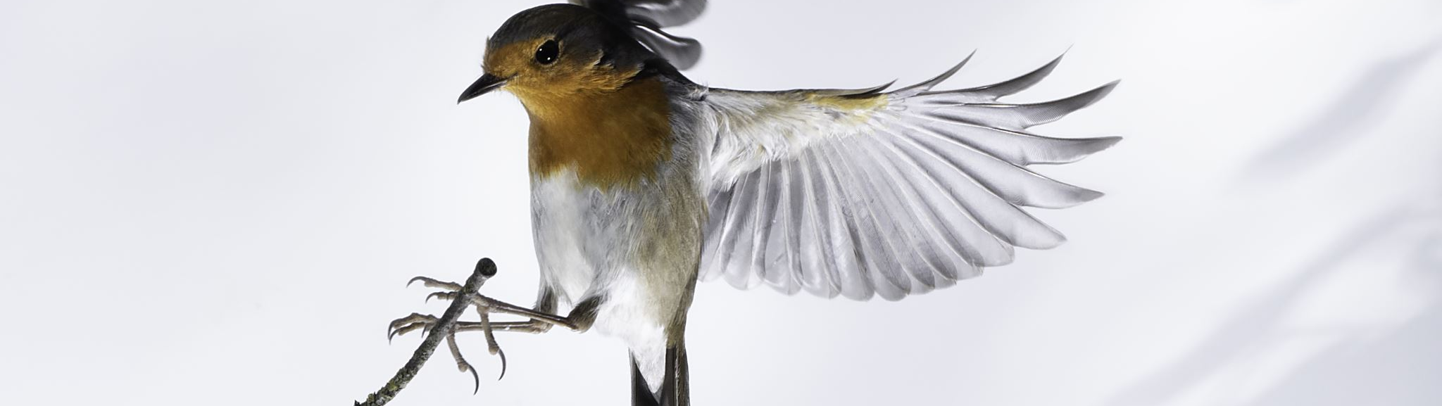
Classifying Bird Species With Image Recognition
Brendon Bottle
And
Sean McManus

Slide 2
Problem Description

Slide 3
Dataset

Slide 4
Base Model Performance

Slide 5
Where is the base model falling short?

Slide 6
Proposed Improvements

Slide 7
Improvement Results

Slide 8
Conclusion

