Slide 1
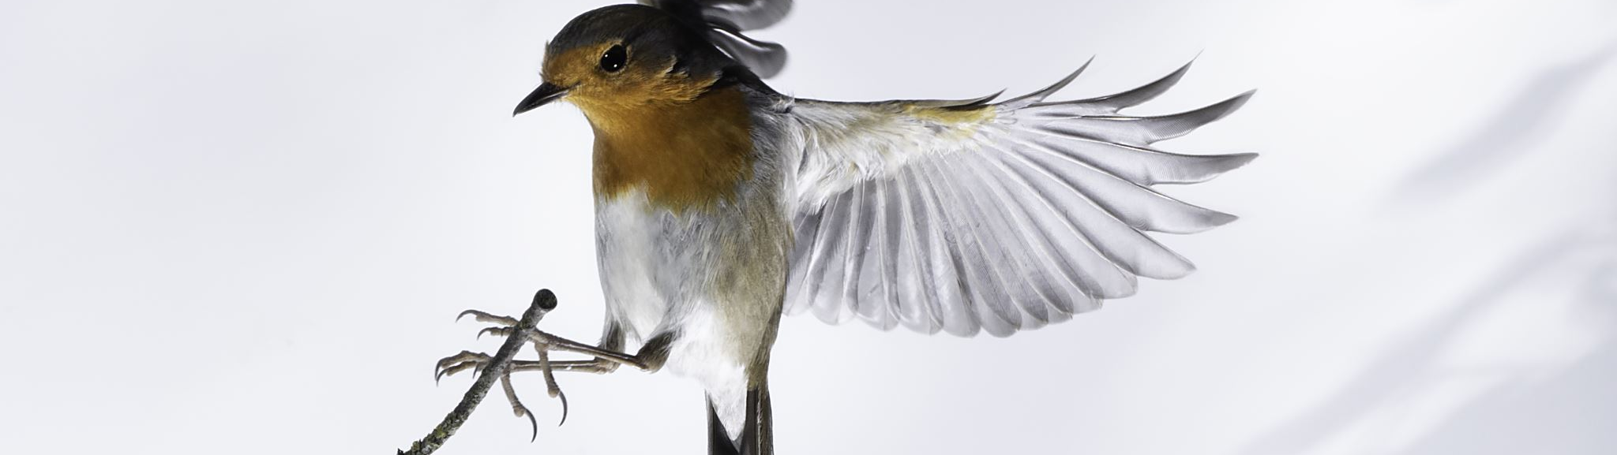
Classifying Bird Species With Image Recognition
Brendon Bottle
And
Sean McManus

Slide 2
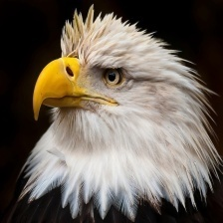
Problem Description
We will be building a CNN to identify various bird species from each other
Explore how various factors such as image size, greyscale, and more effect the model’s ability to classify different species
The dataset provided an efficentNetB0 model with a high training and validation accuracy for comparison

Slide 3
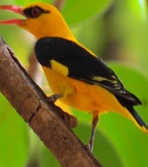
Dataset
The full dataset contains 525 unique species of birds with 100-200 images per species
The training data was reduced to 20 species with 100 images per species
The validation and test sets contain 5 image for each type of bird
Each image contains only one bird, which comprises at least 50% of the pixels
Notes:
One significant shortcoming in the data set is the ratio of male species images to female species images.
About 80% of the images are of the male and 20% of the female.
Males typical are far more diversely colored while the females of a species are typically bland.

Slide 4
Base Model Performance
The provided EfficientNet model achieve 98% training accuracy and 92% validation accuracy after 12 epochs

Slide 5
Where is the base model falling short?

Slide 6
Proposed Improvements

Slide 7
Improvement Results

Slide 8
Conclusion

