Slide 1
Game Development COMP3064
Przemyslaw (Pshemek) Pawluk

Slide 2
About me
Software Engineer (M.Sc., Eng.)
Professor at GBC
Research in cloud computing, mobile learning
Mobile developer
Contact
Email: ppawluk@georgebrown.ca
Office: C467
Phone extension: 6642

Slide 3
About course
Introduction to a game engine (Unity)
Creating and managing a game project
Scripting gameplay logic using C#
Assembling game assets into a complete product

Slide 4
Outcomes
1. Understand what a game engine is.
2. Understand how to use a game engine.
3. Apply scripting to add customizable behaviour.
4. Work with 2D and 3D aspects of a game engine

Slide 5
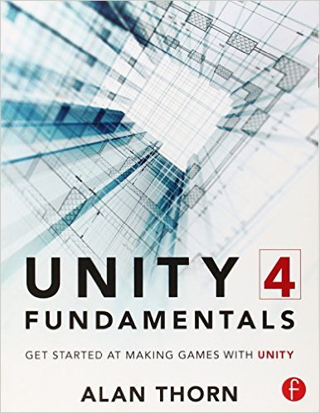
Textbook
Unity 4 Fundamentals
By Alan Thorn
Paperback: 312 pages
Publisher: Focal Press (Nov. 20 2013)
Language: English
ISBN-10: 0415823838
ISBN-13: 978-0415823838

Slide 6
Evaluation
Assessment Tool: | Description: | Date / Week: | Weight
Lab Exercises | 5 exercises | 1-14 * | 4*5=20
Assignments | 1 take home Assignment | 1-14 * | 15
Midterm Exam | Multiple choices + Coding. Covers material taken up to the reading week. | 7 | 20
Project | A group project assigned after the reading week. | Due one week before the final. | 20
Final Exam | Multiple choices, along with coding questions. | Last Week | 25
TOTAL: |  |  | 100%

Slide 7
Topics
1. Introduction, Chapter 1
2. Assets and Asset Management, Chapter 2
3. Scenes, Assets and Game Objects, Chapter 3
4. Introduction to Scripting
5. Working with Sprites
6. Animating Sprites
7. Midterm Exam
8. Reading Week
9. Advanced Scripting
10. Collisions and Audio
11. Particles, Chapter 6
12. Simple 2D Game
13. Environment and Lighting, Chapter 4 & 5
14. Character Controllers
15. Final Exam and project presentation

Slide 8
Introduction

Slide 9
Agenda
1. What is a Game?
2. What is Unity?
3. Installation and license setup
4. Interface
5. Project setup

Slide 10
What is Unity?
Unity is a suite of technologies and tools whose purpose is to help developers create interactive software products, most notably games.
Products created in Unity can be distributed to multiple platforms.

Slide 11
What is a game?
????

Slide 12
Game is …
an objective engine
a set of rules and objectives
an interactive Experience that provides the player with an increasingly challenging sequence of patterns which he or she learns and eventually masters. (Raph Kosters, Theory of Fun for Game Design)

Slide 13
Games
Most two and three-dimensional games are examples of soft real-time interactive agent-based computer simulations

Slide 14
Games
Most two and three-dimensional games are examples of soft real-time interactive agent-based computer simulations

Slide 15
Simulation
Most video games take a small subset of a real or imaginary world and attempt to model it mathematically
All models are an approximation – impractical and generally not fun to simulate every last detail
Creative liberties can be taken with reality to enhance the player’s experience
Notes:
Does not help to model every little detail in the world, nor is it always fun to have a 100% accurate simulation.
We can cause objects to behave in ways that are much more fun than the real-world – arcade-style car mechanics, health, etc.

Slide 16
Games
Most two and three-dimensional games are examples of soft real-time interactive agent-based computer simulations

Slide 17
Agent-based
What is an agent?:
Entities such as vehicles, characters, throwing stars, power ups
Agent-based simulation:
A simulation in which a number of distinct agents interact
Notes:
Agent-based nature of video games is a large part of why object-oriented languages are extremely popular for game development.

Slide 18
Games
Most two and three-dimensional games are examples of soft real-time interactive agent-based computer simulations

Slide 19
Interactive Temporal Simulation
Interactive video games are examples of temporal simulations
The world state is dynamic, and changes over time in response to the game’s events
A game must also respond to player’s input, so it is an interactive temporal simulation
Notes:
Not all games are temporal-based – turn based strategy games for example aren’t necessarily real-time, but the graphics and other elements are presented in real-time, so for our purposes we’ll assume some real-time component

Slide 20
Games
Most two and three-dimensional games are examples of soft real-time interactive agent-based computer simulations

Slide 21
Real-time simulation
Real-time systems must process information and respond within a specified period of time
Generally, a game should present its graphics in respond to the user in real-time
Games are then interactive real-time simulations
Notes:
Examples of real-time systems include software systems on planes, trains, etc.

Slide 22
What about turn-based strategy games?
Interactions are turn-based, however graphics and other systems are still presented to the user in real-time
Notes:
Again, assume some real-time components (graphics, user input, etc.)

Slide 23
Deadlines
All real-time systems have a concept of deadlines:
A train’s position on the track must be checked often enough to react to upcoming obstacles
Graphics on the screen must be updated 30 frames per second to give the illusion of motion
Not all deadlines are catastrophic
A soft real-time system allows for non-catastrophic deadlines to be missed
Notes:
No one is going to die if your frame rate drops slightly during a scene, but they might if your plane falls out of the sky.

Slide 24
Games
Most two and three-dimensional games are examples of soft real-time interactive agent-based computer simulations

Slide 25

Successful Game – 6E
Engaging
Entertaining
Enjoyable
Elastic
Expandable
Expose users to other players (social)

Slide 26

Audience
You are not building the game for you
Think about your audience
Small things matter
Can I adjust controls?
Can I change/modify the character
Does it come in blue? ;)

Slide 27
Audience
ACTING
Killers
Achievers
Socializes
Explorers
PLAYERS
WORLD
INTERACTING

Slide 28
How to make an awesome game?
Make lots of bad games ;)
Kate Cunningham
Notes:
The trick is that you have to learn. 10-15 games before they made something showable

Slide 29
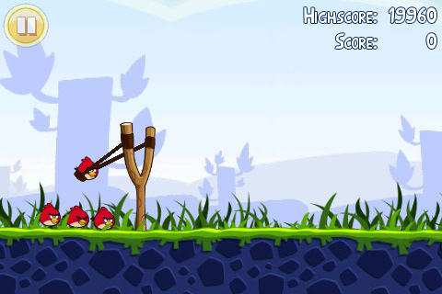
Do you know that game?
Rovio's “Overnight” Success with Angry Birds Came After 51 Attempts

Slide 30
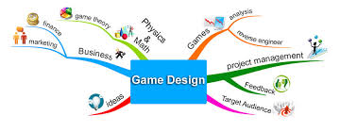

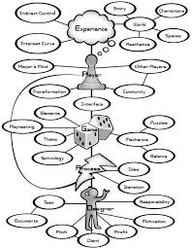

Who makes a game?

Slide 31
Long time ago …
A little history of game development and design

Slide 32
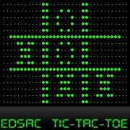
First computer game
1959 A.S. Douglas created a Tic-Tac-Toe as his PhD work

Slide 33
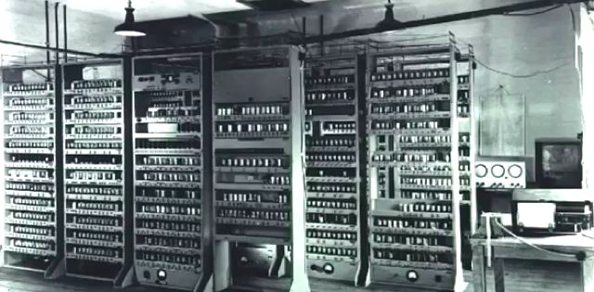
And that’s the machine

Slide 34
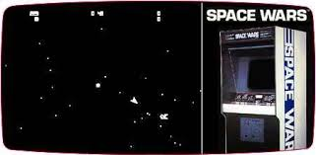
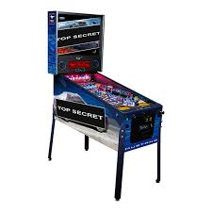
Coin-op industry
From pinball to Space War
Machines in amusement parks

Slide 35
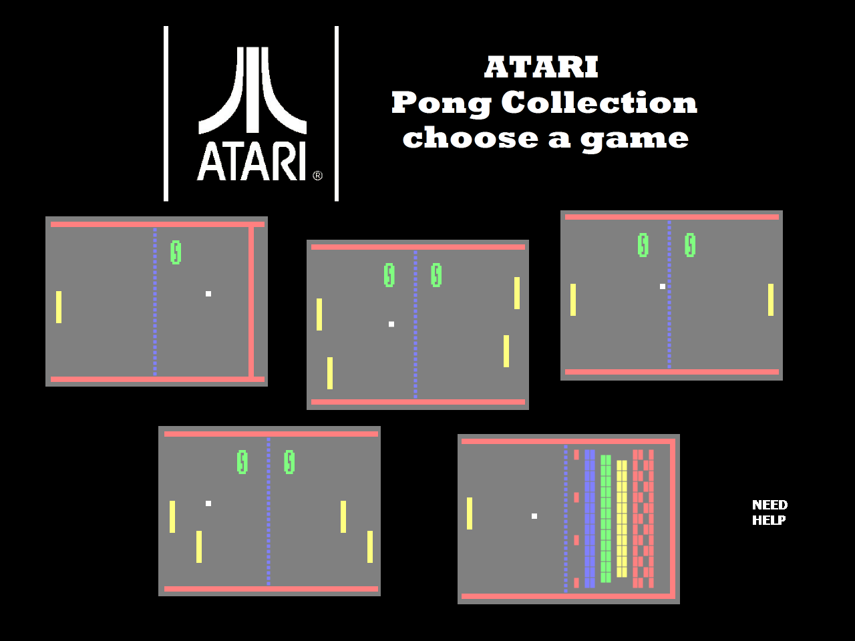
Another famous game

Slide 36
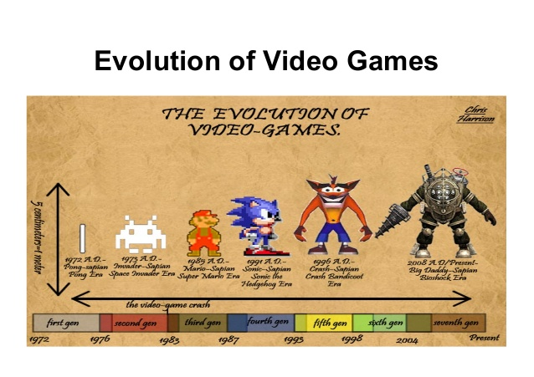

Slide 37
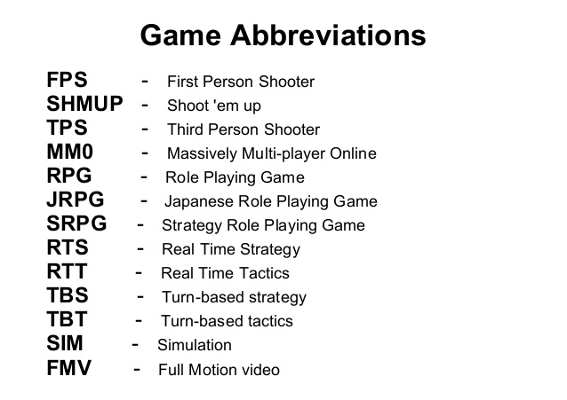

Slide 38
Game Engines
Originally, games were very purpose-built, one-off pieces of software
e.g. pac-man
Starting a new game generally meant starting from scratch
Changes to gameplay or art much more difficult and time-consuming
The more a game contains hard-coded logic or game rules the more difficult it is to create a different game out of it
Notes:
The term arose in the mid 90’s in reference to Id software’s Doom. Doom was created in such a way that there was a clear separation between its core software components (graphics, collision detection, audio system) and the art assets, game world and game play elements.
Other developers were able to license the engine and produce new games with only minor changes to the core system. Also gave birth to the modding community.

Slide 39
Game Engines
One of the first major examples of a Game Engine was id software’s Doom
Doom was architected in such a way that there was a clear separation between the games core components (graphics, collision detection, audio system,…) and the art assets, levels and gameplay
Data-driven architecture
Notes:
The term arose in the mid 90’s in reference to Id software’s Doom. Doom was created in such a way that there was a clear separation between its core software components (graphics, collision detection, audio system) and the art assets, game world and game play elements.
Other developers were able to license the engine and produce new games with only minor changes to the core system. Also gave birth to the modding community.
Data-driven architecture is what makes it an engine vs. simply a game. The more a game employs hard-coded logic or game rules the more difficult it is to create other games with it

Slide 40
Benefits of Game Engines
New games can be built on an existing game engine with minimal changes to the core systems (fast prototyping)
User-generated content – simple toolkits can be released for end users to add and generate their own content without requiring the full source
People with limited programming knowledge can use the built-in scripting languages of some engines to customize behaviour
Portability
Notes:
Faster prototyping, not having to re-invent the wheel.
Saves the really difficult engineering tasks for your more elite developers – gameplay and such can be handled by scripters
Same game code can generally run on multiple platforms once you separate out the platform specific functions such as rendering and such.

Slide 41
The Fantasy
A general-purpose engine capable of playing virtually any game content imaginable on any platform
Notes:
You might think you can produce a game engine that would work for every type of game imaginable.

Slide 42
Trade-offs
Optimizing a piece of software involves certain assumptions about how the software will be used
A graphics engine for mostly indoor environments will have different needs than an engine handling large-scale outdoor scenes
Notes:
Outdoor would need to employ much more aggressive level of detail (LOD) techniques and less exact occlusion routines to deal with the sheer amount of objects to be rendered.

Slide 43
Game engine architecture
Platform
Core Systems
Resources
Low-level Renderer
Collision & Physics
HID
Audio
Visual Effects
Front-End
Gameplay Foundations
Game-specific rendering
Game Cameras
AI
Player Mechanics
HUD

Slide 44
The Game Loop
Gather Player Input
Update World State
Apply Game Logic
Draw Frame
Notes:
Need to perform all of this so that we’re updating the graphics every 30-60 fps

Slide 45
Game Time
Independent of real-time, though usually coincides with it
We can pause, reverse or slow-down our game-time (useful for debugging problems)
Rendering and some other systems can operate on an independent timeline and continue to function in real-time

Slide 46
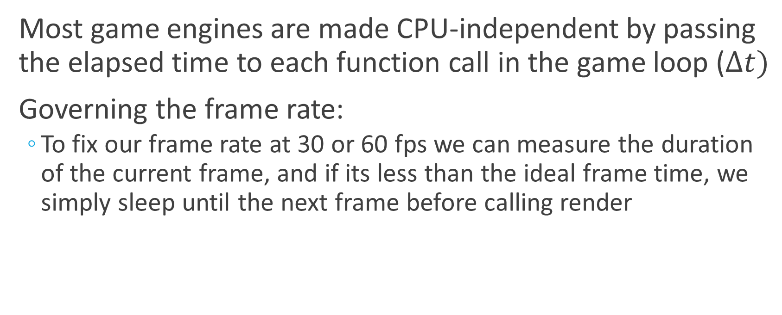
Elapsed Time
Most game engines are made CPU-independent by passing the elapsed time to each function call in the game loop ($∆t)$
Governing the frame rate:
To fix our frame rate at 30 or 60 fps we can measure the duration of the current frame, and if its less than the ideal frame time, we simply sleep until the next frame before calling render
Notes:
Multiple updates may be called inbetween renders
The other method involves finding the average / expected time of the next frame, and determining if that falls within the frame that we want to render.

Slide 47

Questions

Slide 48

Distribution
Tools
Engine

Slide 49
Distribution
Tools
Engine

Slide 50
Unity Engine Technologies
3D Graphics Engine
Physics Engine
Scripting
Audio, Animation, Lighting, Particles, and more …

Slide 51
Physics Engine(s)
Unity supports both 2D and 3D physics.
Separate physics simulations.
3D physics engine built on top of nVIDIA’s PhysX.
2D physics engine built on top of Box2D.
Physics simulation is calculated on each tick.
At a fixed rate.
This is important to correctly run a physics simulation.

Slide 52
Scripting
Writing source code that defines gameplay logic.
How is gameplay logic defined in Unity?
Unity API (Application Programming Interface) provides script code with the ability to listen to logic events that are reported by the engine.
Script code can then act on those events by instructing the engine (or other script code) to modify the game’s state.
C# Object-Oriented Language.

Slide 53
Distribution
Tools
Engine

Slide 54
Unity tools
Scripting Tools
Unity API
Engine feature, but also the most basic tool for developers to make use of the engine.
MonoDevelop (included with Unity)
Unity Editor
Unity Asset Store

Slide 55
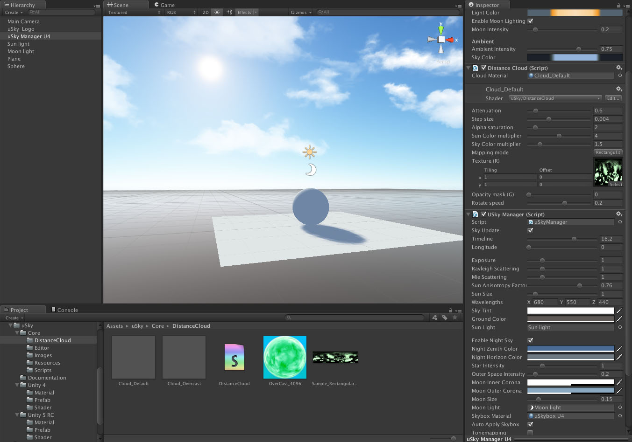

Slide 56
Editor
Unity Editor provides tools to manipulate and combine pre-existing assets into one complete game.
As such, the Unity Editor is not an asset creation tool (e.g. Photoshop, 3DS Max, Maya, etc.)
However, Unity Editor can be extended through code to add new features to it (e.g. creating assets).
This is accomplished through Unity Editor scripting. (advanced topic)
Unity Asset Store features community-made plugins that provide such extended features.

Slide 57
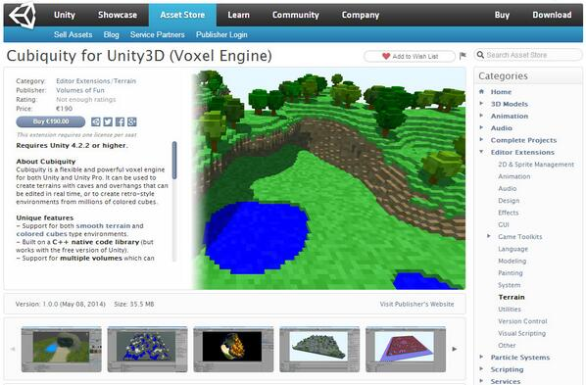

Slide 58
Asset Store
Unity Asset Store account required to download store products.
Store products are made up of Unity assets.
E.g. Unity Editor extensions, scripts, textures, audio files, complete projects, etc.

Slide 59
Distribution
Tools
Engine
Game Creation

Slide 60
Distribution
Tools
Engine
Game Creation

Slide 61
Platform Distribution
Desktop
Mac OS X, Windows, Linux, Web
Mobile
iOS, Android, Windows Phone, Blackberry
Console

Slide 62
Platform Distribution
Driven by a “Build” process.
Combines all game assets (that are in use) into a bundle.
The bundle is platform-specific.
Unity can deploy directly to the selected platform (e.g. a mobile phone).

Slide 63

Distribution
Build
Distribution
Tools
Engine
Game Creation

Slide 64
Distribution
Tools
Engine
Game

Slide 65
In the lab
Create new projects
Add Scenes (levels)
Add game objects to the scene
Build project

Slide 66
Next week
Assets and asset management

