Slide 1
COMP 3064
Game Development
More About Scripting

Slide 2
Today: More Scripting
Building a point system
Persistent Data
Static Members and Singleton Classes
Introduction to UI

Slide 3
Persistent Data
Recall: Each scene contains game objects, and each game object contains one or more Components.
Data can be stored via Unity Script Components when they are attached to a GameObject.

Slide 4
Loading Scenes
Switching between levels or screens of your game is done using SceneManager class
using UnityEngine;
using UnityEngine.SceneManagement; public class ExampleClass : MonoBehaviour {
void Start () {
SceneManager.LoadScene ("OtherSceneName");
}
}

Slide 5
Persistent Data
When using SceneManager.LoadScene() data existing inside a scene is destroyed once another scene is loaded with SceneManager.LoadScene()
Some times we want to store selected data or objects (e.g., the player)

Slide 6
Persistent Data
There are several ways to preserve data:
Preserve GameObjects that contain scripts
Store data inside a singleton class
Save data to persistent storage (e.g. hard drive)

Slide 7
Preserving GameObjects
During a scene transition:
target scene is loaded into memory
source scene is unloaded from memory
To preserve a GameObject across scene transitions, you can instruct Unity to exempt it from being destroyed when a scene unloads.
UnityEngine.Object class has a static method that can do it:
static void DontDestroyOnLoad(Object target);

Slide 8
Preserving GameObjects
Example:
GameObject player;
• …
DontDestroyOnLoad(player);
SceneManager.LoadScene(“Level2”);

Slide 9
Preserving GameObjects
Suppose Level2 also contains a player GameObject:
Problem with DontDestroyOnLoad() is that, after Level2 loads, there will be duplicate players existing in the hierarchy.

Slide 10
Preserving GameObjects
Naive fix: remove player from Level2.
But wait! What happens when you reload the current level?
SceneManager.LoadScene(SceneManager.GetActiveScene());

Slide 11
Preserving GameObjects
Application.LoadLevel(Application.loadedLevel);
In this case, player GameObject is duplicated each time the level reloads.
Here is how to get around this problem:

Slide 12
Singleton GameObjects
A “Singleton” is an object that ensures there is only ever one instance of it.
Recall: Awake() method is called on every MonoBehaviour script in the scene when the scene is loaded.
This means that if you call DontDestroyOnLoad() on a game object, then reload a scene, the object’s Awake() method will be called again!
That’s great! We can use this to our advantage.

Slide 13
Singleton GameObjects
Using the fact that Awake() is called each time a scene loads, we can check if the GameObject already exists.
But! We will not do this by searching for a duplicate, as that is not a reliable way of creating singletons.
We will instead use a static member to reference and maintain a single instance of our GameObject.

Slide 14
What is a static?
Recall what object-oriented language provides: Classes and objects.
Classes have static members.
Created objects have non-static members.

Slide 15
What is a static?
A static member of a class is:
A member that is part of the class, not its objects.
There are no copies of a static member in its class’ objects.
No copies? This is great for singletons!

Slide 16
Prefab Analogy
Now suppose the House blueprint is a Prefab of an actual house model.
You can instantiate the prefab into many GameObject copies to create houses in your scenes.

Slide 17
Prefab Analogy
The prefab relates to GameObjects the same way a class does to its objects.
A change done to the prefab will change all of its GameObject instances in all scenes.
Changing a prefab is similar to changing a class.
Changing a prefab property is similar to changing a static member of a class.

Slide 18
In Conclusion
Therefore, changing a value of a static member changes it for all objects of that class.
How so? Because there is only ever one copy of a static member.
Why? Because the static member is stored in the class itself (the “blueprint” space)!
A formal term for this space is static memory space.

Slide 19
In Conclusion
Static memory space
does not get destroyed
by scene transitions.

Slide 20
Calling Static Members
You have already done so!
Object.Instantiate(planet Prefab);
Object.Destroy( this. gameObject);
Scene Manager.LoadScene( “ L evel1 ”);
Debug.Log( “Some message …”);
Constants are static too!

Slide 21
Calling Static Members
Static members can be called from anywhere their class names can be used.
In other words, if you can write
String name = new String(“Bob”);
you can also write
name = String.Empty;
• where Empty is a static member with a value “ ” (empty string).

Slide 22
Singleton GameObjects
// Suppose this code is inside Player.cs script.
void Awake
{
() // <— Gets
called
on scene
load.
}

Slide 23
Singleton GameObjects
// | We | need | a static | variable | to | hold
// | the | one | copy of | Player.
private
static
Player
Instance
= null;
void Awake () // <—
{
//
//
}
Gets
called
on scene load.
The code that goes here.
maintains
our singleton

Slide 24
Singleton GameObjects
private
static
Player
Instance
= null;
void Awake () // <—
{
//
//
}
Gets
called
on scene load.
The code that
maintains
our singleton
goes here.
…
// You can call Player.Instance
the static
member
like
this:

Slide 25
Singleton GameObjects
private static Player Instance = null;
void Awake ()
{
if (Instance ==
{
null)
Player.Instance = this; DontDestroyOnLoad(this.gameObject);
}
else
{
Destroy(this.gameObject);
}
}

Slide 26
Singleton GameObjects
private static Player Instance = null;
If this is the first time this object is being loaded, save a reference to the object in the static variable
Instance
void Awake ()
{
if (Instance ==
{
null)
Player.Instance = this; DontDestroyOnLoad(this.gameObject);
}
else
{
and set it to not be destroyed on next scene load.
Destroy(this.gameObject);
}
}

Slide 27
Singleton GameObjects
private
static Player
Instance
= null;
void Awake ()
{
if (Instance
{
== null)
Player.Instance = this; DontDestroyOnLoad(this.gameObject);
}
else
{
Destroy(this.gameObject);
}
}
If the object already exists in the scene, then Awake() has run twice and there is a duplicate. Destroy it.

Slide 28
Singleton GameObjects
Scene 1 Loads
Scene 1 Reloads
Awake() gets called.
Player.Instance gets set.
Awake() gets called again.
Player.Instance is already set.
Destroy the duplicate.
Destroying is OK, because DontDestroyOnLoad() preserves the object in the first place.

Slide 29
Persistent Data
Preserve GameObjects that contain scripts.
Store data inside a singleton class.
Save data to persistent storage (e.g. hard drive).

Slide 30


Slide 31
Sometimes it is about data not GameObjects

Slide 32
Singleton Class
Similar to a GameObject singleton, except it is not a Unity script but a regular C# class.
public class
{
PlayerManager
private
static
PlayerManager
instance
= null;
public static
{
get {
if
PlayerManager
Instance
(instance
== null) {
= new PlayerManager();
instance
}
return instance;
}
}
// Private
constructor
private
PlayerManager
() { }
}

Slide 33
Singleton Class
PlayerManager.Instance.Score = 3;
Now we can call non-static members of a class via the static read-only member property called Instance .
In this example, we can set a player’s score in any script, without requiring a reference to PlayerManager .

Slide 34
Persistent Data
Preserve GameObjects that contain scripts.
Store data inside a singleton class.
Save data to persistent storage.

Slide 35
Persistent Storage
Singletons preserve data across scene transitions.
However, they do not preserve data when the game is closed.
To save data between game sessions, you can use a persistent storage offered by UnityEngine called
PlayerPrefs .

Slide 36
Persistent Storage
PlayerPrefs class contains these static methods to set and get three value types (float, int, and string):
SetFloat(string key, float value) SetInt(string key, int value) SetString(string key, string value) GetFloat(string key)
GetInt(string key) GetString(string key)

Slide 37
Persistent Storage
Example usage:
PlayerPrefs.SetInt(“Score”, 3);
int score =
PlayerPrefs.GetInt(“Score”);
if (PlayerPrefs.HasKey(“LastLevel”)
// Set the last visited level to
== false) {
the first level.
PlayerPrefs.SetInt(“LastLevel”, 1);
}
// Save all player preferences PlayerPrefs.Save();
to disk.

Slide 39
Introduction to UI

Slide 40
User Interface
UI in Unity can exists as part of screen space as well as world space.
Screen space UI provides a way to define a HUD (heads up display), menus with buttons, text displaying game information, etc.

Slide 41
User Interface
UI in Unity can exists as part of screen space as well as world space.
Screen space UI provides a way to define a HUD (heads up display), menus with buttons, text displaying game information, etc.

Slide 42
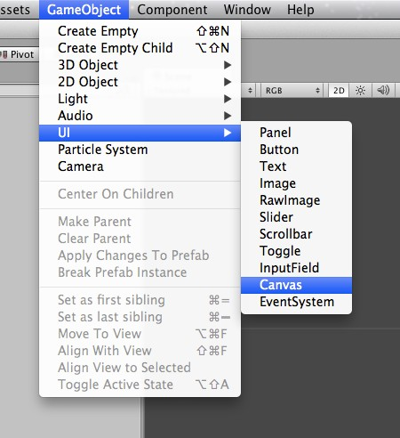
Creating a UI

Slide 43
UI Canvas
Contains all UI elements.
Creating a UI element without a canvas will automatically create a Canvas game object.

Slide 44
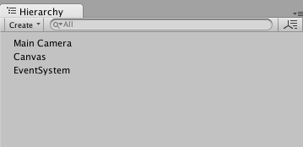


UI Canvas
Contains all UI elements.
Creating a UI element without a canvas will automatically create a Canvas game object.
A Canvas is accompanied by an EventSystem game object to keep track of UI input events (e.g. button click).

Slide 45
UI Draw Order
Unlike Sprites, UI objects in the Canvas are drawn in the top-down order they appear in the transform Hierarchy.
The first child is drawn first, the second child next on top of the first, and so on.
The last child is drawn last, on top of all of its siblings.

Slide 46
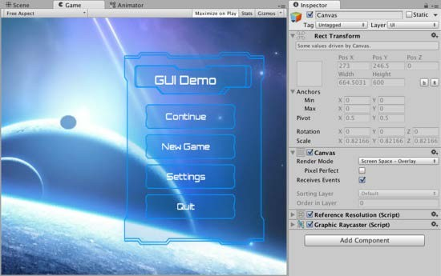
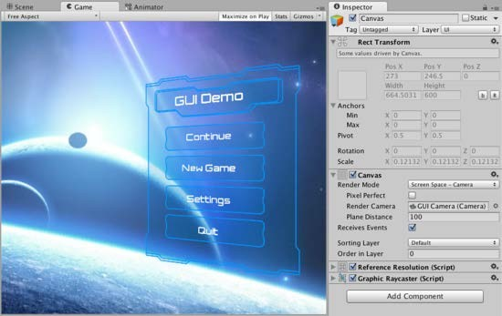
Render Modes
Screen Space - Overlay
Standard for 2D UI.
Screen Space - Camera
Adds camera perspective (for 3D UI)
World Space
Can place UI in world space (on top of a game object in 3D space)

Slide 47

Resizing UI objects
UI resize tool bound to the “T” key.

Slide 48
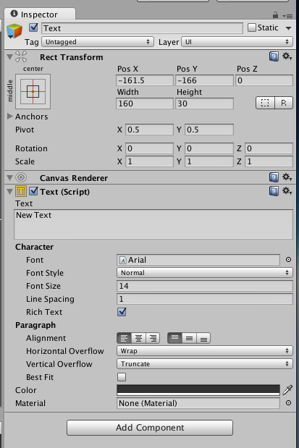


Rect Transform for UI Text

Slide 49
Rect Transform
RectTransform is a type of transform component intended for use only by UI game objects.
All UI game objects contain a RectTransform component.
No UI game object contains the Transform component.

Slide 50


UI Anchor

Slide 51
UI Anchors
Used in the event of a screen size or aspect ratio change.
Anchors UI objects to a point, edge, or area on the screen.
Ensures a UI object remains at a point, edge or within an area of the screen when the screen size or aspect ration change.

Slide 52
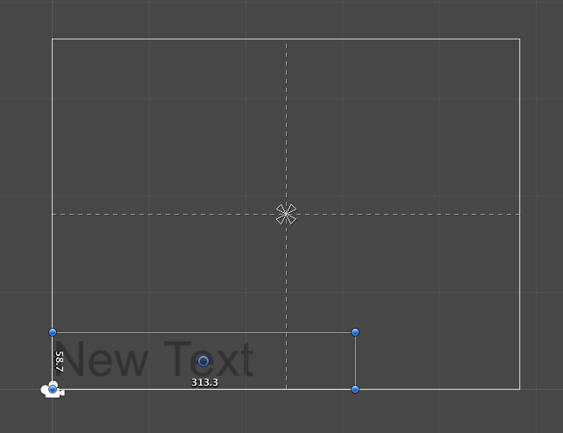
UI Anchors
Anchored to the center of the screen rectangle.

Slide 53
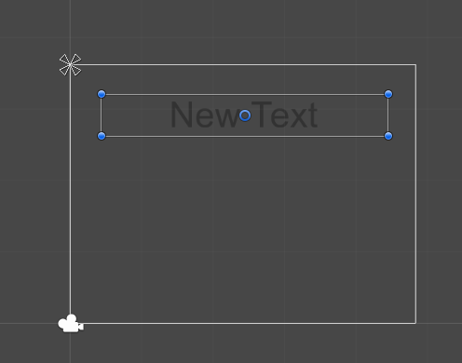
UI Anchors
Anchored to the top left corner of the screen rectangle.

Slide 54
UI Anchors
Anchor effect on a UI object can be previewed by:
Clicking on the UI object and seeing the screen bounds rectangle highlight.
Dragging and releasing the screen rectangle bounds.

Slide 55
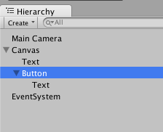
UI Button
Created by selecting Game Object > UI > Button
Automatically includes a child Image and Text objects.
Image
Text

Slide 56
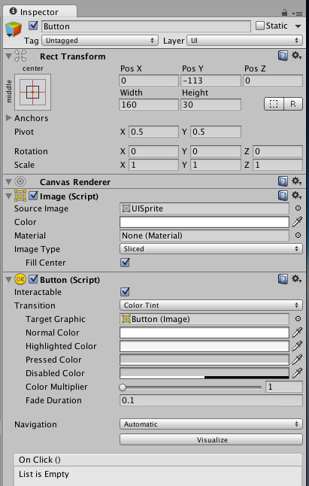
UI Button
Image

Slide 57
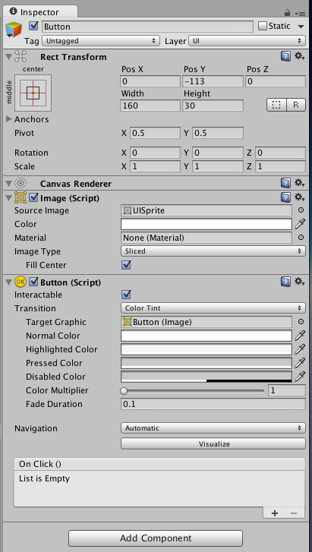
On Click Event
Add handler
Event hadler list

Slide 58
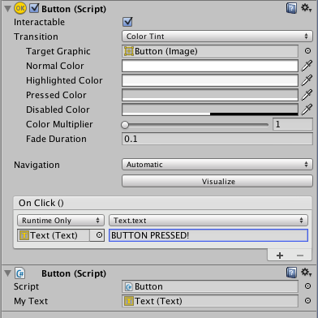
This handler changes a text of another UI object to “BUTTON PRESSED!”

Slide 59
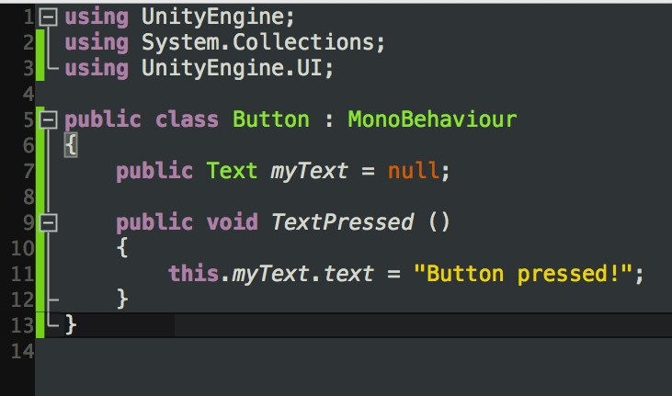


We can also write a handler of our own.
This one is a method called TextPressed() inside a script called Button.cs

Slide 60
UI Handler Methods
To be a UI event handler, methods need to either:
Return nothing (be void),
Have no parameters, or
Have only one parameter of type string, int, float, bool, or Object

Slide 61
TextPressed () has no parameters

Slide 62
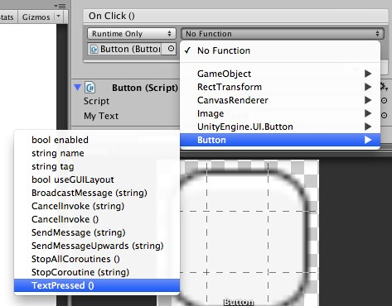
Selecting TextPressed() event handler from the UI button component.

Slide 63
If TextPressed() had a parameter, we would set the parameter value within the OnClick() section in the Inspector

Slide 64

TextPressed()
Button.cs
Here we access Button.cs script’s TextPressed() method

