Slide 1
COMP3064
Game Development
Week 3

Slide 2
Today: Collisions and Audio
•
Collisions in 2D and 3D Physics
•
AudioListener, AudioSource, AudioClip
•
Debugging in MonoDevelop and Unity

Slide 3
Physics Collisions
•
3D Collisions
•
2D Collisions

Slide 4
Physics Engine(s)
•
Unity supports both 2D and 3D physics.
•
Separate physics simulations.
3D physics engine built on top of nVIDIA’s PhysX. 2D physics engine built on top of Box2D.
•
•
Physics simulation is calculated each tick. At a fixed rate.
•
•
•
This is important to correctly run a physics simulation.

Slide 5
3D Collision Components
•
Rigidbody
•
Collider
•
BoxCollider, SphereCollider, CapsuleCollider
•
MeshCollider

Slide 6
2D Collision Components
•
Rigidbody2D
•
Collider2D
•
BoxCollider2D, CircleCollider2D
•
PolygonCollider2D

Slide 7
Rigidbody (3D)
•
Enables physical behaviour for a game object.
•
Places its game object under the control of the 3D physics engine.
•
•
The game object immediately responds to gravity.
The game object is effected by collisions with other objects in the scene.
•
At least one Rigidbody is required in any collision between two or more objects.
•
For performance reasons, Rigidbody is recommended for dynamic objects, i.e. objects that react to a static environment.
•
Global physics settings in: Edit > Project Settings > Physics

Slide 8
Forces vs Transform
•
Rigidbody component takes over the movement of its game object via a physics simulation.
•
Apply forces to push the object, letting the physics engine calculate the results.
•
This should be done for all non-kinematic or
physics-driven Rigidbody/Rigidbody2D components.
•
We have been ignoring this thus far. Now we will do things correctly.

Slide 9
Forces vs Transform
•
For a physics-driven (non-kinematic) Rigidbody or Rigidbody2D
•
we should not change the Rigidbody or Rigidbody2D’s Transform
because it interferes with the physics simulation
forces the physics engine to recalculate the entire scene’s physics
•
•
•
From the physics engine’s point of view the object is being “teleported” through space each frame, instead of moved continuously with a set velocity.

Slide 10
Forces vs Transform
•
Transform can be in local or world space
•
Forces are applied in world space direction
•
To transform a local space direction to world space, use:
Transform.TransformDirection(Vector3 localDirection)

Slide 11
Forces vs Transform
Rocket example:
Suppose a rocket’s forward direction is up (Vector2.up)
// What is the world space
// direction?
direction
of my forward
Vector2
worldForwardDirection =
this.transform.TransformDirection(Vector2.up);
Now, if a rocket rotates to the right, its thrust force can push it in the direction the rocket is facing.
// Apply a force in the direction the rocket is facing. float force = 10; this.rigidbody2d.AddForce(worldForwardDirection * force);

Slide 12
Forces vs Transform
In this example, we ignore the rocket’s forward facing direction:
Vector2
someDirection = Vector2.up;
float force = 10; this.rigidbody2d.AddForce(someDirection
* force);
But now, a force in the upwards direction will be applied to the rocket at all times, regardless of which way it is facing.

Slide 13
Kinematic Rigidbody
•
IsKinematic property set to true
•
Not affected by forces, gravity or collisions
•
Can be moved by changing the object’s Transform
via a script
•
Can interact with other physics-driven, non-kinematic Rigidbodies
•
used for when you want one object to push another without being pushed itself, e.g. Pinball paddles

Slide 14
Colliders
•
A collider component defines the shape of an object involved in physics collisions.
•
Visible only to the physics engine.
•
Shape often defined via primitive collider types (rough approximation of the actual object shape)
•
•
In 3D: BoxCollider, SphereCollider, CapsuleCollider, …
In 2D: BoxCollider2D, CircleColider2D, PolygonCollider, …
•
The simpler the shape the better. Complex shapes decrease physics engine performance, by adding more geometry calculations.

Slide 15
Collider Setup Techniques
•
Compound Collider
•
Static Collider
•
Rigidbody Collider (Dynamic)
•
Kinematic Rigidbody Collider (Dynamic)
•
Triggers

Slide 16
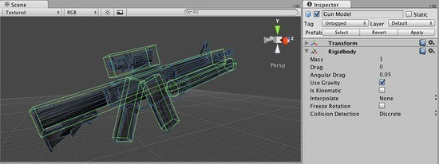
Compound Colliders

Slide 17
Compound Colliders
•
Combination of primitive colliders that more accurately define a collision shape.
•
This technique often provides a good approximation of the visible 3D mesh shape.
•
Can be defined through child game objects.
•
E.g. Instead of using a box to define a character’s collider, smaller colliders can be set up for the arms, legs, torso and head.

Slide 18
Static Collider
•
Game objects that do not have a Rigidbody or Rigidbody2D component attached, but do have a Collider attached.
•
Intended for stationary level objects that do not move, or move very little.
•
Example: Wall block sprites.

Slide 19
Rigidbody Collider (Dynamic)
Game object that contains both a Rigidbody and Collider components.
•
•
Completely affected by the physics engine through forces and collisions.
•
Can collide with another collider that does not have a rigidbody component.
•
Used for dynamic, moving objects.
•
Example: Player object, projectiles.

Slide 20
Kinematic Rigidbody Collider (Dynamic)
•
Same as a Rigidbody Collider setup, except the rigidbody component is set to IsKinematic = true
•
Not affected by physics forces or collisions
•
Move the game object by changing its Transform
•
Example: moving platforms, elevators

Slide 21
Triggers
•
Used for detecting collider intersections
•
IsTrigger property set to true for a Collider component
•
Trigger colliders:
•
•
are ignored by the physics engine
report no collisions and can pass through other objects
•
Triggers do report when they are intersected by another collider. This is used to detect collisions without the physics engine reacting to them.
•
Example: Automatic sliding door, coin pickup.

Slide 22
Rigidbody2D
•
Same as Rigidbody except objects respond to 2D physics
•
Limited to XY plane only.
•
Intended to be rotated about the Z axis only, i.e. axis perpendicular to XY plane.

Slide 23
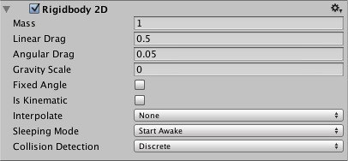
Rigidbody2D
Mass: how difficult it is to push the object.
More massive objects require more force to move.

Slide 24
Rigidbody2D
Linear Drag: friction or resistance to translation movement. E.g. ground or air resistance.

Slide 25
Rigidbody2D
Angular Drag: same as linear drag, only it affects the object’s rotation movement. E.g. wheel spin.

Slide 26
Rigidbody2D
Gravity Scale: how much the object is affected by gravity.
Zero means none, 1 means normal, 2 means double gravity.

Slide 27
Rigidbody2D
Fixed Angle: If true, the object will not rotate when colliding with other objects.

Slide 28
Rigidbody2D
Is Kinematic: If true, ignores forces and collisions, but it can still be used to detect collisions.

Slide 29


BoxCollider2D CircleCollider2D

Slide 30

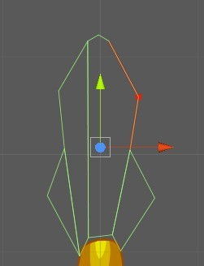
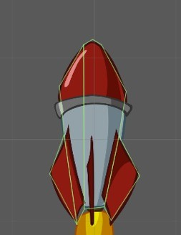
PolygonCollider2D

Slide 31
Scripting Colliders
•
Recall that in a physics-driven collision:
At least one object has a non-kinematic
rigidbody.
Both objects have colliders that are not
triggers.

Slide 32
Scripting Colliders
When a collision between two physics-driven objects occurs, the 2D and 3D physics engines will call MonoBehaviour methods with specific names:
•
OnCollisionEnter(), OnCollisionStay(), OnCollisionExit(),
OnCollisionEnter2D()
OnCollisionStay2D() OnCollisionExit2D()

Slide 33
Scripting Colliders

Slide 34


Scripting Colliders
OnCollisionEnter2D()

Slide 35

Scripting Colliders
OnCollisionStay2D()

Slide 36
Scripting Colliders
OnCollisionExit2D()

Slide 37
Scripting Colliders
•
When a collision occurs with a trigger object, the 2D and 3D physics engines will instead call:
OnTriggerEnter(), OnTriggerStay(), OnTriggerExit(),
OnTriggerEnter2D()
OnTriggerStay2D() OnTriggerExit2D()

Slide 38
Scripting Colliders

Slide 39
Scripting Colliders
OnTriggerEnter2D

Slide 40
Scripting Colliders
OnTriggerStay2D

Slide 41
Scripting Colliders
OnTriggerExit2D

Slide 42

Collision Demo

Slide 43
Audio
Audio feature in Unity is provided through the following Components:
AudioListener AudioSource
and the following asset type:
AudioClip

Slide 44

Audio Listener
Listens to sounds in your game environment and
delivers the sound to your speakers.
Acts like a microphone.
AudioListener component typically placed inside the main camera, where it acts as the player’s “ears”.
✓
It is added to any new Camera game object by default.
There can only be one active Audio Listener in a scene.

Slide 45

Audio Source
•
Plays back an Audio Clip.
•
Recall: AudioClip is a Unity asset file interpreted from one of the supported audio file formats.
•
Audio Source provides the means to play audio
•
Think of is as a music player attached to speakers or a Jukebox; it is the controller for starting and stopping playback of its audio clip.

Slide 46
Creating an Audio Source
Import an audio file in a supported format to get an Audio Clip asset.
Create an empty game object.
Add an Audio Source component to the object.
Assign the Audio Clip to the Audio Source component in the Inspector.

Slide 47
Audio Demo

Slide 48
Debugging
•
Debugging is the process of analyzing code logic to uncover information about its process and fix any detected issues.
•
Name comes from the activity of “resolving bugs”. Hence, “de-bug”.
•
The term “bug” relates to a problem with the code that is causing unwanted behaviour in a software application.
•
Bugs often break software, though most game companies ship their games with at least a few “acceptable” bugs, in order to meet their deadlines.

Slide 49
Debugging in Unity
•
Unity Editor Tools
•
Console — lists errors, warnings and messages relating to your game and the Unity Editor.
•
Scene Playback Controls — stop through each frame or pause your game.
•
Game View Stats — shows basic statistics about your game.
•
Unity Profiler (Pro-only feature) — tracks memory and CPU usage, among many other statistics.

Slide 50
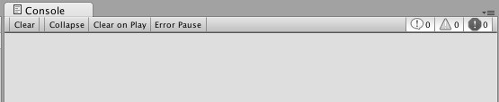







Console
Show/hide Logs, Warnings, Errors
Whether to collapse similar messages into one line
Whether to pause the game when an error occurs
Whether to clear console when the game starts

Slide 51
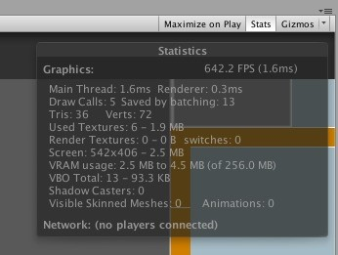
Game View Stats

Slide 52
Unity Script Debugging
•
Debug.Log() — prints a message to the Unity Console window.
•
Debug.LogWarning() — treats the message as a warning.
•
Debug.LogError() — treats the message as an error. Pauses the game if the console is set to Pause Error.
•
Debug.Break() — pauses the editor so you can inspect the game scene.

Slide 53
MonoDevelop Debugging
•
Breakpoints provide a way to halt code execution at a specific line of code.
•
Once halted, variable values can be examined.
•
Execution can be advanced each call step.
•
You can trace calls to a given method.
•
Example: You are trying to figure out when a collision occurs, or what is destroying your objects.

Slide 54
MonoDevelop Debugging
•
In order to halt Unity Editor execution of your game, MonoDevelop must attach itself to the Unity Editor process.
•
Run > Attach to Process … > Unity Editor
•
If a breakpoint occurs, Unity Editor will be unresponsive until:
•
Execution resumes, or
•
MonoDevelop detaches from Unity Editor.
•
Run > Detach

Slide 55
Debugging Demo

Slide 56
Questions?

