Slide 1
Movie Matcher
Andy R., Sean P., Sean N., Caleb P.

Slide 2
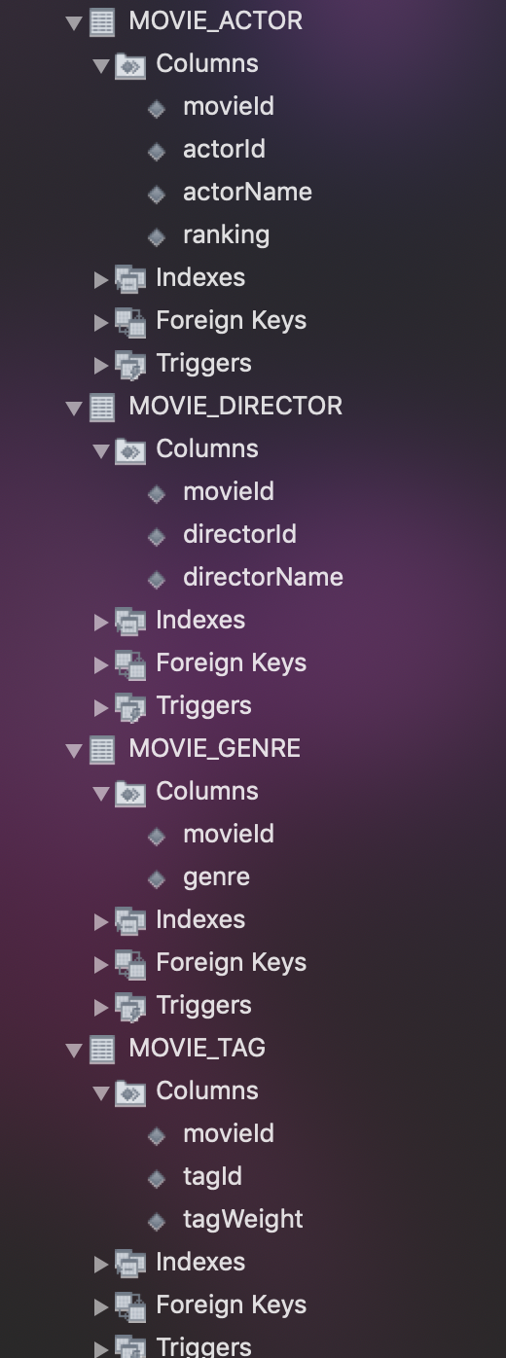
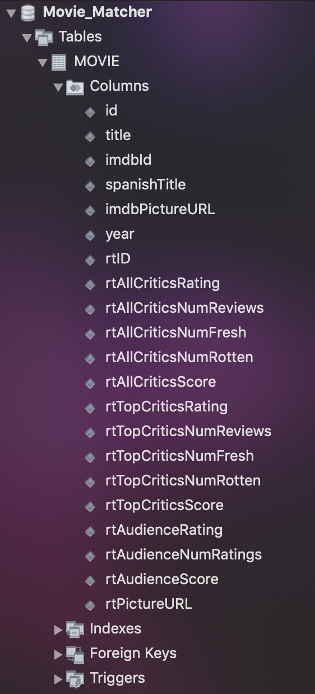
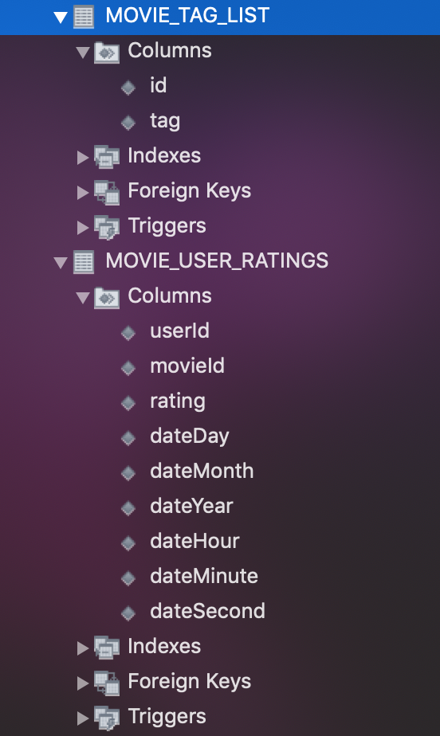
Schema

Slide 3
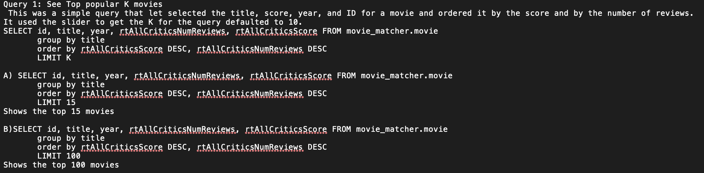
Queries

Slide 4
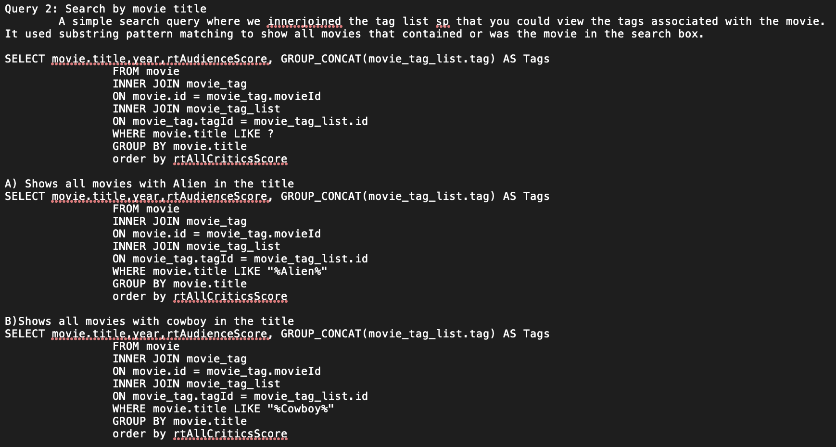
Queries

Slide 5
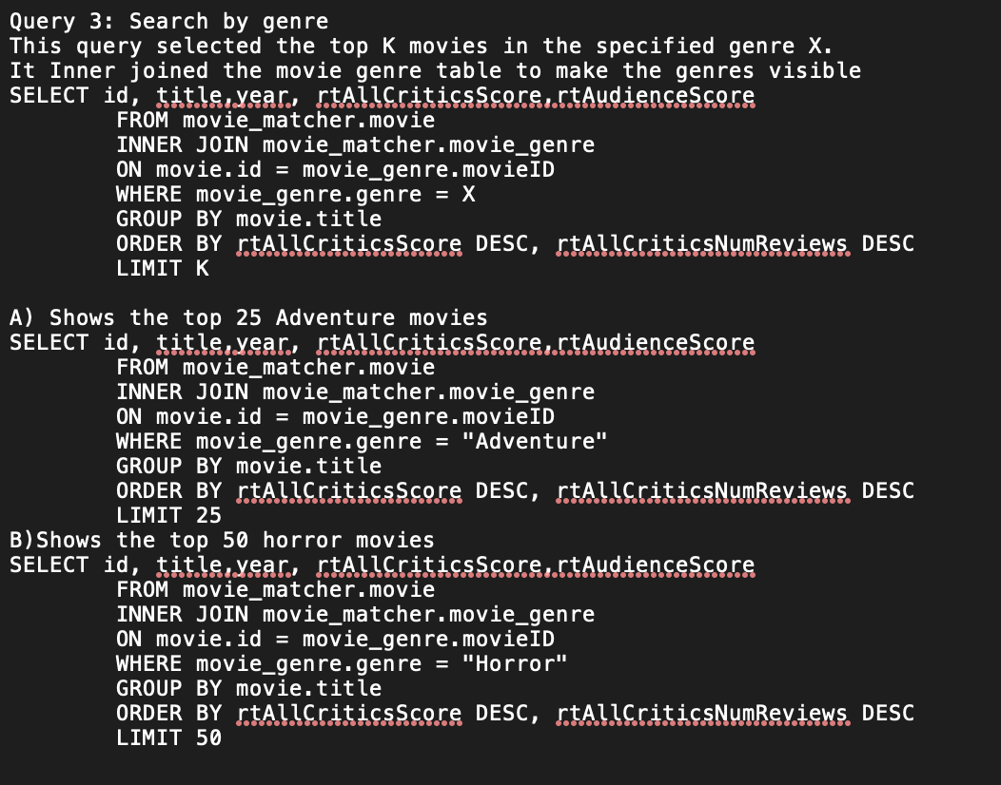
Queries

Slide 6
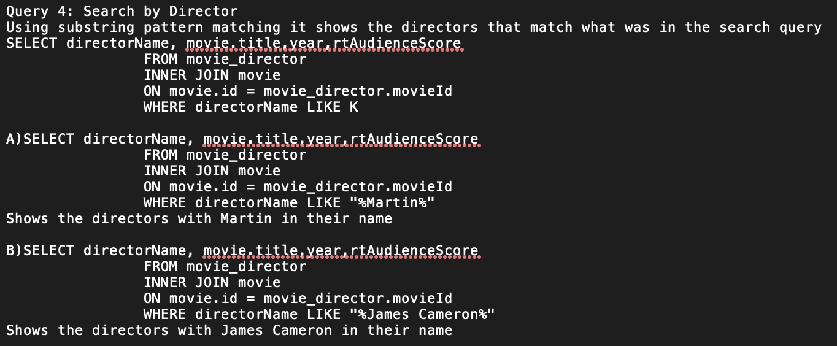
Queries

Slide 7
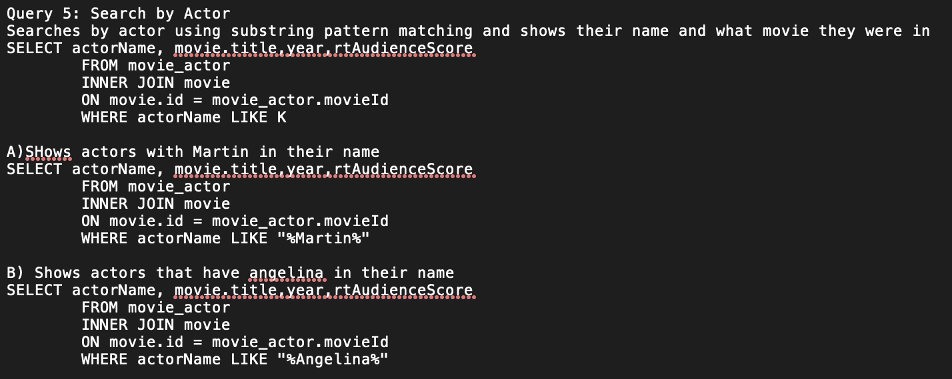
Queries

Slide 8
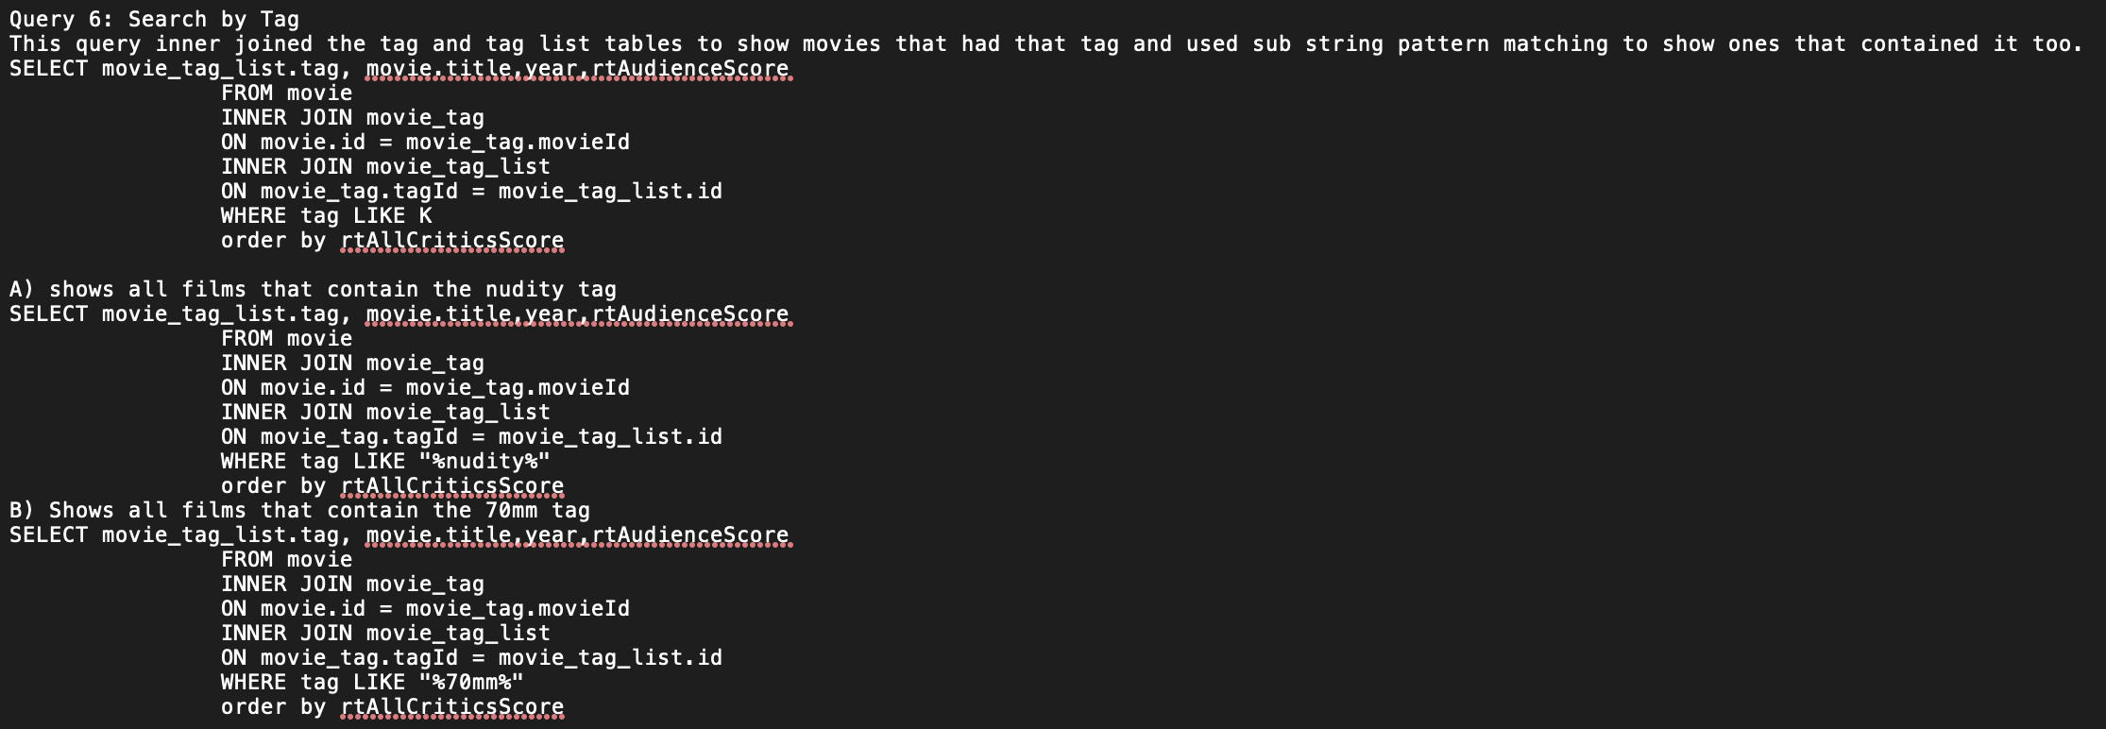
Queries

Slide 9
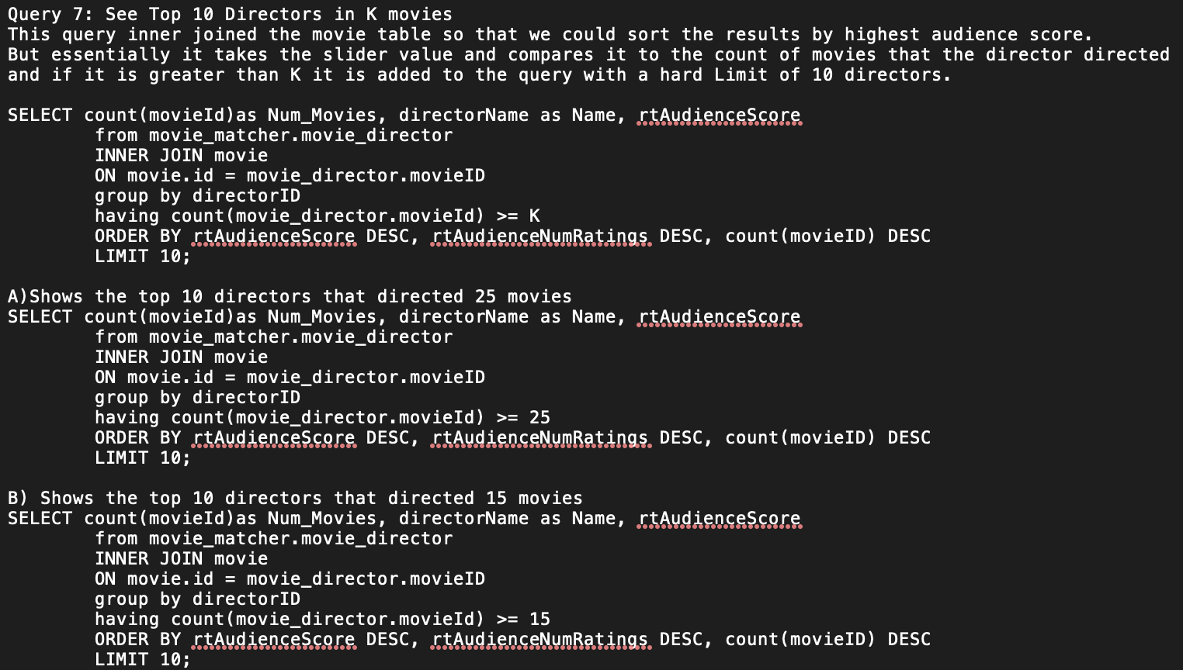
Queries

Slide 10
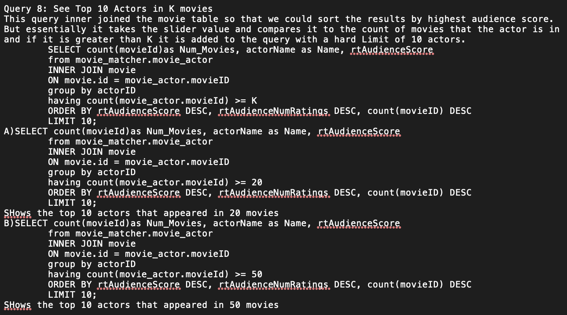
Queries

Slide 11
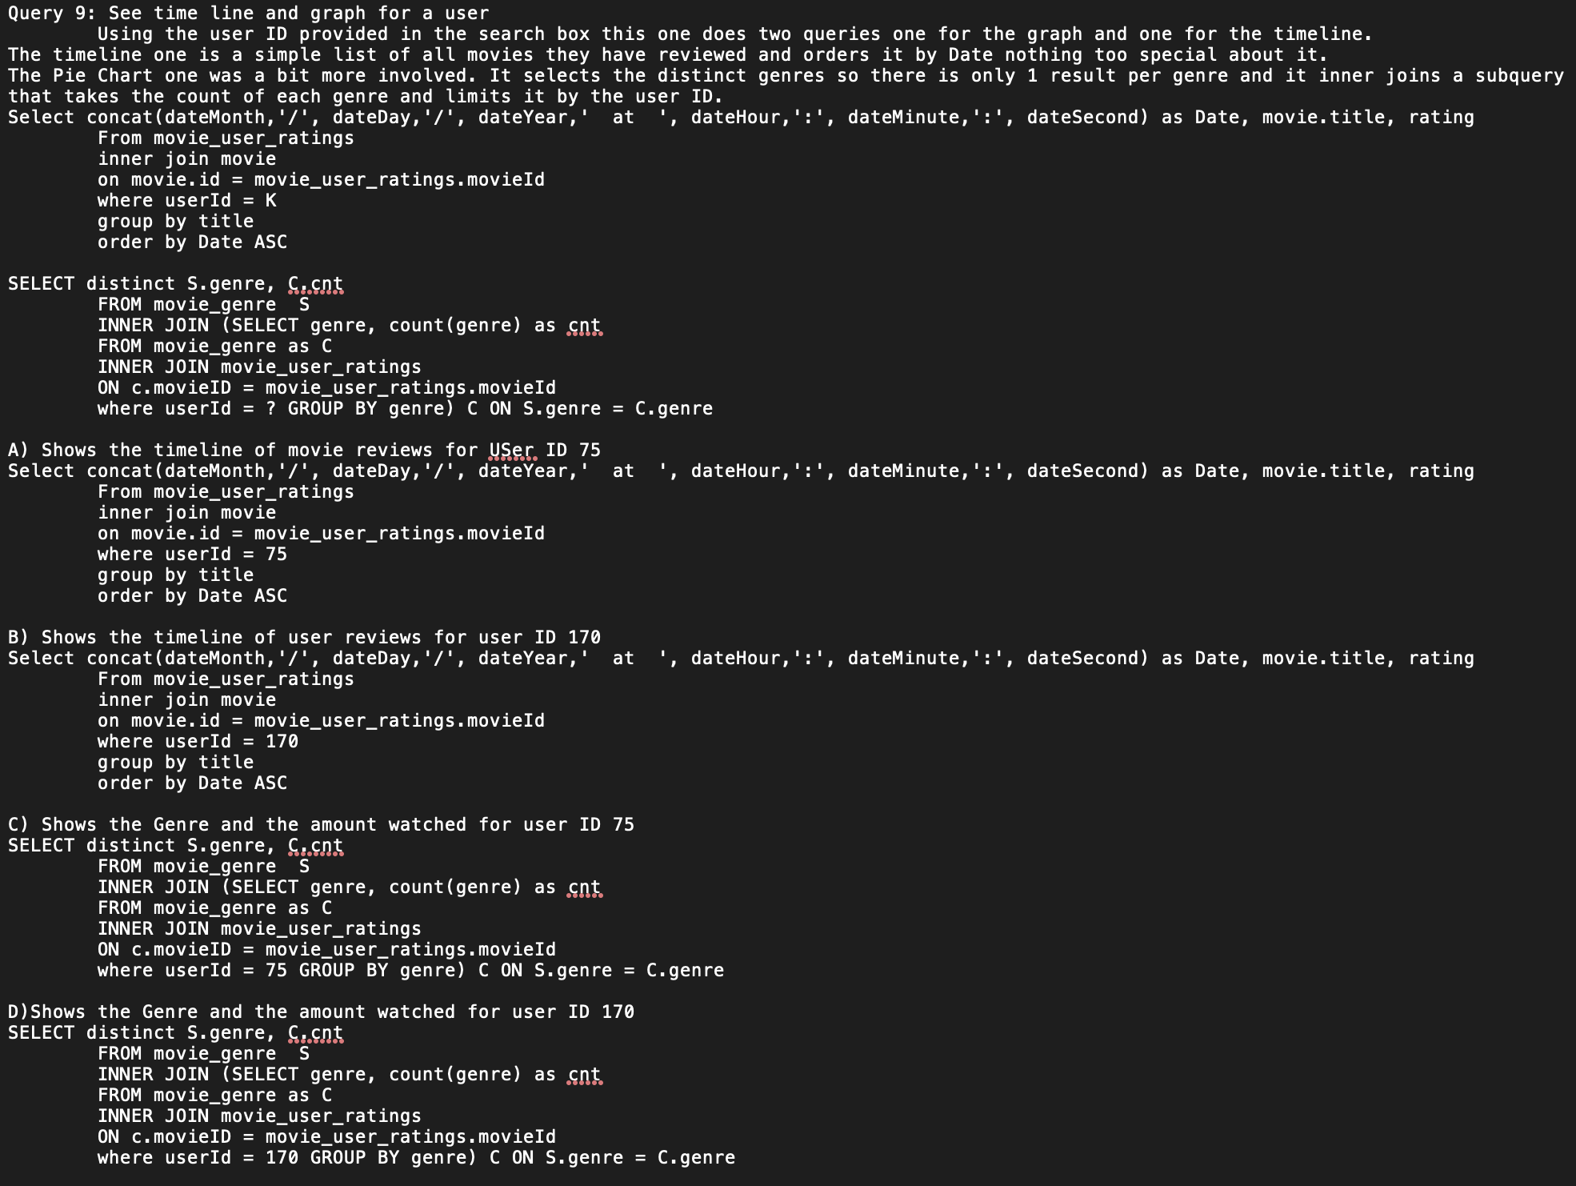
Queries

Slide 12
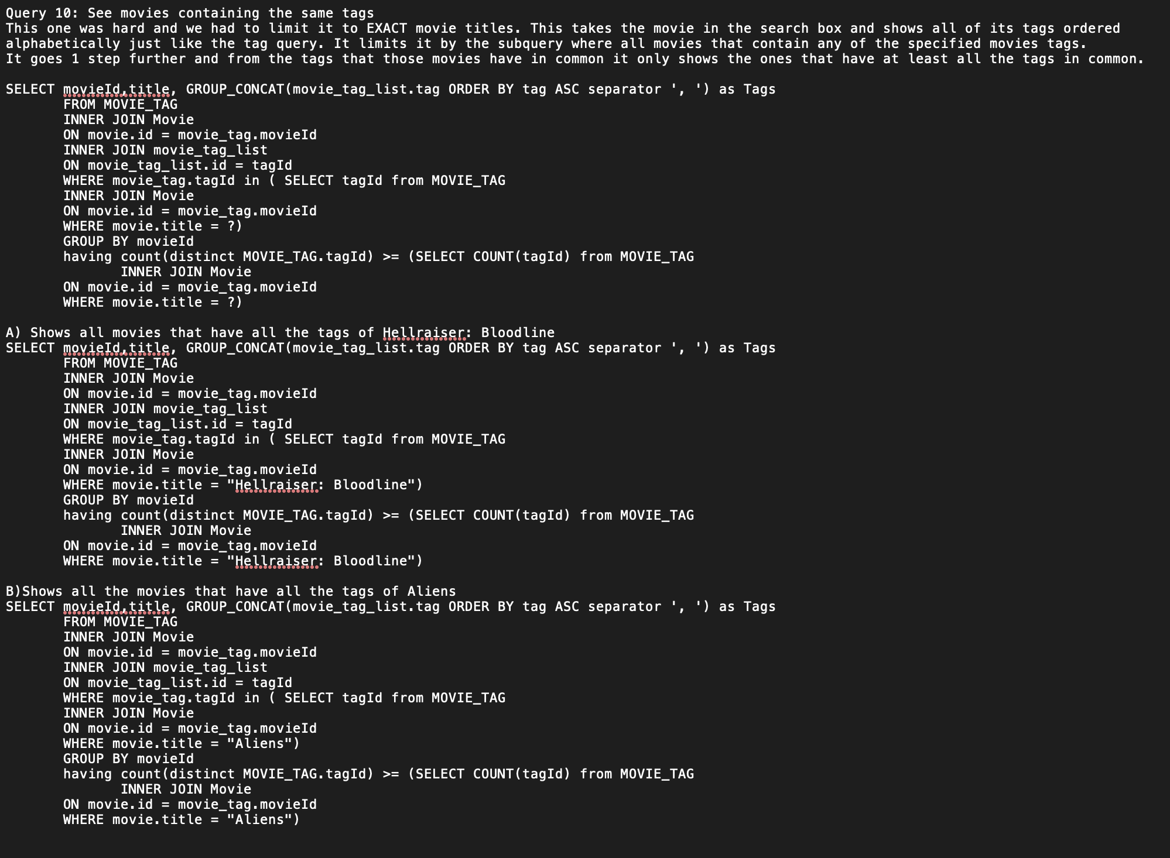
Queries

Slide 13
Workload
Andy R. - Responsible for the GUI and SQL Statement 9
Sean P. - Responsible for Big Data import/processing and SQL Statement 10
Sean N. - Responsible for statements 1 - 4
Caleb P. Responsible for statements 5 - 8

Slide 14
Learning Outcome
We all learned a great deal about manipulating and querying data with SQL during this project. It was much easier to jump right in and have things come together in a project rather than small demonstrations.
We also all learned more about Git and Github together as well as learning how to be a contributing member of a remote team.

