Slide 1
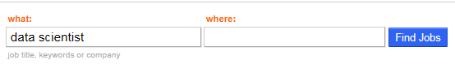
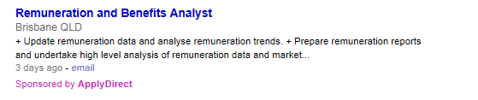
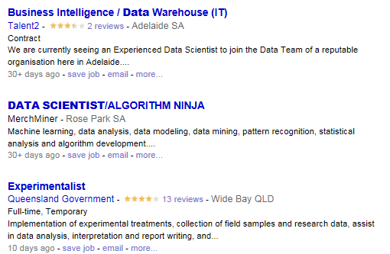
Business problem
Indeed is one of the worlds largest job board. There is an opportunity to 1. improve search accuracy related to salary expectation and also for companies that want to 2. gain market intelligence in a competitive landscape.
Project Challenges
✗
1 in 5 advertised jobs have a salary
Data obtained through website scraping is not clean, companies make it difficult.
Data provided by advertising companies is not consistent
Not all companies advertise a salary
Interpretation of salary can vary.
Salary frequency can vary e.g. hourly, daily, weekly, fortnightly, annual.
Job Titles are not clean
✓
✓
✗

Slide 2
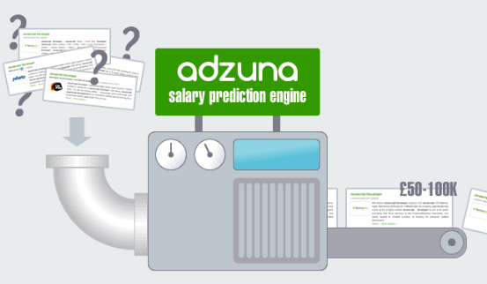

Proposal
Build of predictive model to predict missing salaries
Two Benefits:
Indeed.com - This will improve user search accuracy – Increase user return and referral rates.
Organisation - Knowledge of competitive landscape – Improve employee retention and attraction of top talent.
$200k
Future Enhancement:
Forecast Model on Future Salary and Job Demand – likely future capstone project

Slide 3









Data Model
Current Project
30,000
Jobs per day
Job Board Salary Predictive Model
Indeed Job Board Data (Primary Source)
Future Capstone Project
Yahoo Market Data (Secondary Source)
Google Keyword Trends
(Secondary Source)
Salary Forecast and Labour Demand Model
ABS Economic Data
(Secondary Source)
RBA Economic Data
(Secondary Source)

Slide 4
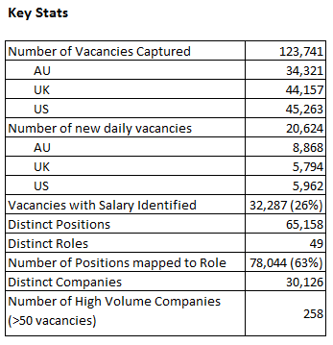
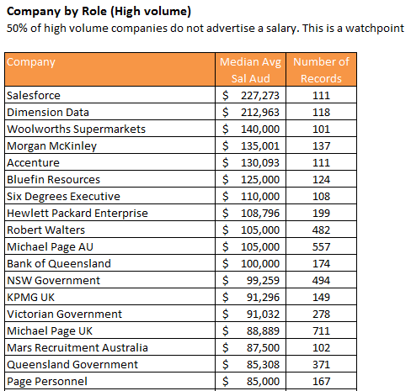
Data Exploration

Slide 5
Data Exploration

