Slide 1
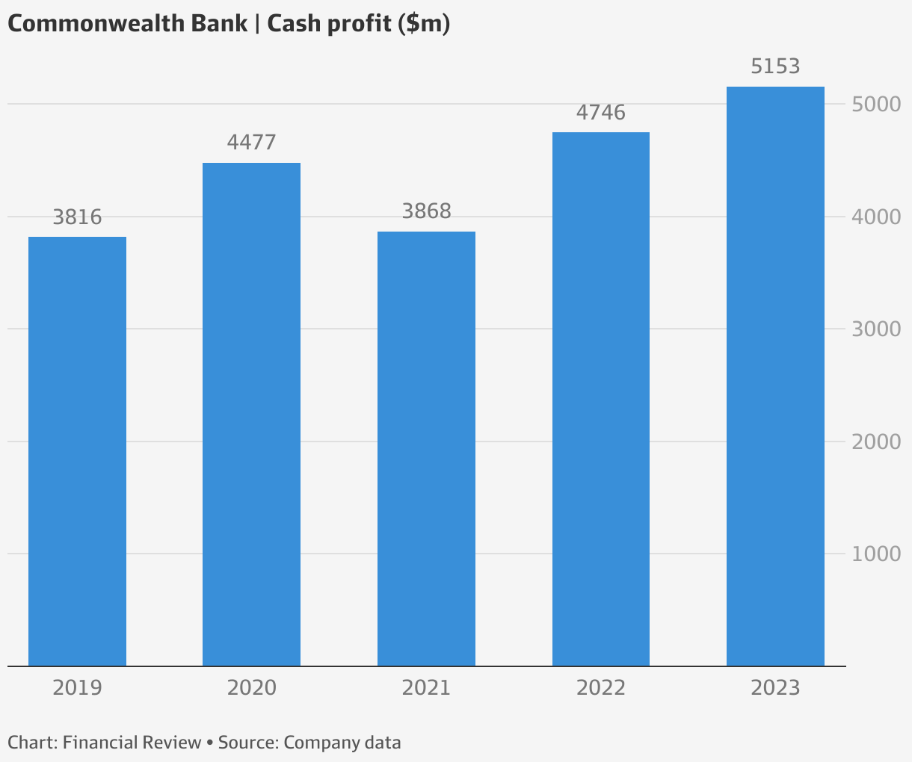
4. “I’m a goner” joke
Ask: “Say ‘I’m a’.”
Ask: “Now say what you call someone who’s disappeared forever.” (They say “goner”)
Result: “I’m a goner”
5. “Spell joke”
Ask them to spell “I cup” slowly.
Result: Sounds like “I see you pee.” (Classic schoolyard one.)

Slide 2
