Slide 1

HAU-Sync
Patient Record Management and Appointment System
for the Holy Angel University Clinic
CS-302 · Software Engineering Final Project · Prof. Evicen Flores
Notes:
Sean Jarin Dela Cruz
Good day, everyone. We are a group of third-year Computer Science students from section CS-302 of Holy Angel University, and this is our final project in Software Engineering under Prof. Evicen Flores.
Our project is called HAU-Sync. It is a patient record and appointment system that we built for the Holy Angel University Clinic.
In this video, the six of us will walk you through the problem we saw, how we studied it, how we designed the system, and then the working system itself.

Slide 2



Today, the clinic works on paper
THE PROBLEM
Patient log
Patient records
Medicine inventory
Written by hand at the front desk
Kept on paper and passed around
Counted and updated by hand
Slow at peak hours. Hard to search. Easy to misplace.
Notes:
Sean Jarin Dela Cruz
Let us start with the problem. Right now, the University Clinic does almost everything by hand.
When you visit the clinic, your name goes into a handwritten patient log. Your medical record is on paper. Even the list of medicines in stock is kept by hand.
Paper works, but it is slow. During busy hours, when many students come in at the same time, the staff have to write, find and pass papers around. It is hard to search for an old record, and a sheet of paper can easily be misplaced.

Slide 3




One record, shared by everyone
OUR IDEA
Front desk
Nurse
Doctor
logs the patient
records the visit
sees the same record at once
No paper handed over. Nothing leaves the clinic's computers.
Notes:
Sean Jarin Dela Cruz
So our idea is simple. Instead of passing paper from one person to the next, everyone in the clinic looks at the same record.
The front desk logs the patient. The nurse records the visit. And the doctor sees that same record right away on their own screen, without anyone handing anything over.
The system runs only inside the clinic, on the clinic's own network. Nothing leaves the clinic's computers. That matters because health information is sensitive and is protected by the Data Privacy Act of 2012.
To explain how we studied the clinic, here is Mikko.

Slide 4
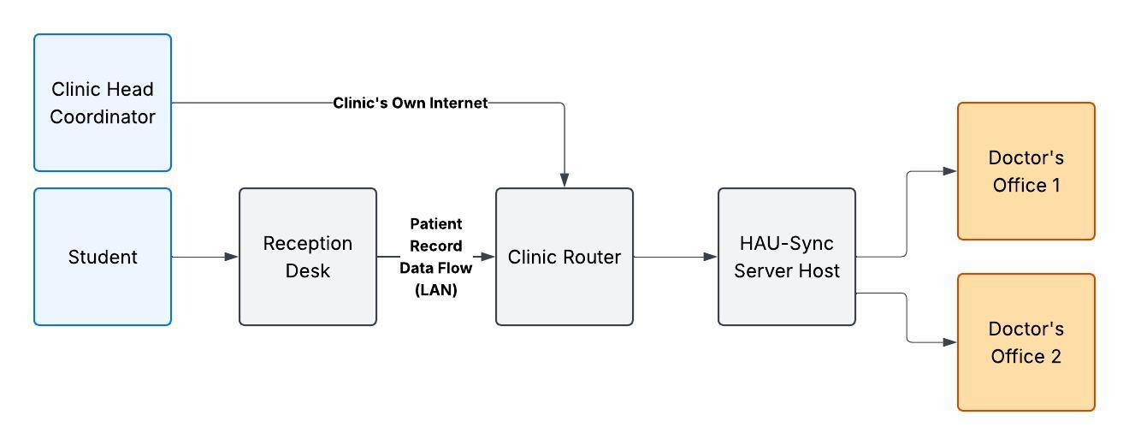



The site: the University Clinic
SITE CONTEXT
Computers and a router already in place
Its own internet connection
A building with a generator
Notes:
Mikko Brandon B. Panergo
Thank you, Sean. Before we wrote any code, we first had to understand the place where the system will be used.
The clinic is on the ground floor of the PGN Building, in the middle of the campus, so it is easy for students and employees to reach. It has a waiting area, an infirmary, two doctor's offices and a dental office.
The good news is that the clinic already has what the system needs. It has computers and a router, it has its own internet connection, and the building has a generator. So we did not need to ask for any new equipment. We designed the system to fit what is already there.

Slide 5




What the clinic told us
THE INTERVIEW
Everything is handwritten
No school portal support
The same details are written again and again
No digital way to keep patient information
Peak hours slow the front desk
Keep it inside the clinic
Many students arrive at the same time
Patient information must stay private
Notes:
Mikko Brandon B. Panergo
We also sat down with the clinic personnel for an interview, and four things stood out.
First, everything is handwritten, so the staff write the same details again and again.
Second, the school portal no longer supports the clinic, so they have no digital way to keep patient information.
Third, the front desk slows down during peak hours, when student traffic is at its highest.
And fourth, they want the system to stay inside the clinic, because patient information must stay private. These four findings shaped everything we built.

Slide 6
What the system must do
REQUIREMENTS
15
15
functional requirements
non-functional requirements
What the system does
How well it does it
Sign-in and roles · Patient records · Visits · Appointments · Inventory · Reports · Dashboard
Security · Data privacy · Usability · Reliability · Backups
Notes:
Mikko Brandon B. Panergo
From the interview and our project paper, we wrote down the requirements. We ended up with fifteen functional requirements and fifteen non-functional requirements.
The functional requirements are the things the system does: signing in with a role, keeping patient records, recording visits, managing appointments, tracking the medicine inventory, making reports and showing a dashboard.
The non-functional requirements describe how well it should do those things: it must be secure, it must keep data private, it must be easy to use, and it must be reliable.
Next, Bernard will show how we turned these requirements into diagrams.

Slide 7
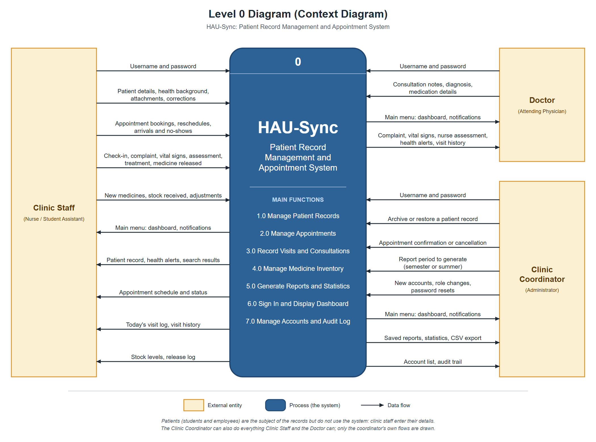

Level 0: the system at a glance
ANALYSIS
Three kinds of users
Clinic staff
Nurses and student assistants
Doctor
Attending physician
Clinic coordinator
Manages the clinic
Patients have no account.
Notes:
Bernard Rodriguez Jr.
Thanks, Mikko. This is our Level 0 diagram, also called the context diagram. It shows the whole system as one circle, and the people who give it information and get information back.
There are three kinds of users. The clinic staff, which means the nurses and the student assistants. The doctor. And the clinic coordinator, who manages the clinic.
You might notice that the patient is not here. That is on purpose. The clinic asked for a clinic-only system, so patients do not have accounts. The staff enter the patient's details for them.

Slide 8
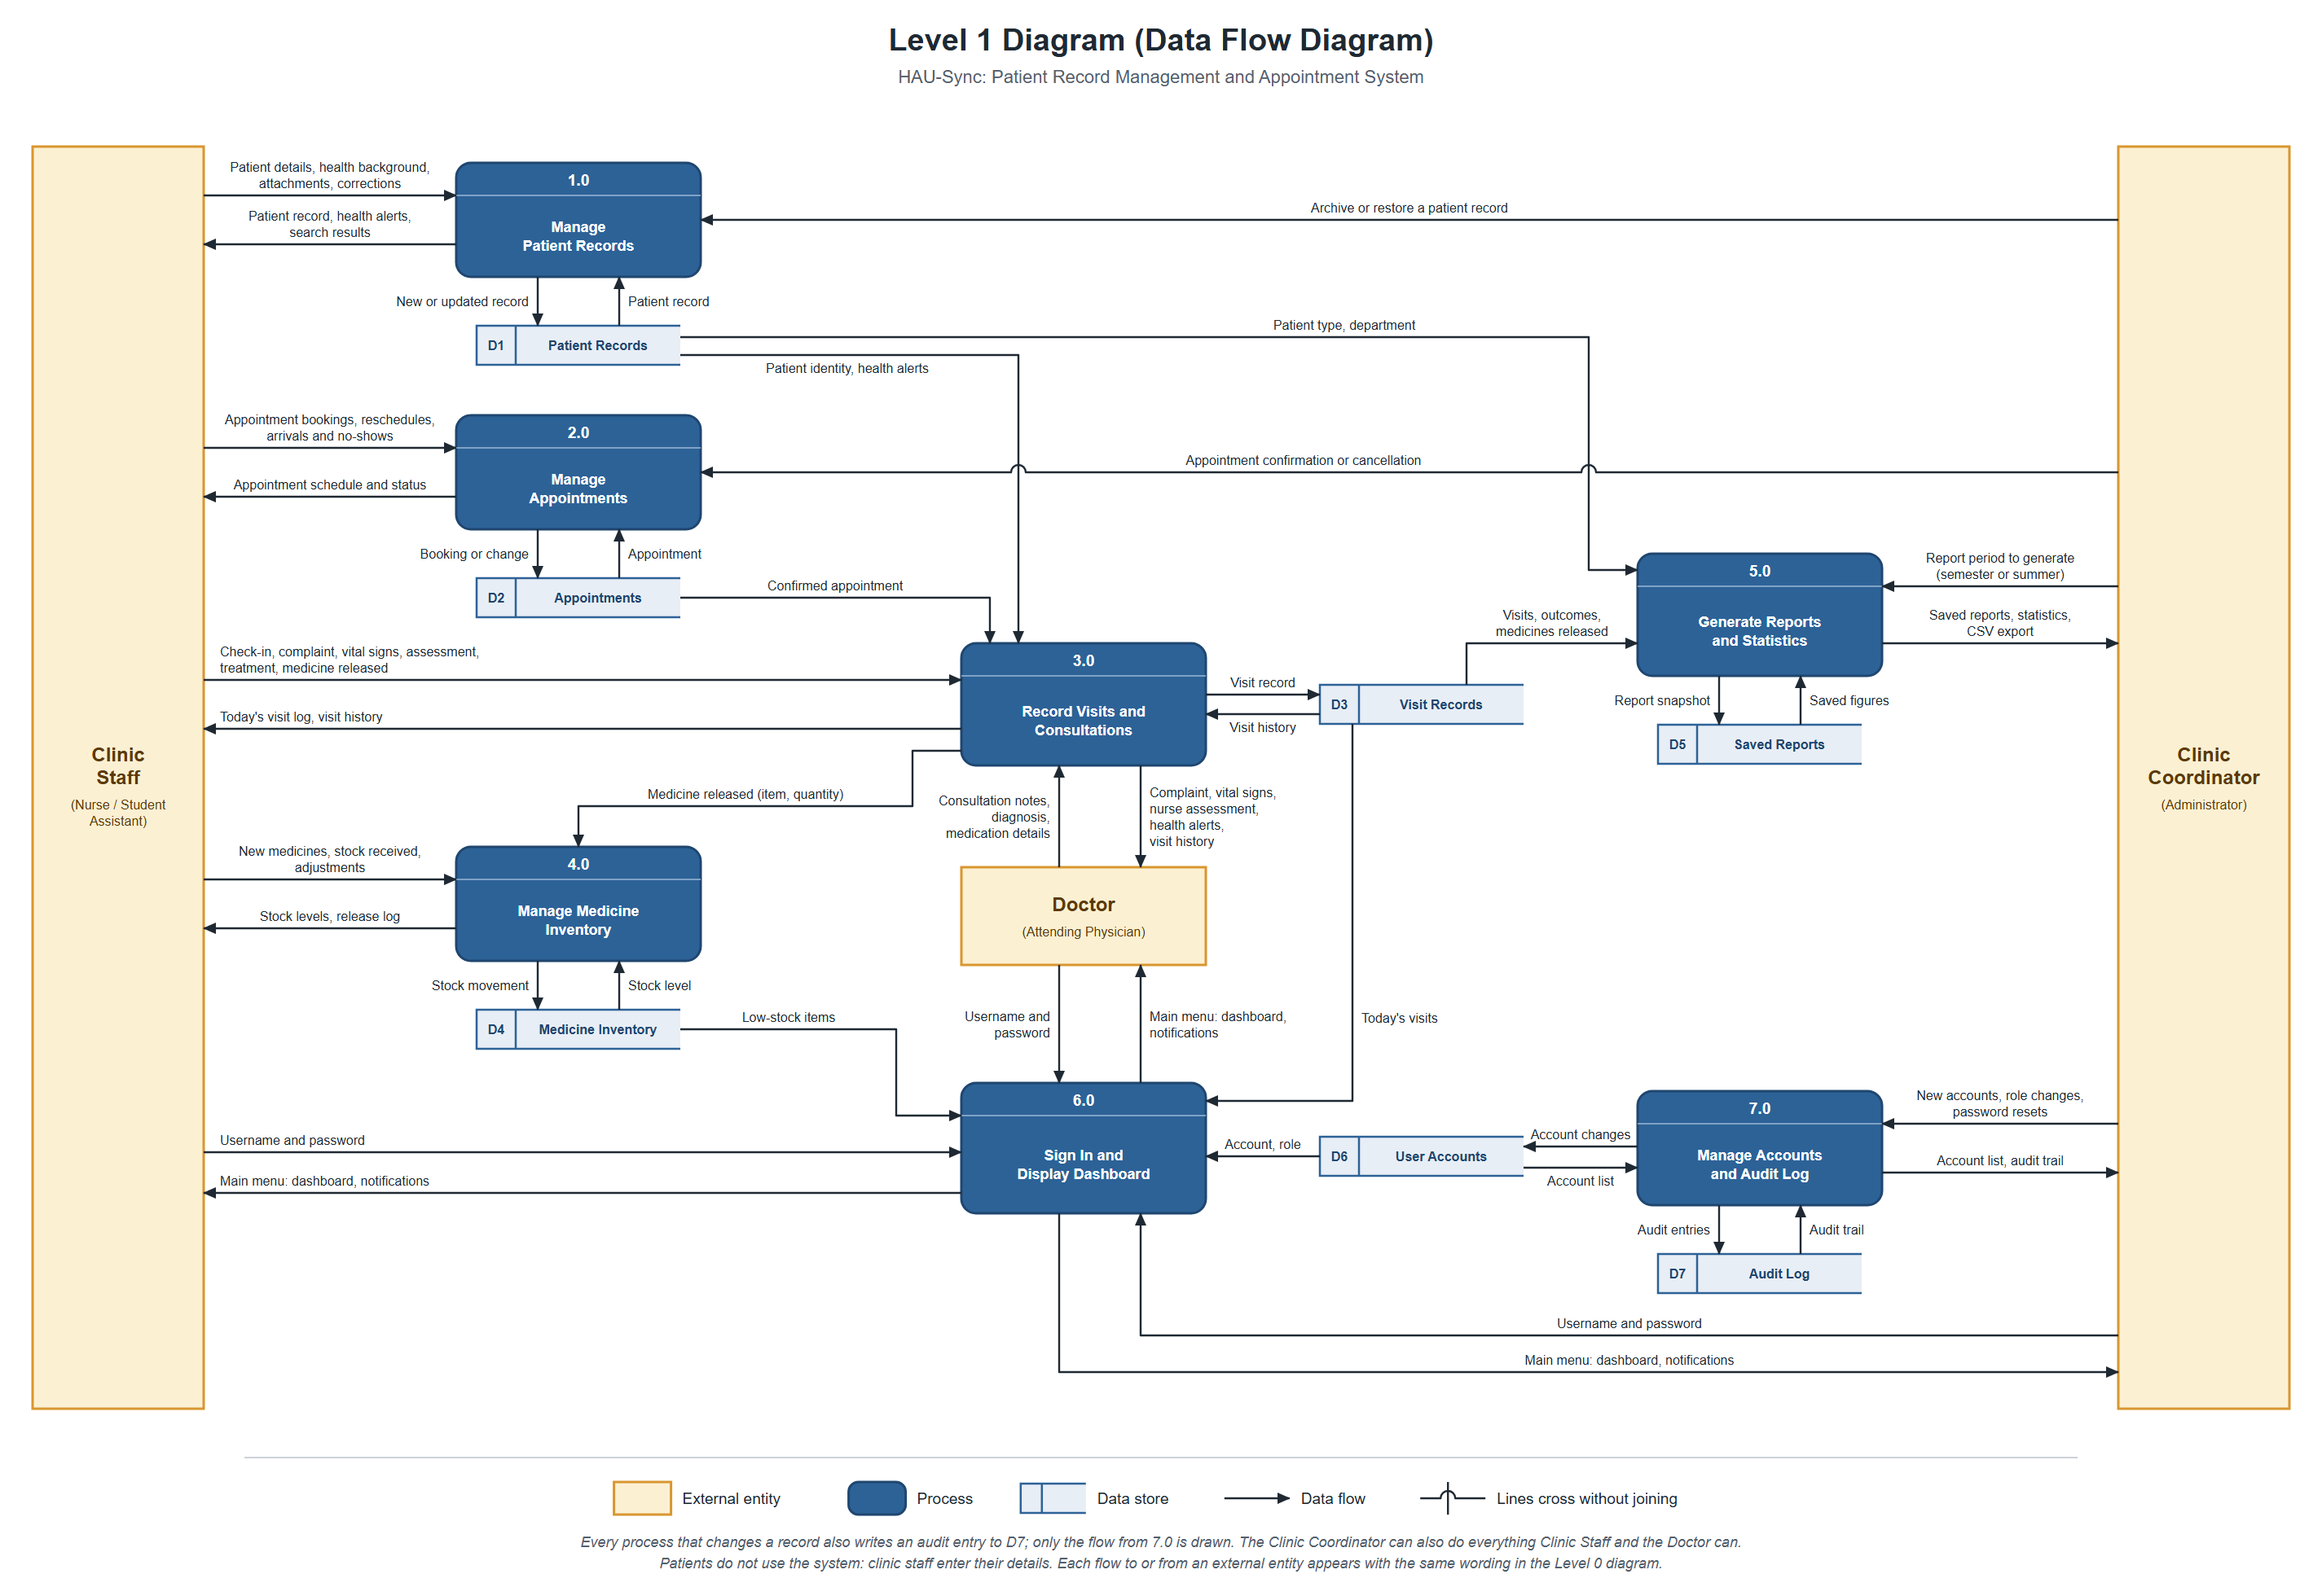
Level 1: inside the system
ANALYSIS
7
processes
7
data stores
Notes:
Bernard Rodriguez Jr.
Now we open that one circle and look inside. This is our Level 1 data flow diagram.
The system is made of seven processes: managing patient records, managing appointments, recording visits and consultations, managing the medicine inventory, generating reports, signing in and showing the dashboard, and managing accounts and the audit log.
It also has seven data stores, which is where the information is kept. The arrows show how information moves. For example, when a nurse releases medicine during a visit, that goes to the inventory process, which takes it off the stock.

Slide 9
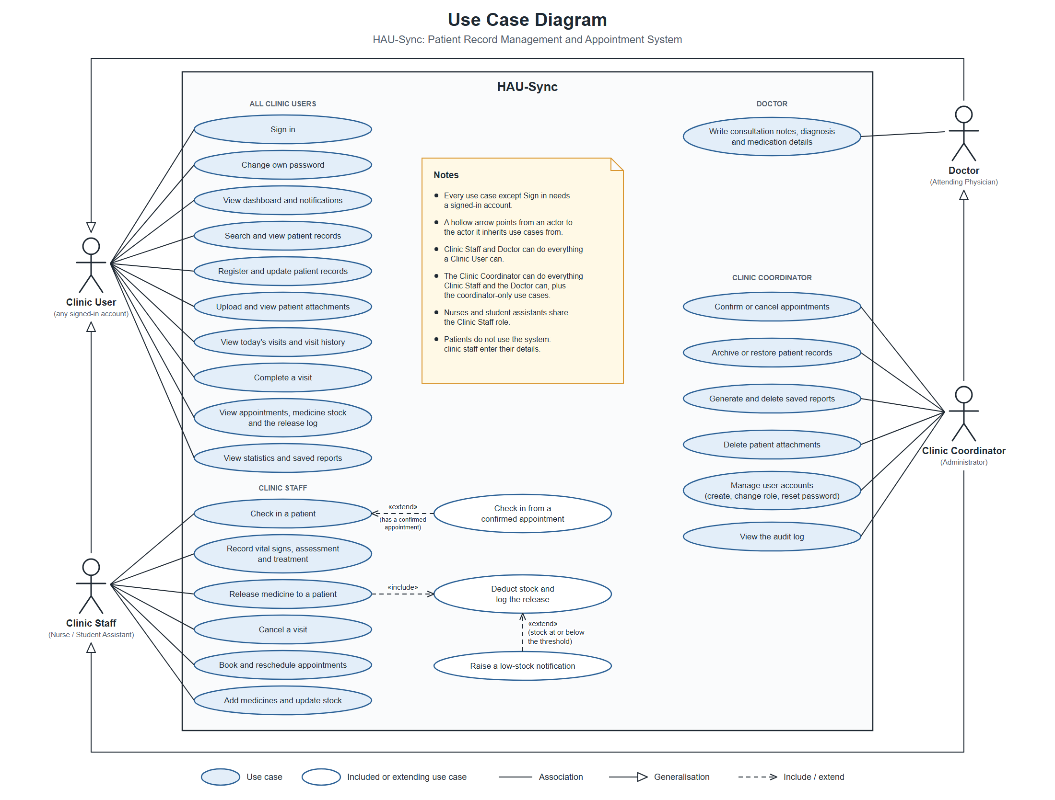
Who can do what
SOFTWARE MODEL
Clinic staff
Check-in, visits, medicine, appointments
Doctor
Consultation notes and diagnosis
Coordinator
Everything, plus accounts and the audit log
Notes:
Bernard Rodriguez Jr.
This is our use case diagram. It answers one question: who is allowed to do what?
The clinic staff check patients in, record visits, release medicine and book appointments.
The doctor writes the consultation notes and the diagnosis.
The coordinator can do everything the staff and the doctor can, and also confirms appointments, manages the accounts and reads the audit log.
This is important for privacy. Each person only sees and does what their work needs. Now Gil will show you the actual system.

Slide 10
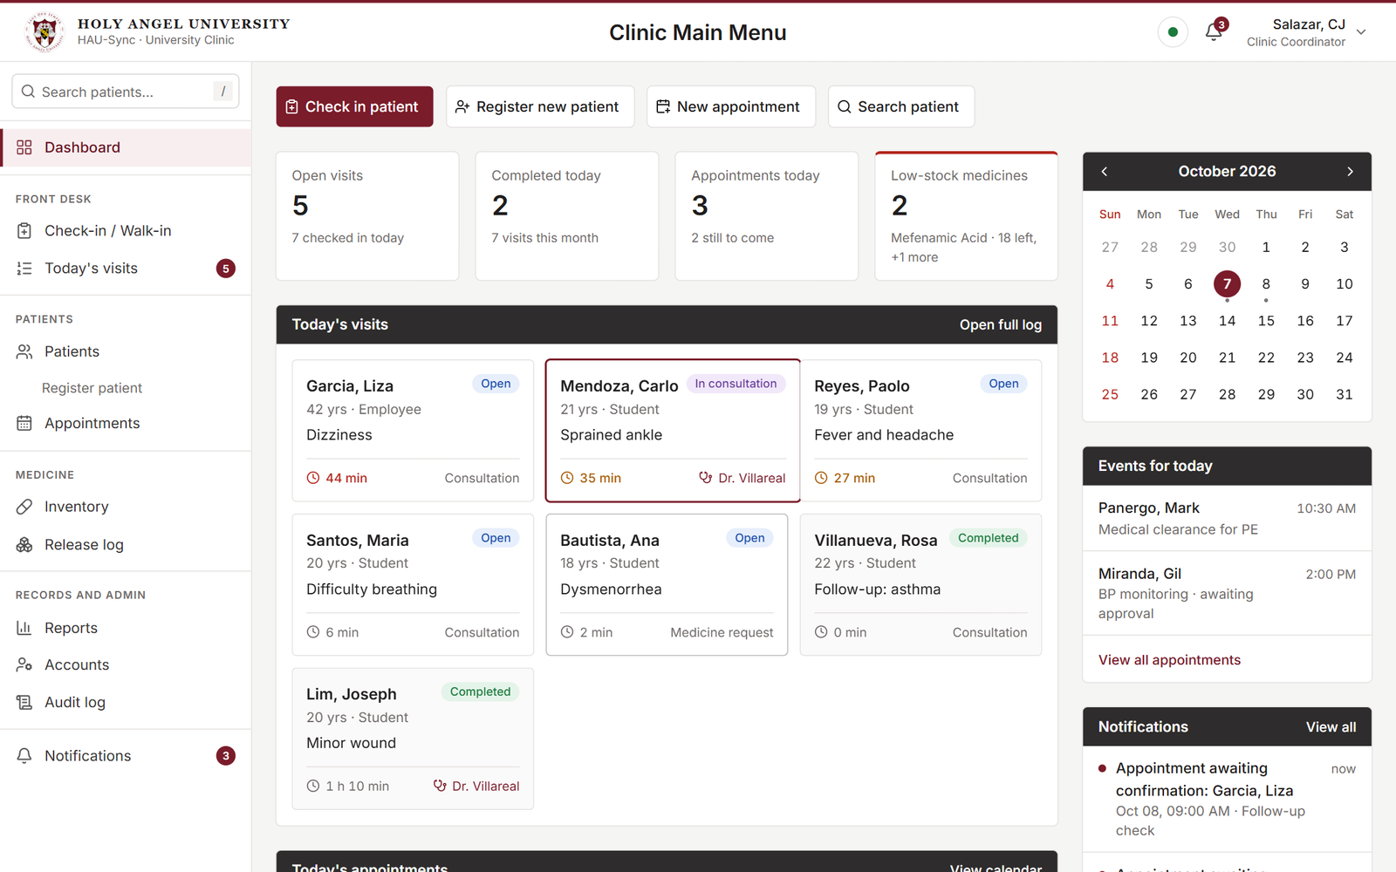



The clinic's day on one screen
THE SYSTEM
Today at a glance
Visits and appointments
Alerts
Low stock and notifications
Live
Updates at every station
Notes:
Gil Miranda
Thank you, Bernard. Now let us look at the real thing. This is the dashboard, the first screen you see after signing in.
It puts the clinic's whole day on one screen: the visits today, the appointments today, the medicines that are running low, and the latest notifications.
And it updates live. If the front desk checks in a patient, the nurse and the doctor see it on their screens right away. Nobody needs to refresh the page.

Slide 11
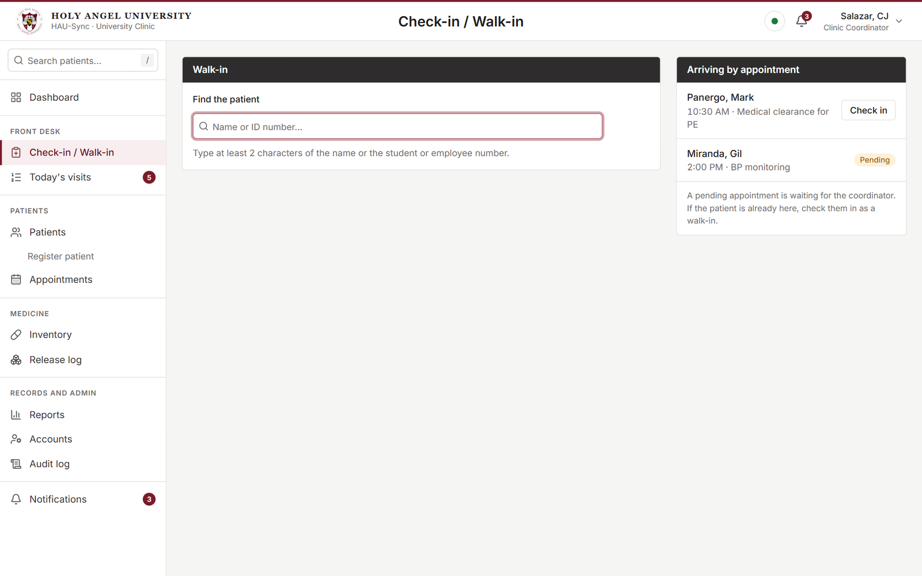
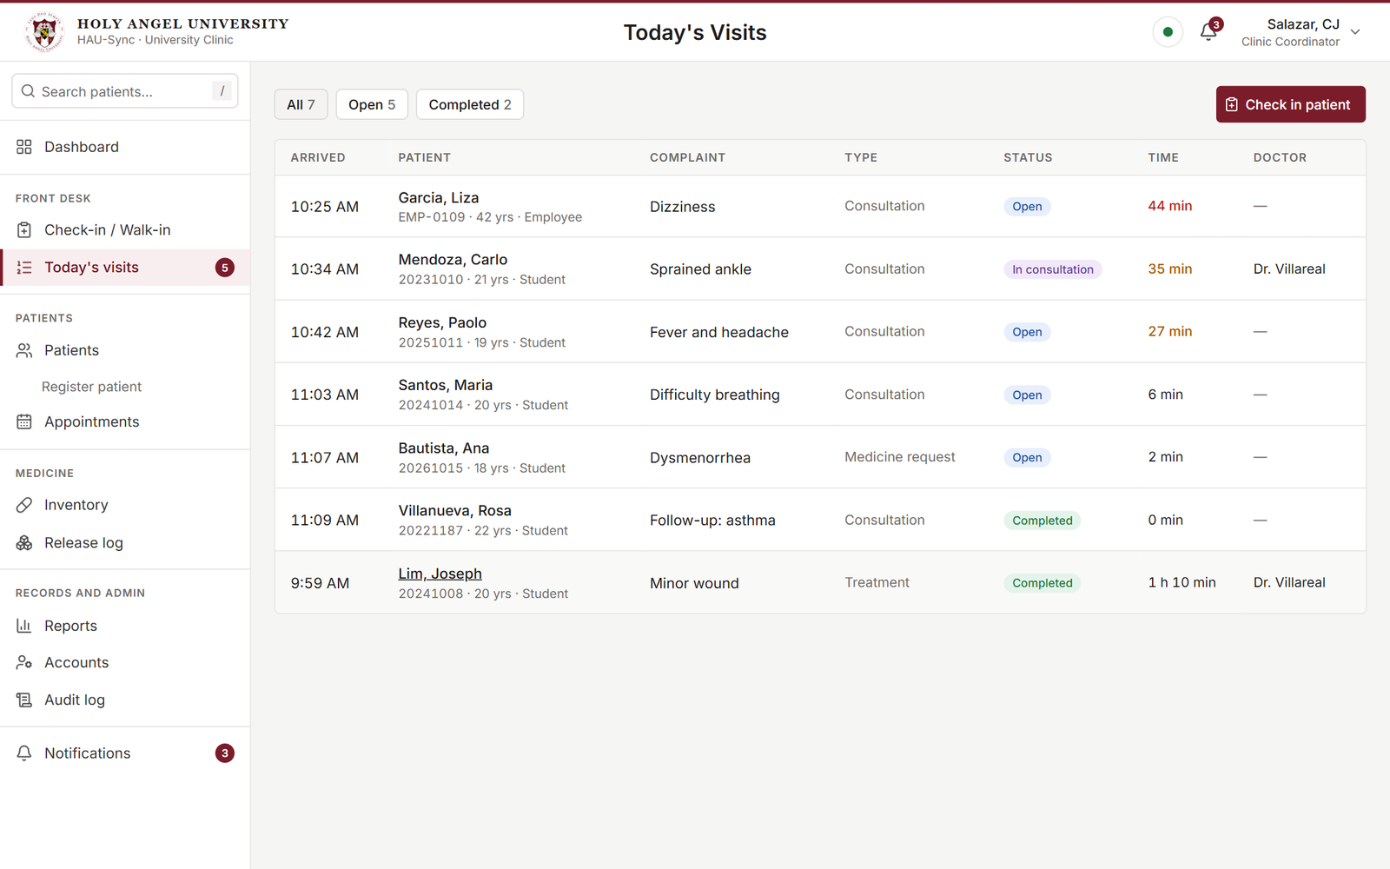
Check in, then record the visit
THE SYSTEM
Check in in a few taps
Every visit, seen by nurse and doctor
Notes:
Gil Miranda
When a patient walks in, the staff search for them by name or by ID number, tap a common complaint such as headache or fever, and check them in. It only takes a few taps.
That opens a visit record. The nurse enters the vital signs, the assessment and the treatment. The system also checks what is typed. If someone enters a value that is not possible, like an oxygen level of one hundred twenty percent, it will not accept it.
Then the doctor opens the very same visit and adds the consultation notes and the diagnosis. While the doctor is editing, the system tells the nurse, so they do not overwrite each other's work.

Slide 12
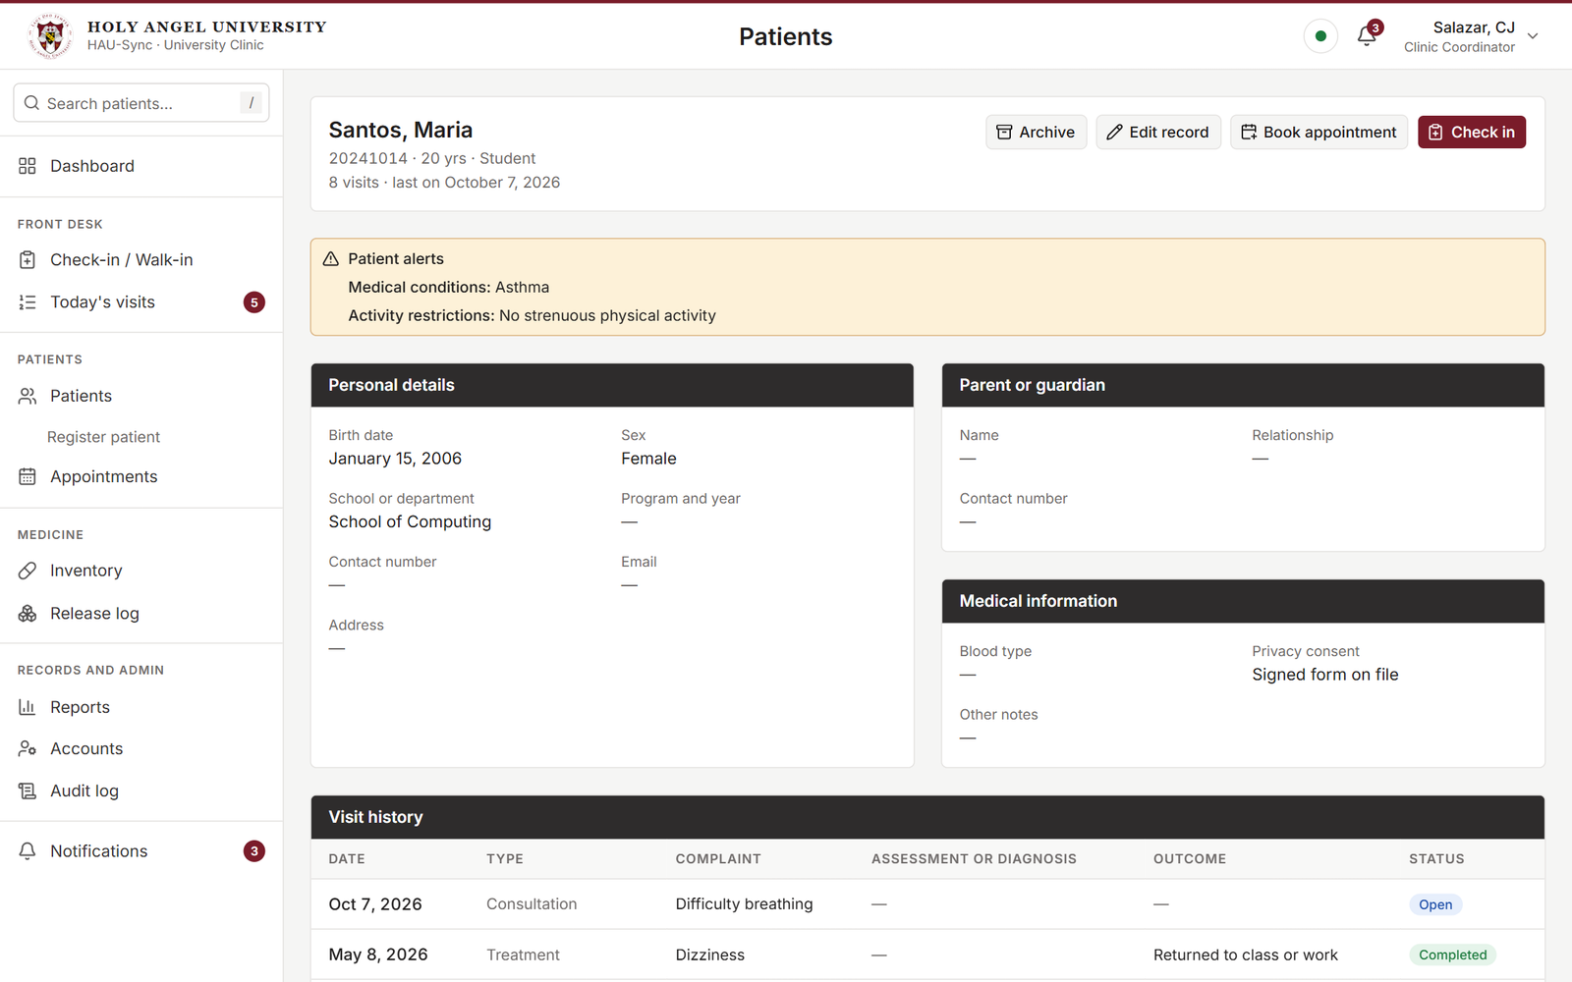



Each patient's record in one place
THE SYSTEM
Alerts first
Allergies and restrictions
Full history
Every visit, newest first
Attachments
Such as lab results
Notes:
Gil Miranda
Every patient has one record. At the very top, the system shows the alerts first: allergies, health conditions and restrictions. So the staff see the important warnings before anything else.
Below that is the full history of the patient's visits, from the newest to the oldest. The staff can also attach files, such as a lab result.
And patients are never deleted. If a record is no longer needed, it is archived, so the history is always kept. Next is Mclaren.

Slide 13
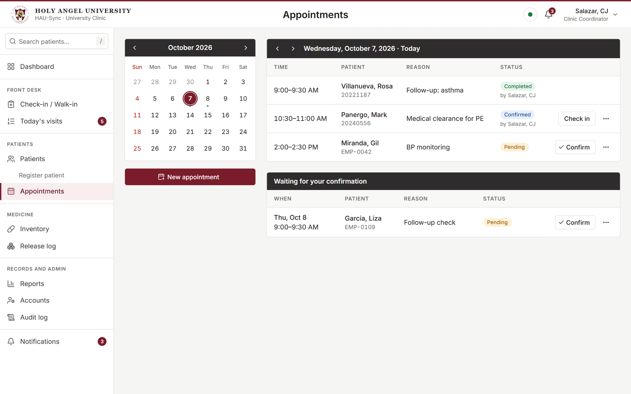
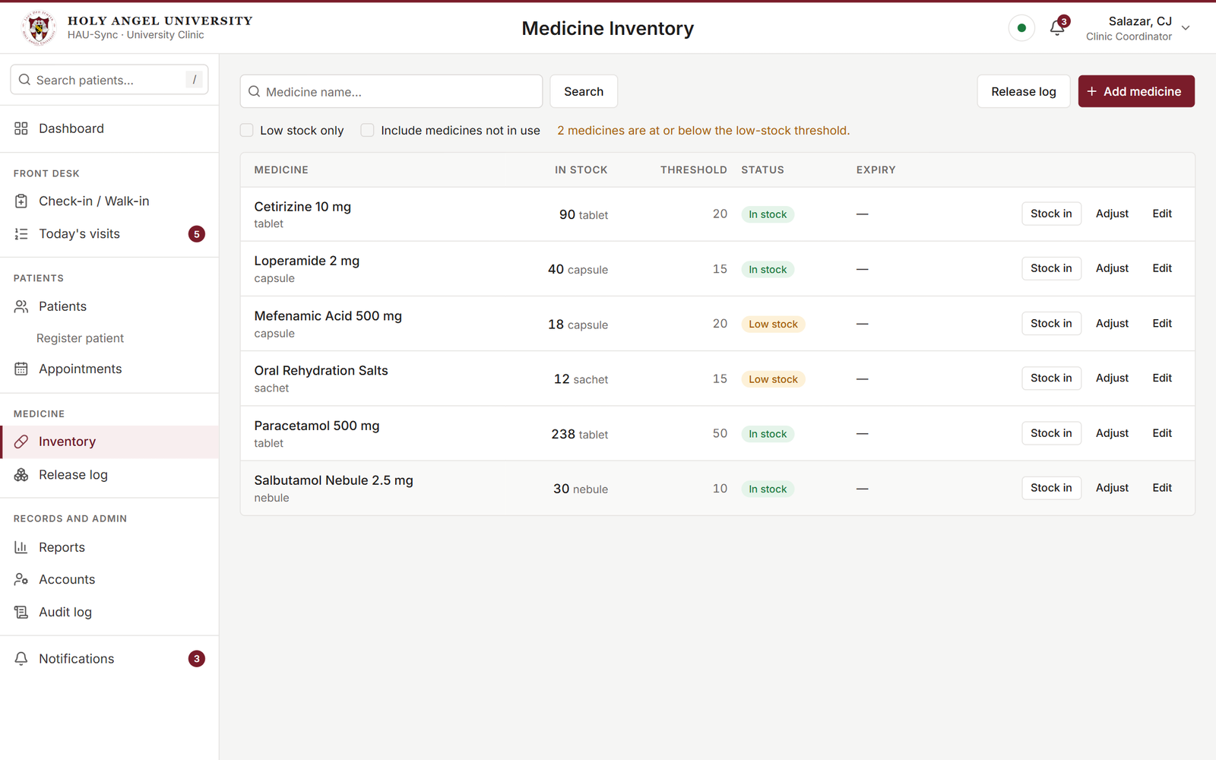
Appointments and medicine stock
THE SYSTEM
Book, confirm and check in
Stock that keeps its own count
Notes:
Mclaren Ais Miranda
Thanks, Gil. Let us continue with appointments. The staff can book an appointment and move it to another day. A new appointment starts as pending, and the coordinator confirms or cancels it. When the patient arrives, one tap checks them in.
For medicine, the system keeps count for the clinic. When a nurse releases medicine during a visit, the stock goes down by itself. When a medicine is running low, the system gives a warning. And every release is written in a log, so the clinic can always see where the medicine went.

Slide 14
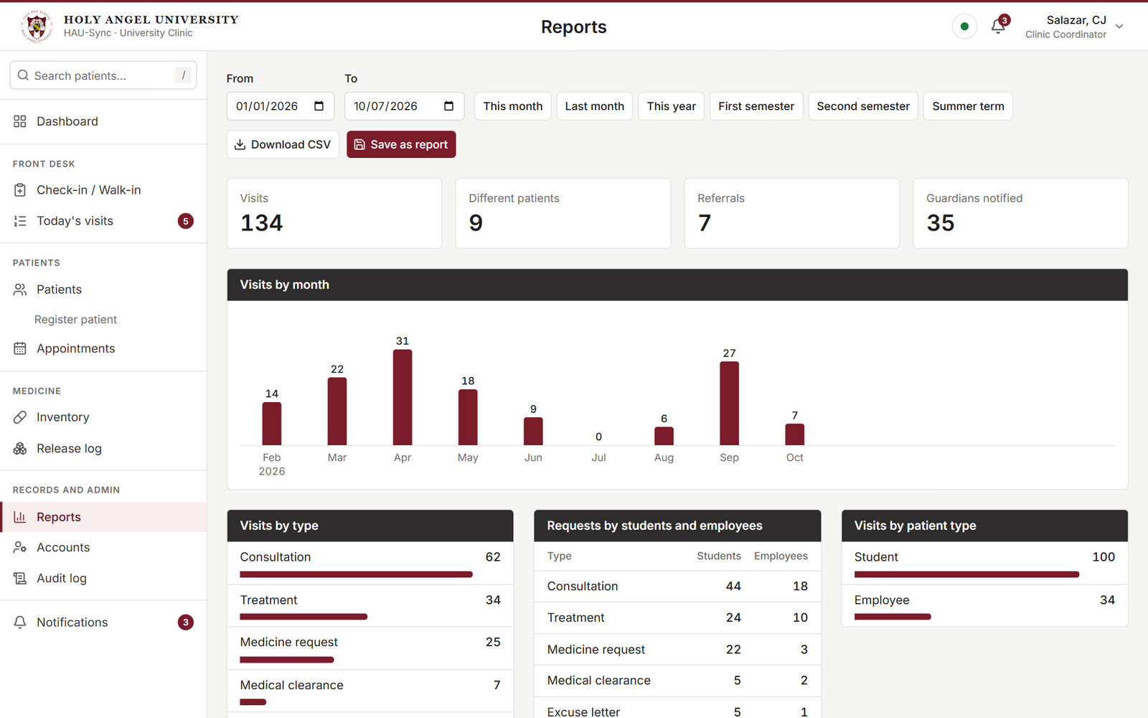



Clinic statistics for any period
THE SYSTEM
Any period
Month, semester or summer term
Charts and tables
By type, department, complaint
Download or save
Opens in Excel
Notes:
Mclaren Ais Miranda
The clinic also needs to submit reports. Before, someone had to count everything by hand.
Now the staff just choose a period, such as a month, a semester or the summer term, and the system shows the numbers and the charts: how many visits there were, what kind, from which department, and the most common complaints.
The report can be downloaded as a file that opens in Excel, or saved inside the system for later.

Slide 15




Built to protect patient data
PRIVACY AND SECURITY
Stays in the clinic
Access by role
Every view is logged
Automatic sign-out
Runs on the clinic's own network
Each user sees only what the work needs
The audit log shows who did what
After an hour unused
In keeping with the Data Privacy Act of 2012
Notes:
Mclaren Ais Miranda
Because this is health information, we treated privacy as a main feature, not as an extra.
First, the data stays in the clinic. The system runs on the clinic's own network.
Second, access depends on your role, so you only see what your work needs.
Third, every time someone views or changes a patient's record, it is written in an audit log that the coordinator can read.
And fourth, a computer that is left unused for an hour signs itself out. All of this is in keeping with the Data Privacy Act of 2012. To explain how we built all of this, here is Paolo.

Slide 16





How it is built
IMPLEMENTATION
Front desk
Database
Nurse
Clinic server
Files and backups
One address for every station, with live updates
Doctor
Screens: React, TypeScript Backend: Python, FastAPI Data: SQLite or PostgreSQL
Notes:
Paolo Villanueva
Thank you, Mclaren. Here is how the system works behind the screen, in simple terms.
The system has two halves. The first half is what you see in the browser. We built it with React and TypeScript. The second half is the backend, which keeps the rules and the data. We built it with Python and FastAPI, and it saves everything in a database.
At the clinic, one computer acts as the server. The front desk, the nurse and the doctor simply open one address in their browser. The server also sends live updates to every station, which is why a change on one screen appears on the others.

Slide 17
How we worked: Agile, in five phases
PROCESS MODEL
1
2
3
4
5
Proposal
Requirements
Database and API
Screens
Testing
Approved
Clinic interview
Records and security
Every screen built
Happening now
Built in small parts, tested, and improved as we learned from the clinic.
Notes:
Paolo Villanueva
For our process, we followed the Agile model. That means we built the system in small parts, tested each part, and improved it as we learned more from the clinic.
We worked in five phases. First, the proposal and its approval. Second, gathering the requirements through the interview. Third, the database and the backend. Fourth, the screens. And fifth, where we are now, testing and evaluation.

Slide 18
Tested, and what comes next
TESTING AND NEXT STEPS
75
1
Team testing
On each member's computer
backend tests
2
Clinic walkthrough
Clinic personnel try it and tell us what to change
275
3
Installation and turnover
Set up on the clinic's computer
screen tests
Left out by the team: the urgent-case queue.
Notes:
Paolo Villanueva
We do not just hope that the system works. We wrote automated tests that check it for us every time we change the code: 75 tests for the backend and 275 tests for the screens.
We also want to be honest about one thing. Every feature in our project paper is built, except the urgent-case queue, which our team decided to leave out.
From here, there are three steps left. We finish testing as a team. Then the clinic personnel try the system and tell us what to change. And finally, we install it on the clinic's computer and turn it over to them.

Slide 19
Thank you
The team · CS-302
Sean Jarin Dela Cruz
Mikko Brandon B. Panergo
Bernard Rodriguez Jr.
Gil Miranda
Mclaren Ais Miranda
Paolo Villanueva
Project adviser: Prof. Evicen Flores
With thanks to the Holy Angel University Clinic
Notes:
Paolo Villanueva, then everyone
To sum up: HAU-Sync replaces the clinic's paper with one shared record that is faster to use, easier to search, and safer for patient information.
We would like to thank the Holy Angel University Clinic for their time and support, and Prof. Evicen Flores for guiding us.
(Everyone) Thank you for watching!

