Slide 1

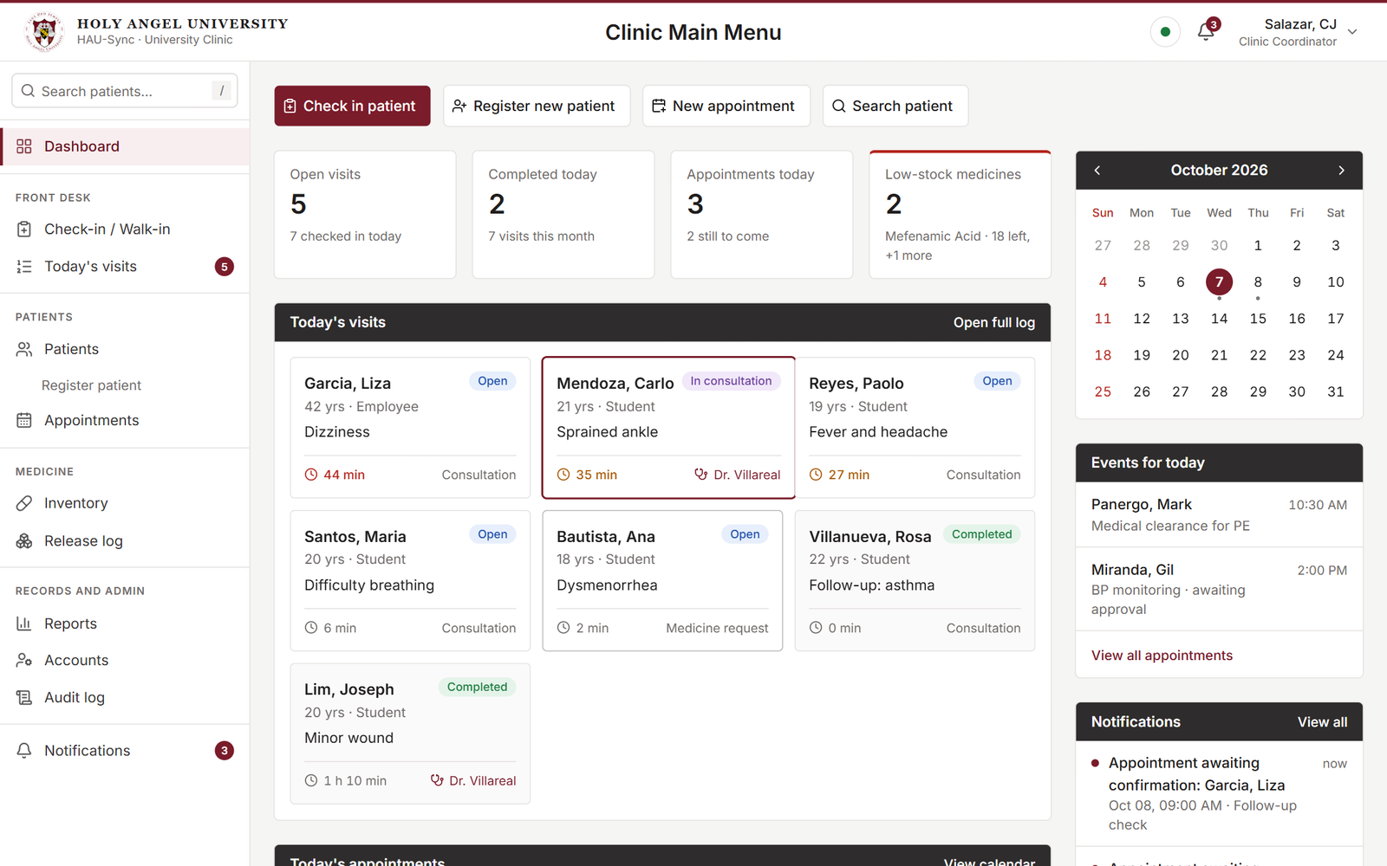
HAU-Sync
Patient records and appointments for the University Clinic
Holy Angel University · CS-302
Notes:
Introduce the team and the project. HAU-Sync is our CS-302 final project, made for the University Clinic. Today we show the goal of the system and how far it has come. All data on screen is made up.

Slide 2



Today, the clinic works on paper
Patient log
Three things are kept by hand.
Paper is slow to pass from the front desk to the nurse and the doctor.
Patient records
Medicine inventory
Notes:
From our interview with the Clinic Coordinator: the patient log, the patient records and the medicine inventory are all kept on paper today.

Slide 3




Our goal: one record, shared by everyone
Front desk
Nurse
Doctor
logs the patient
records the visit
sees the same record at once
No paper handed over. Nothing leaves the clinic’s computers.
Notes:
The goal in one sentence: the front desk logs a patient, the nurse records the visit, and the doctor sees the same record right away. The system runs on the clinic’s own network.

Slide 4



The clinic’s day on one screen
Today’s visits and appointments
Low-stock medicines and notifications
Updates live at every station
Notes:
This is the main menu. It shows who is in the clinic now, today’s appointments, medicines running low and notifications. When one station changes something, the others see it without reloading.

Slide 5
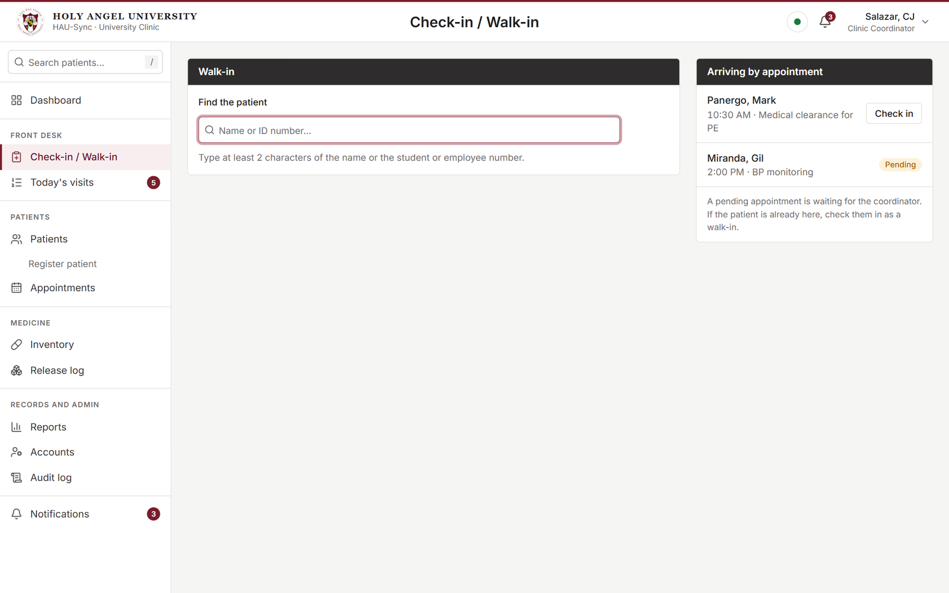



Check in a patient in a few taps
Search by name or ID number
Tap a common complaint
See who is arriving by appointment
Notes:
For walk-ins: find the patient, tap the complaint, check in. Patients with an appointment today are listed at the side. A visit written on paper earlier can also be entered for a past date.

Slide 6
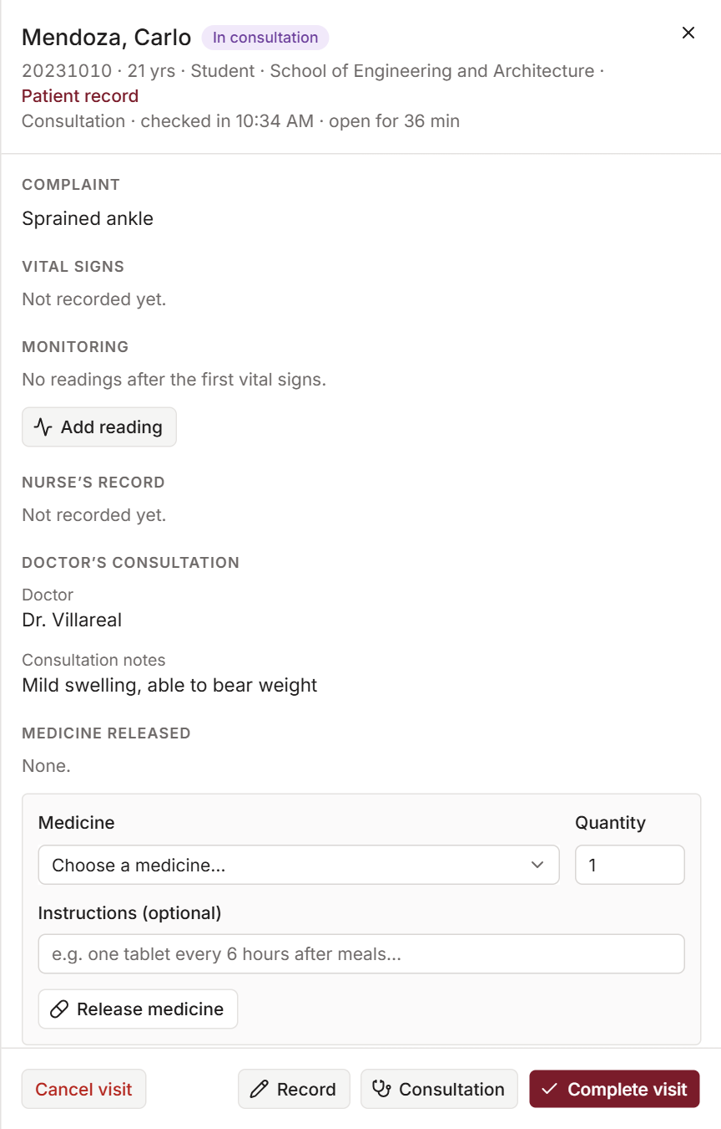

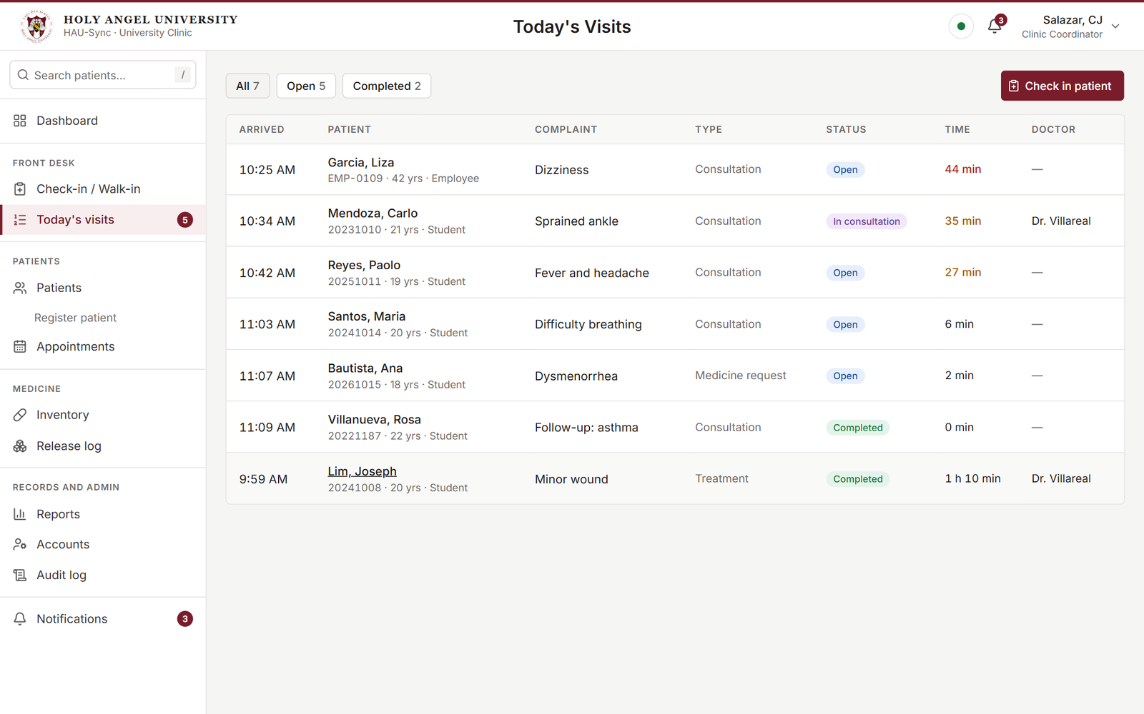

One visit record for nurse and doctor
Nurse records vital signs and treatment
Doctor adds notes and diagnosis
Medicine is released from the same record
Notes:
The list on the left is today’s visits. Opening one shows the visit record on the right. The nurse and the doctor work on the same record, and only one of them can edit at a time.

Slide 7
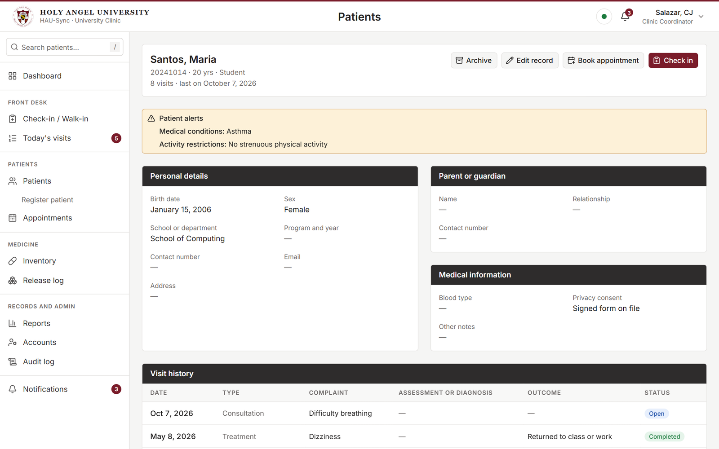



Each patient’s record in one place
Alerts are shown first
Full visit history
Attachments such as lab results
Notes:
A patient record opens with the alerts first: allergies, medical conditions and activity restrictions. Below are personal details, the guardian, and every past visit. Patients are archived, never deleted.

Slide 8
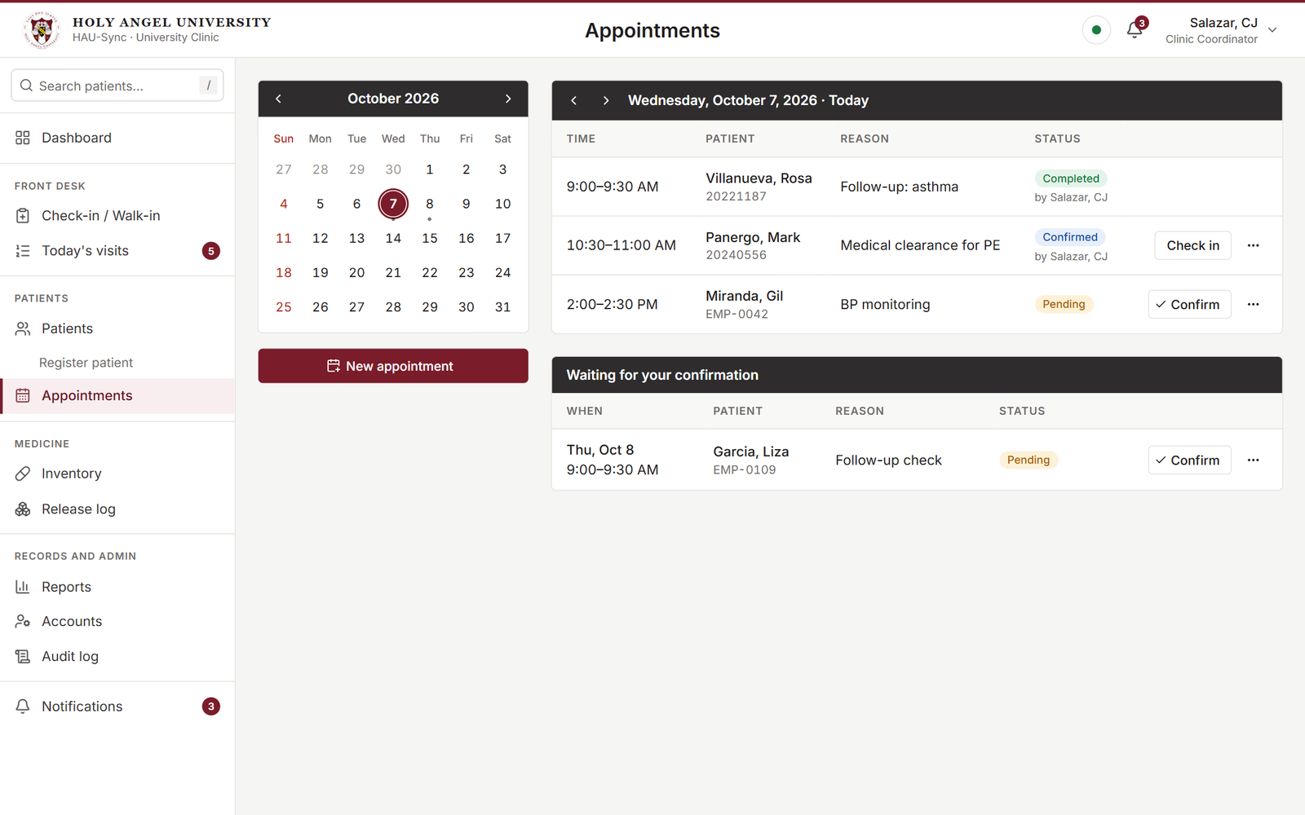



Book, confirm and check in
Appointments by day
The coordinator confirms or cancels
One tap to check in on arrival
Notes:
Clinic staff book and reschedule appointments. They start as pending until the coordinator confirms. When the patient arrives, one tap starts the visit.

Slide 9
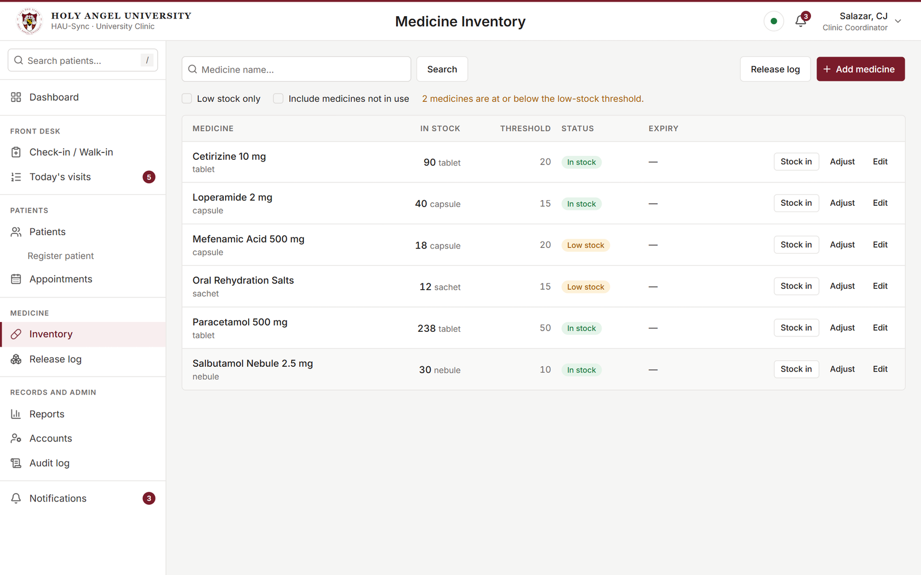
Medicine stock that keeps count
Stock goes down when medicine is released
Low-stock warning
Every release is in the log
Notes:
Releasing medicine during a visit lowers the stock automatically. Medicines at or below their threshold are marked low stock and appear on the dashboard. The release log lists every release.

Slide 10
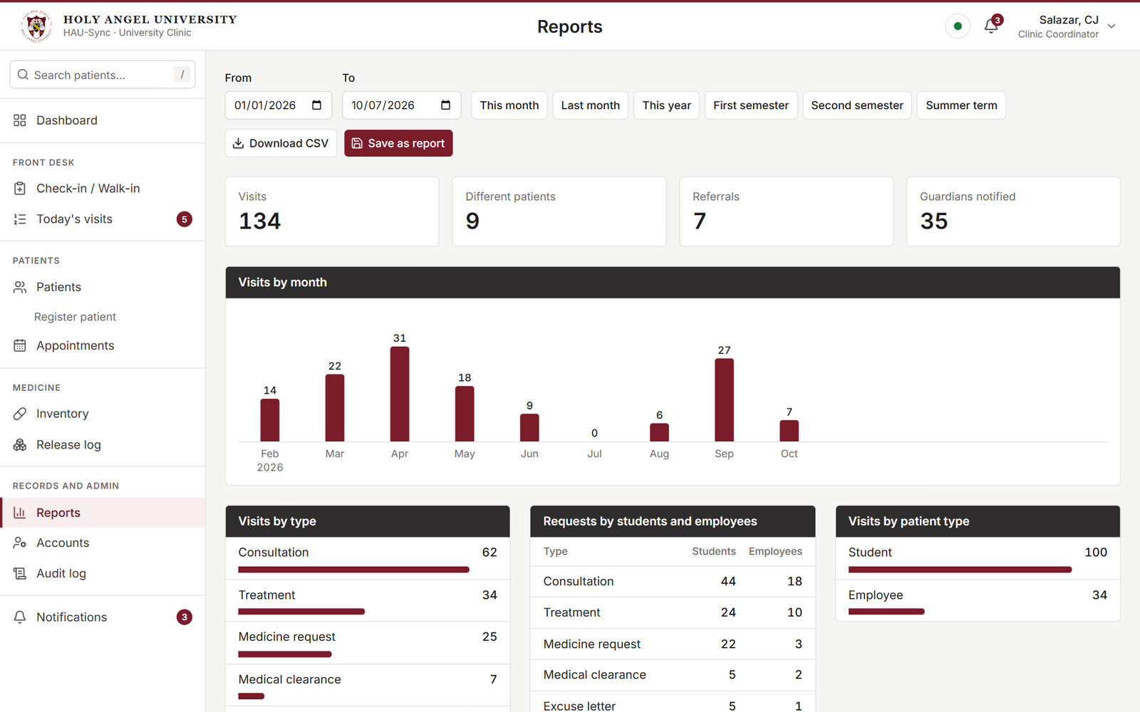


Clinic statistics for any period
By month, semester or summer term
Visits by type, department and complaint
Download as CSV or save the report
Notes:
Reports are ready for any date range, with presets for the semesters and the summer term. The figures can be downloaded or saved. The numbers shown here come from made-up demo data.

Slide 11




Built to protect patient data
Stays in the clinic
Access by role
Runs on the clinic’s own network
Coordinator, clinic staff and doctor see only what they need
Every view is logged
Automatic sign-out
The audit log shows who viewed or changed a record
A station left unused for an hour signs out
In keeping with the Data Privacy Act of 2012
Notes:
Patient data is confidential under the Data Privacy Act of 2012 (RA 10173). Nothing leaves the clinic’s computers, each role is limited to its own work, and every view or change of patient data is written to the audit log.

Slide 12


Where the project is now
Phase 1
Phase 2
Phase 3
Phase 4
Phase 5
Proposal
Requirements
Database
Screens
Testing
Approved
Clinic interview
Records and security
Every screen built
Happening now
Built and working. Every planned feature is in, except the urgent-case queue.
Notes:
Phases 1 to 4 are finished: proposal, requirements from the interview, the database and security, and every screen. We are now in Phase 5, testing. The urgent-case queue was left out of this version.

Slide 13

Next steps with the clinic
1
Team testing
We finish testing on our own computers
2
Clinic walkthrough
What we ask
Clinic personnel try it and tell us what to change
Your time for a short walkthrough, and your honest feedback.
3
Installation
Set up on the clinic’s computer, then turnover
Notes:
What happens next, and what we need from the clinic: a walkthrough with clinic personnel and their feedback, before we install the system on the clinic’s computer and turn it over.

Slide 14
Thank you
We welcome your questions and suggestions.
The team · CS-302
Sean Jarin Dela Cruz
Mikko Brandon B. Panergo
Bernard Rodriguez Jr.
Gil Miranda
Mclaren Ais Miranda
Paolo Villanueva
Project adviser: Prof. Evicen Flores
Notes:
Thank the clinic and open the floor for questions and suggestions.

