Slide 1

HAU-Sync
Patient Record Management and Appointment System for the Holy Angel University Clinic
Final Presentation · CS-302 Software Engineering
Notes:
Good day, everyone. We are third-year Computer Science students from section CS-302, and this is our final presentation in Software Engineering. Our project is HAU-Sync, a patient record and appointment system we built for the Holy Angel University Clinic. Today we will show you the problem we saw, how we studied it, how we designed the system, the working system itself, and how it goes to the clinic next.

Slide 2







The clinic still runs on paper
Student arrives
Written by hand
Paper passed along
Filed on paper
Tells the receptionist the concern
Patient log, again and again
From the desk to the doctor
Kept in cabinets
Slow at peak hours
Hard to search
Easy to lose
The front desk backs up when student traffic is highest
Finding an old record means going through the files
A single sheet of paper can be misplaced
Notes:
Today the clinic does almost everything by hand. A student tells the receptionist their concern, the receptionist writes it down, the paper goes to the doctor, and the record is filed on paper. The school portal no longer supports the clinic, so there is no digital record at all. Paper works, but at peak hours it is slow, an old record is hard to find, and a sheet can be misplaced.

Slide 3




One record, shared by everyone
Front desk
Logs the patient in a few taps
One visit record
Nurse
Records vital signs and treatment
Nothing is handed over. A change at one station appears at the others without a refresh.
Doctor
Runs only on the clinic's network, in keeping with the Data Privacy Act of 2012.
Sees it at once and adds the consultation
Notes:
Our idea is simple. Instead of passing paper from one person to the next, everyone in the clinic looks at the same record. The front desk logs the patient, the nurse records the visit, and the doctor sees that record right away on their own screen. It runs only on the clinic's own network, because health information is protected by the Data Privacy Act of 2012.

Slide 4
HAU-Sync at a glance
15
3
19
4
461
functional requirements
user roles
screens
sessions with the clinic
automated tests
What we will cover
1
2
3
4
5
Studying the clinic
Designing the system
The working system
Medicine, reports and privacy
Building, testing and the pilot
Notes:
Here is the system in numbers. Fifteen functional requirements, three user roles and nineteen screens. We met with the clinic four times, one interview and three review sessions, and the system is checked by 461 automated tests. Over the next few minutes we will go through how we studied the clinic, how we designed the system, the system itself, and finally how we built it, tested it and how it will reach the clinic.

Slide 5
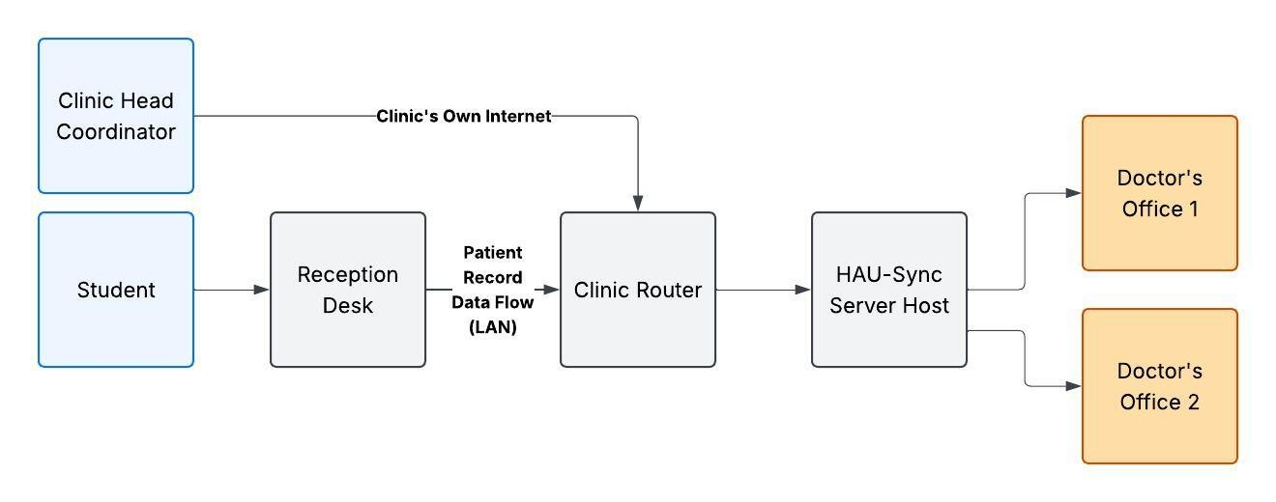


The site already has what the system needs
Site context
PGN Building
Ground floor, easy for students and employees to reach
Computers in place
The stations are already at the clinic
Network and power
Router, own internet and a generator
Waiting area
Infirmary
2 doctor's offices
Dental office
Notes:
Before writing any code, we studied the place where the system will be used. The clinic is on the ground floor of the PGN Building. It has a waiting area, an infirmary, two doctor's offices and a dental office. It already has computers, a router and its own internet connection, so no new equipment is needed. This diagram shows how the reception desk, the clinic router, the server computer and the doctor's offices connect on the clinic network.

Slide 6
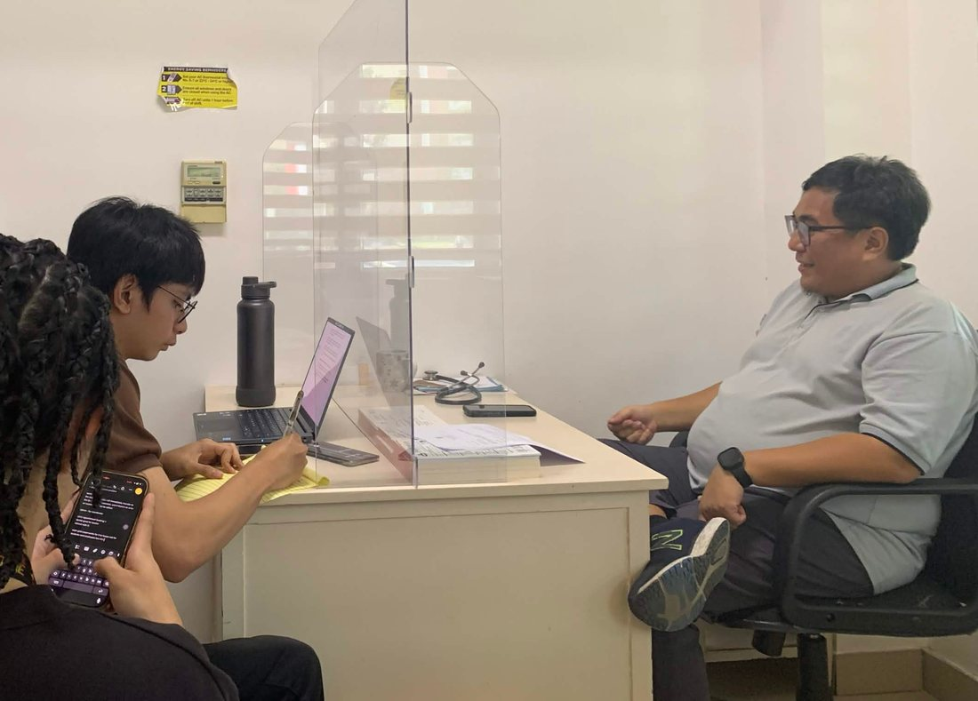
What the clinic told us
Interview, 30 September 2026
1
Everything is handwritten
The same details are written again and again
2
The portal no longer supports the clinic
There is no digital way to keep patient records
3
The front desk slows at peak hours
Student traffic is highest at the same times each day
4
It must stay inside the clinic
Patient information has to remain private
Notes:
We sat down with the clinic for an interview on the thirtieth of September, and four things stood out. Everything is handwritten, so the staff write the same details repeatedly. The school portal no longer supports the clinic. The front desk slows down at peak hours. And they want the system to stay inside the clinic, because patient information must stay private. These four findings shaped everything we built.

Slide 7


Fifteen functions, fifteen quality targets
15 functional
15 non-functional
requirements: what the system does
requirements: how well it must do it
Sign-in and roles
Patient records and search
Security and privacy
Confidentiality
Medical and visit history
Visits and consultations
Data integrity and reliability
Performance
Walk-ins and appointments
Nurse-to-doctor record transfer
Usability and clear screens
Availability on the clinic network
Inventory and low-stock alerts
Reports, statistics and dashboard
Maintainability and scalability
Recoverability and compatibility
Notes:
From the interview and our project paper we wrote down the requirements: fifteen functional and fifteen non-functional. The functional requirements are what the system does, like signing in with a role, keeping records, recording visits and making reports. The non-functional requirements are how well it must do them: secure, private, reliable and easy to use.

Slide 8
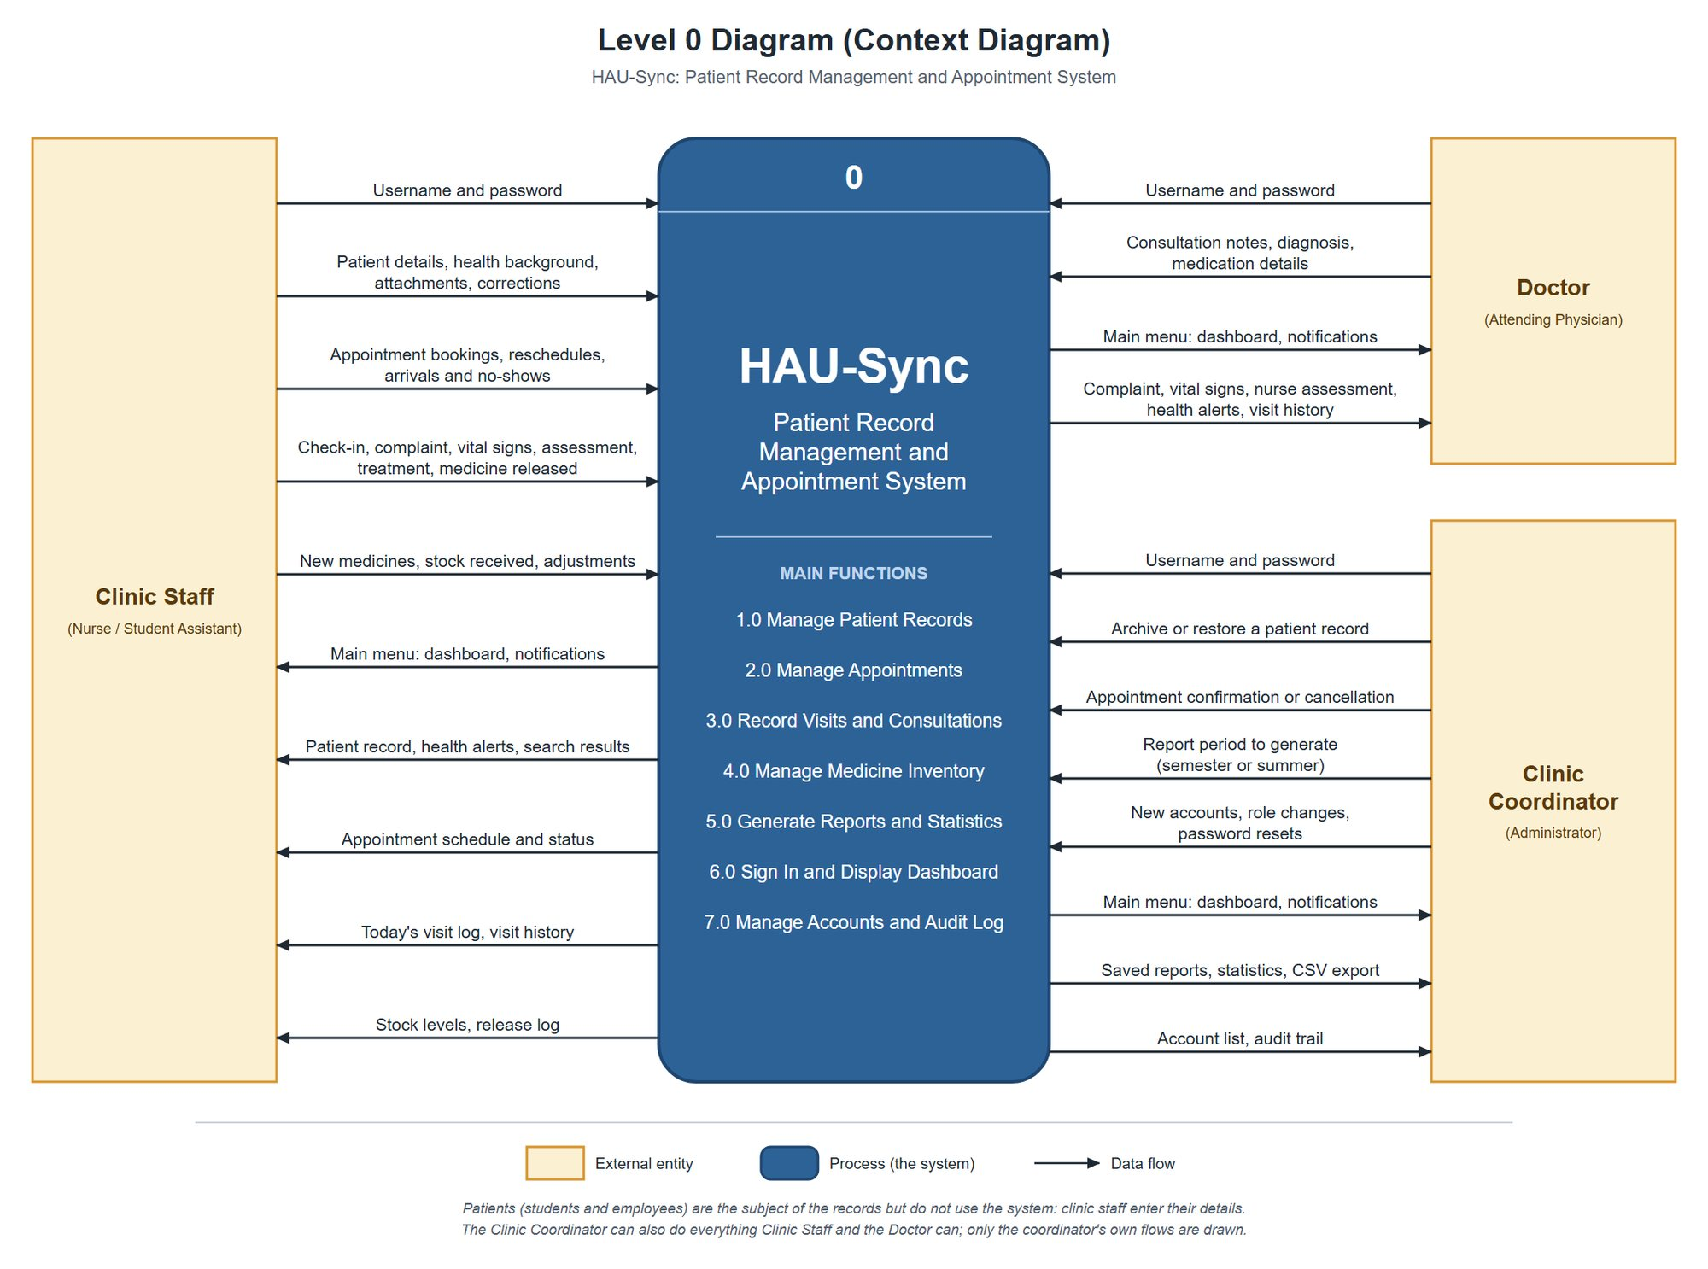

Level 0: the system and the people around it
Level 0 context diagram
Clinic staff
Nurses and student assistants share one role
Doctor
Reads the record and writes the consultation
Clinic coordinator
Everything above, plus approvals and accounts
Patients have no accounts. It is a clinic-only system.
Notes:
This is the context diagram. It shows the whole system as one process and the people who exchange information with it: clinic staff, the doctor and the clinic coordinator. The patient is not on this diagram on purpose. The clinic asked for a clinic-only system, so patients have no accounts and the staff enter their details for them.

Slide 9
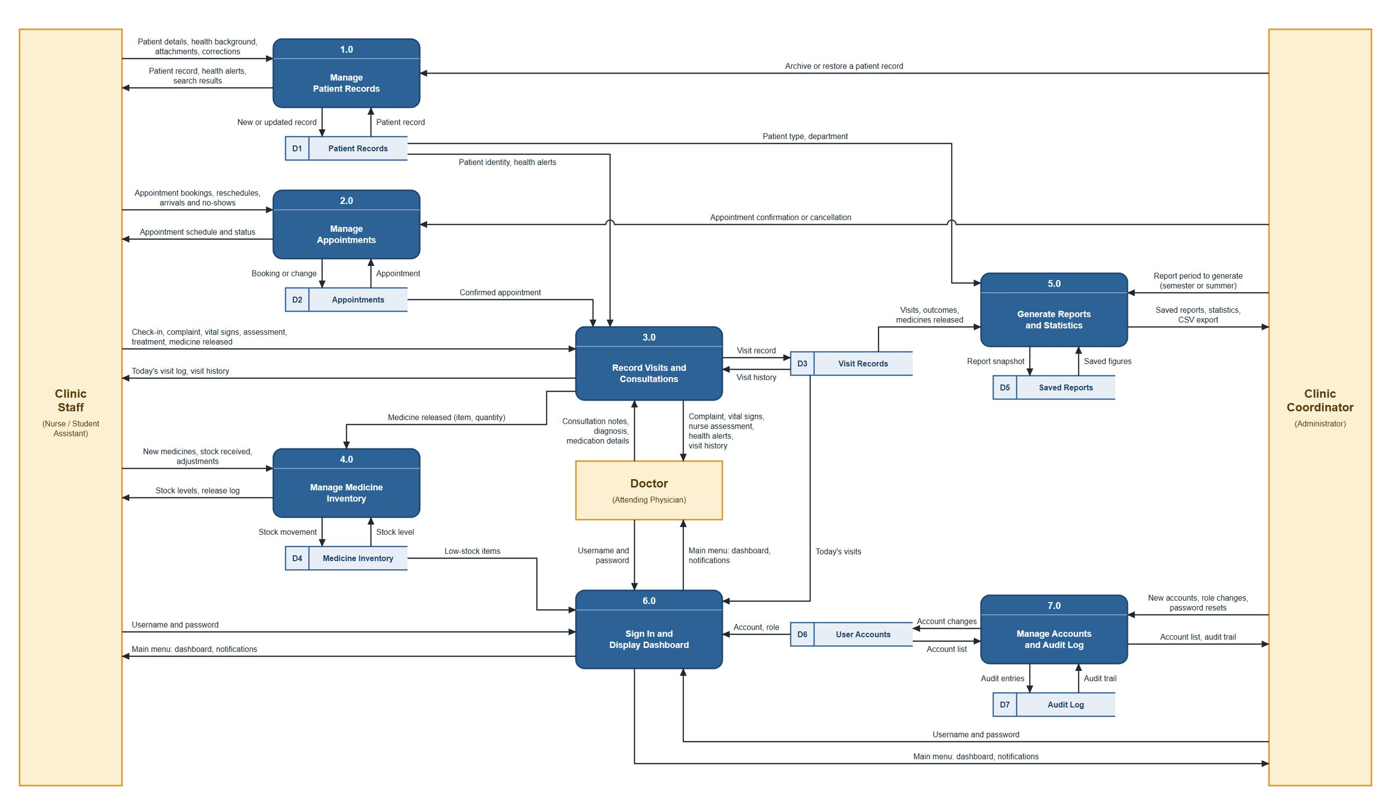
Level 1: seven processes, seven data stores
Level 1 data flow diagram
7
processes, from patient records to accounts and audit
7
data stores, one for each kind of record
Every change is written to the audit log.
Notes:
Now we open that single process. The Level 1 data flow diagram has seven processes and seven data stores. Follow one example: when a nurse releases medicine during a visit, process 3 sends it to process 4, which takes it off the stock and records the movement. Every process that changes a record also writes to the audit log.

Slide 10
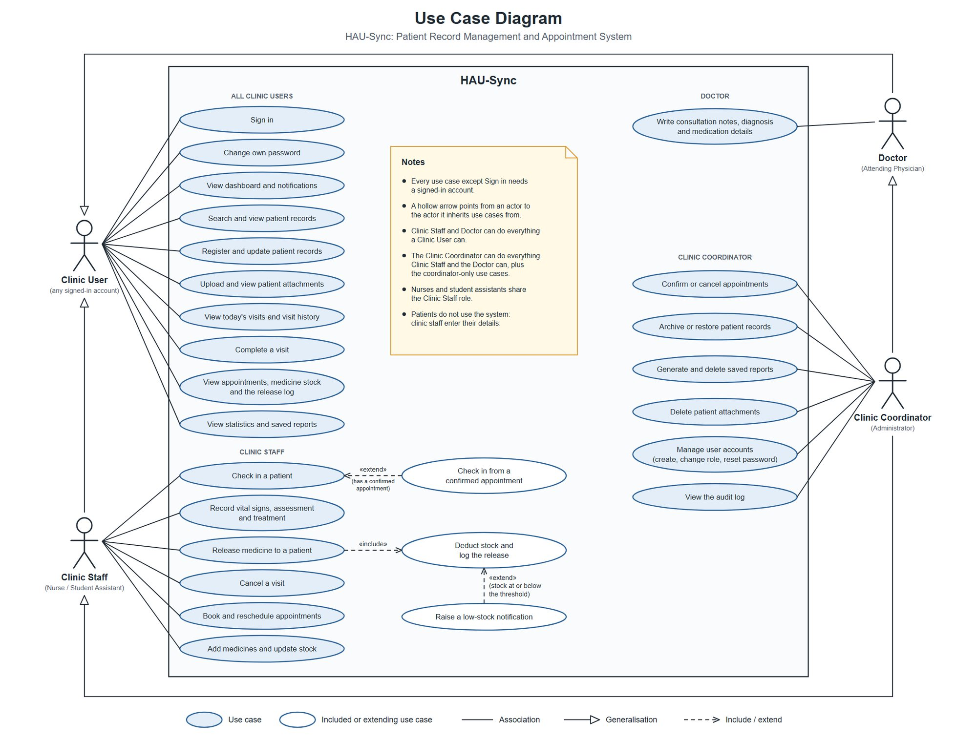
Each role does only what its work needs
Use case diagram
Clinic staff
Check in and record visits
Release medicine
Book appointments and issue kits
Doctor
Consultation notes and diagnosis
Complete a visit
Coordinator
Confirm or cancel appointments
Accounts and audit log
Archive and restore patients
Notes:
The use case diagram answers one question: who is allowed to do what? Clinic staff check patients in, record visits, release medicine and book appointments. The doctor writes the consultation notes and diagnosis. The coordinator can do all of that, and also confirms appointments, manages accounts and reads the audit log. Each person only sees and does what their work needs.

Slide 11
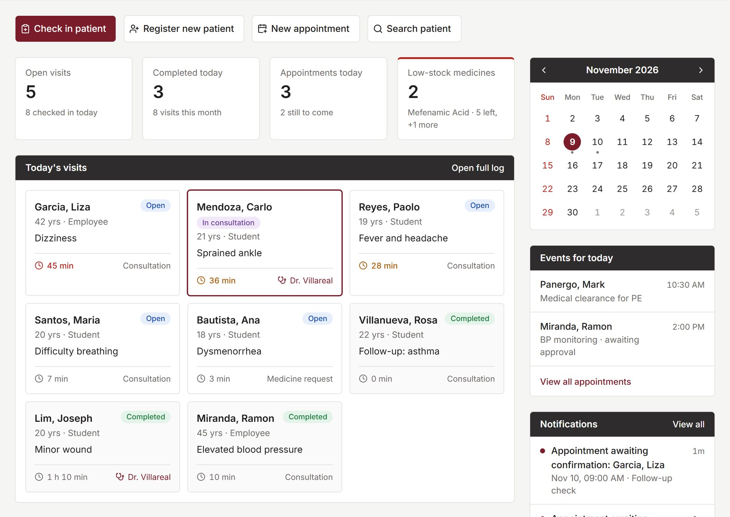



The clinic's whole day on one screen
Clinic Main Menu
The day at a glance
Open visits, appointments and low-stock medicines
Live on every station
A check-in appears everywhere with no refresh
Alerts that find you
Low stock, overdue kits and appointment decisions
All data shown is made up for this demonstration.
Notes:
This is the dashboard, the first screen after signing in. All the data you see here is made up for this demonstration. It shows open visits, today's appointments, medicines running low and the latest notifications. It updates live: when the front desk checks in a patient, the nurse and the doctor see it right away without refreshing.

Slide 12
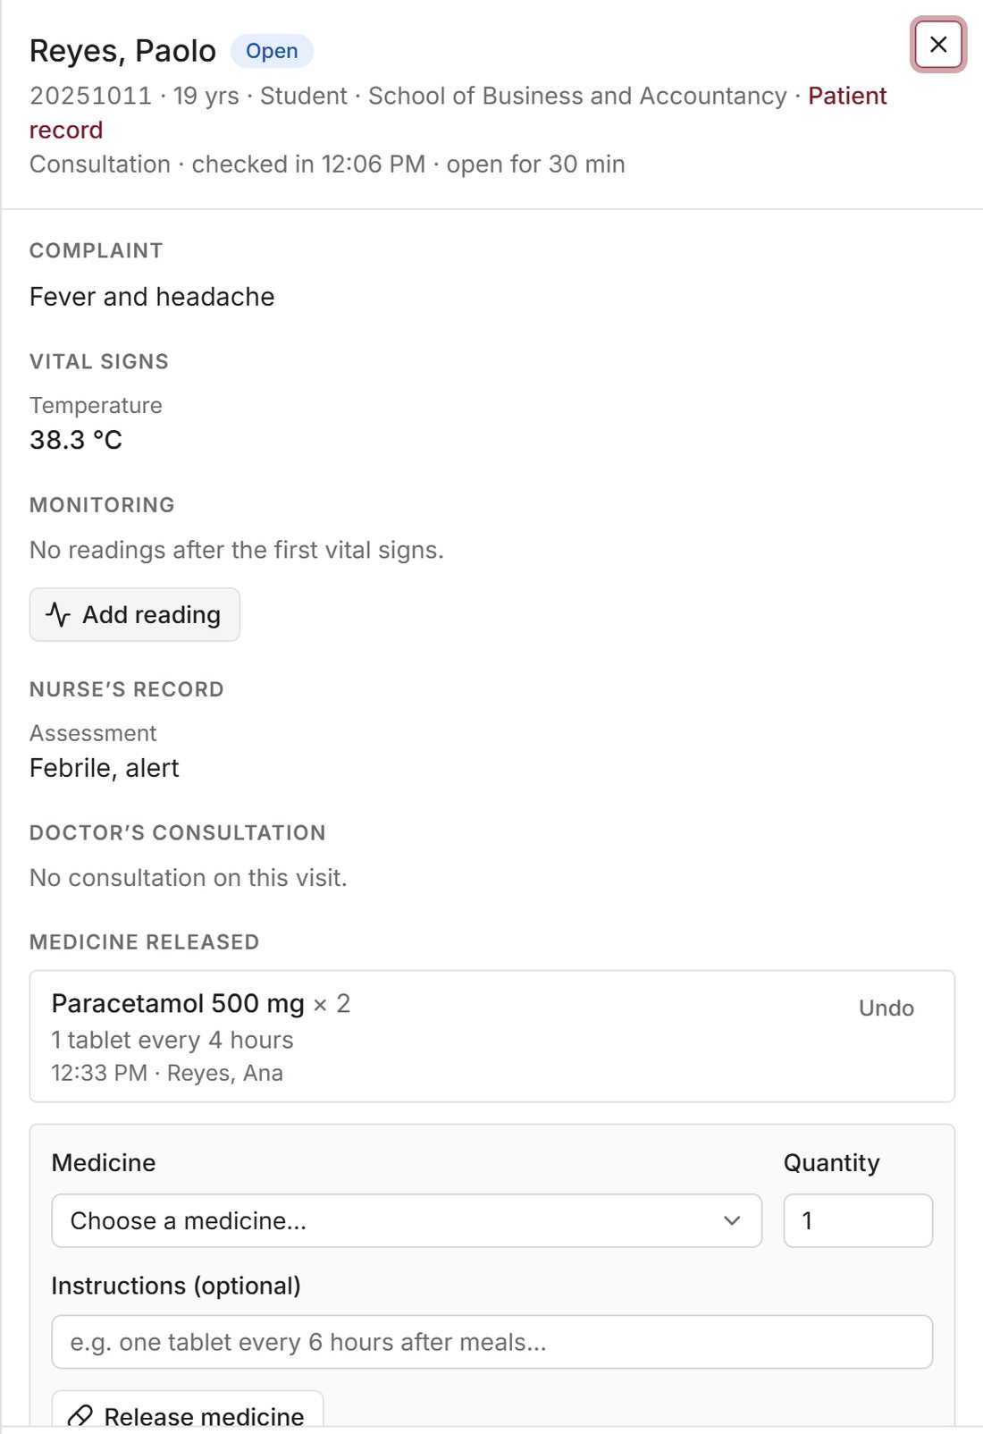
From arrival to record, with nothing handed over
One visit, one record
1
Check in
Search by name or ID, tap a common complaint
2
Nurse records
Vital signs, assessment, treatment, medicine released
3
Doctor consults
Notes and diagnosis on the same visit
4
Complete
Becomes part of the patient's permanent history
Impossible values refused
such as SpO2 of 120%
No overwriting
a record being edited is locked
Notes:
When a patient walks in, staff search by name or ID number, tap a common complaint and check them in. That opens one visit record. The nurse enters vital signs, assessment and treatment. The system refuses impossible values, like an oxygen level of 120 percent. The doctor opens the very same visit and adds the consultation. While one person is editing, the system tells the others, so nobody overwrites anyone's work.

Slide 13
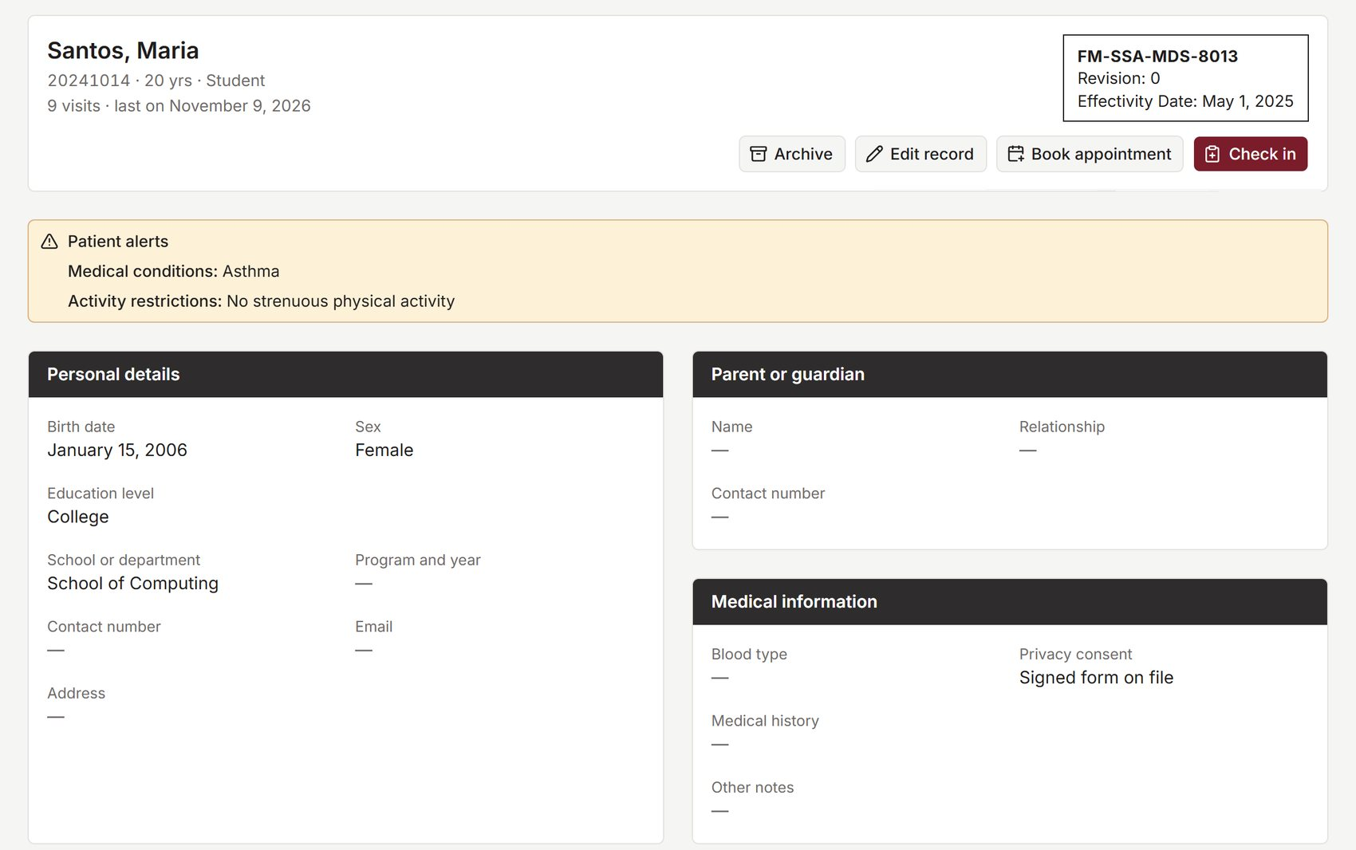



Every patient has one record, alerts first
Patient record
Alerts come first
Allergies, conditions and restrictions on top
Three kinds of patient
Students, employees, and others such as visitors
Files and form codes
Attachments and the clinic's ISO form codes
Archived, never deleted
The history is always kept
Notes:
Every patient has one record. At the very top the system shows allergies, health conditions and restrictions, so staff see the warnings before anything else. Below that are the details and the full visit history. Staff can attach files such as a lab result. Patients are never deleted. A record that is no longer needed is archived, and the coordinator can restore it.

Slide 14
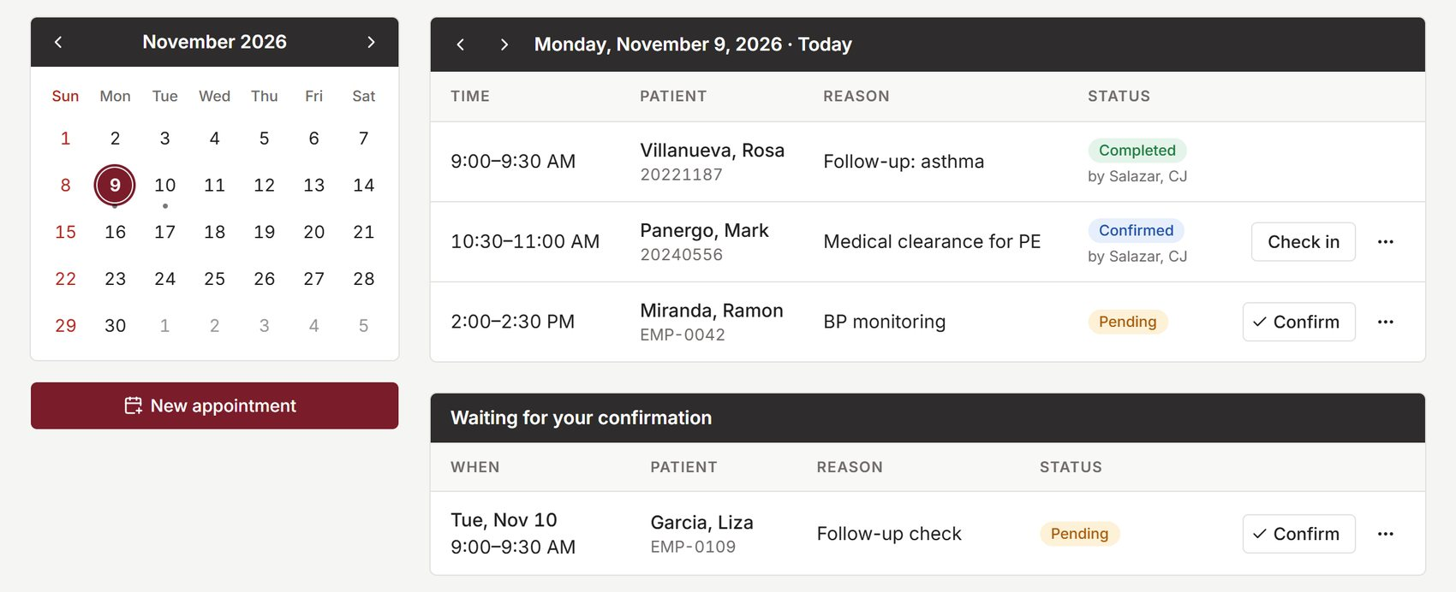


Appointments wait for the coordinator
Appointments
Book and move
Staff schedule and reschedule
Coordinator decides
Only the coordinator confirms or cancels
One tap on arrival
Check-in opens the visit record
Pending
Confirmed
Checked in
Notes:
Staff can book an appointment and move it to another day. A new appointment starts as pending, and only the coordinator confirms or cancels it. When the patient arrives, one tap checks them in and opens the visit. A patient whose appointment is still pending can still be checked in as a walk-in.

Slide 15
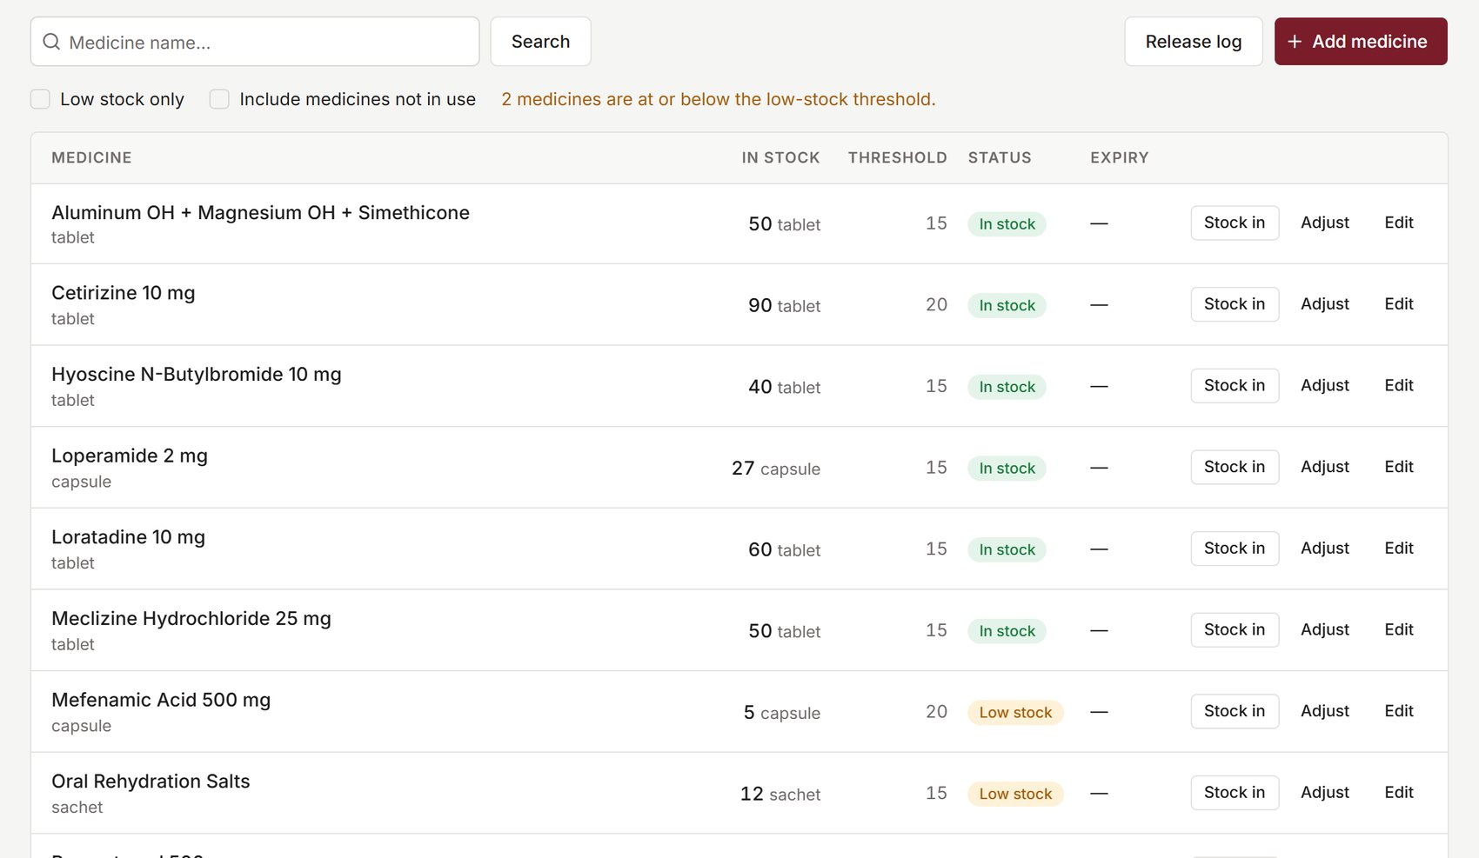



Medicine stock keeps its own count
Medicine inventory
Deducted on release
Stock drops the moment medicine is given
Cannot go short
Refused, with how many are left
Low-stock warning
Sent when a medicine reaches its threshold
Every release logged
Who, what, and for which visit
Notes:
For medicine, the system keeps count for the clinic. When a nurse releases medicine during a visit, the stock goes down by itself. If there is not enough, the system refuses and says how many are left. When a medicine runs low, the system warns the staff. And every release goes into a log, so the clinic can always see where the medicine went.

Slide 16
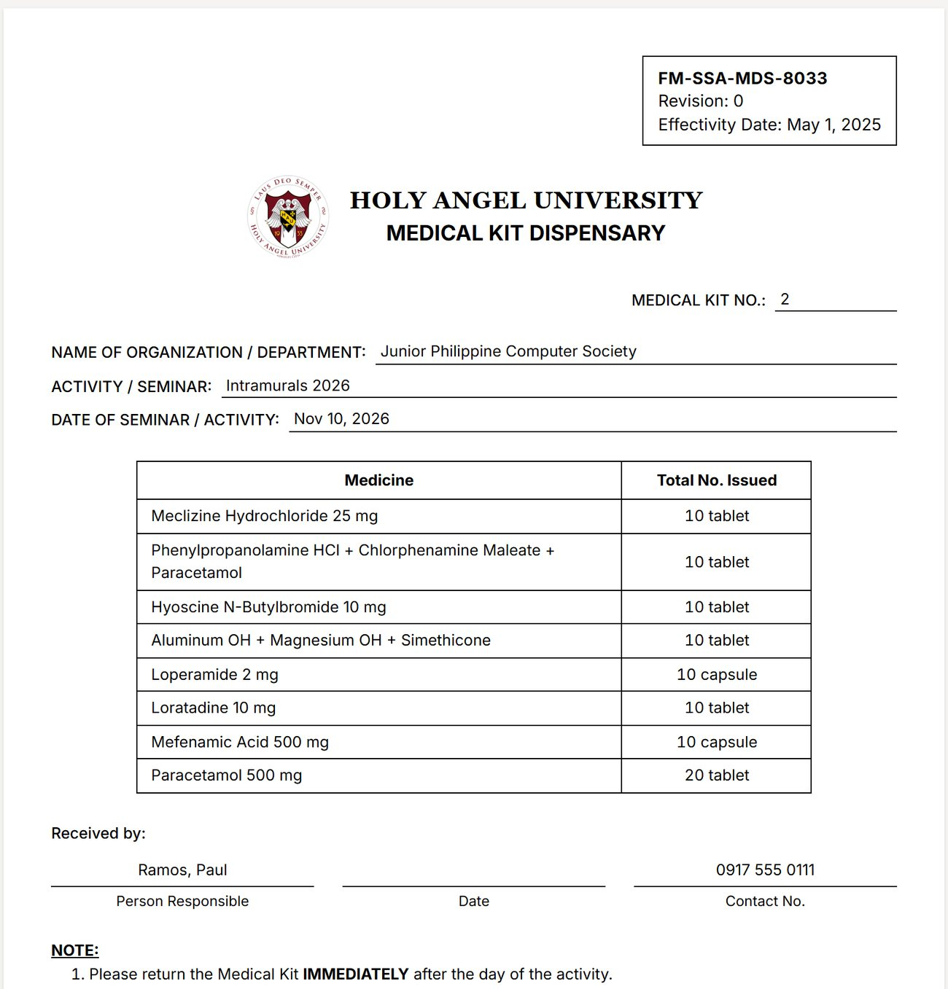




Medical kits: asked for by the clinic
Printable form FM-SSA-MDS-8033
Request
Form FM-SSA-MDS-8032. Nothing leaves the stock yet.
Issue
Items leave the same stock. If one is short, nothing moves.
Take back
Each item is counted. What returns goes back to stock.
Overdue or lost
Flagged automatically, with one notification per kit.
Notes:
This feature came straight from the clinic. At our 19 October session they told us they lend numbered medical kits to organizations for their activities. So we built the whole flow from their own forms: a request, then issuing the kit from the same medicine stock, then counting what came back. A kit that does not return is marked lost, and an overdue kit is flagged. The system also prints the clinic's dispensary form, ready for signing.

Slide 17
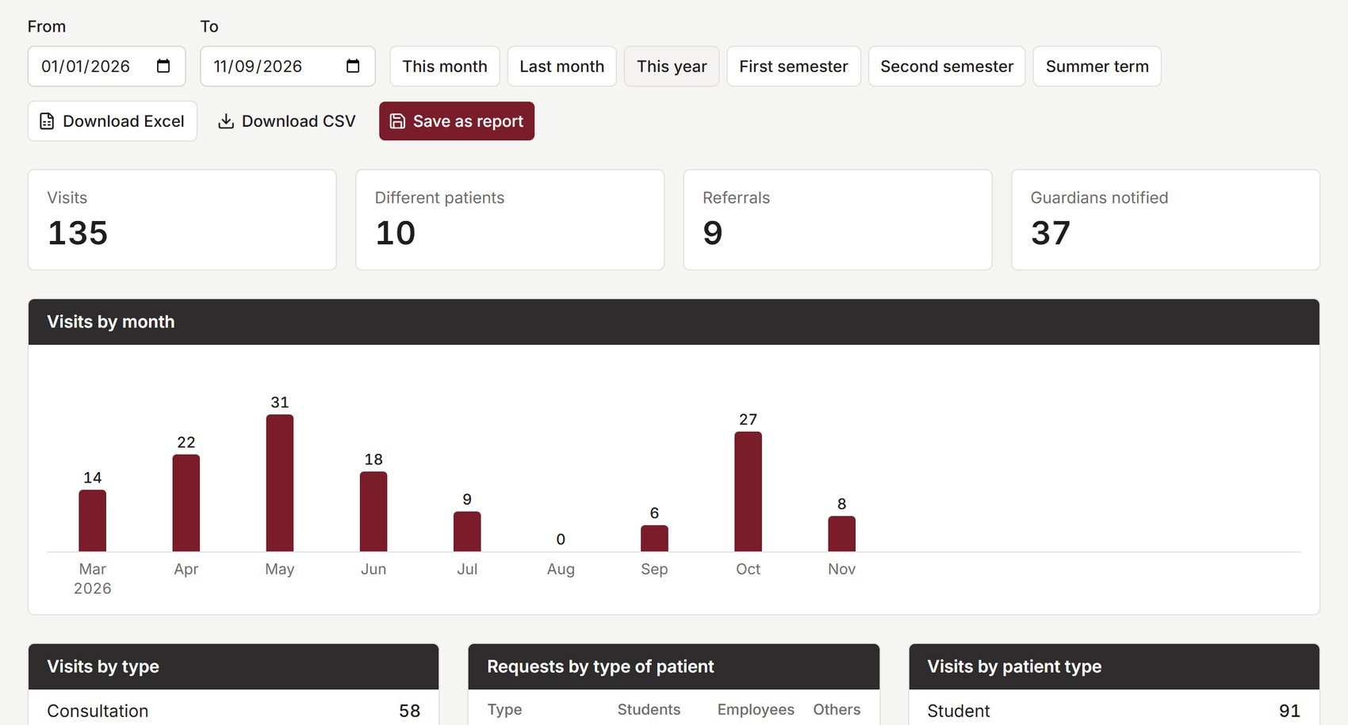



A semester report in a few clicks
Reports
Any period
Month, semester, summer term or custom
The clinic's own tally
Each request split by students, employees and others
Excel with letterhead
University seal and formatted tables, CSV too
Notes:
The clinic submits reports every semester. Before, someone counted everything by hand. Now staff choose a period, such as a month, a semester or the summer term, and the system shows the numbers: how many visits, what kind, from which department, and the most common complaints. It splits each type of request by students, employees and others, which is the tally the clinic submits. It downloads as an Excel file with the university letterhead, or as CSV.

Slide 18




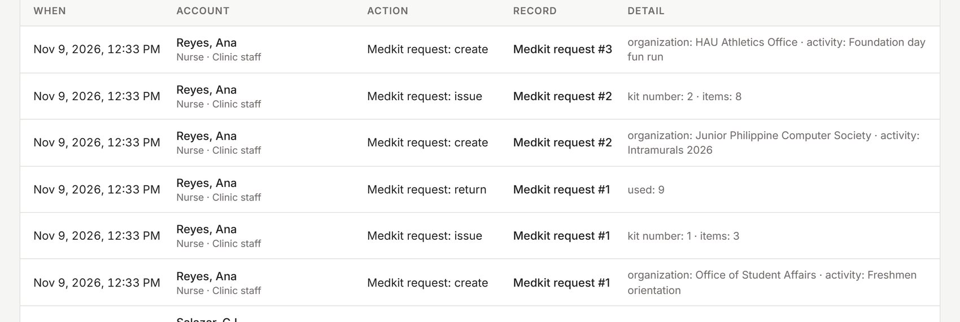
Privacy is a main feature, not an extra
Stays in the clinic
Access by role
Every view is audited
Signs itself out
Runs on the clinic's own network
Passwords are hashed, every route is checked
Who saw or changed what, by name and role
After an hour left unused
Audit log
Republic Act No. 10173
Data Privacy Act of 2012
The clinic calls the patient record its legal basis, so records are kept and every access is traceable.
Notes:
Because this is health information, we treated privacy as a main feature. The data stays in the clinic, on the clinic's own network. Access depends on your role. Every time someone views or changes a patient's record, it is written in an audit log, by name and role, that the coordinator can read. And a station left unused for an hour signs itself out. All of this is in keeping with the Data Privacy Act of 2012.

Slide 19



One server, one address for every station
Front desk
Database
HAU-Sync server
SQLite or PostgreSQL
Nurse station
Serves the screens and the API from the clinic's own computer, and pushes live updates to every station.
Files and backups
Doctor's office
Zip archives on request
Screens
Backend
Security
Live updates
React 19, TypeScript, Tailwind CSS, TanStack Query
Python, FastAPI, SQLAlchemy 2, Alembic
JWT sign-in, bcrypt hashes, role-based access
One WebSocket per signed-in station
Notes:
Here is how it works behind the screen. What you see in the browser is built with React and TypeScript. The backend keeps the rules and the data, built with Python and FastAPI. At the clinic, one computer acts as the server, and every station simply opens one address in its browser. The server pushes live updates over WebSockets, which is why a change on one screen appears on the others.

Slide 20
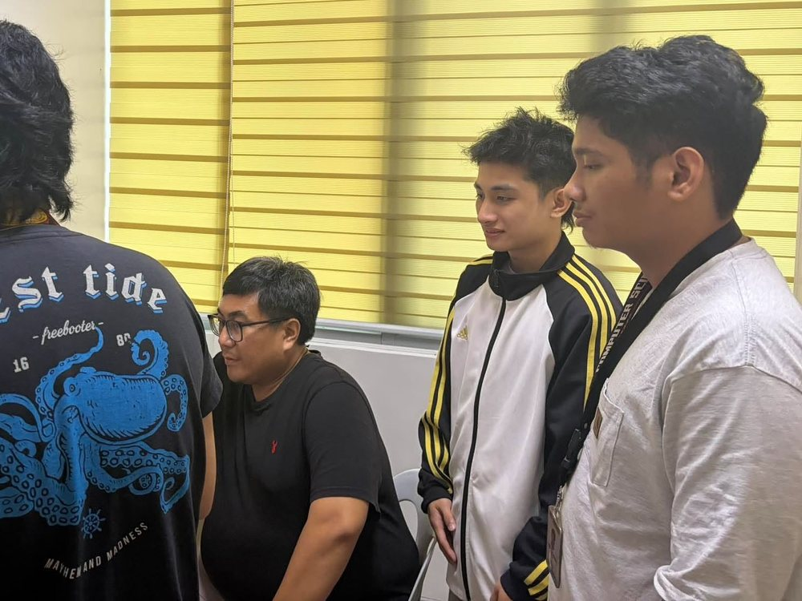
The clinic shaped it, one review at a time
Then: the pilot
30 Sep
7 Oct
13 Oct
19 Oct
Interview
Review 1
Review 2
Review 3
At the clinic, first review
Seven changes from the 19 October review, all built
Medical kit loans
Excel reports with letterhead
Archive page
Others patient type
Audit log by name and role
Blood pressure in one box
Corrected form codes
Notes:
We followed the Agile model: we built in small parts, showed each part to the clinic, and changed it based on what they said. After the first interview we held three review sessions at the clinic. At the last one, on the 19th of October, the student assistants tried it and asked for seven changes. All seven are built: the medical kit, Excel reports, the archive page, a new patient type for visitors, audit entries by name, blood pressure typed in one box, and the corrected form codes.

Slide 21
We tested it by trying to break it
Things we tried, and the system refused
111
350
A second open visit for the same patient
backend tests, all passing
screen tests, all passing
Releasing more medicine than is in stock
Issuing a kit when one item is short
A doctor checking in, or a nurse confirming
76
57
An oxygen reading of 120%
Editing a record someone else has open
screen loads across 4 accounts, no errors
workflow and rule checks, every rule held
Uploading an .exe file as an attachment
Every feature in the project paper is built, except the urgent-case queue, which the team left out.
Notes:
We do not just hope the system works. 461 automated tests run whenever we change the code: 111 for the backend and 350 for the screens. Before this presentation we also opened every screen as every role, 76 page loads with no errors, and ran 57 checks through the real workflows, including trying to break the rules. Every rule held. One thing to be open about: every feature in our project paper is built except the urgent-case queue, which the team decided to leave out.

Slide 22
Next: a pilot at the clinic
1
Clear the demo data
2
Install on the clinic's server
To tighten during the pilot
Made-up records, accounts and backups removed
Production mode with its own secret key
A limit on repeated sign-in attempts
Encrypted connections on the clinic network
The real form code for Others patients
Off-site copies of the daily backups
3
Create real accounts
4
Load the clinic's stock
Each person changes their password at first sign-in
Its medicines, numbered kits and kit contents
5
Schedule daily backups
6
Use it and listen
Copied to another drive
Real days at the clinic, then another round of changes
Notes:
After this presentation, the system moves to a pilot at the clinic. We clear all the demonstration data, install it on the clinic's computer in production mode, and create the real accounts. The clinic adds its medicines and kits, daily backups are scheduled, and then the staff use it on real days and tell us what to change. We have already rehearsed this on an empty database. We also know what to tighten during the pilot, which is listed on the right.

Slide 23
Thank you
One shared record: faster to use, easier to search, and safer for patient information.
With thanks to the Holy Angel University Clinic and Prof. Evicen Flores
Notes:
To sum up: HAU-Sync replaces the clinic's paper with one shared record that is faster to use, easier to search, and safer for patient information. We would like to thank the Holy Angel University Clinic for their time and support, and Prof. Evicen Flores for guiding us. Thank you, and we welcome your questions.

