Slide 1

Herm0ni Chess Bot Seán Rourke C00251168
(Vecteezy, n.d.)
Final Year Project Presentation

Slide 2
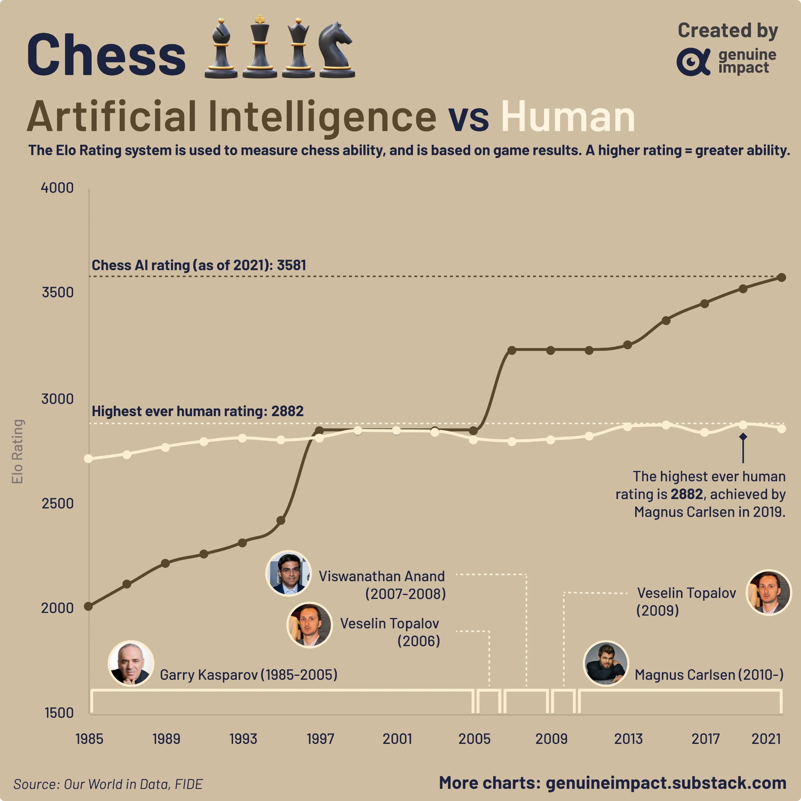

AI in Chess First implemented in as early as 1912 First fully automated engine created in 1957 Surpassed human ability in 1997 Current estimated Elo of 3642 Highest human Elo is 2882
Ai and Human Elo over time (Genuine Impact, 2023)

Slide 3


Practicing with AI
Over 100 different bots on Chess.com
Vast majority require a paid subscription
Large skill gaps between free bots

Slide 4



The Herm0ni Bot
Multiple levels of difficulty
Free to play on lichess.org
Play against users for fun or practice
Play against other bots
Artificial Intelligence and Chess: An Evolving Landscape
(Deverell, 2023)

Slide 5
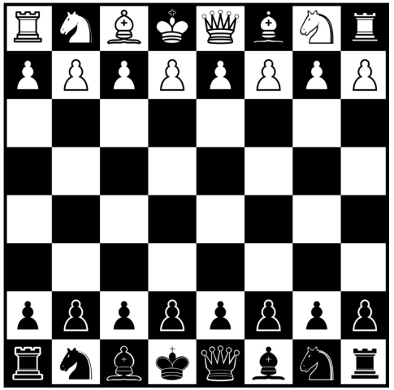

Design
Calculate moves using minimax algorithm with alpha-beta pruning
Track positions using bitboards
Implement Lichess Bot API

Slide 6



Technologies C++ Lichess Bot API (Python) UCI (JSON)

Slide 7


Additional Features Use of opening books Use of endgame tablebases

Slide 8


Questions

Slide 9
References
Deverell, J., 2023. Artificial Intelligence and Chess: An Evolving Landscape. [Online] Available at: https://www.regencychess.com/blog/artificial-intelligence-and-chess-an-evolving-landscape/ [Accessed: 24/10/2024].
Genuine Impact (2022). AI vs human chess Elo ratings over time. Available at: https://www.reddit.com/r/dataisbeautiful/comments/113mll8/oc_ai_vs_human_chess_elo_ratings_over_time/ (Accessed 20/10/2024).
Vecteezy, n.d. Vecteezy. [Online] Available at: https://www.vecteezy.com/free-vector/chess-silhouette [Accessed 24 November 2024].

