Slide 1
Neural Networks and Categorization Problems
By
Sean Skwerer

Slide 2
What is a Categorization Problem?
A categorization is an association of subsets of a space S to elements of another space C . Each subset is associated with a unique element.
A separation map transforms from S onto C according to the categorization
Problem: train a neural network to approximate the separation map.

Slide 3
Example One
Use a two layer network and increase the number of nodes in the hidden layer to see the effect on the separation capability of the network
Training Set: 1000 data points, dense to really show the network what the regions are.
Same Training Data used for every case.

Slide 4
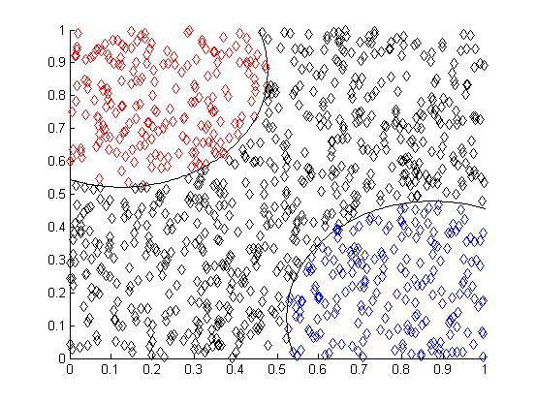
Example One: Training Set

Slide 5
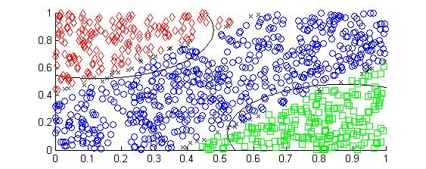
Ex1: 2 Nodes

Slide 6
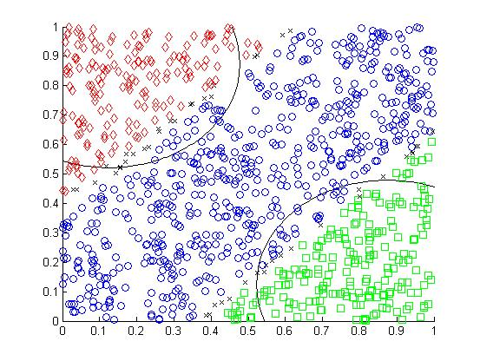
Ex1: 3 Nodes

Slide 7
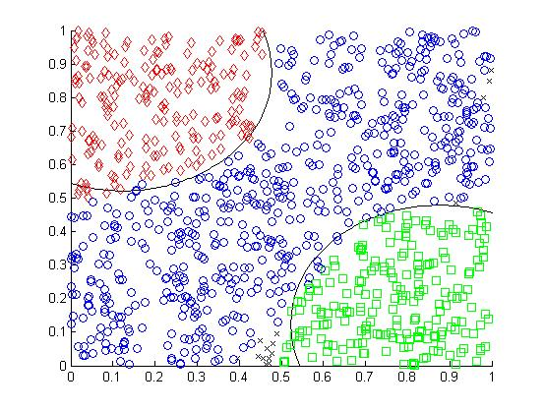
Ex1: 4 Nodes

Slide 8
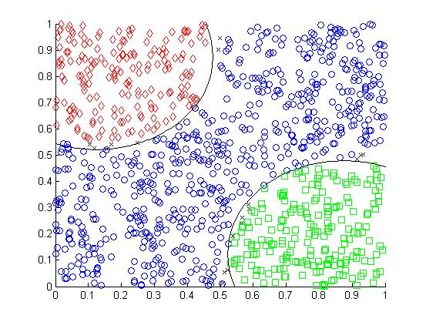
Ex1: 5 Nodes

Slide 9

Ex1: 8 Nodes

Slide 10
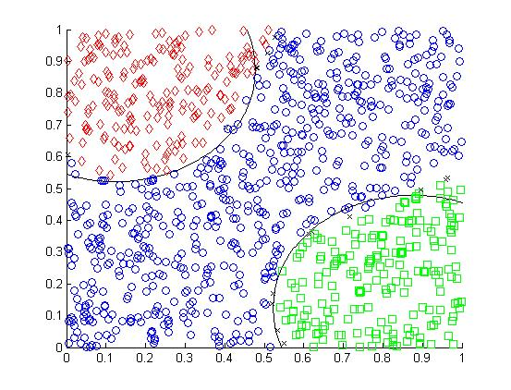
Ex1: 3 Nodes – Good Start

Slide 11
Ex1: Summary Data
Example One
Intermediate Nodes | 2 | 3 | 4 | 5 | 8 | 3 Good Start
Error 100,000 Iterations | 12.7034 | 12.9837 | 7.8815 | 6.5509 | 4.9156 | 8.6136
Error Million Iterations | 12.0145 | 12.0657 | 6.292 | 5.3418 | 3.257 | 6.1972
Points Wrong | 95 | 88 | 21 | 3 | 8 | 19
Points Uncategorized | 31 | 49 | 15 | 18 | 4 | 16

Slide 12
Back-propagation
Why didn’t back-propagation find a good solution the first time?
Back-propagation is a steepest descent optimization algorithm and therefore can get stuck at local minima.
The error function is probably very complicated and has many local minima

Slide 13
Example Two
Same idea as example one except that the categories have a different shape.
The shape of the data in this example is more complicated so the number of intermediate nodes will be increased faster.

Slide 14
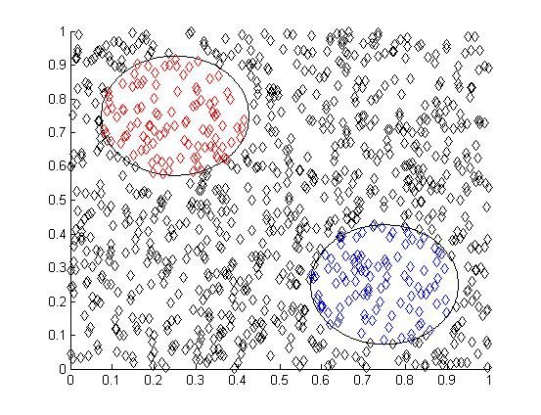
Ex2: Training Set

Slide 15
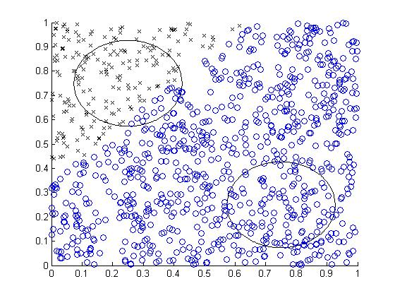
Ex2: Two Nodes

Slide 16
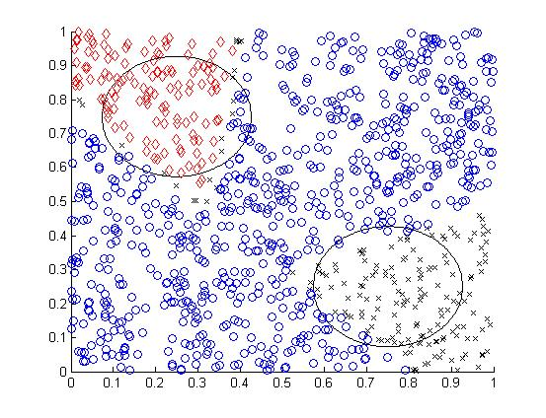
Ex2: Three Nodes

Slide 17
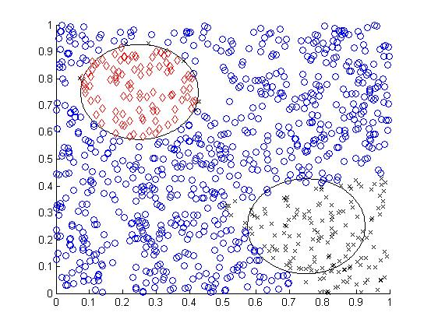
Ex2: Six Nodes

Slide 18
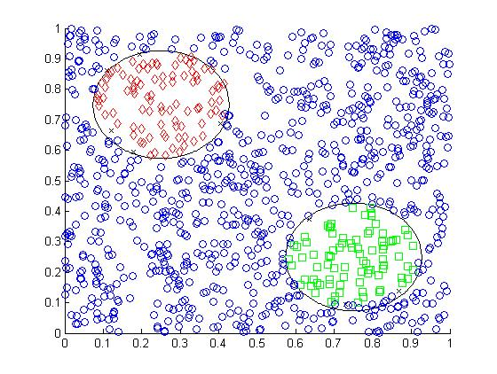
Ex2: Nine Nodes

Slide 19
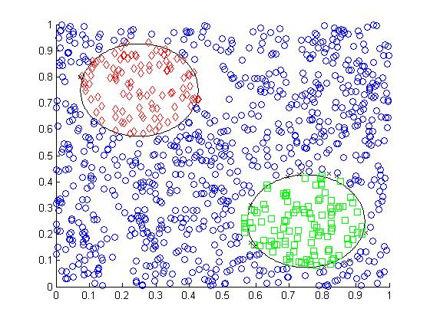
Ex2: Twelve Nodes

Slide 20
Ex2: Summary Data
Example Two
Intermediate Nodes | 2 | 3 | 6 | 9 | 12
Error 100,000 Iterations | 16.0542 | 141,645 | 11.9779 | 11.5367 | 10.7949
Error Million Iterations | 16.0647 | 13.8064 | 10.0904 | 5.5746 | 4.8995
Points Wrong | 117 | 68 | 7 | 15 | 16
Points Uncatagorized | 197 | 177 | 171 | 8 | 13

Slide 21
Example Three
Same idea: increase the number of intermediate nodes .

Slide 22
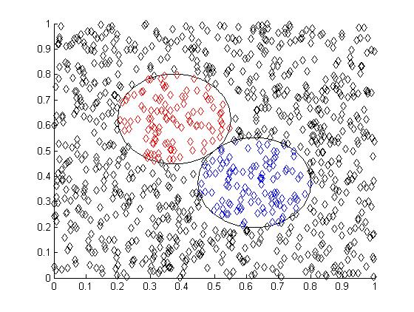
Ex3: Training Set

Slide 23
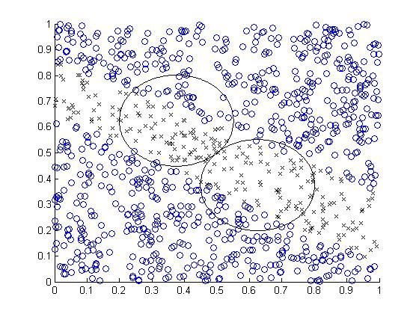
Ex3: Two Nodes

Slide 24
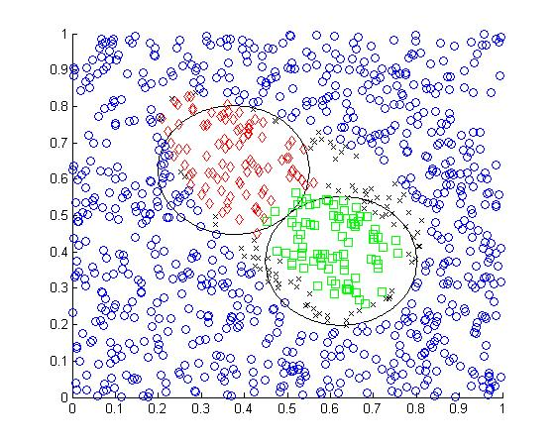
Ex3: Three Nodes

Slide 25
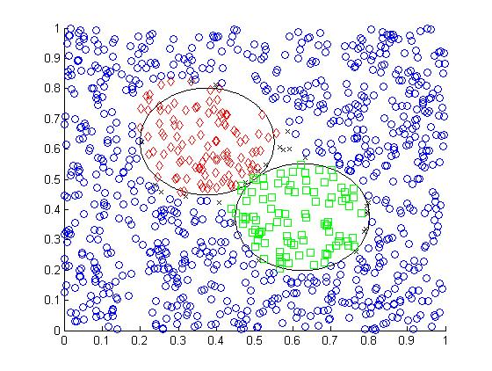
Ex3: Six Nodes

Slide 26
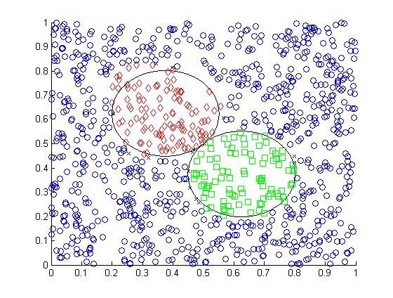
Ex3: Nine Nodes

Slide 27
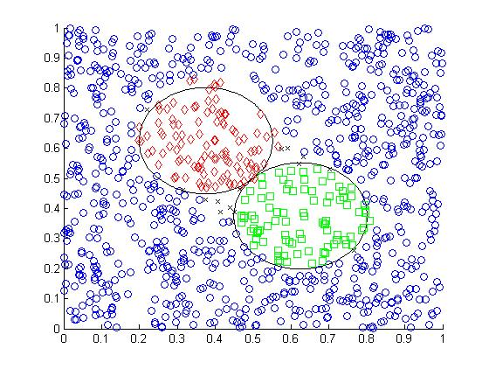
Ex3: Twelve Nodes

Slide 28
Ex3: Summary Data
Example Three
Intermediate Nodes | 2 | 3 | 6 | 9 | 12
Error 100,000 Iterations | 16.4712 | 11.2403 | 7.0033 | 7.7878 | 7.6687
Error Million Iterations | 16.3241 | 10.3637 | 6.5029 | 6.1615 | 6.0394
Points Wrong | 57 | 18 | 17 | 17 | 14
Points Uncatagorized | 235 | 75 | 25 | 16 | 15

Slide 29
Example Four
What are the effects of transforming the data?
The training sets from the three previous examples are used.

Slide 30
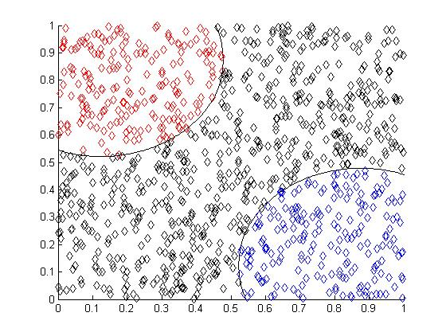
Ex4 A: Training Set

Slide 31
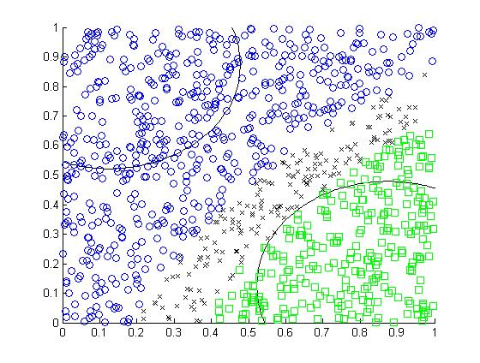
Ex4 A: One Node

Slide 32
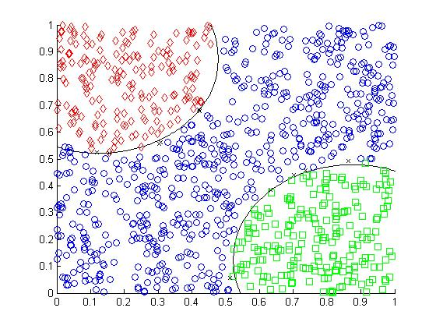
Ex4 A: Two Nodes

Slide 33
Ex4 A: Summary Data
Example Four A
Intermediate Nodes | 1 | 2
Error 100,000 Iterations | 17.5846 | 6.993
Error 500,000 Iterations | 18.4253 | 4.08
Points Wrong | 264 | 4
Points Uncatagorized | 175 | 11

Slide 34

Ex4 B: Training Set

Slide 35
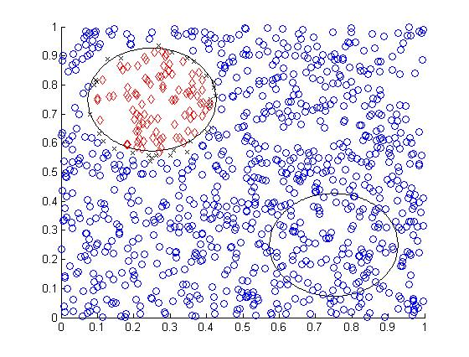
Ex4 B: One Node

Slide 36
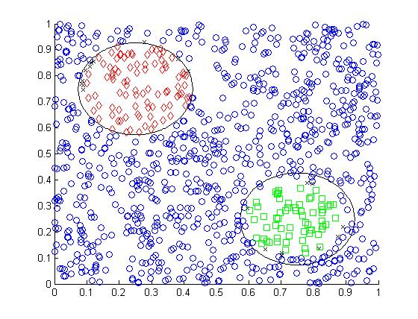
Ex4 B: Two Nodes

Slide 37
Ex4 B: Summary Data
Example Four B
Intermediate Nodes | 1 | 2
Error 100,000 Iterations | 17.1714 | 15.3428
Error 500,000 Iterations | 14.1197 | 7.7818
Points Wrong | 102 | 30
Points Uncatagorized | 31 | 20

Slide 38
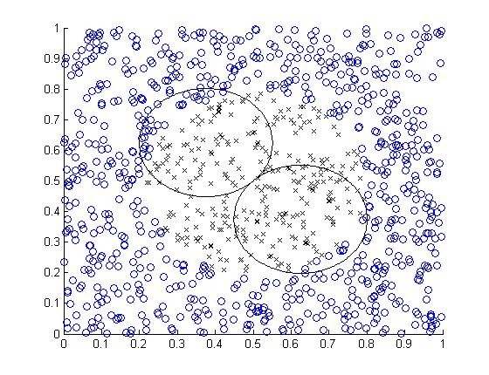
Ex4 C: Training Set

Slide 39
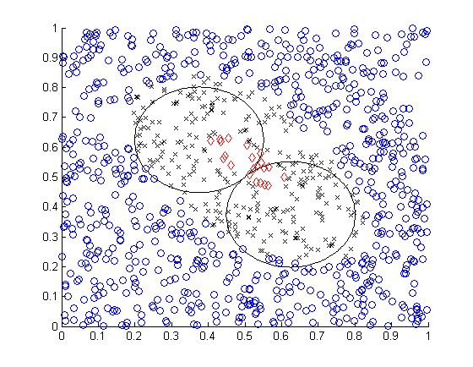
Ex4 C: Two Nodes

Slide 40
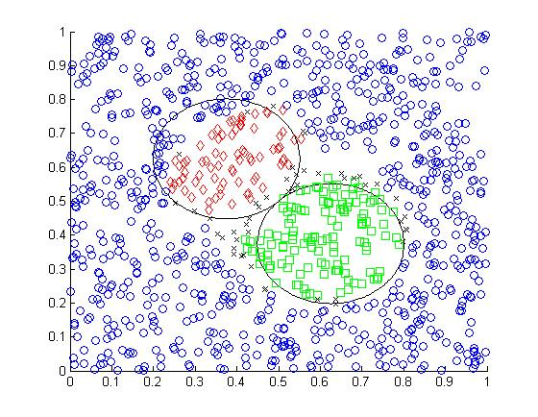
Ex4 C: Two Nodes – Good Start

Slide 41
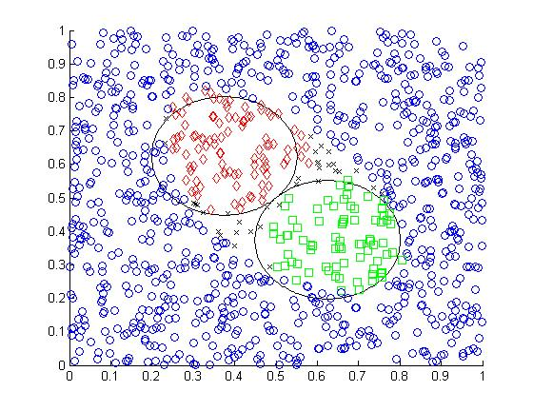
Ex4 C: Three Nodes

Slide 42
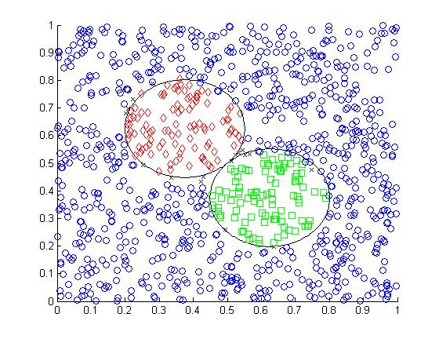
Ex4 C: Ten Nodes

Slide 43
Ex4 C: Summary Data
Example Four C
Intermediate Nodes | 1 | 2 | 3 | 10 | 2- good start
Error 100,000 Iterations | 15.2754 | 13.0401 | 7.7329 | 6.3342 | 11.5733
Error 500,000 Iterations | 15.2254 | 12.8589 | 7.9461 | 4.3988 | 10.0481
Points Wrong | 38 | 17 | 33 | 13 | 38
Points Uncatagorized | 290 | 267 | 30 | 17 | 48

Slide 44
Example Five
Various examples of separation spaces and networks.

Slide 45
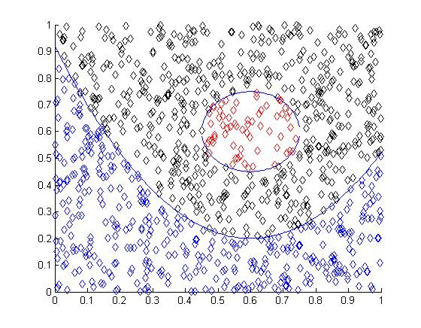
Ex5 A: Training Set

Slide 46
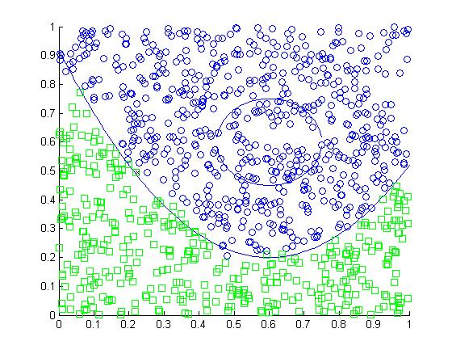
Ex5 A: Six Nodes

Slide 47
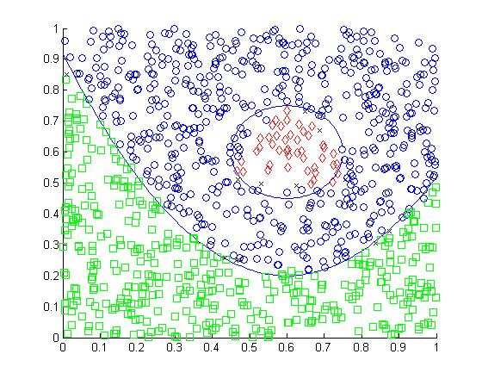
Ex5 A: Six Nodes – Good Start

Slide 48
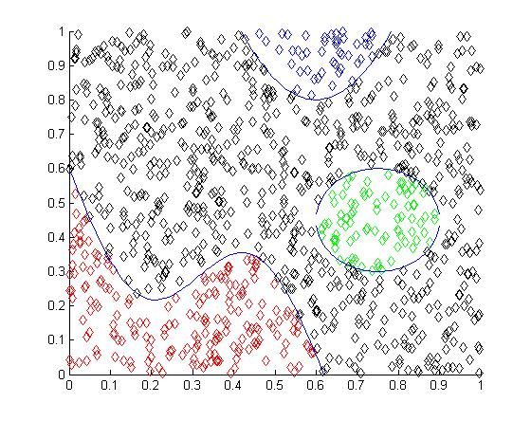
Ex5 B: Training Set

Slide 49
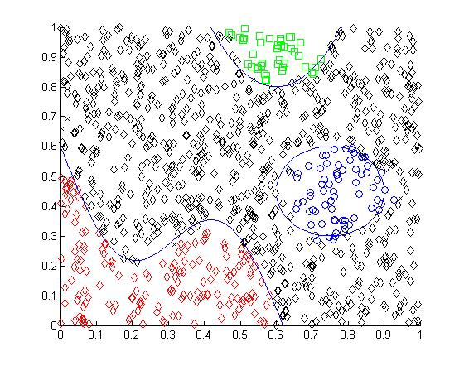
Ex5 B: Ten Nodes

Slide 50
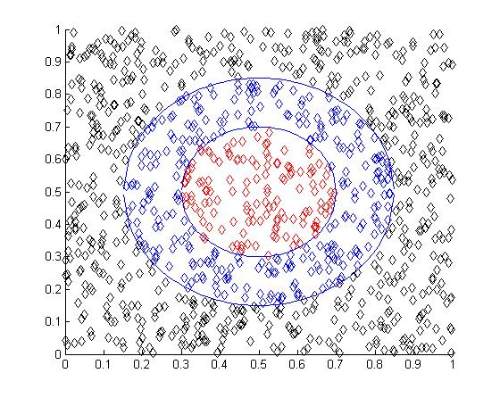
Ex5 C: Training Set

Slide 51
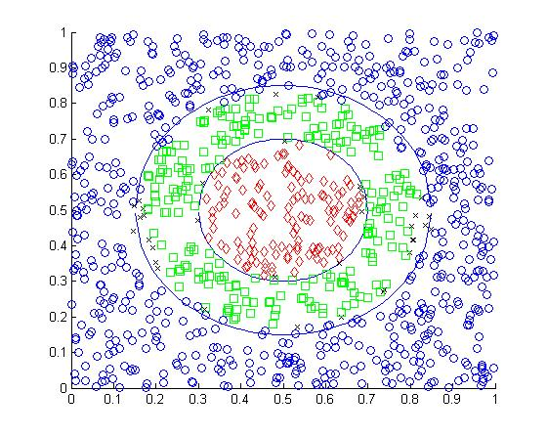
Ex5 C: Four Nodes

Slide 52
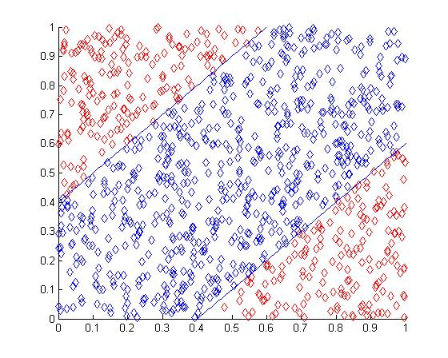
Ex5 D: Training Set

Slide 53
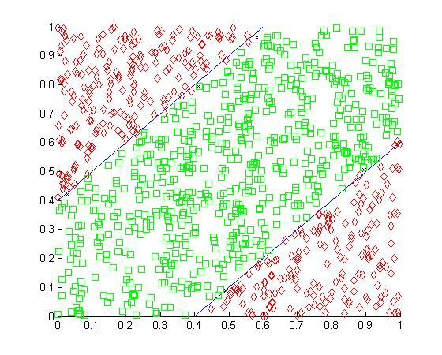
Ex5 D: Six Nodes

Slide 54
Ex5: Summary Data
Example Five
Problem | A | A good Start | B | C | D
Error 100,000 Iterations | 6 | 6 | 10 | 4 | 6
Error 500,000 Iterations | 10.5371 | 8.1414 | 8.7715 | 13.0256 | 4.9493
Error Million Iterations | 10.9076 | 6.3551 | 6.0153 | 9.9428 | 3.3389
Points Wrong | 71 | 22 | 31 | 23 | 8
Points Uncatagorized | 3 | 13 | 8 | 36 | 5

Slide 55
Project Summary
Adding nodes in the hidden layer increases separation capabilities of the network
Transforming the data nonlinearly helps if the category regions have nonlinear ‘boundary’
Sometime back-propagation gets stuck in a bad place.

