Slide 1
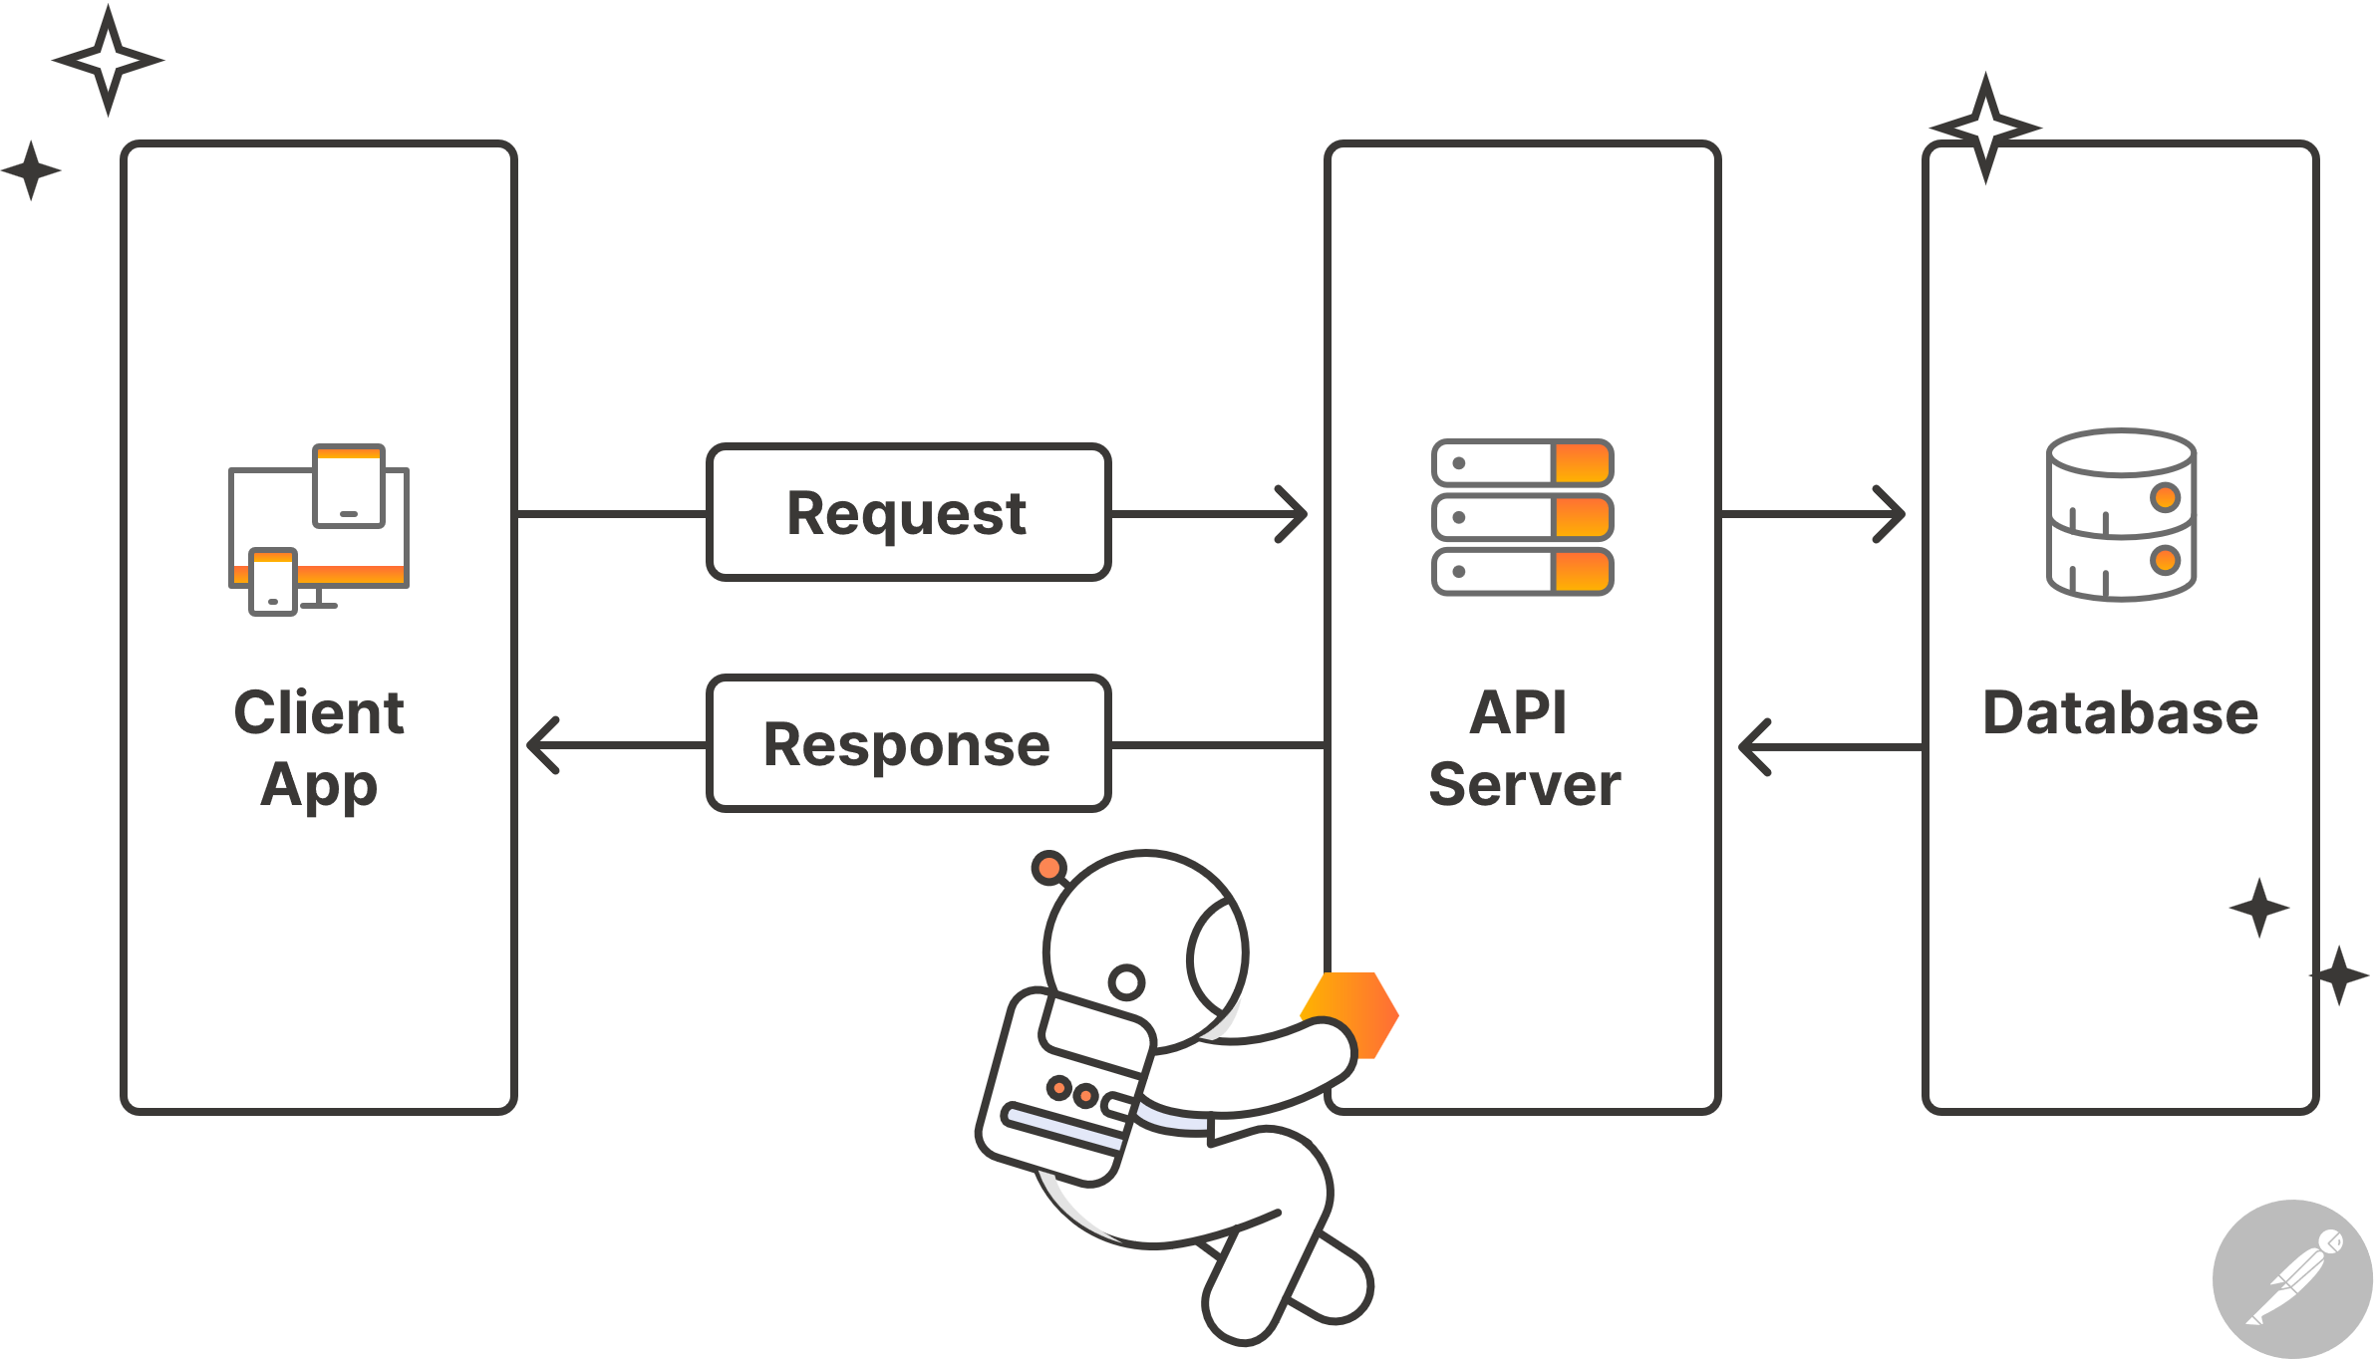


Movie Management System
Introduction
The Movie Database System is a database system that stores all movie title data, which allows users to book tickets for movies they like or want to watch, in which we provide details regarding the official release time of the movie as well as the price for each movie. In addition, we have also created an API with many functions such as add, edit, delete, search, etc.
Database and API Design

Slide 2
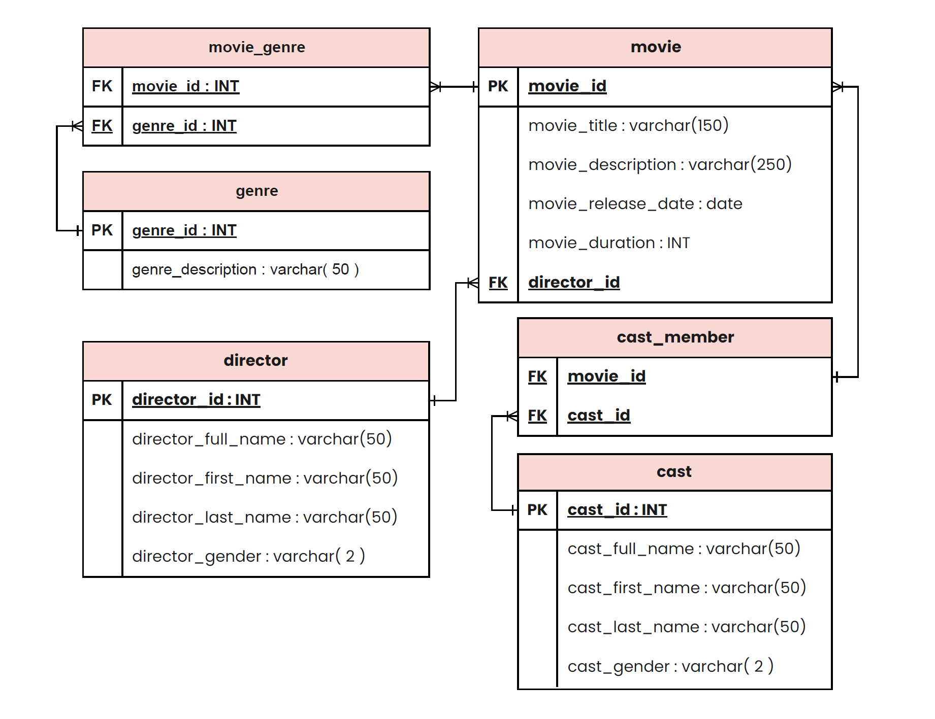
Introduction
ERD Database
The Movie Database System is a database system that stores all movie title data, which allows users to book tickets for movies they like or want to watch, in which we provide details regarding the official release time of the movie as well as the price for each movie. In addition, we have also created an API with many functions such as add, edit, delete, search, etc.

Slide 3
ERD Database

Slide 4
DEMO API

Slide 5

THANK YOU!! FOR YOUR ATTENTIONS

