Slide 1
Predicting Hours Worked and Successful Sales Targets via Sentiment Features: A Supervised Learning Approach
Sean Steinle
University of Pittsburgh, Computer Science and Linguistics 2022

Slide 2

Exploratory Data Analysis

Slide 3
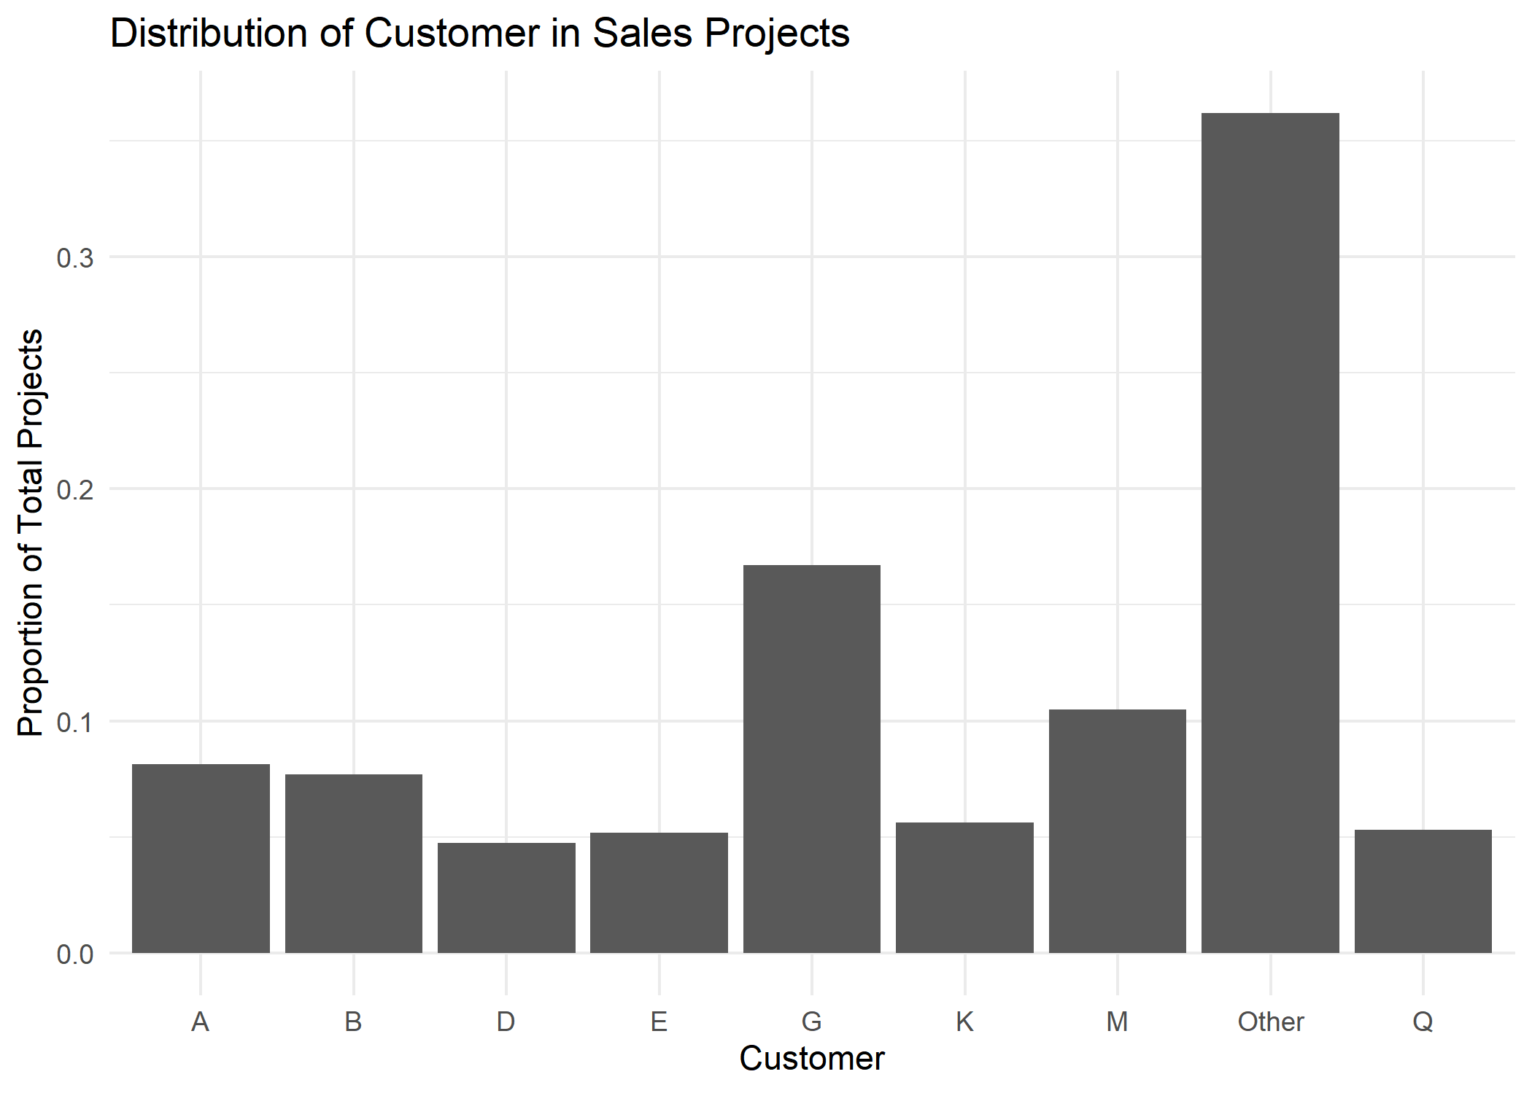
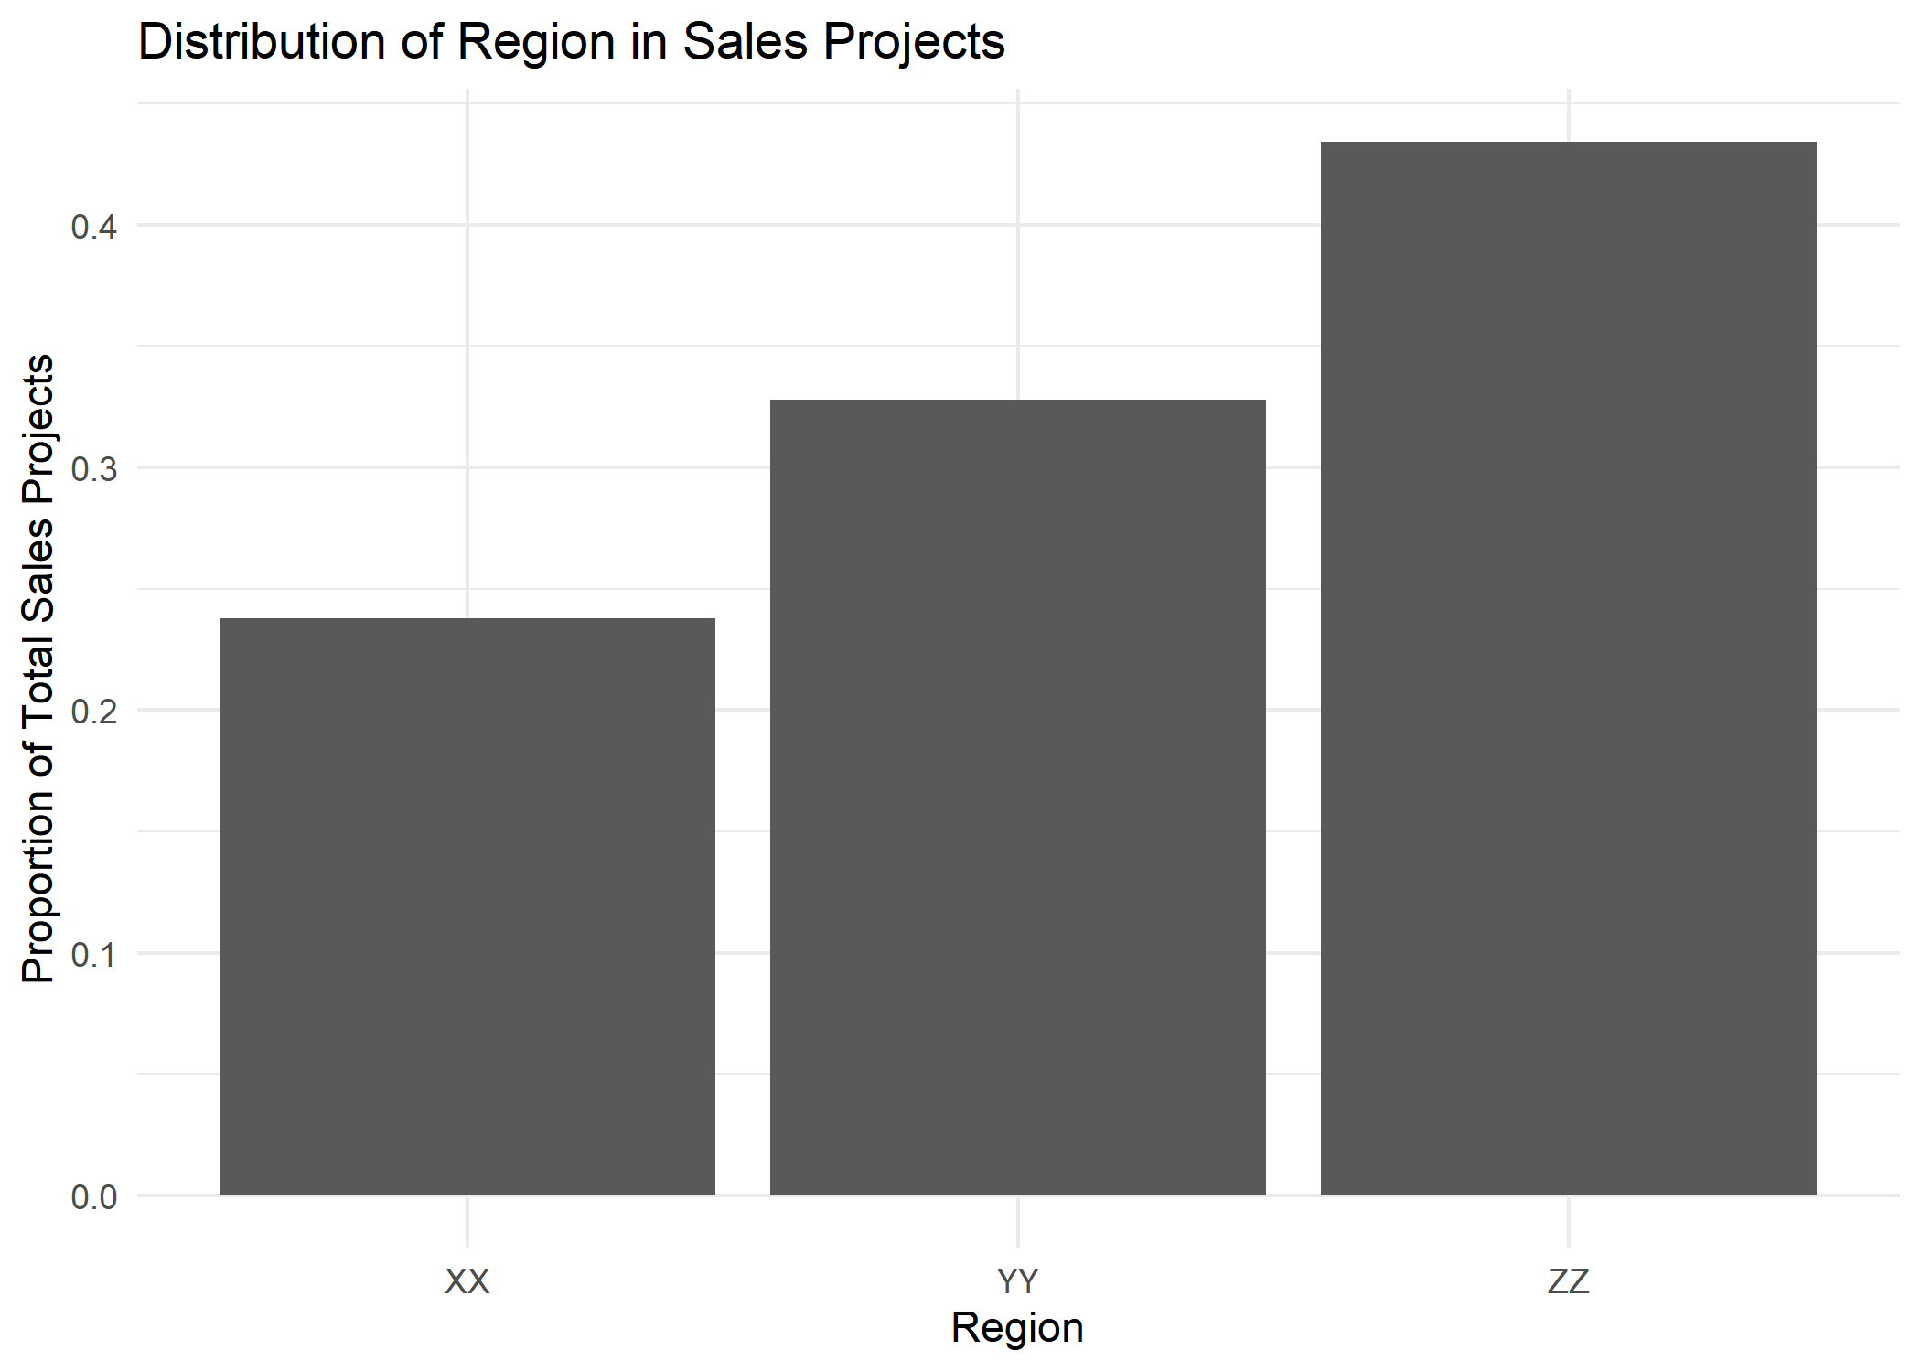
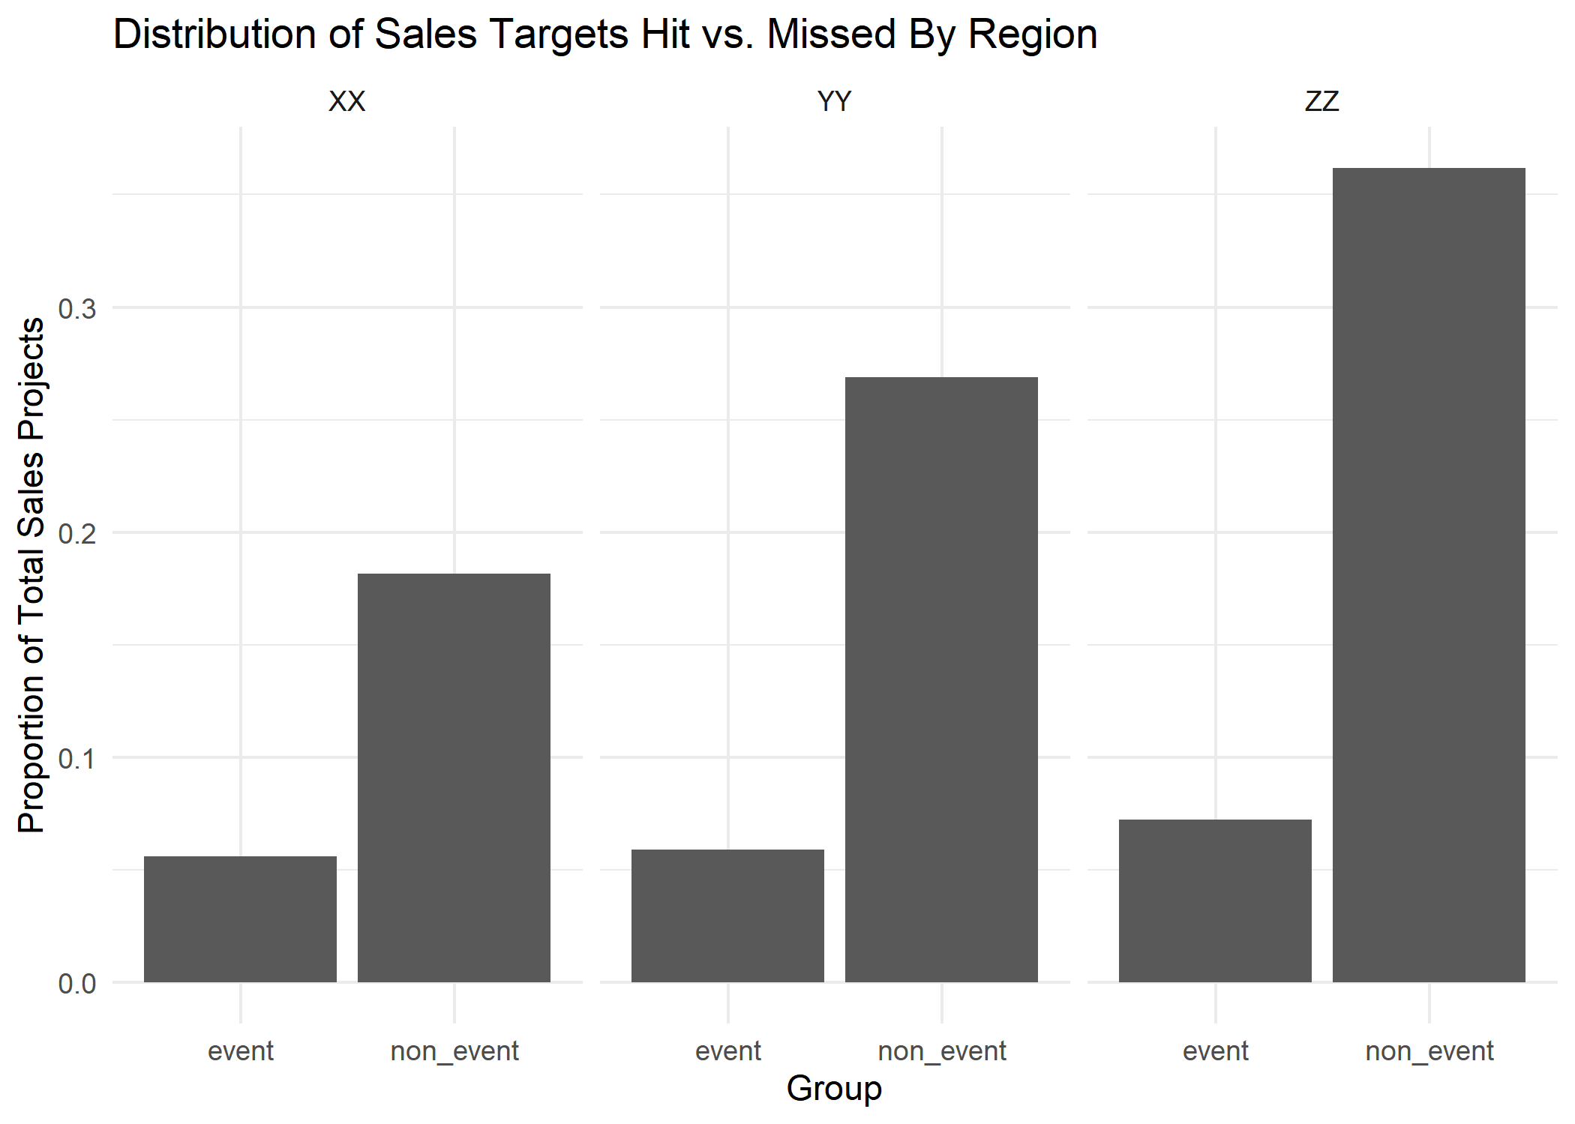
Factors
two factors: region and customer
region: 3 regions of similar sizes
ZZ has highest project success rate, then YY, then XX
customer: 8 main customers and “other”
“other” the largest category, main customers differ in size
customer-region: only some customers in some regions
(K,M only in region ZZ)

Slide 4
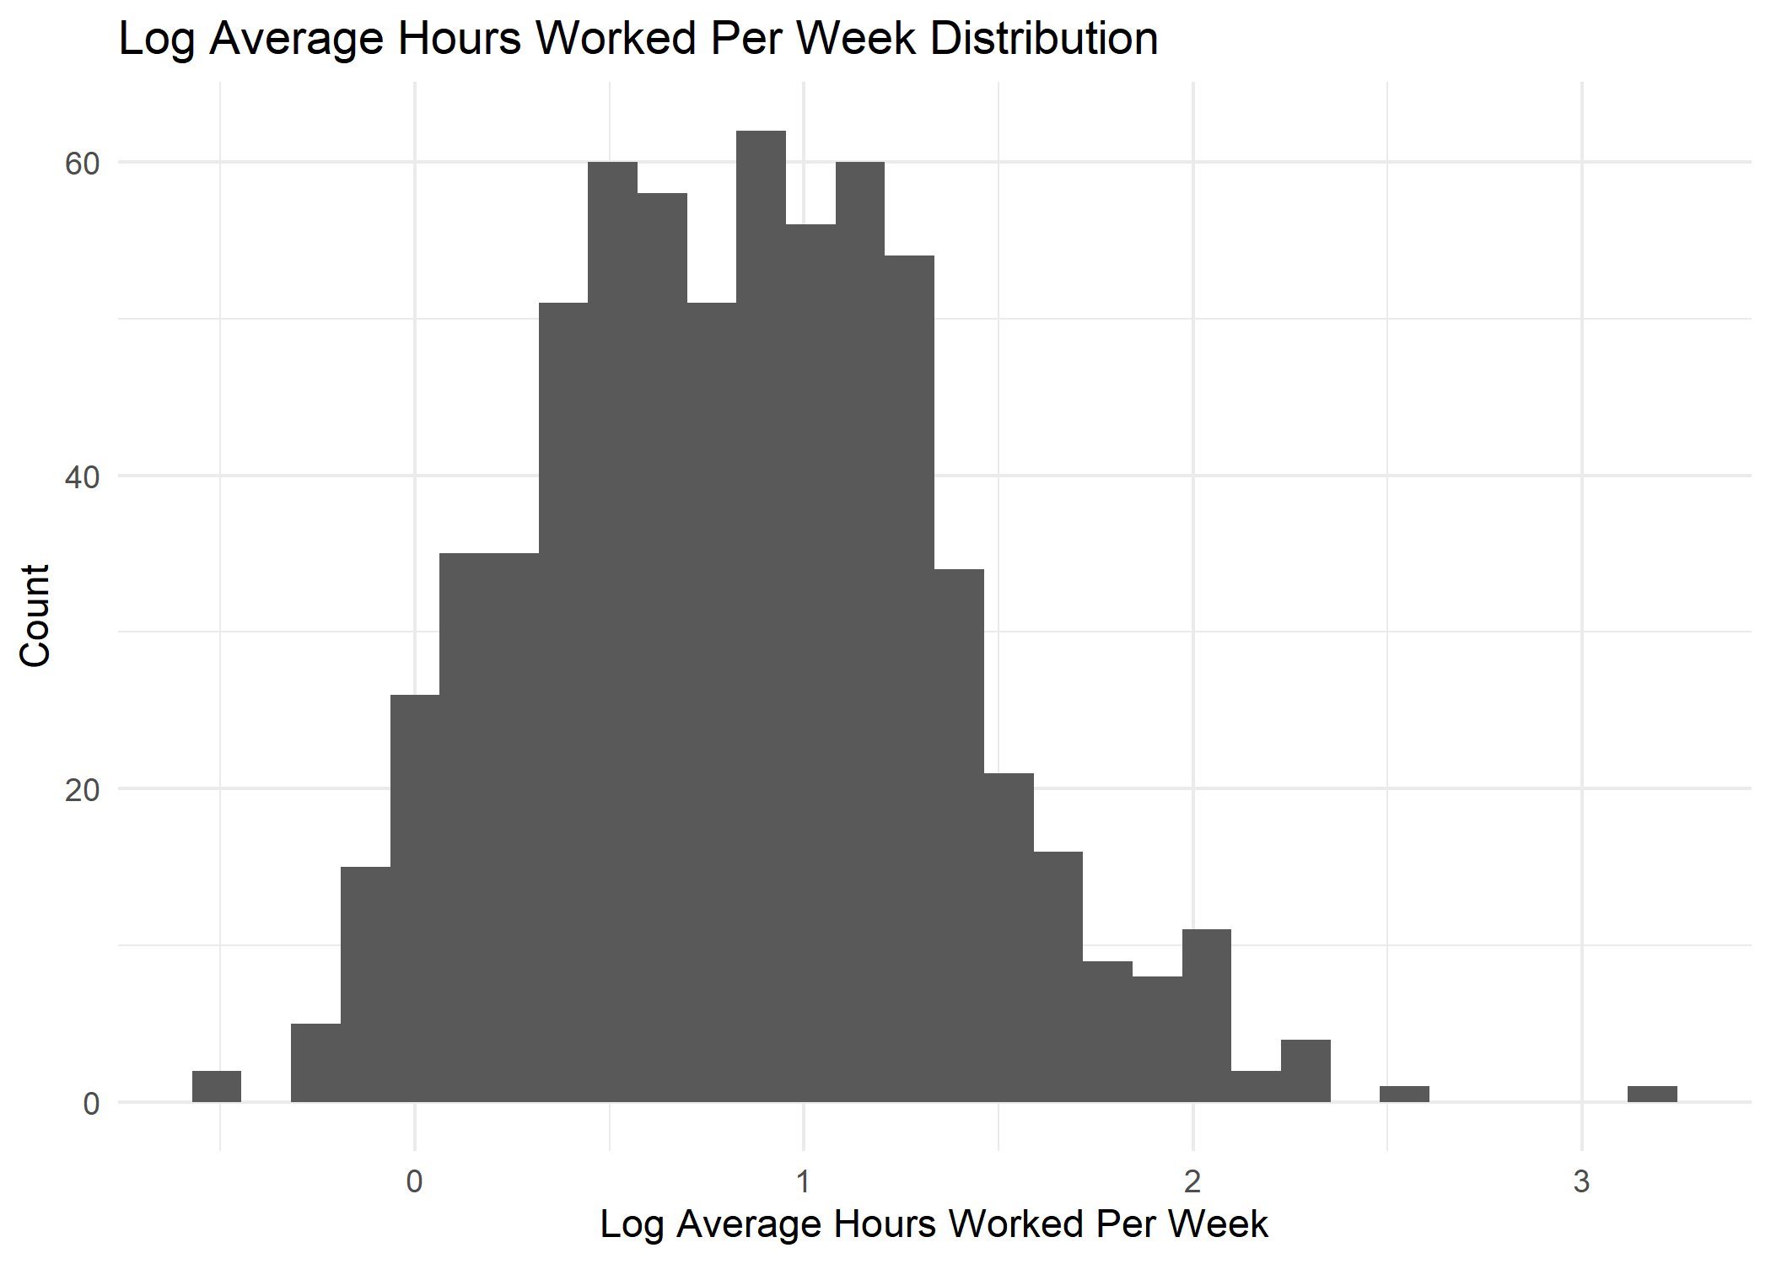
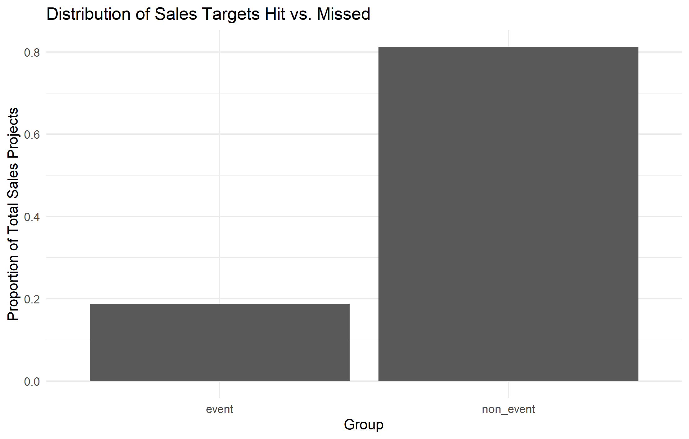
Responses
two responses: hours worked and project success
hours worked:
most jobs take 2-3 hours, one outlier took 20
predict in log-space to respect lower bound of 0
project success:
highly imbalanced: ~80% of projects fail

Slide 5
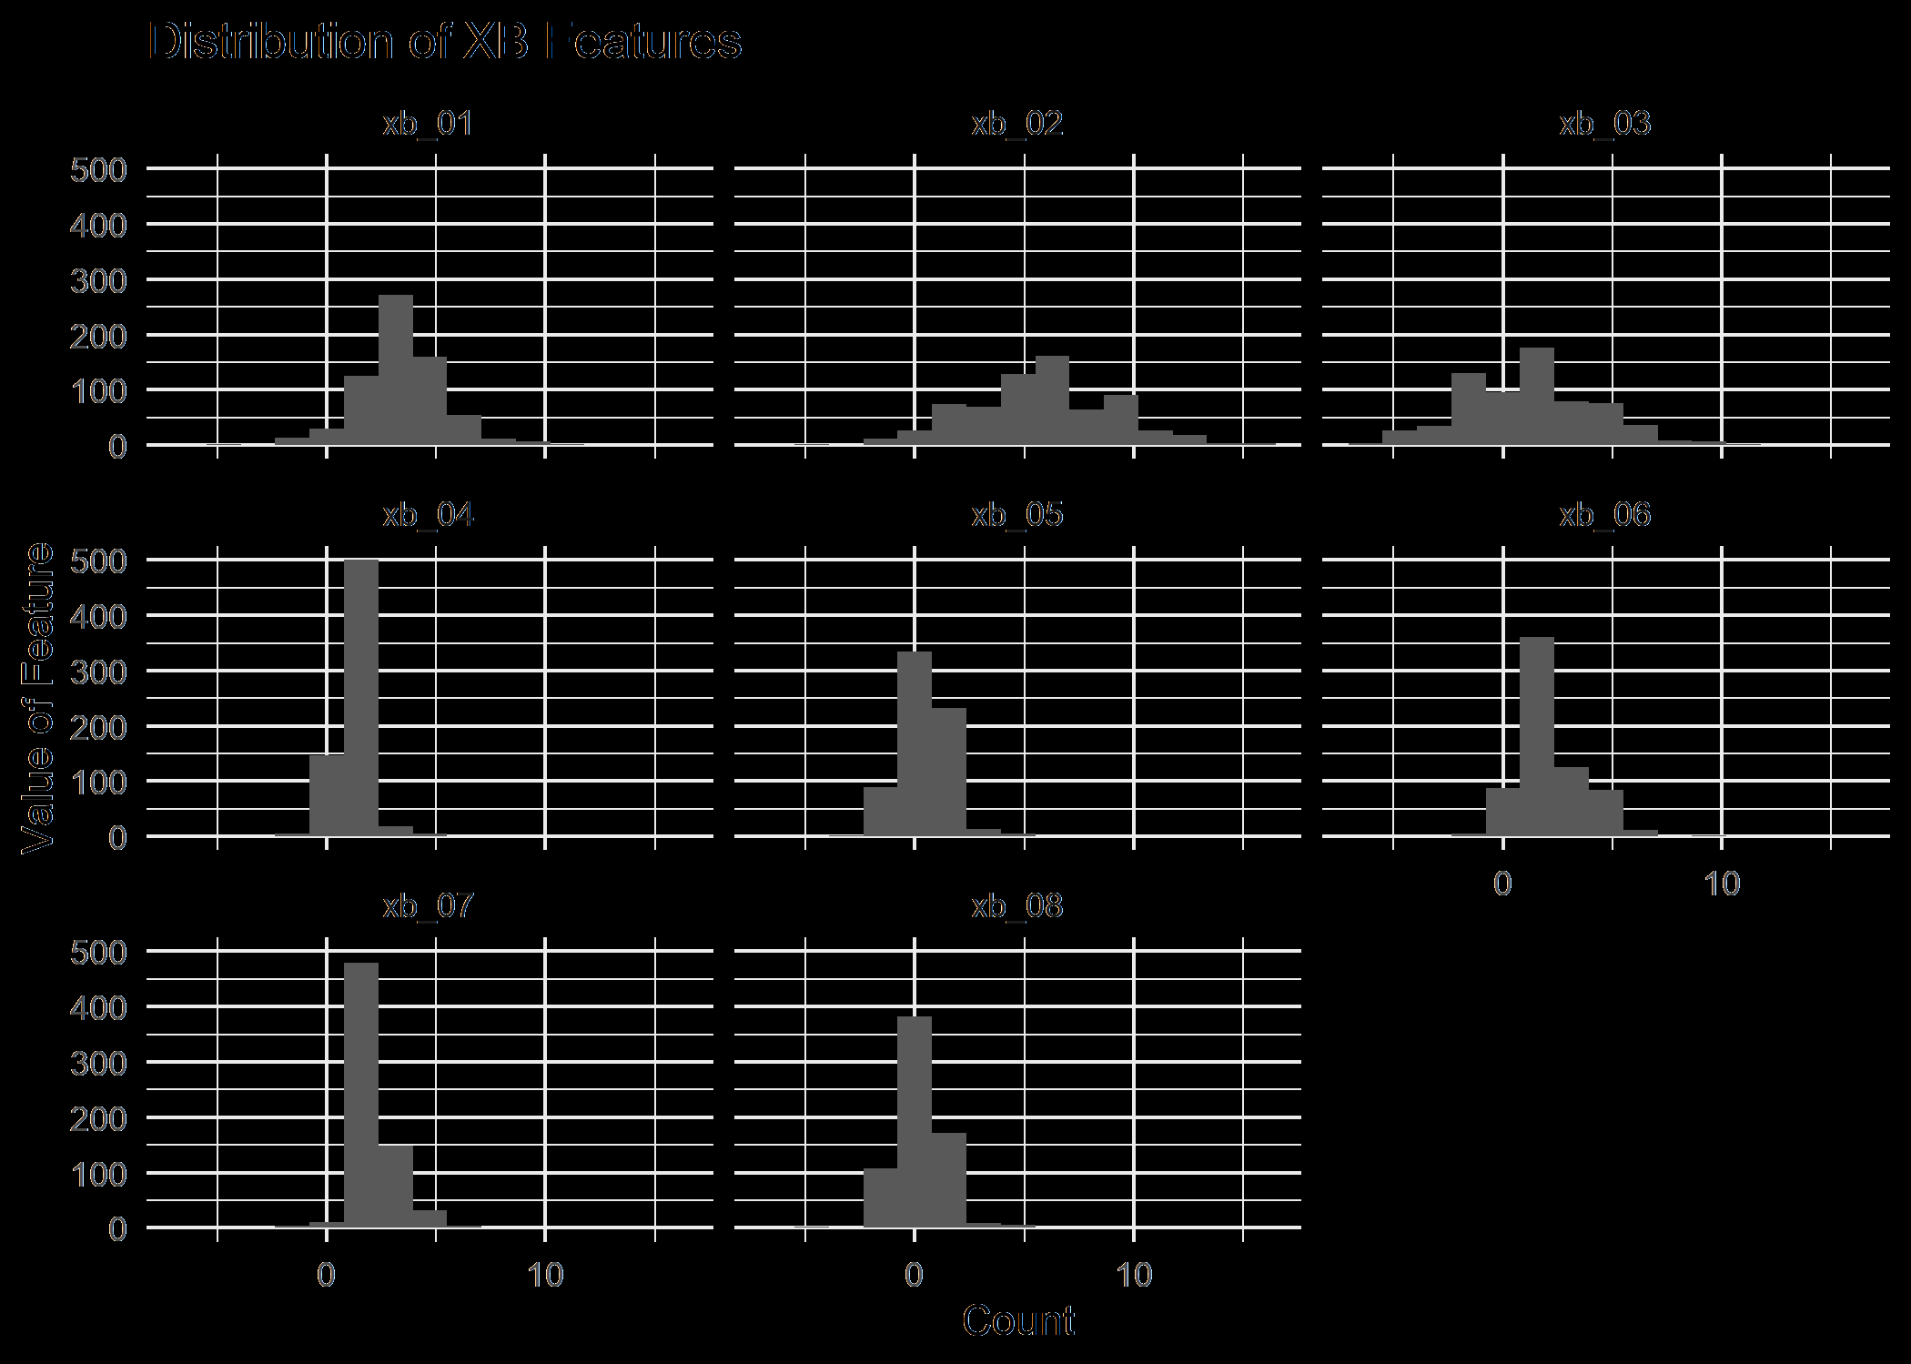
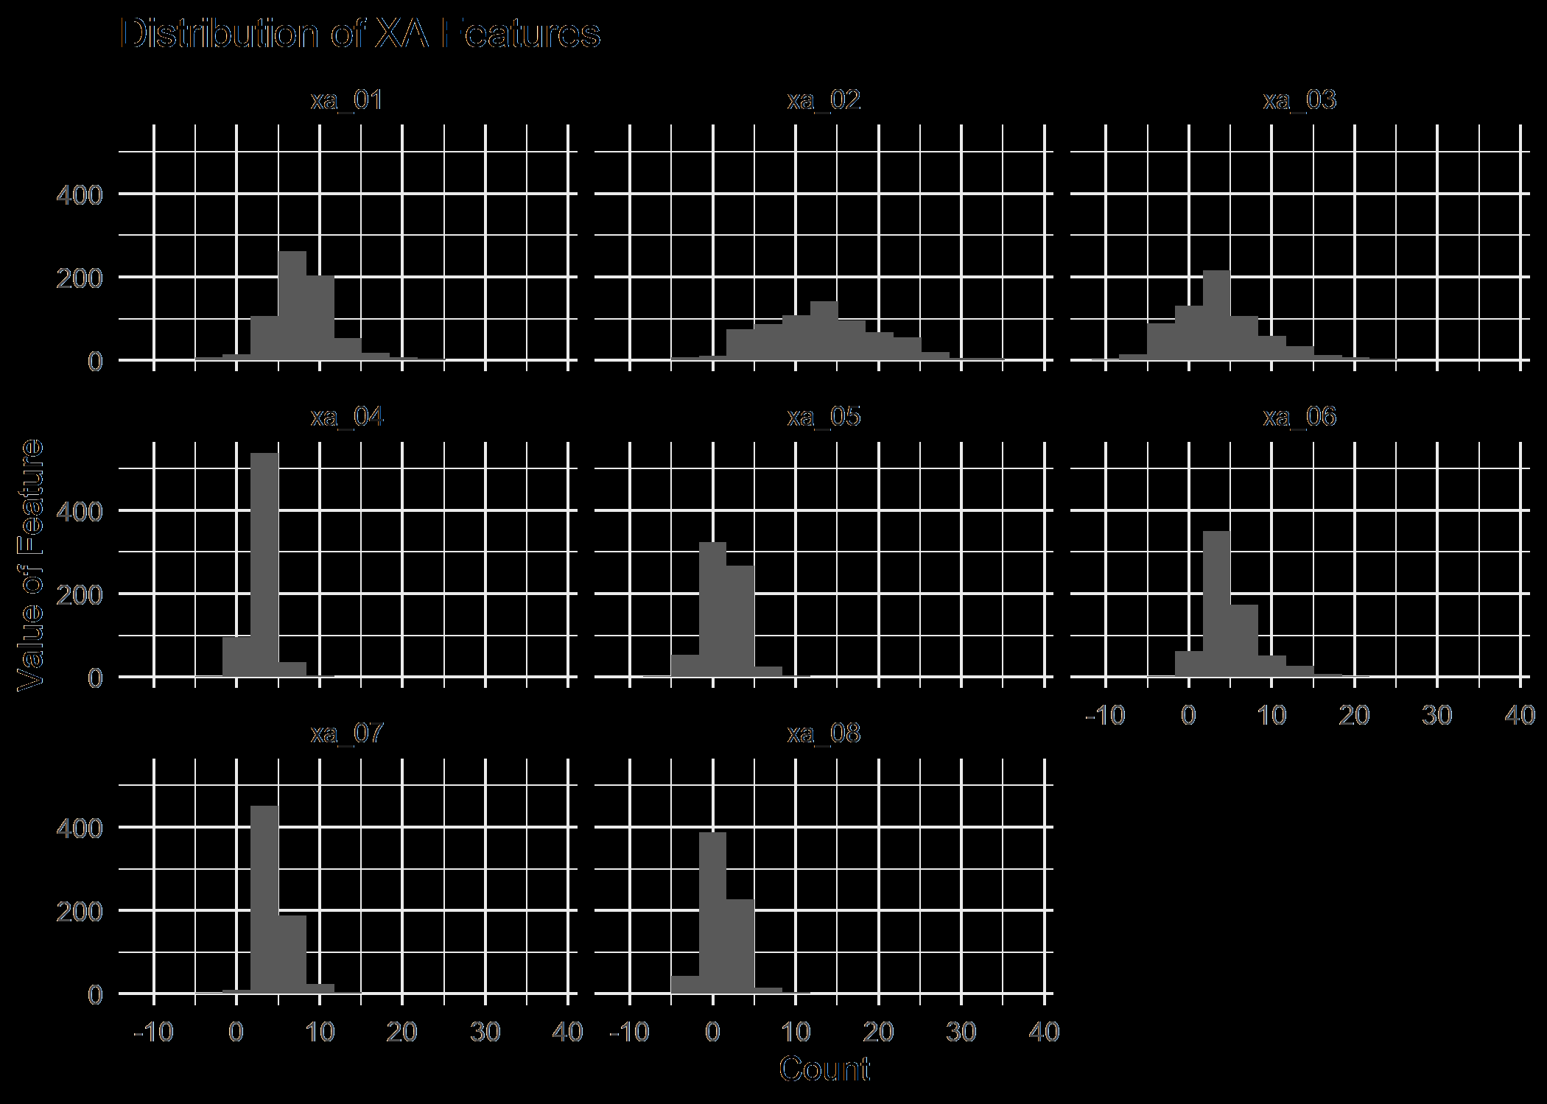
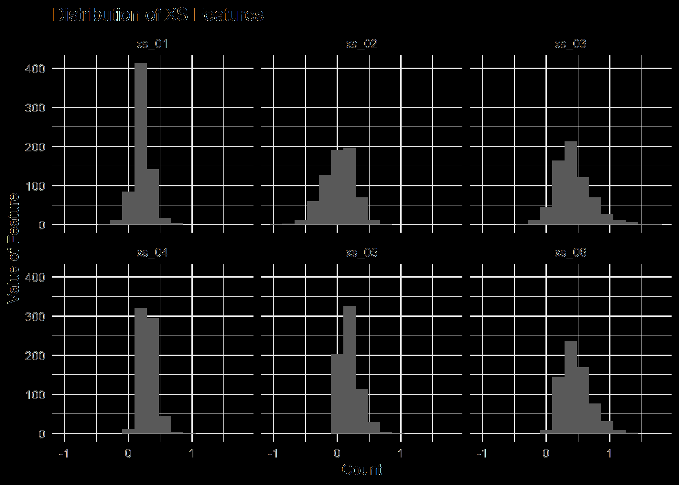
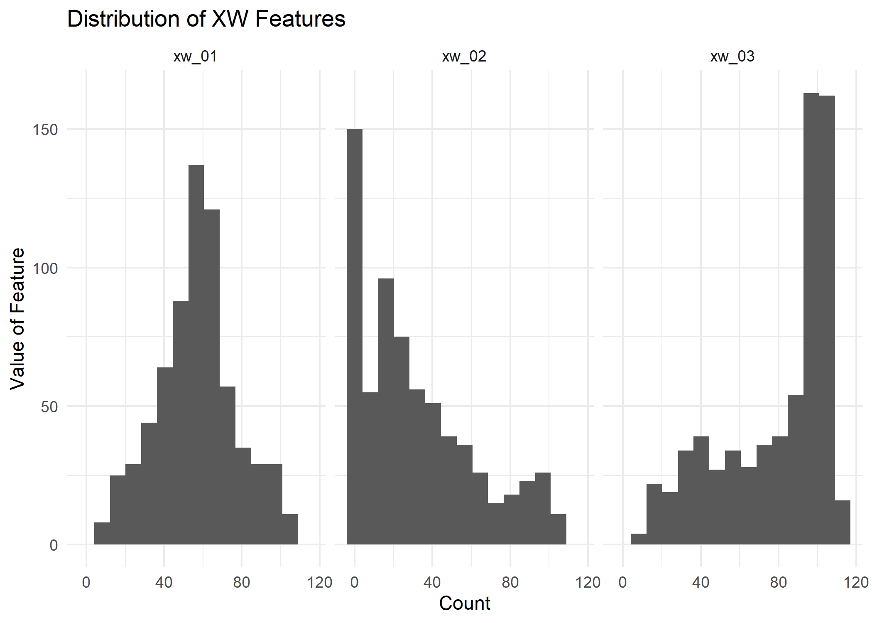
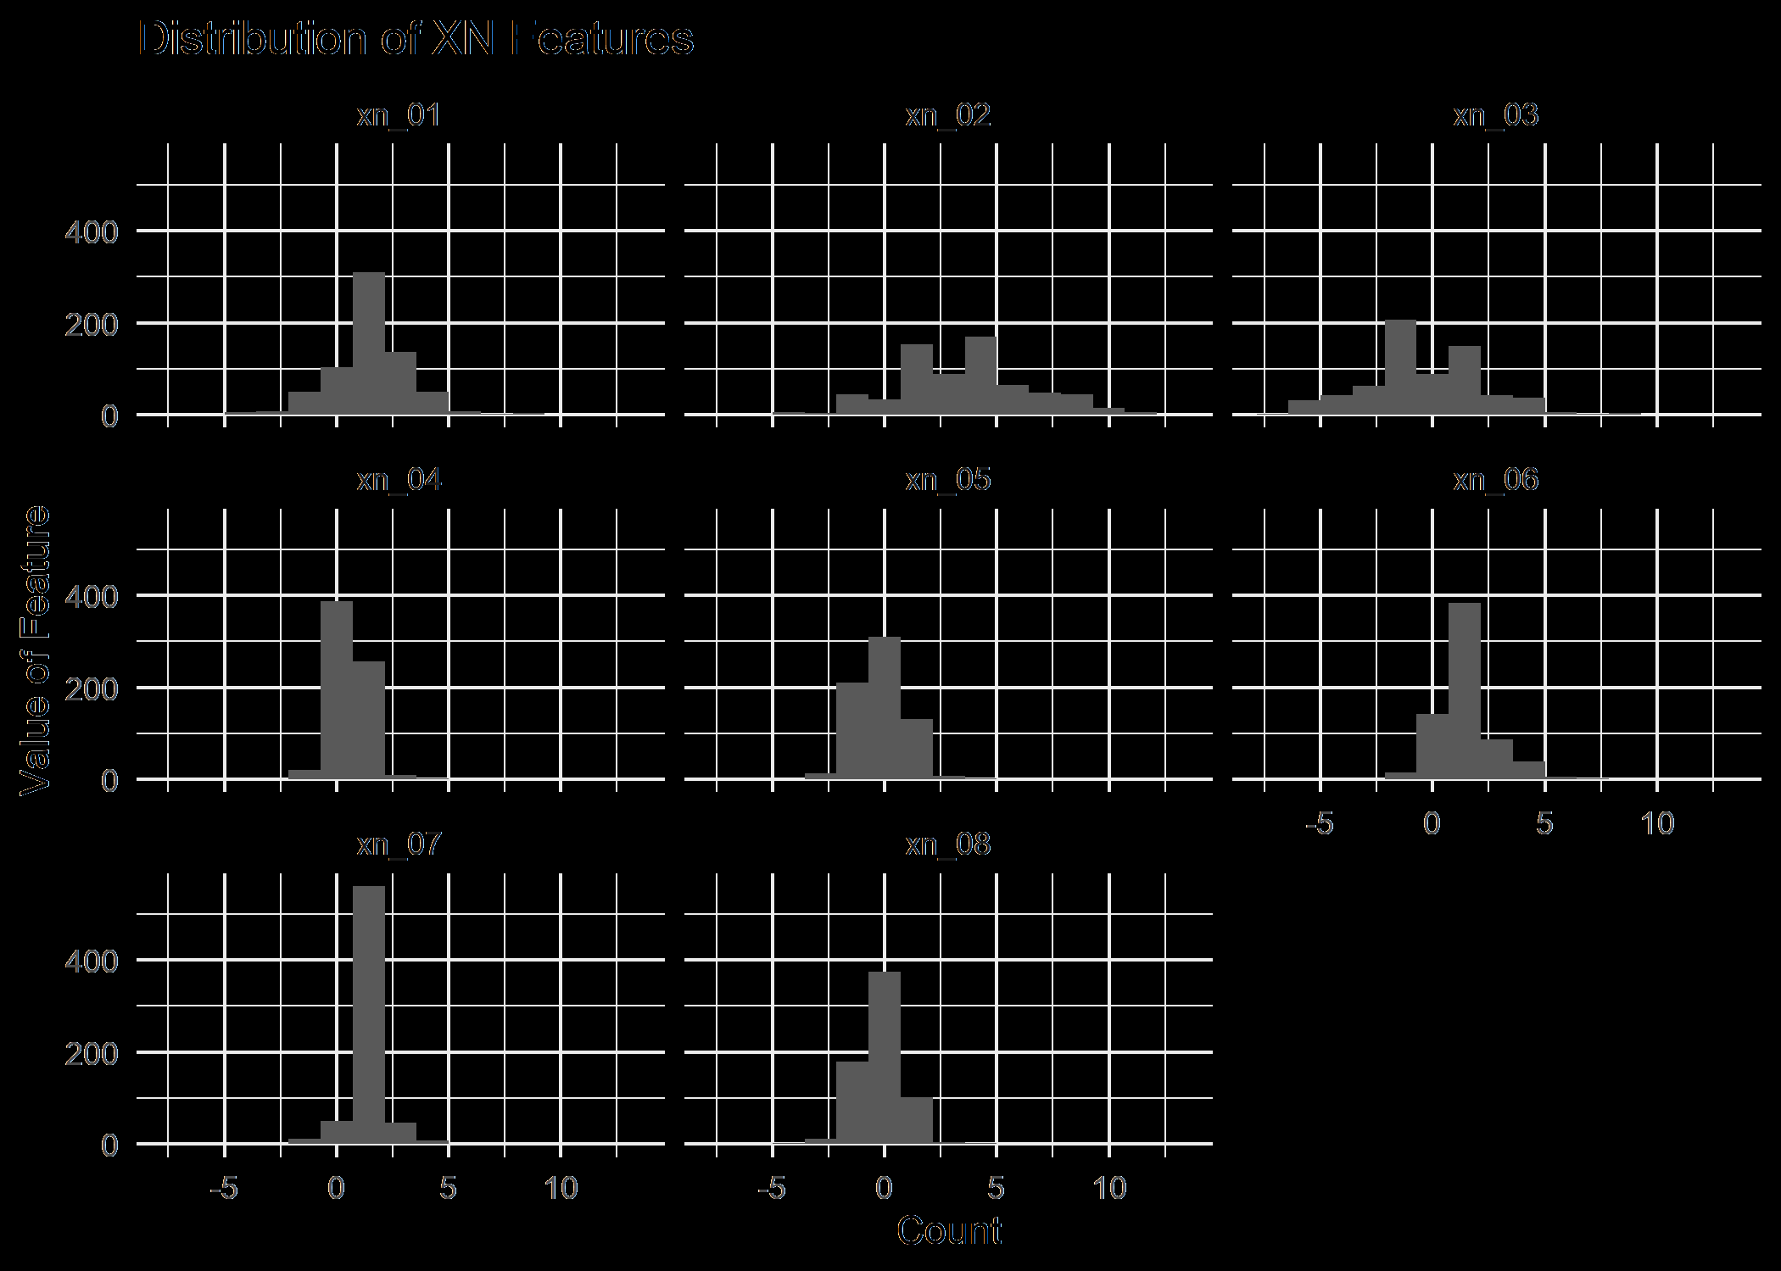
Predictors
5 sets of sentiment analysis features
vary by bounds, discreteness
3 dominated
AFINN, Bing, NRC
other 2 mostly useless
sentimentr, word-based
not at all interpretable, no “golden” feature

Slide 6
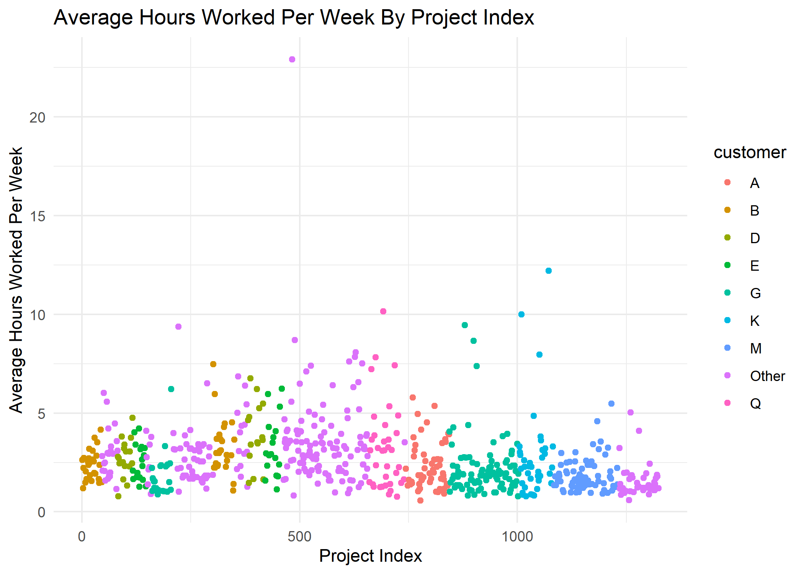
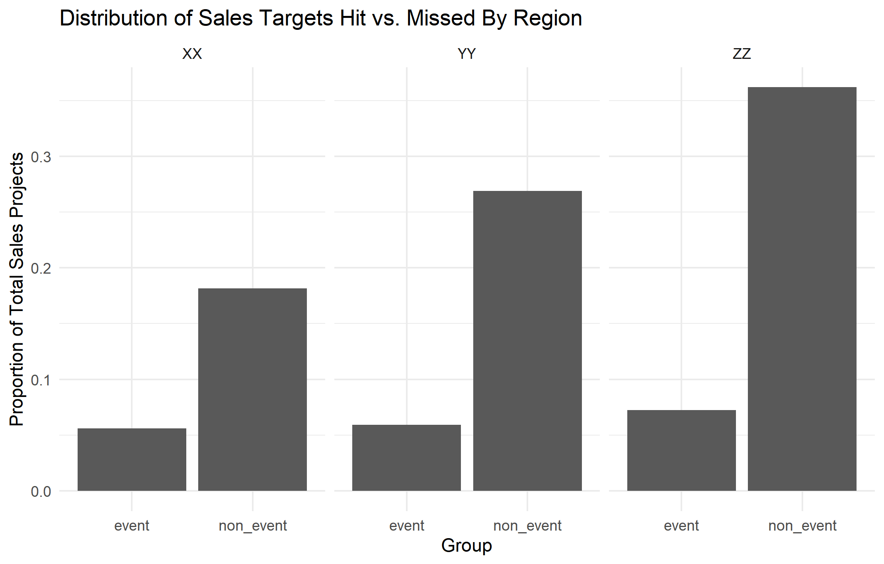
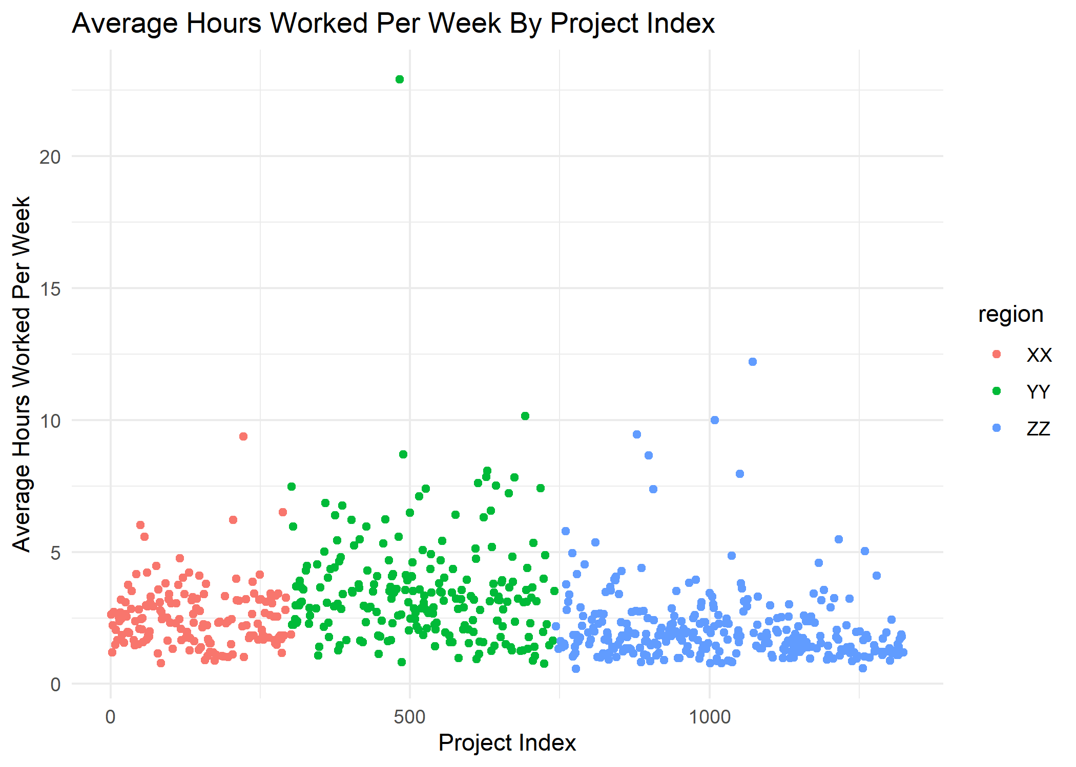
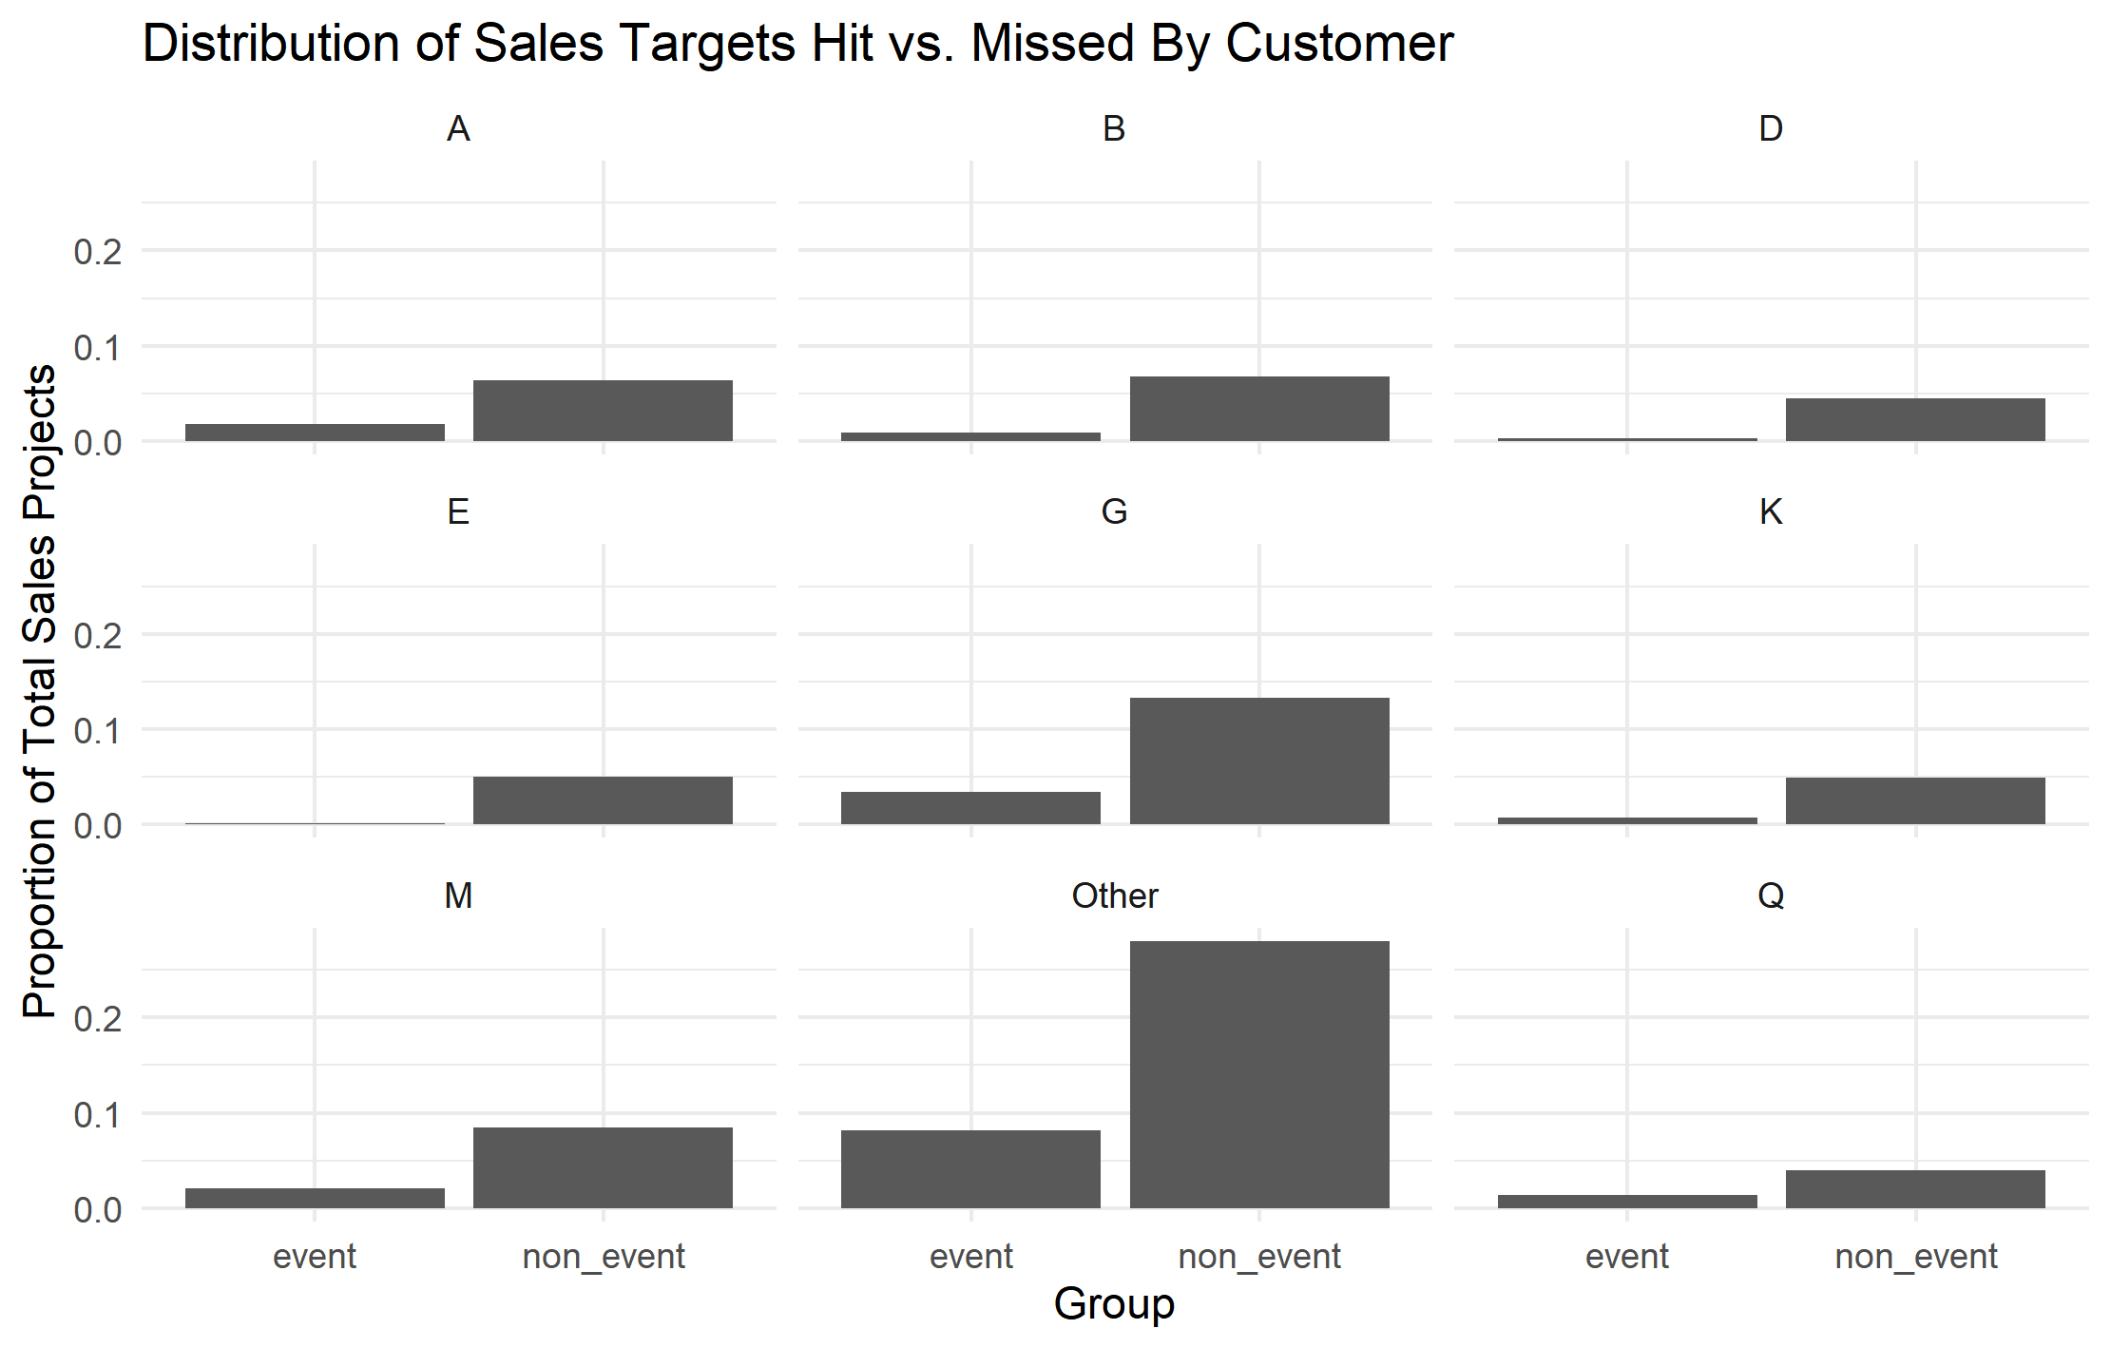
Factor-Response Visualizations

Slide 7
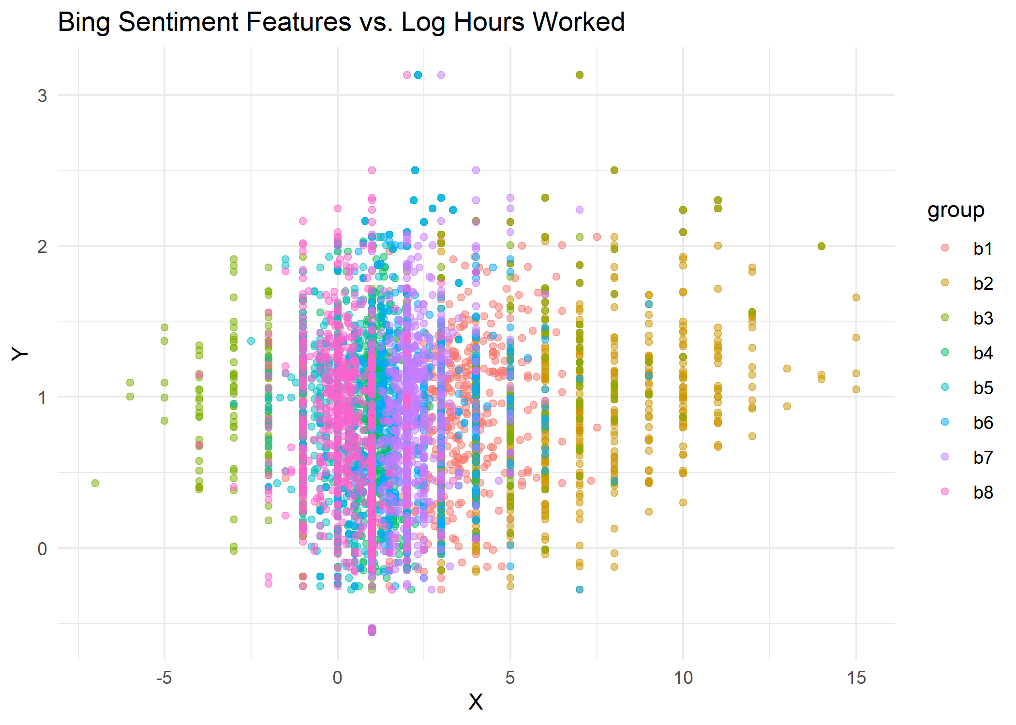
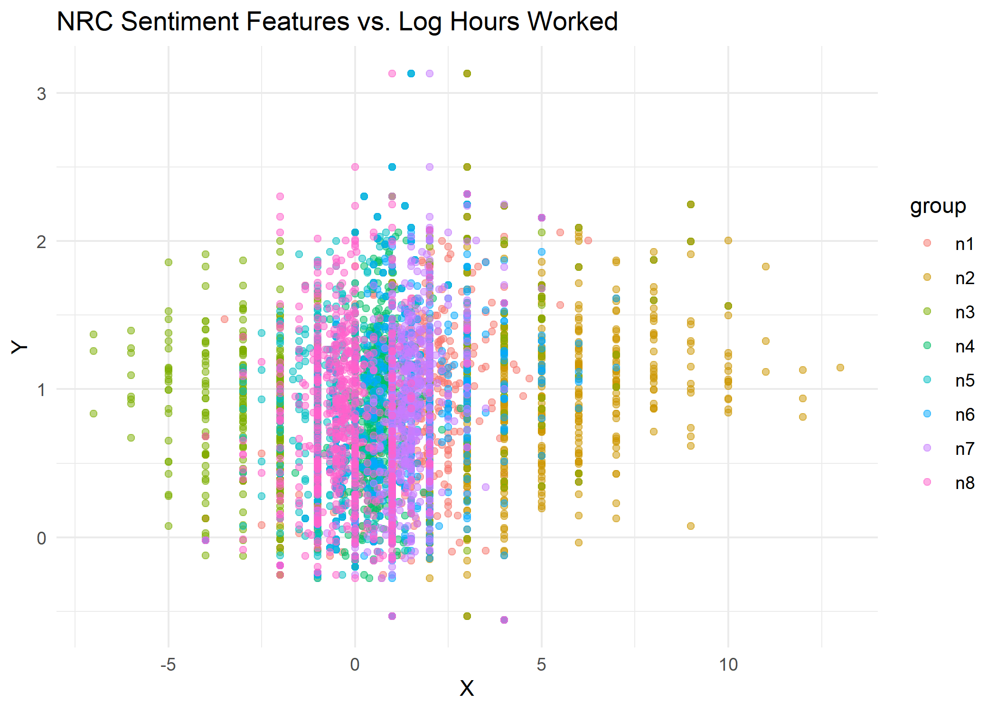
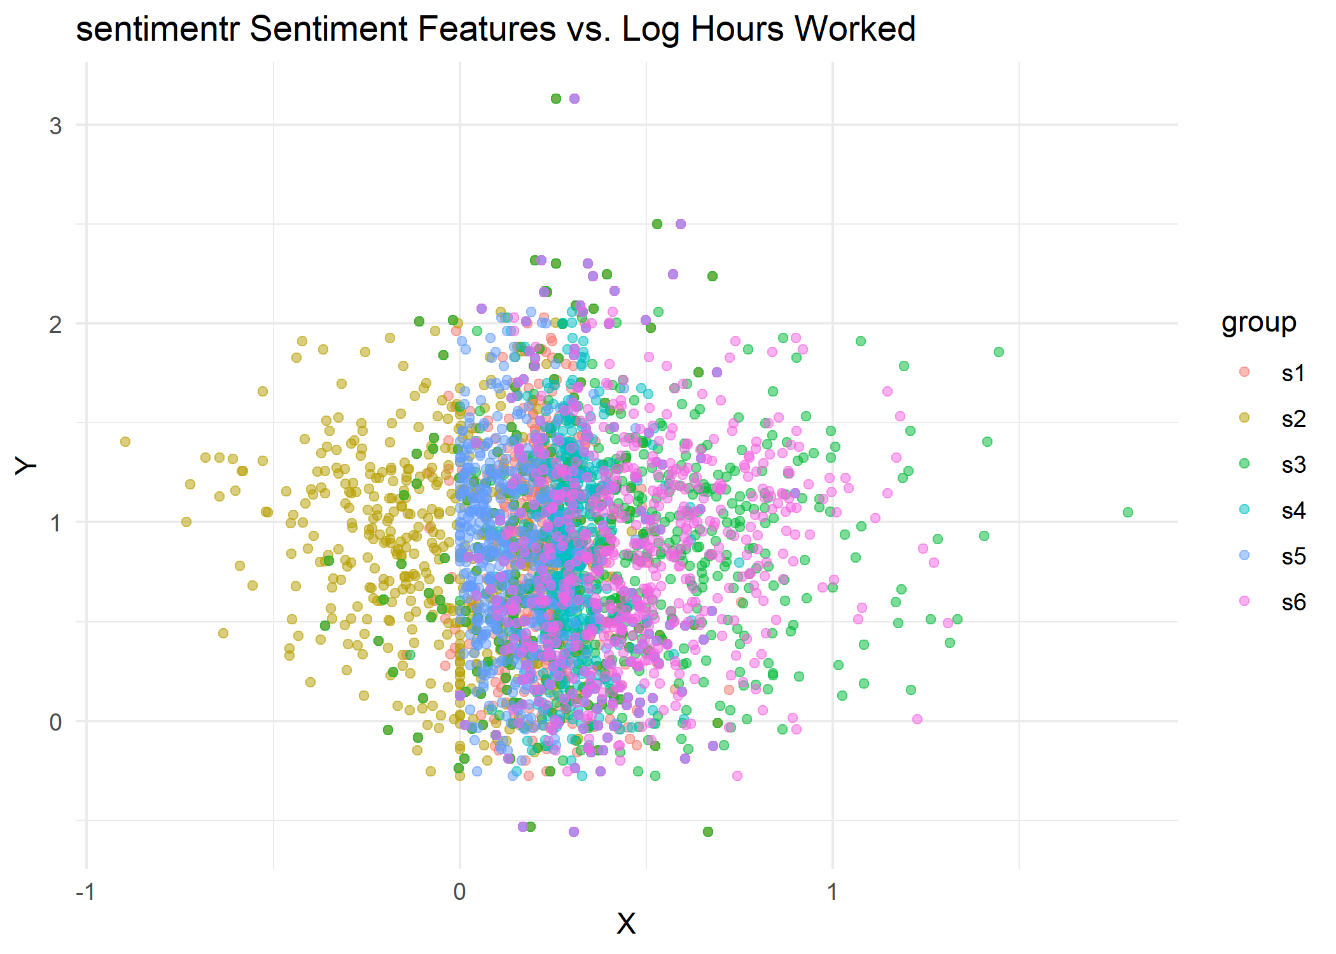
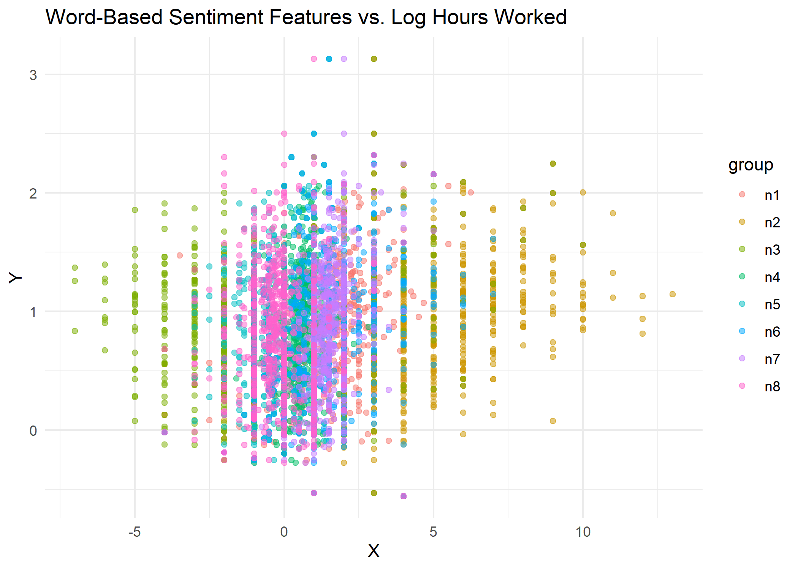
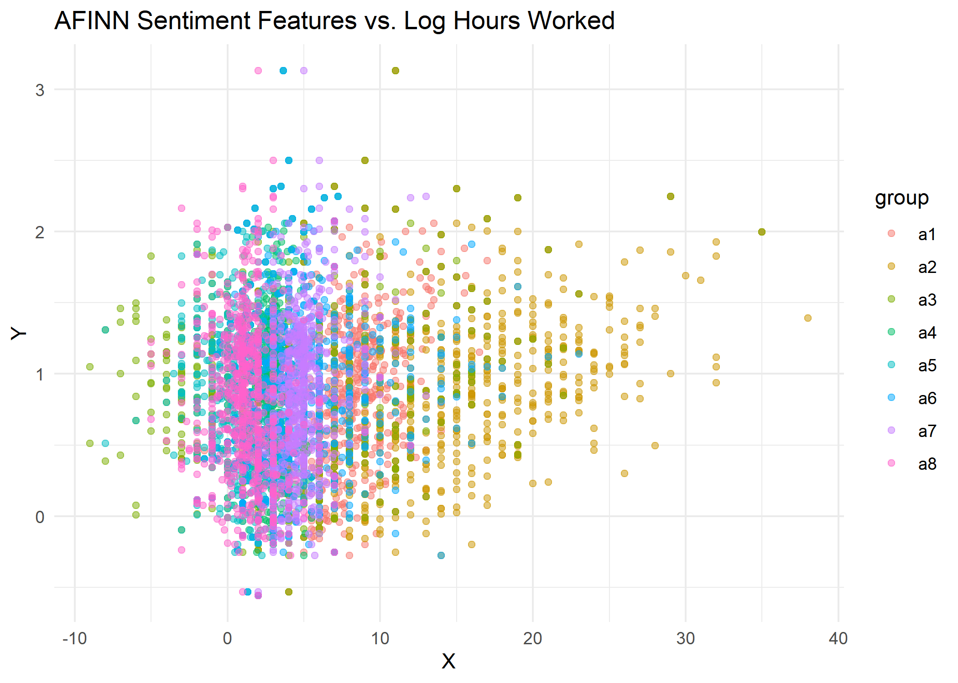
Response-Predictor Visualizations

Slide 8

Task I: Predicting Hours Worked

Slide 9
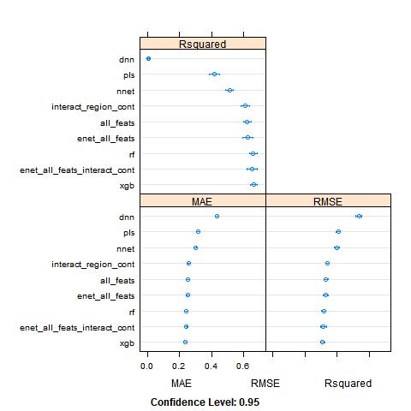
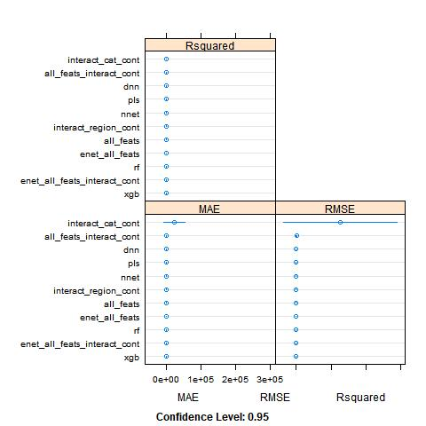
The Full Model Suite
tried a combination of:
linear models
4 sets of features, includes interactions
neural networks
simple
deep
elasticnet
2 sets of features
random forest
xgboost
partial least squares
one linear model was horrible, so had to remove it from model summary

Slide 10
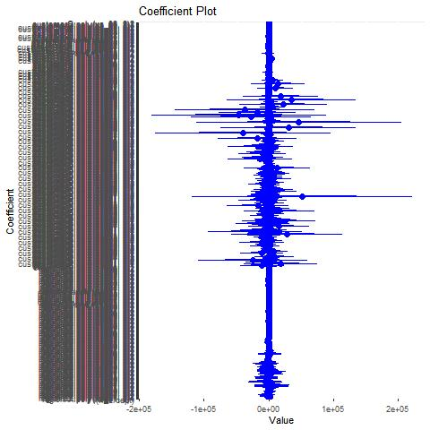
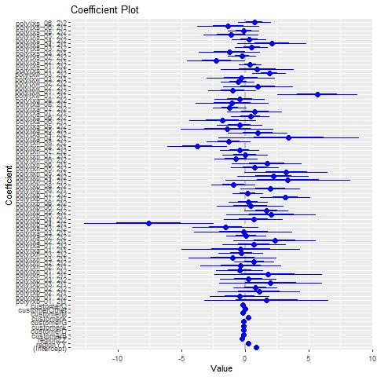
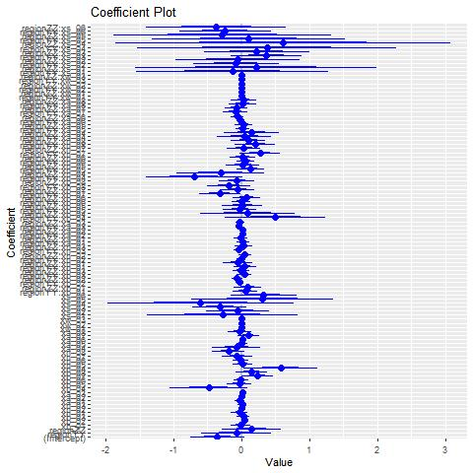
Best Models
little performance gap between linear models and more complex algorithms
examined 3 linear models further
additive with continuous terms, interact region
additive with 2nd degree polynomials
additive with 2nd degree polynomials, interact region and customer

Slide 11
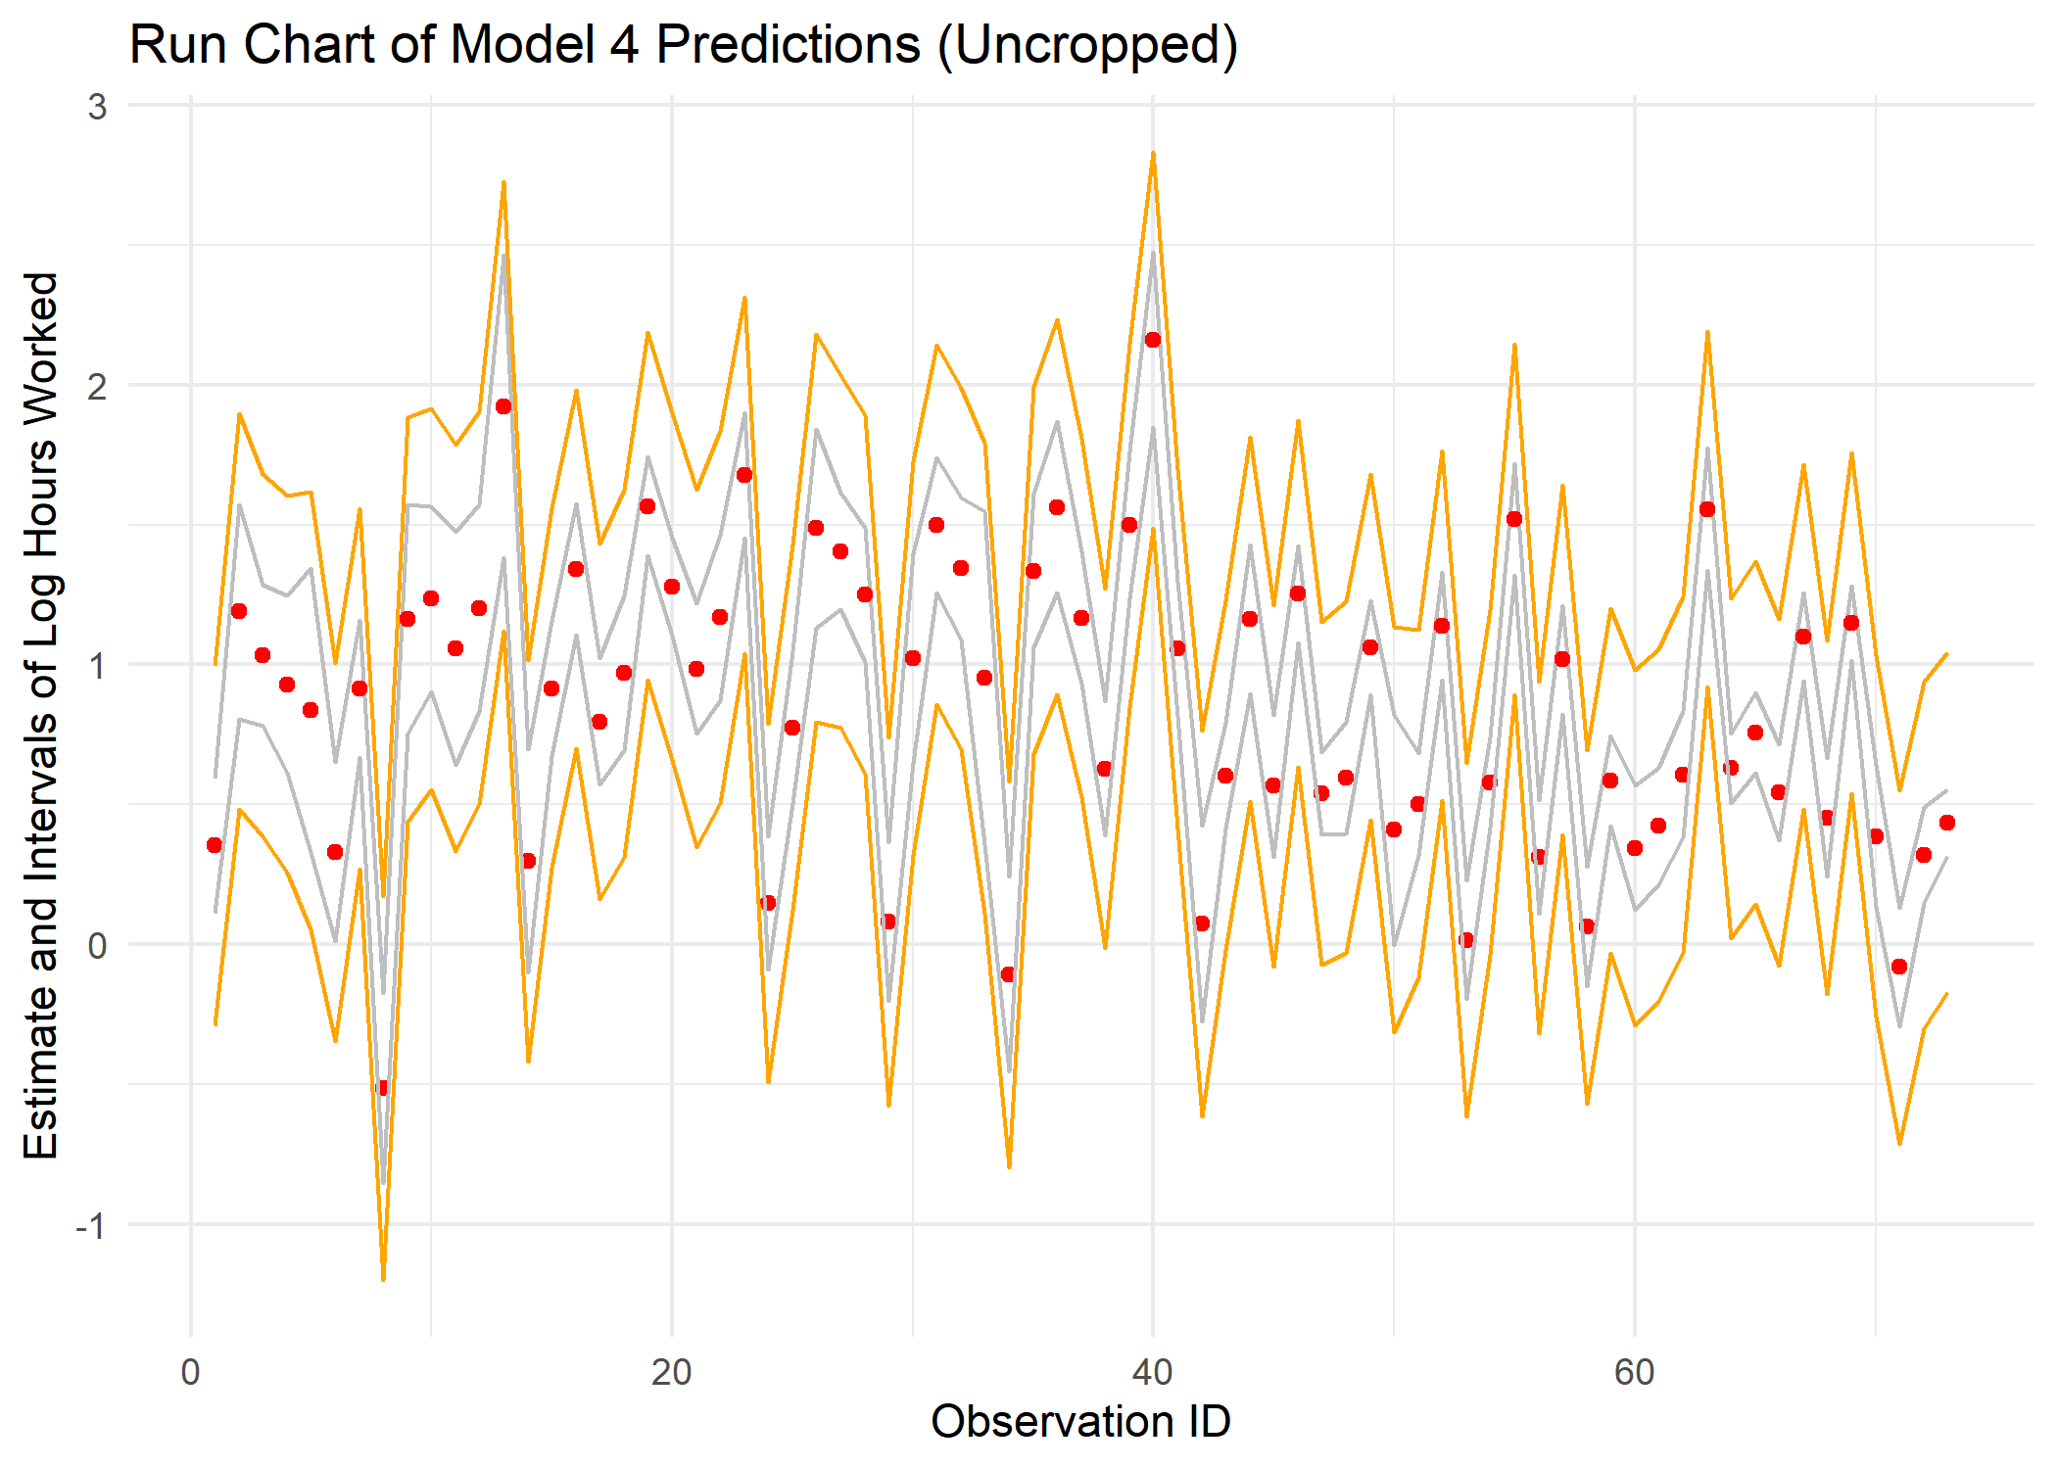
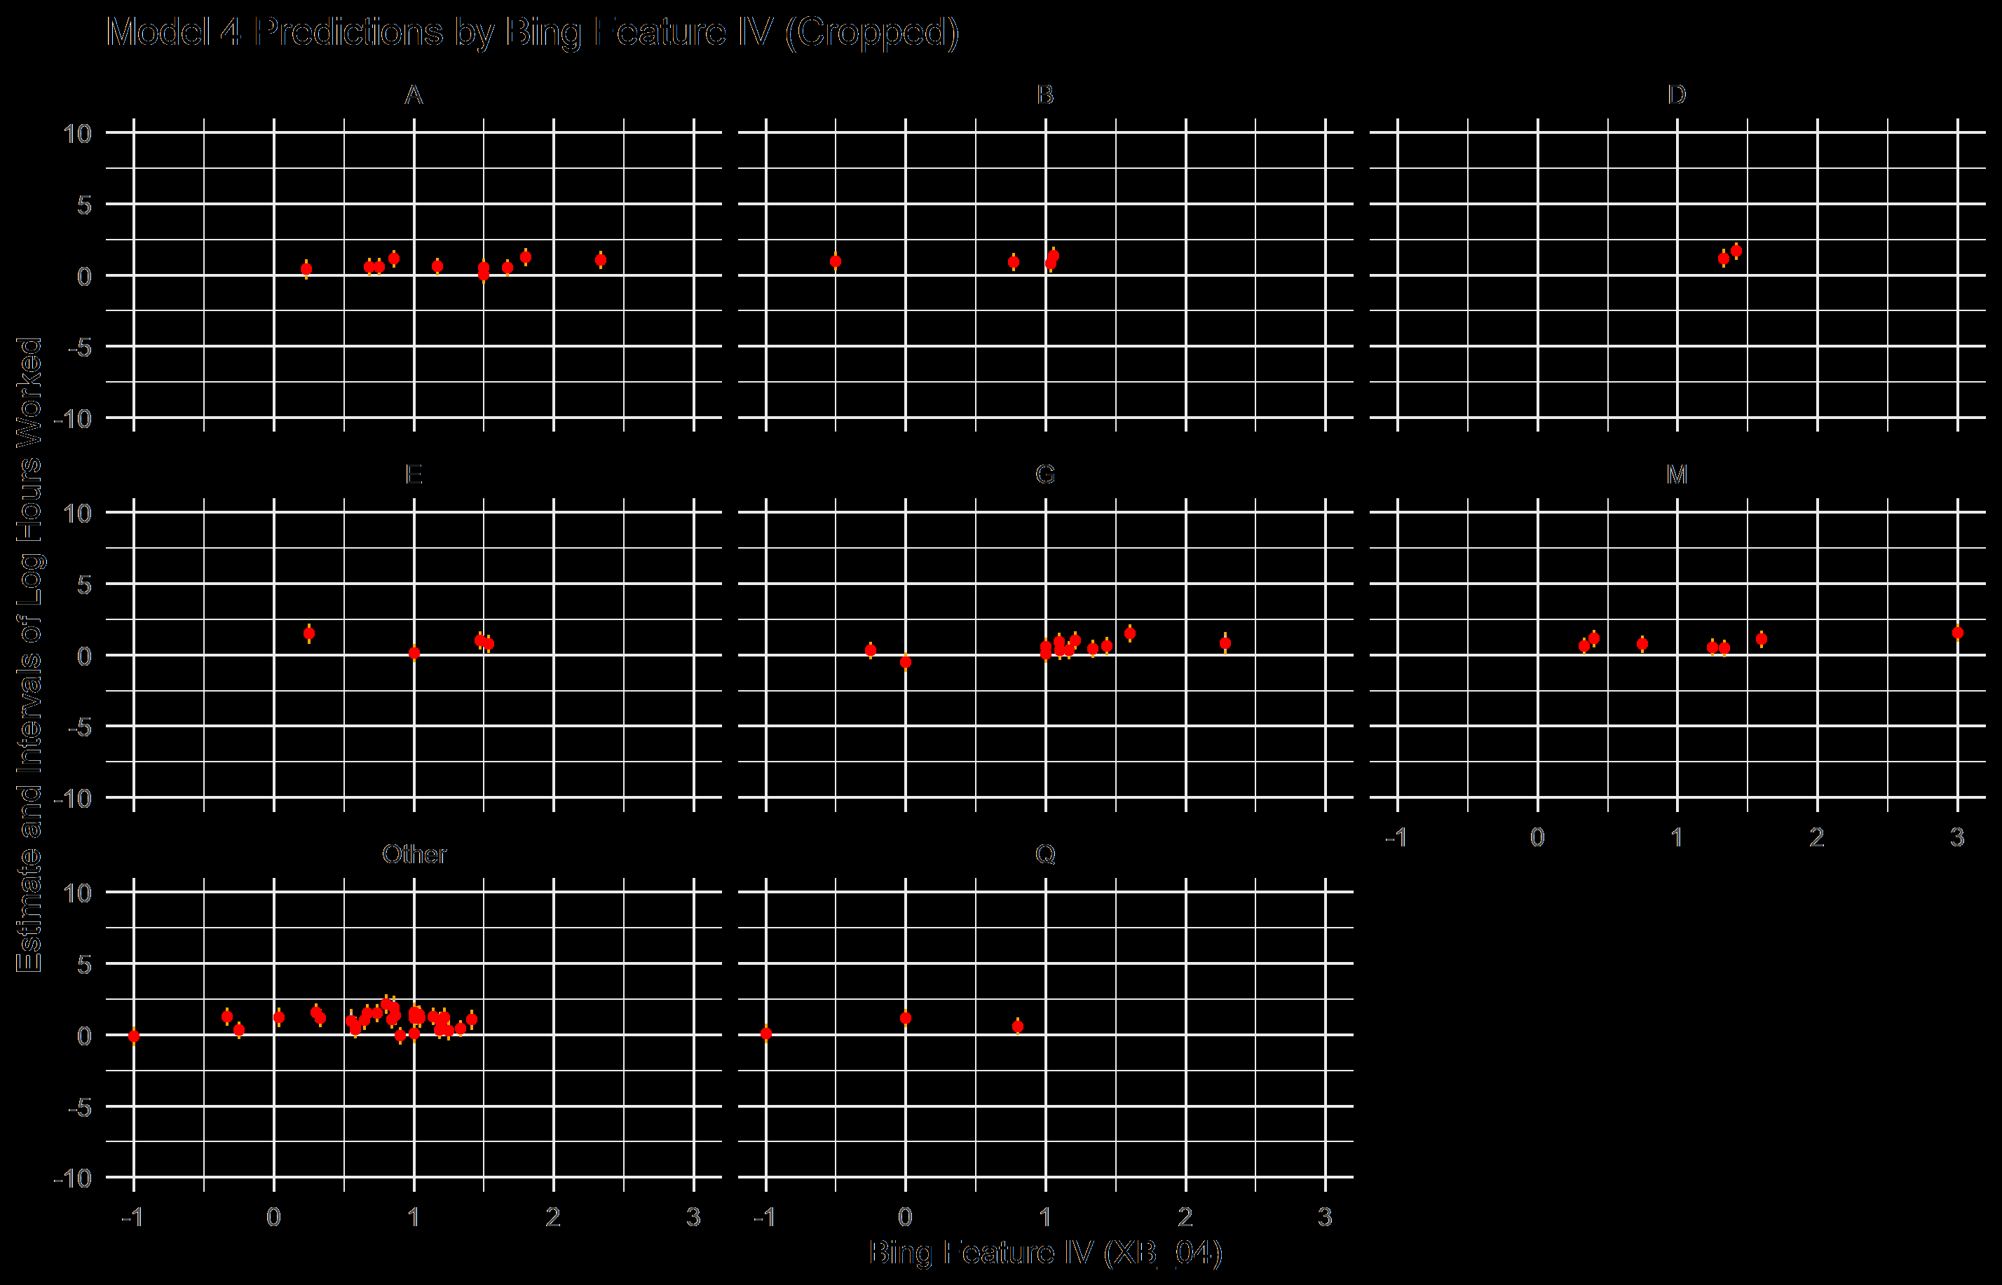
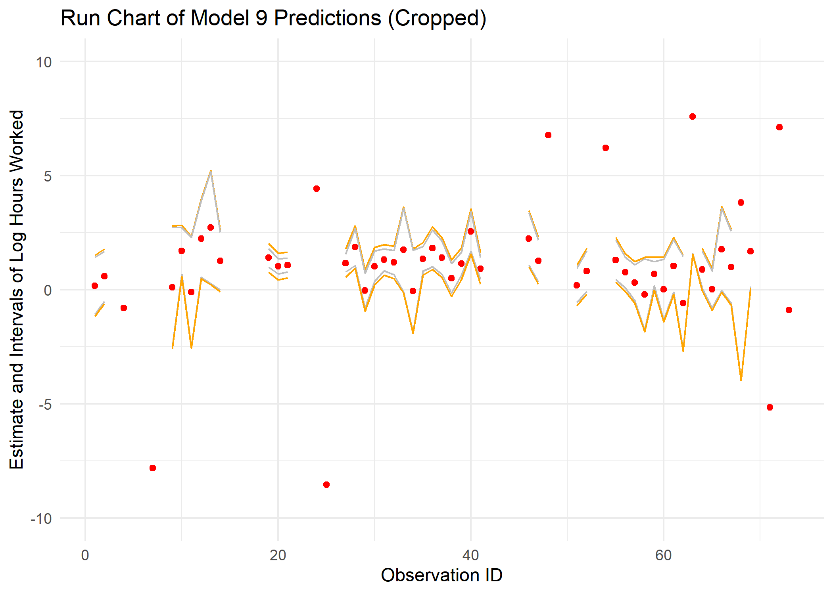
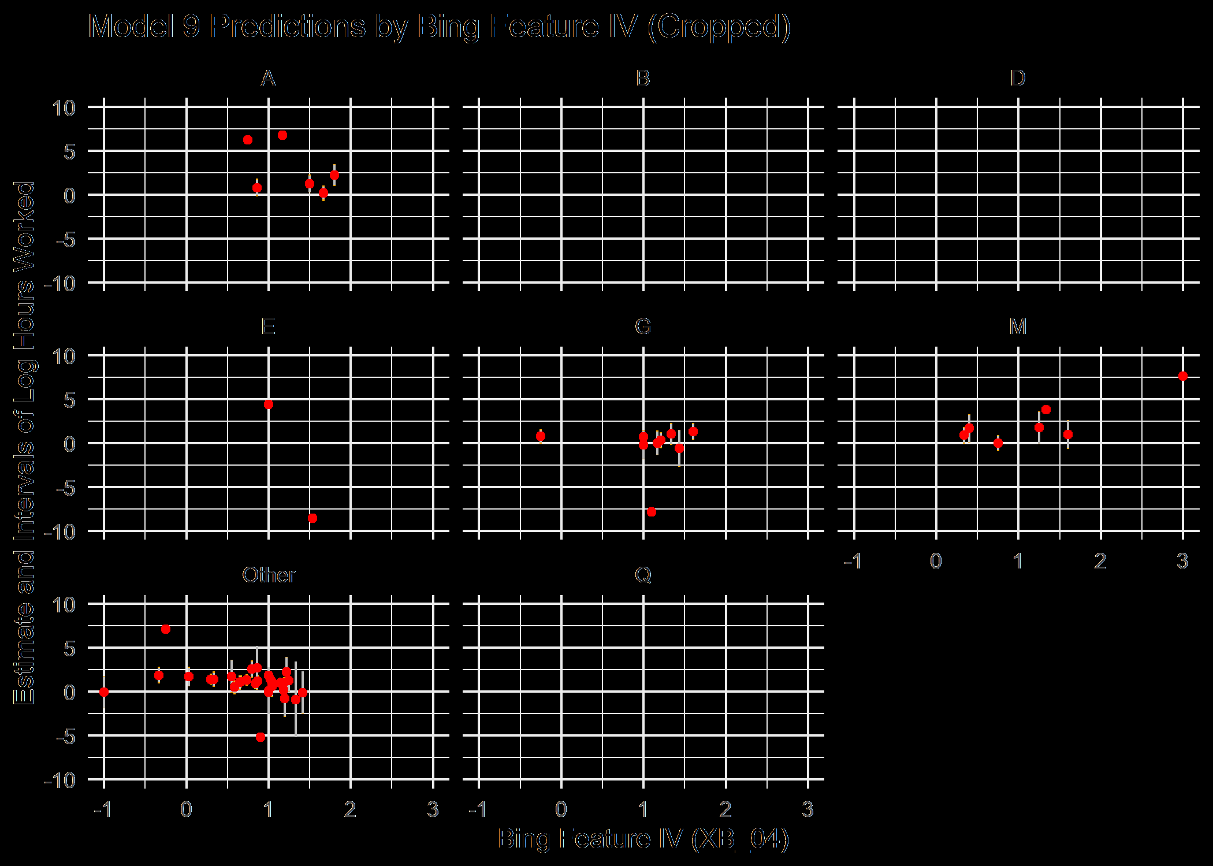
Best Model: Coefficients and Predictive Trend
dropped the model with no interactions
worst performance
examined interaction models with and without polynomial features
run-style plots and by-feature plots
complex model had huge coefficients, had to crop

Slide 12

Task II: Predicting Sales Target Success

Slide 13
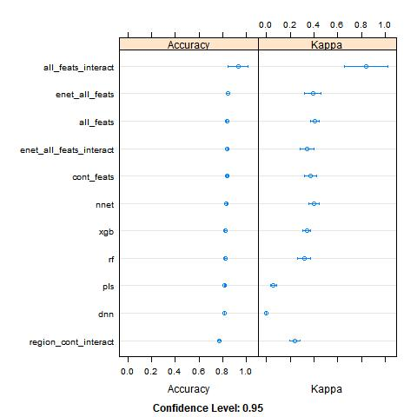
The Full Model Suite
tried a combination of:
linear models
4 sets of features, includes interactions
neural networks
simple
deep
elasticnet
2 sets of features
random forest
xgboost
partial least squares
one linear model was horrible, so had to remove it from model summary

Slide 14
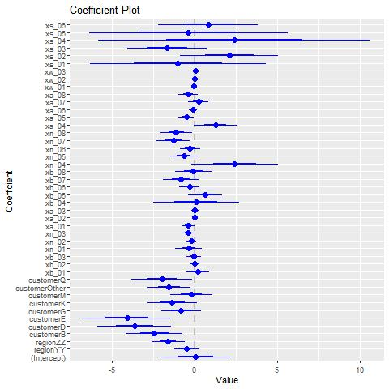
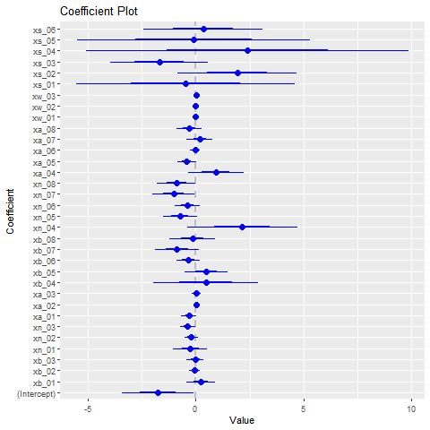
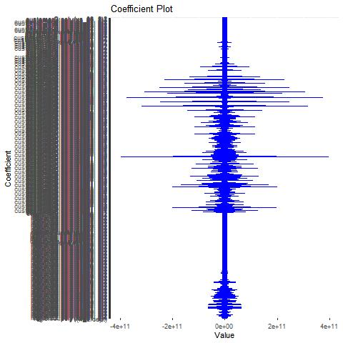
Best Models
little performance gap between linear models and more complex algorithms
examined 3 linear models further
additive with continuous predictors
additive with continuous and categorical predictors
additive with 2nd degree polynomials, interact region and customer

Slide 15
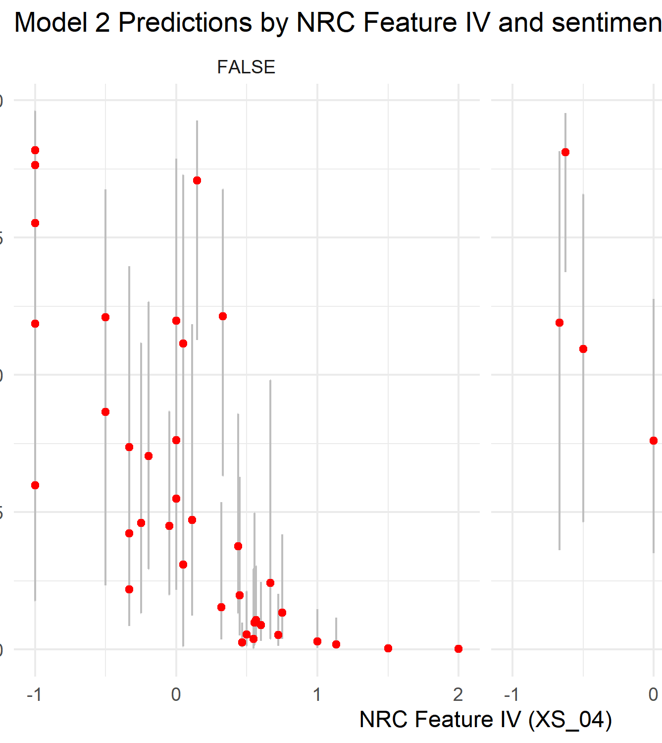
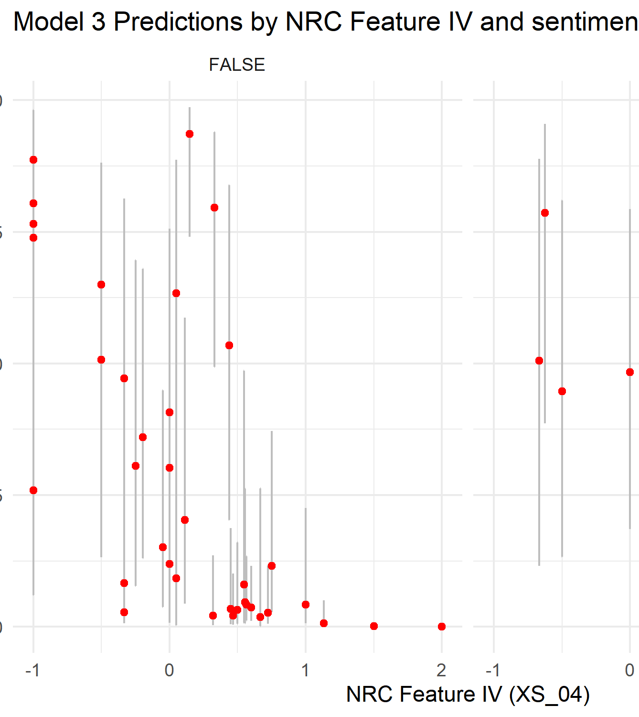
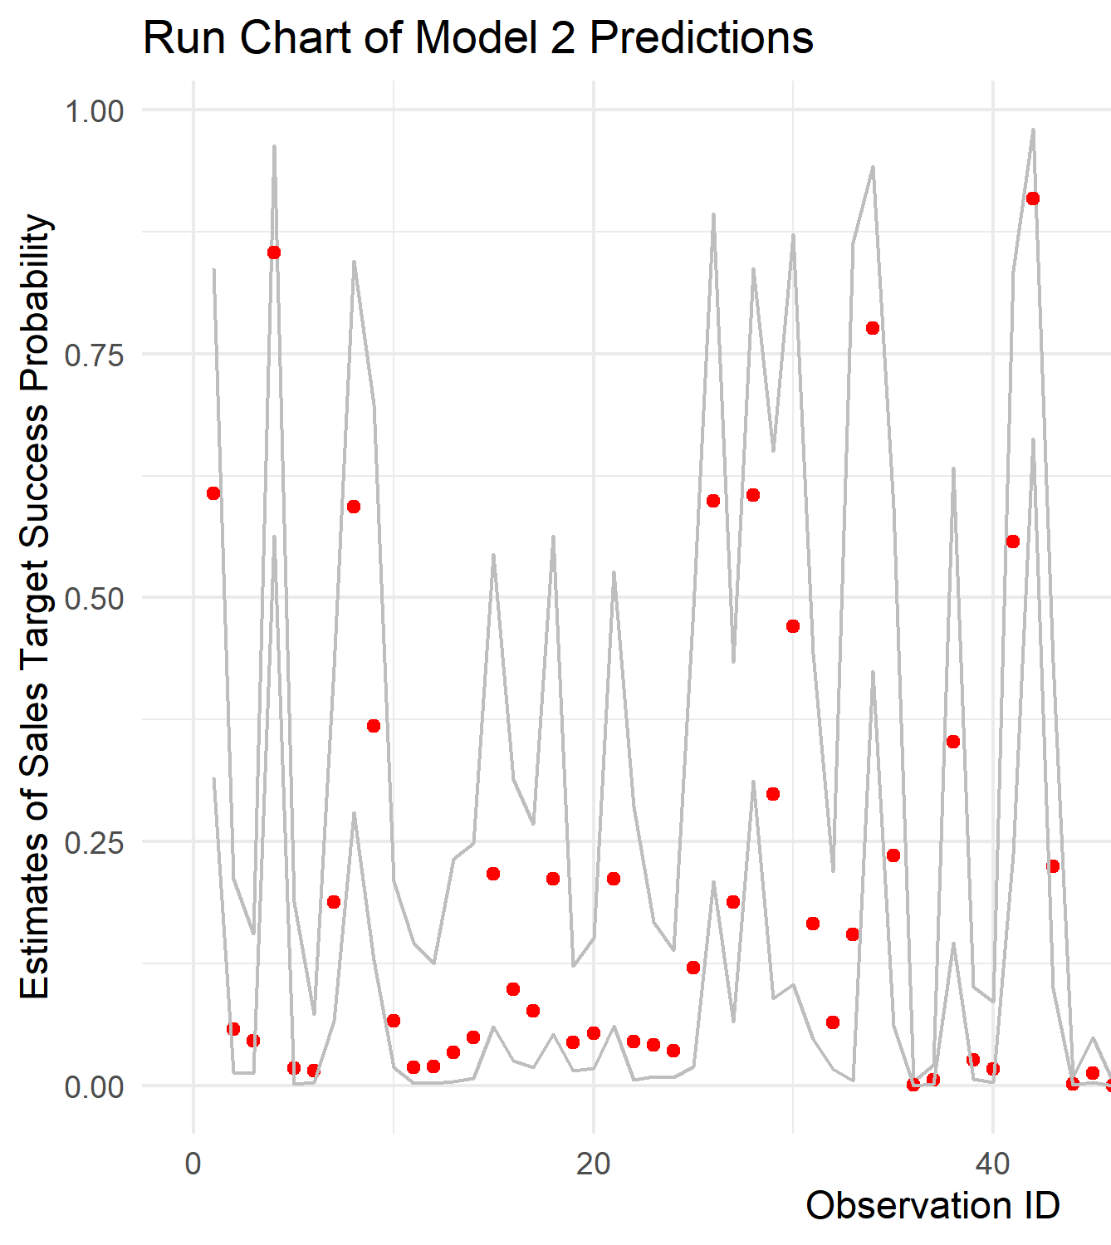
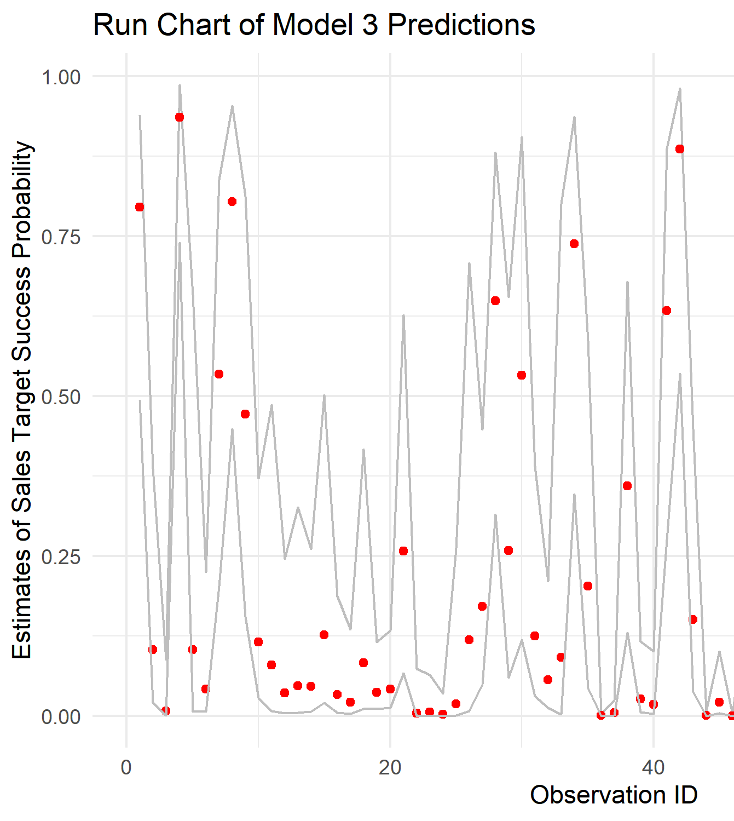
Best Model: Coefficients and Predictive Trends
dropped the most complex model
complex model had huge coefficients, had to crop
overfitting concerns
training warnings
examined linear additive models with and without categorical features
run-style plots and by-feature plots

