Slide 1

An Introduction to World Models
Kiya Aminfar
Sean Steinle

Slide 2
An Introduction to World Models
Kiya Aminfar
Sean Steinle

Slide 3
Agenda
Motivating World Models
World Model Components
Applications of World Models
World Models Today
Q&A

Slide 4

Motivating World Models

Slide 5

World Model Components

Slide 6
Vision

Slide 7
Memory

Slide 8
Controller

Slide 9
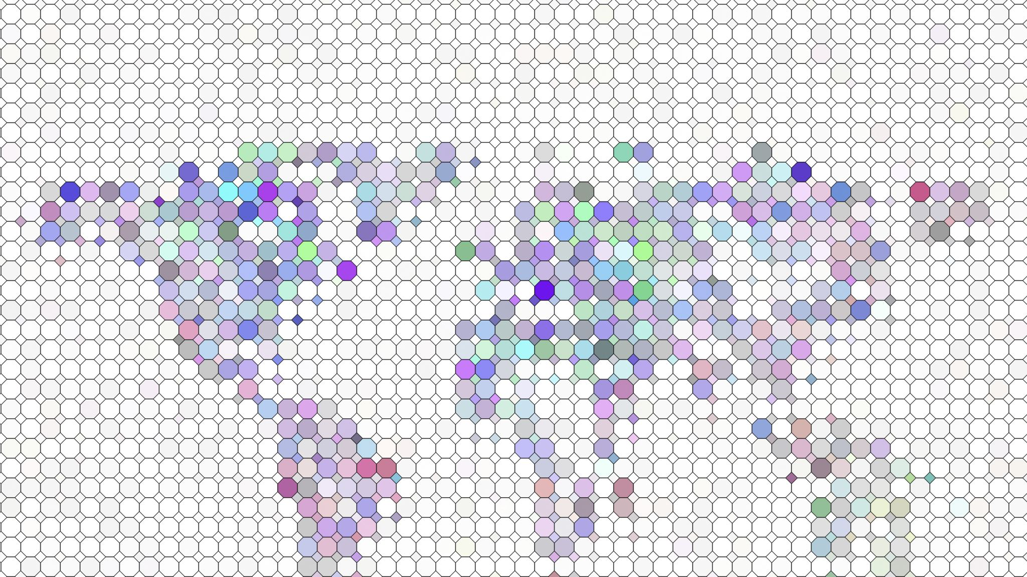
Applications of World Models

Slide 10
Dreaming in Atari

Slide 11
World Models Today

Slide 12
Dreamer: Diverse World Models

Slide 13
Surfer: Interactive World Models

Slide 14
Genie2: World Models for Robust Agents

Slide 15
Questions

Slide 16
Physical World Models with MuJoCo
Kiya Aminfar
Sean Steinle

Slide 17
Agenda
Background
Reinforcement Learning
OpenAI’s Gymnasium
MuJoCo
Physical World Model Components
Applications of Physical World Models
Q&A

Slide 18
Background

Slide 19
Physical World Model Components

Slide 20
Applications of Physical World Models

Slide 21
Questions

