Slide 1

World Models for Human Motion!
Kiya Aminfar
Sean Steinle

Slide 2
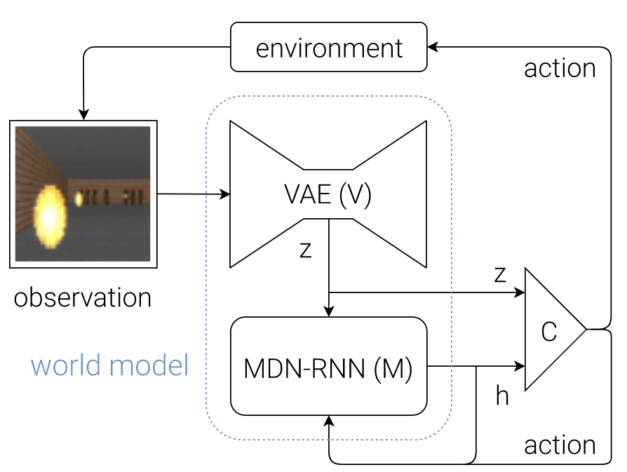
World Models Blend Reinforcement Learning with Generative AI to Master Environments
Core Components
VAE (V) – distill observations
MDN-RNN (M) – predict next state
Controller (C) – take action
Because system is complex, original authors implemented simple components

Slide 3
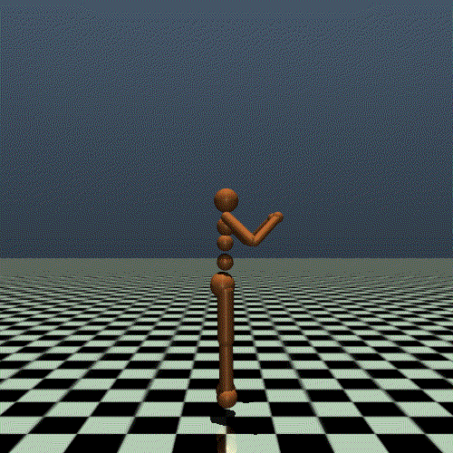
Can World Models Learn Human Motion?
Our task: make a human walk!
Gym/MuJoCo’s ‘Humanoid-v5’ task
Task is highly dimensional
>300 observations per step, 17-dimensional actions
Compared with random and PPO policies

Slide 4
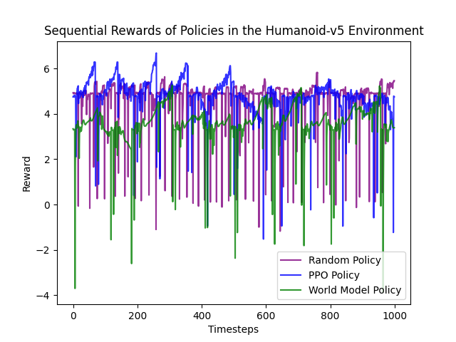
World Models Might Physical Dynamics Well
Learning human motion is expensive
PPO had ~2 hours to train, world model ~10
Neither policy performed better than random
World models have a sub random resting reward
Poor world learning leads to reward sinks?
Both models exhibit learning momentum

Slide 5

World Models Can ‘Dream’ Up Physics!
We didn’t get to ‘in-dream’ training
But, we did attempt to visualize dreams
Rendering from observations is incredibly lossy in MuJoCo
Rendered from true state

Slide 6
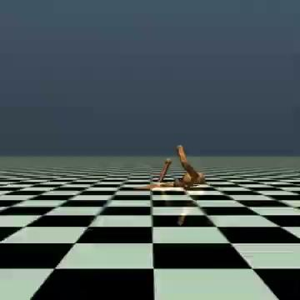
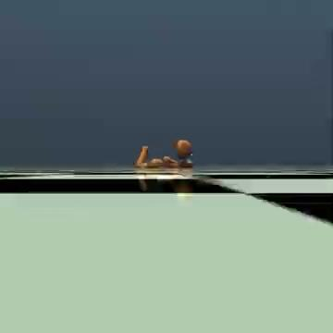
Rendering From Observations is Suboptimal
Rendered from reconstructed observations
Rendered from true observations

