Slide 1
Adaptive Independent Metropolis-Hastings
Paper by Lars Holden, Ragnar Hauge and Marit Holden

Slide 2


Standard Metropolis-Hastings
Choose $x_{t}$, an arbitrary point. Choose proposal function $g(x|y)$ (symmetric)
For each iteration $t$
Propose a candidate $x′$ from distribution $g(x^{′}|x_{t})$
Calculate the acceptance ratio $α=f(x^{′})/f(x_{t})$
Generate a uniform $u∈[0,1]$
Accept $x′$ if $u≤α$, $x_{t+1}=x′$
Reject otherwise, $x_{t+1}=x_{t}$
$f(x)$ is a function proportional to the target distribution $P(x)$

Slide 3
Remember Generalized Adaptive Rejection Sampling
The adaptivity is coming from using rejected observations to tune the proposal density
Store rejected observations, produce proposal density that uses the rejected observations

Slide 4

Adaptive Metropolis-Hastings
Set ${\tilde{y}}^{0}=∅$
Generate Initial state $x_{0}∈Ω$ from density $p_{0}$.
For $i=1,…,n:$
Generate a state $z_{i}$ from density $q_{i}(z_{i}|x_{i−1},{\tilde{y}}^{i−1})$.
Calculate $α_{i}\left(z_{i},x_{i−1},{\tilde{y}}^{i−1}\right)=min⁡\{1,\frac{π\left(z_{i}\right)q_{i}\left(x_{i−1} | x_{i−1},{\tilde{y}}^{i−1}\right)}{π\left(x_{i−1}\right)q_{i}\left(z_{i} | x_{i−1},{\tilde{y}}^{i−1}\right)}$
Set $x_{i}$
$z_{i}$ with probability $α_{i}\left(z_{i},x_{i−1},{\tilde{y}}^{i−1}\right)$
$x_{i−1}$ with probability $1−α_{i}\left(z_{i},x_{i−1},{\tilde{y}}^{i−1}\right)$
Set ${\tilde{y}}^{i}$= ${\tilde{y}}^{i−1}$ if $q_{i}$ depends on $x_{i−1}$, otherwise append ${\tilde{y}}^{i−1}$ with
$z_{i}$ if $z_{i}$ rejected
$x_{i−1}$ if $z_{i}$ accepted

Slide 5


Using The History Vector ${\tilde{y}}^{i}$ For Proposal
The history vector is used to choose proposal function $q_{i}$
Parametric
Use the history vector to estimate parameters
Target distribution complexity could be an issue
Non-Parametric
Issues with large history vector
Proposal density should not adapt too fast and should have heavier tails than the target distribution

Slide 6

Convergence
Doeblin condition:
Let $a_{i}\left({\tilde{y}}^{i−1}\right)∈\left[0,1\right]$ be a constant. Condition is satisfied if
$$q_{i}\left(z | x,{\tilde{y}}^{i−1}\right)≥a_{i}\left({\tilde{y}}^{i−1}\right)π\left(z\right)$$
For all $\left(z, x,{\tilde{y}}^{i−1}\right)∈Ω^{i+1}$ and for all $i≥1$.
The Doeblin condition requires that the proposed distribution has heavier tails than the target distribution.
This can be achieved by using $\left(1−ε\right)q_{i}\left(z | x,{\tilde{y}}^{i−1}\right)+εg(z)$
Where $g\left(z\right)$ is a density with very heavy tails.

Slide 7


Convergence
Let $p_{i}\left(x_{i}\right)$ be the distribution of $x_{i}$ after $i$ iterations and let ${\hat{p}}_{i}\left(x_{i}|{\tilde{y}}^{i}\right)$ be the conditional distribution of $x_{i}$ given the history vector.
Theorem 1. The limiting density $π$ conditioned on the history is invariant for the adaptive independent Metropolis-Hastings algorithm, that is,
${\hat{p}}_{i}\left(x_{i}|{\tilde{y}}^{i}\right)=π\left(x_{i}\right)$ $⇒$ ${\hat{p}}_{i+1}\left(x_{i+1}|{\tilde{y}}^{i+1}\right)=π\left(x_{i+1}\right)$

Slide 8


Total Variance (TV) norm or total variation distance is given as:
$${\left|\left|p_{i}−π_{i}\right|\right|}_{TV}=\int_{Ω}{|p_{i}(x)−π_{i}(x)|dμ(x)}$$
Theorem 2. Assume the adaptive independent Metropolis-Hastings algorithm satisfies Doeblin Condition. Then
$${\left|\left|p_{i}−π_{i}\right|\right|}_{TV}≤2\int_{Ω^{i}}{{\tilde{p}}_{i}\left({\tilde{y}}^{i}\right)\prod_{j=1}^{i}{\left(1−a_{i}\left({\tilde{y}}^{i−1}\right)\right)dμ\left({\tilde{y}}^{i−1}\right)}}$$
$$=2E\prod_{j=1}^{i}{\left(1−a_{i}\left({\tilde{y}}^{i−1}\right)\right)}$$
If $a_{i}\left({\tilde{y}}^{i−1}\right)≥a_{j}$ for all j and $\left({\tilde{y}}^{i−1}\right)∈Ω^{j−1}$ then
$${\left|\left|p_{i}−π_{i}\right|\right|}_{TV}≤2\prod_{j=1}^{i}{\left(1−a_{j}\right)}$$
This algorithm converges if this product goes to zero when $i→∞$. If $a_{j}>a>0$ infinitely often, the algorithm samples from the target distribution within a finite number of samples with a probability arbitrarily close to 1.

Slide 9

Theorem 2
Convergence is geometric
In each iteration chain jumps to the limiting density $π$ with probability $a_{j}\left({\tilde{y}}^{j−1}\right)$
Chain then remains in this density due to the invariance (Theorem 1)
Success in generating better proposal distribution increase the probability of a jump to the limiting density
This will also decrease the number of iterations before convergence.

Slide 10
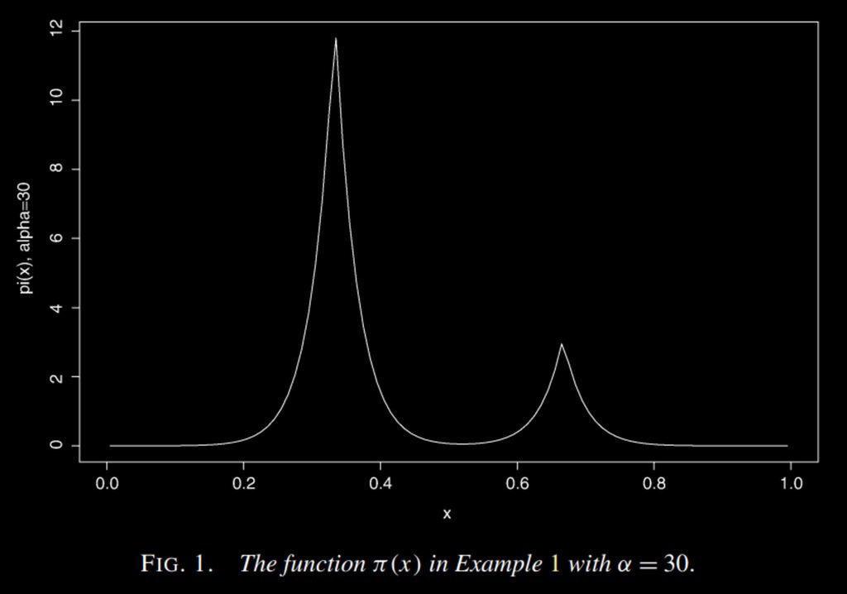

Example 1
$π\left(x\right)=4c min\left\{{\left(x+\frac{2}{3}\right)}^{α},{\left(\frac{4}{3}−x\right)}^{α}\right\}+$ $c min\left\{{\left(x+\frac{1}{3}\right)}^{α},{\left(\frac{5}{3}−x\right)}^{α}\right\}$
$q_{i}^{1}\left(x\right)=1$
$q_{i}^{2}\left(x\right)=\frac{1}{L}$ for $x∈\left(x_{i−1}−\frac{L}{2},x_{i−1}+\frac{L}{2}\right)$, 0 otherwise
$q_{i}^{3}\left(x\right)=$
$1−2p+\frac{p}{L}$ if $x∈\left(z_{i}^{j}−\frac{L}{2},z_{i}^{j}+\frac{L}{2}\right)$ $j=1, 2$
$1−2p$ otherwise
$z_{i}^{1}, z_{i}^{2}$ are the best guesses. Observations that have the highest density value.
$L$ is the step length.
$2p$ is the probability of proposing a local jump.

Slide 11
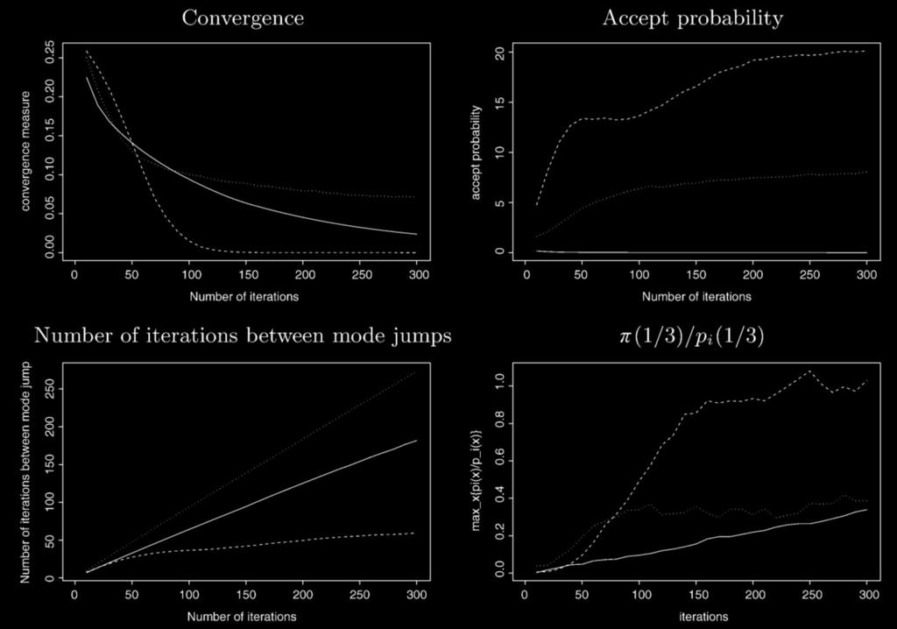
Example 1

Slide 12

Example 2
$$f\left(x\right)=3sin\left(x_{1}π\right)−\frac{x_{1}}{2}+\sum_{i=2}^{5}{\sin\left(\frac{x_{i}π}{2}\right)}$$
Use Bayesian approach with uninformative prior and the likelihood:
$$l\left(x | d\right)=\exp\left(−\frac{{\left(f\left(x\right)−d\right)}^{2}}{σ^{2}}\right)$$
Approximation of function $f(x)$ by a linear regression
$$\hat{f}\left(x\right)=a_{0}+\sum_{i=1}^{5}{a_{i}x_{i}}+bx_{1}^{2}$$
Proposal function is proportional to the likelihood but with linear model above.
$$\hat{l}\left(x | d\right)=\exp\left(−\frac{{\left(\hat{f}\left(x\right)−d\right)}^{2}}{{5σ}^{2}}\right)$$

Slide 13
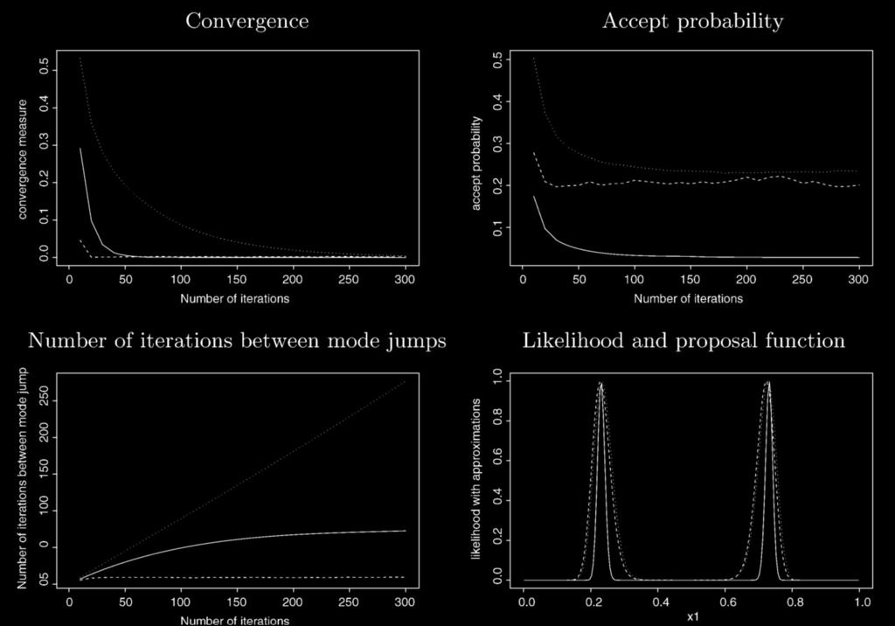
Example 2

Slide 14
Reference
Holden, L., Hauge, R., & Holden, M. (2009). Adaptive independent Metropolis–Hastings. The Annals of Applied Probability, 19(1), 395–413. https://doi.org/10.1214/08-AAP545

