Slide 1
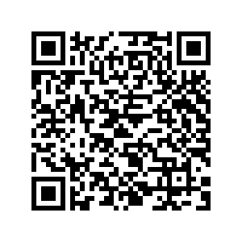
Navigation Assistance for the vision impaired
School of Electrical Engineering and Computer Science
Jacy barr, Samuel Lee & Sean Sylwester
This wearable system consists of a headband of sensors and a waistband mounted with 8 haptic feedback motors.
The system improves navigational ability of the vision impaired by translating visual information that the individual is lacking into tactile feedback.
360° visual information picked up by the headband sensors is analyzed to determine the locations of nearby objects. This information is relayed to the wearer by vibrating the waistband motors.
Motors in the direction of detected objects vibrate, with increasing vibration intensity corresponding to closer objects.
The system has a rechargeable 12hr battery life, a range of 1m in 360° and 5m in front of the user, a response time of 200ms, is completely waterproof, and weighs less than two pounds.
For more information, follow this QR code to
the project’s Google Site.
bit.ly/ECE44x-NAVI
Notes:
Must be in Slide Master mode to swap out photos.

