Slide 1

Southern New Hampshire University Travel Scrum-Agile Team

Slide 2
Scrum-Agile Team Roles
Product Owner – the Product Owner is accountable for creating a valuable, visible, and transparent backlog. The Product Owner also gives direction to the work of the development team.
Scrum Master – The Scrum Master is responsible for leading Scrum events. The Scrum Master maximizes the value of Scrum events such as sprint planning, daily scrums, backlog refinement, sprint reviews and sprint retrospective. It is the Scrum Masters responsibility to ensure that all scrum events adhere to Scrum theory, practices and rules.
Developers – It is a Developers responsibility to plan, design and code the software for a project. Developers are responsible for creating high-standard code using elaborate design templates and other development tools. Developers must know and understand all system requirements and be able to communicate with other team members about requirements.
Testers – A Tester’s duty is to test already developed software and work out any bugs that may exist. A Tester uses information given from the Product Owner to create user stories to ensure that the software that is being developed will meet all the client and stakeholders’ needs. If software needs debugged or updated it is a Tester’s job to fix the code or communicate with the Product Owner or Developers.

Slide 3
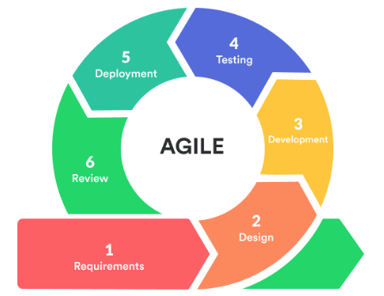
Phases of an Agile Software Development Life Cycle
Analysis – In the analysis phase of the SDLC all the project requirements are collected from the client and stakeholders.
Design – In the design phase of the SDLC charts and diagrams will be created to describe the system that will be developed using the system requirements.
Development – The development phase is the process of producing little bits of system code for testing and deployment.
Testing – The testing phase is where code that has been developed will be tested with use stories and debugged.
Deployment – The deployment phase of the agile process is when the software will be deployed.
Maintenance – After each step in the agile process, the maintenance phase may be implemented if necessary. The maintenance phase is the phase where any maintenance to the system will be done.

Slide 4
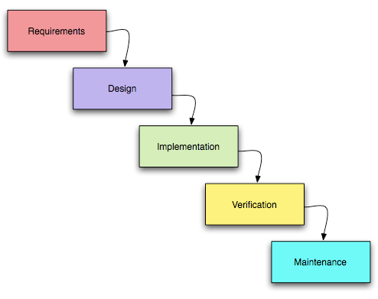
The Difference Between A Waterfall and Agile Approach The phases of a waterfall approach and an agile approach have similar phases but different processes. If a waterfall development approach was used for the SNHU Travel project, the team would have used a top-down development approach; meaning that the phases of the SDLC are completed in sequence. Using a waterfall approach would not have allowed the team to move through SDLC phases freely. Code for the product would have also been developed completely and then tested when all the code was finished. By using an agile approach, the team was able to cycle through any phase of the SDLC at any stage of development with ease. By using the agile approach, code was developed in segments and tested frequently.
VS.

Slide 5
How to Choose Between a Waterfall or Agile Approach
The best way to determine whether a waterfall or agile approach is best for a project is to analyze the requirements. If a project surely will have concrete timelines and concrete requirements a waterfall approach is the logical path. If a project doesn’t have a set timeline and can intuitively be declared as a complex design process, an agile approach is best.

Slide 6
References
Charles G. Cobb. (2015). The Project Manager’s Guide to Mastering Agile : Principles and Practices for an Adaptive Approach. Wiley.
Schwaber, K. (2020). SCRUM development process. Business object design and implementation (pp. 117-134). London: Springer London.

