Slide 1
Grading assistant for lecturers and students
Sean Vowles | 13065858 | CS3D66 | 2017
Supervisors:
Dr. Janusz Kulon
Dr Bertie Muller

Slide 2
What is the project?
Marking and Analysis of electronically submitted assignments
How objectives are outlined
How objectives are achieved
How assignments are scored
Fairness
Encapsulated into a piece of software
Software is a web driven application

Slide 3
rubrics
“A rubric is a coherent set of criteria for a student’s work that includes descriptions of levels of performance quality on the criteria” (Brookheart, 2013)
Notes:
Brookhart, S. (2013). How to create and use rubrics for formative assessment and grading. 1st ed. Alexandria, VA: ASCD

Slide 4
What does this mean?
Divide an assignment into parts or sections
Sections have descriptions of tasks to be completed
Sections of tasks increments in difficulty based on the previous task
Distinction would be the highest level of difficulty
Pass would be the lowest level of difficulty
So what is a fail?

Slide 5
Visualize it
Rubric Component | 1 | 2 | 3 | 4 | Student’s Score
Component 1
Component 2
Component 3
Component 4
Component 5

Slide 6
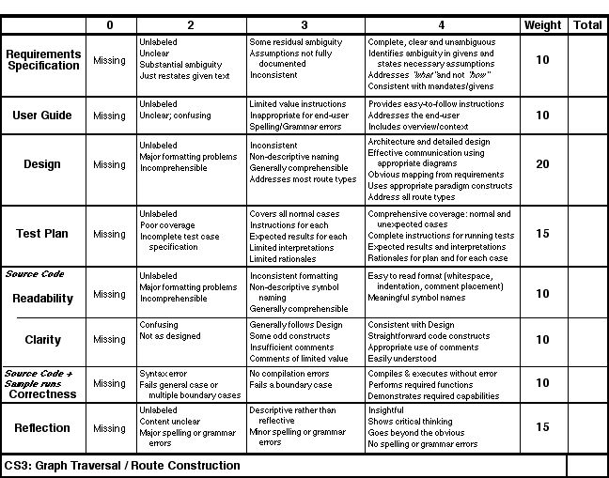
Rubric Example:
Difficulty reads from left to right
Technically, can’t achieve the next tasks section until the previous task has been achieved
A task should be a building block to achieve the next task making up the rubric
(Paul, 2017)
Notes:
Paul, J. (2017). [image].
Source code: No compilation errors. We can assume that there are no syntax errors.
What if we change no compilation errors to correct logical approach?

Slide 7
What does this do?
Provides a guideline for marking
Gives students clear objectives to reach
Reduces interpretation of marking, making cross marking fair

Slide 8
What does the application do?
From the front end:
At its current state the application allows lecturers to view rubrics
Lecturers can score each criterion
Lecturers can save to score
Post assignment grades back to the database

Slide 9
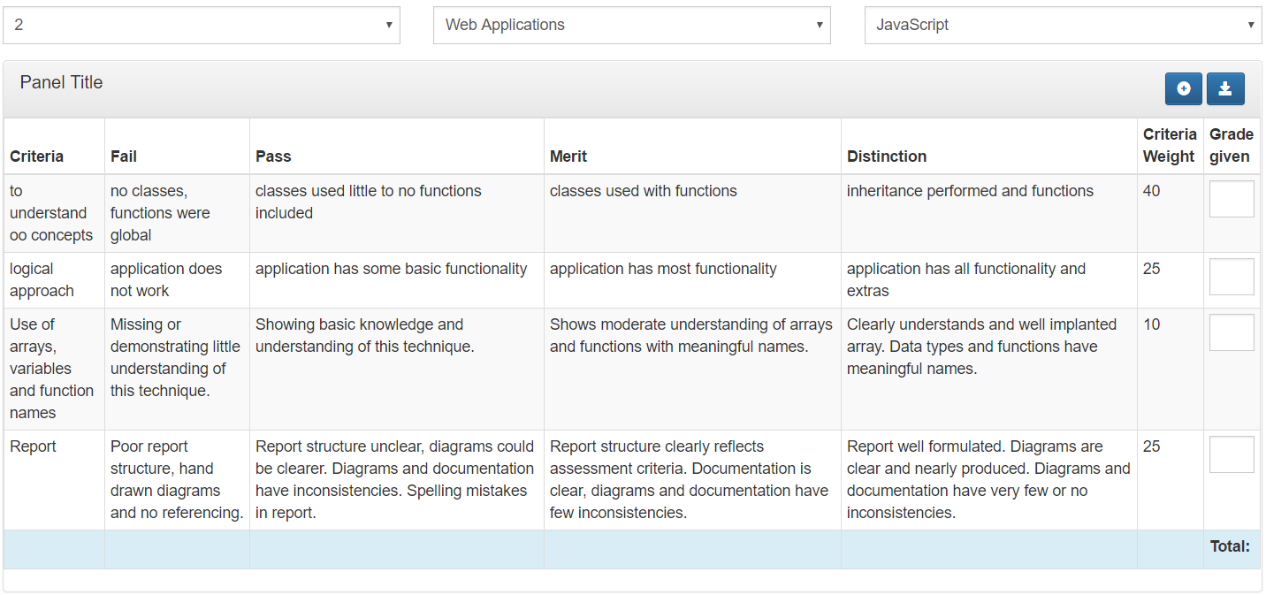
Application
Each criteria has a total weight
The grade given is out of 100
Performs calculations on the overall assignment
Notes:
Demo the application here

Slide 10
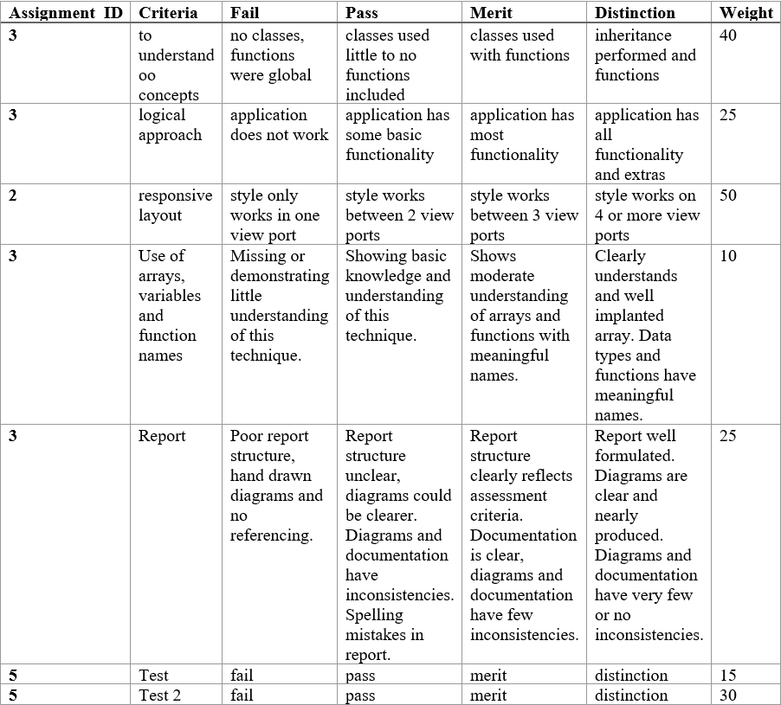
Infrastructure
Database logic is almost complete with few changes required
Stores users, their modules and assignments associated
Stores grades that have been posted from the web client
Notes:
Demo system

Slide 11
Improvements
Design Patterns
Front-end frameworks
Back-end frameworks

Slide 12
MVC Design Pattern

Slide 13
Frameworks
Backend
Symfony
Laravel
CakePHP
.NET
Frontend
VueJS
Ember
Angular

Slide 14
Additions
Rescale module score
Separate Account Privileges
Dashboard class
Instantiate a view dependent on the account type
Mobile View
Possible transpose to a native app?

