Slide 1

The Fourier Transform
Prof John Mitchell
Department of Electronic & Electrical Engineering
University College London
Email: j.mitchell@ucl.ac.uk

Slide 2
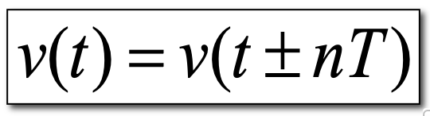
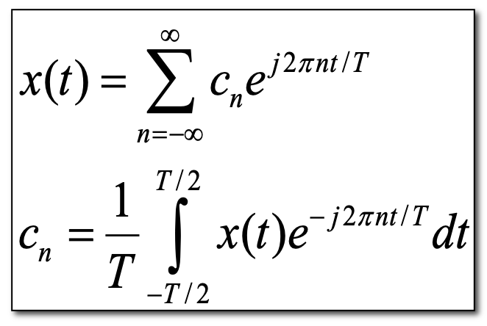
Fourier Series
A periodic signal is one that repeats at equal intervals of T. Formally we can say that:
where n is any integer

Slide 3
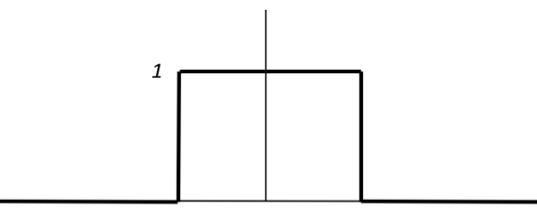
Consider the square pulse again
rect(t)
1 -½ ½ 1
T
F(nω₀)= Sinc (n/T)

Slide 4
T=2

Slide 5
T=4

Slide 6
T=8

Slide 7
What happens as T ➔∞?
The spacing between frequency components gets smaller.
When T=∞ then the spectrum becomes a continuum.
Note: the shape of the curve seems to be independent of T
we can replace nω₀ by a continuous variable ω and the summation by integration

Slide 8
The Fourier Transform
We denote F and F⁻¹ as the Fourier transform and the inverse Fourier transform respectively. Notice that Fourier transform and the inverse Fourier transform are similar in form, albeit with the exception of the 2π scale factor and the different sign in the complex exponential.

Slide 9
However, we like to work with f
Fourier Transform
Inverse Fourier Transform

Slide 10
Definitions
The forward and inverse transforms relate a time signal x(t) and its (Fourier) spectrum X(f)
Commonly x(t) is real and X(f) complex, although in general both x(t) and X(f) may be complex.
Note the use of f as the frequency variable, rather than ω=2πf
Produce a continuous spectrum as they have no well-defined period

