Slide 1
Linearity
What is the Fourier transform of a.x(t)+b.y(t)

Slide 2
Why is this useful
z(t)
2
1
t
-4 -2 0 2 4
x(t)
t
-4 -2 0 2 4
y(t)
-4 -2 0 2 4
t

Slide 5
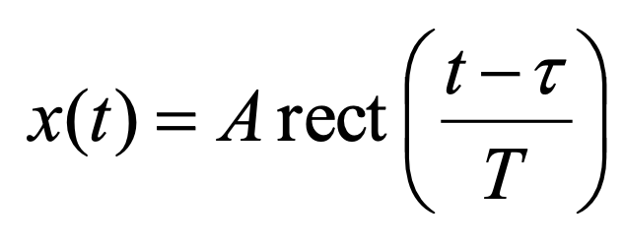
Fourier Transforms
Find X(f)
τ-T/2
τ
τ+T/2
t

Slide 6
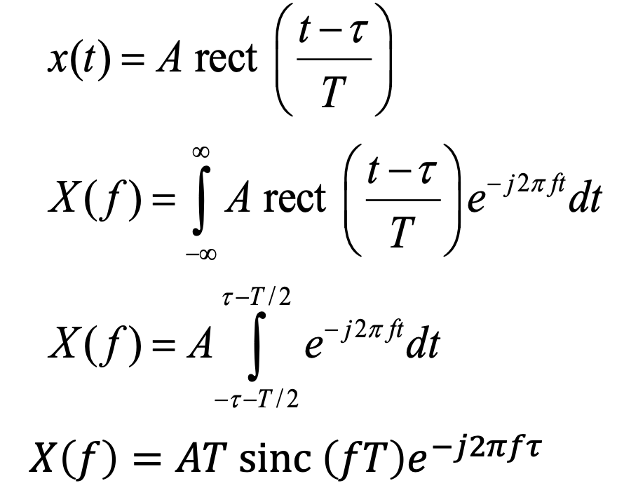
Fourier Transforms - Answer

Slide 7
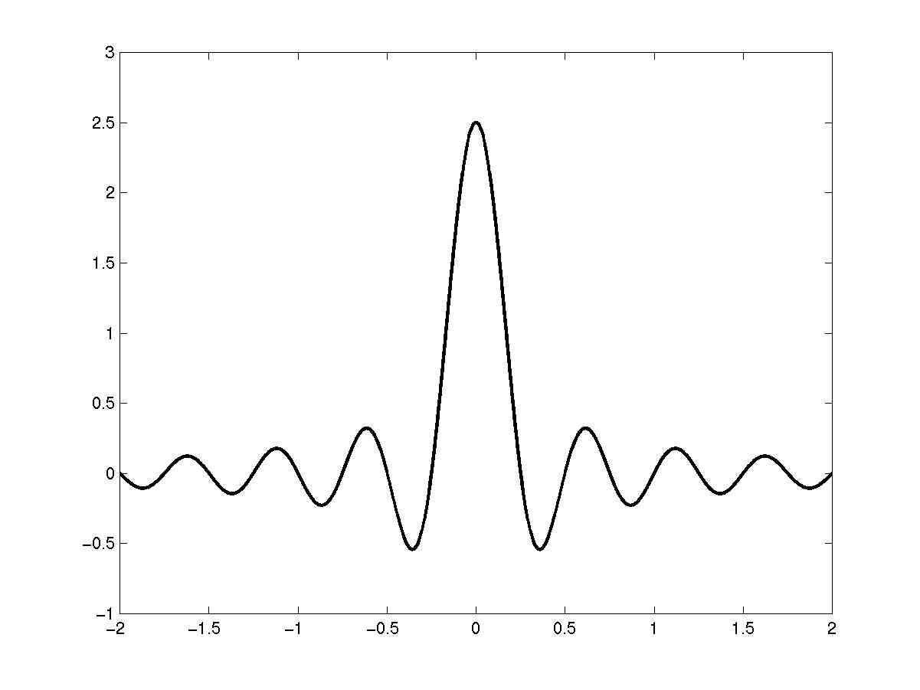
Fourier Transforms - Answer
A=5
T=0.5
τ=2

Slide 8
Shifting and dilation
The results are presented in terms of shifting and dilation a time function but apply equally - via symmetry - to shifting and dilation of frequency domain functions, to within the sign of the exponent.
Notes:
Scaling a function in the time domain involves essentially the inverse scaling operation in the frequency domain. Making a signal wider in the time domain has the effect of concentrating the spectrum more closely around the origin.
Shifting the signal in the time domain simply introduces a linear phase term in the frequency domain.

Slide 9
Modulation
Often when we modulate we times a signal by a carrier (usually a complex sinusoid).
What will the Fourier transform be?

Slide 10

Modulation

Slide 11
Exercise
What is the Fourier Transform of the modulated signal.

Slide 12
Exercise

Slide 14

Convolution
Often we need to convolve two functions. For example if we want to know what the output of a filter we convolve the input signal with the impulse response.
What happens in the frequency domain?

Slide 15
Convolution
Convolution in the time domain results in multiplication in frequency domain.

Slide 16
Why might this be useful?
1
1
*
t
t
-1/2 1/2
-1/2 1/2
2
=
-1 0 1
t

Slide 17
Multiplication
Using our rules of duality we should also be able to work out that multiplication in the time domain results in?

Slide 18
Multiplication
Convolution in the frequency domain

Slide 19
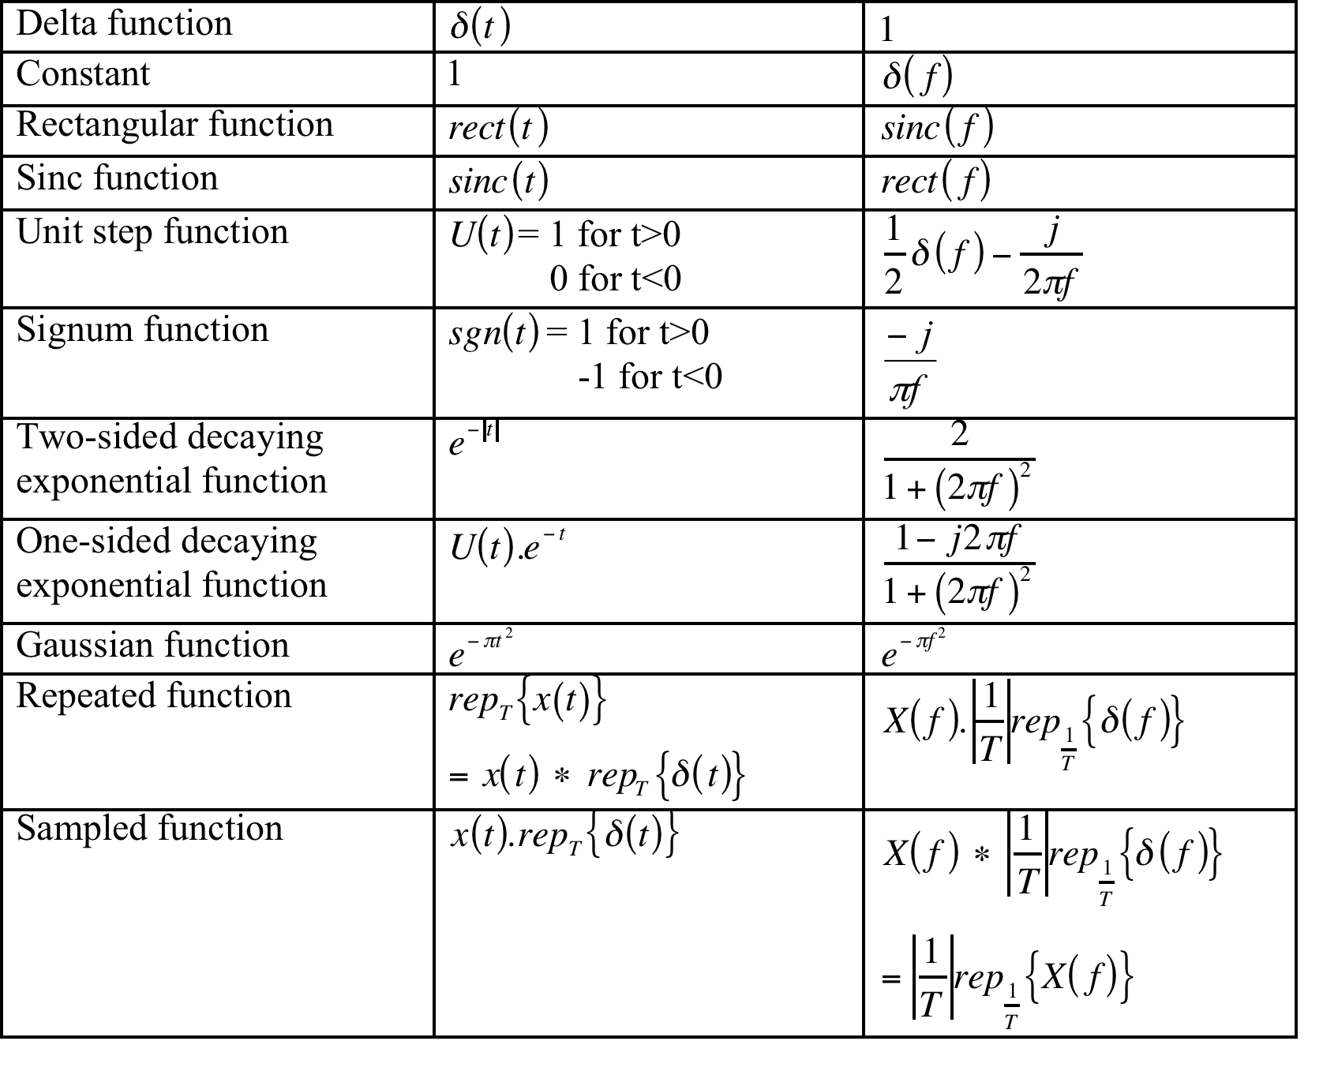
Common Pairs

Slide 20
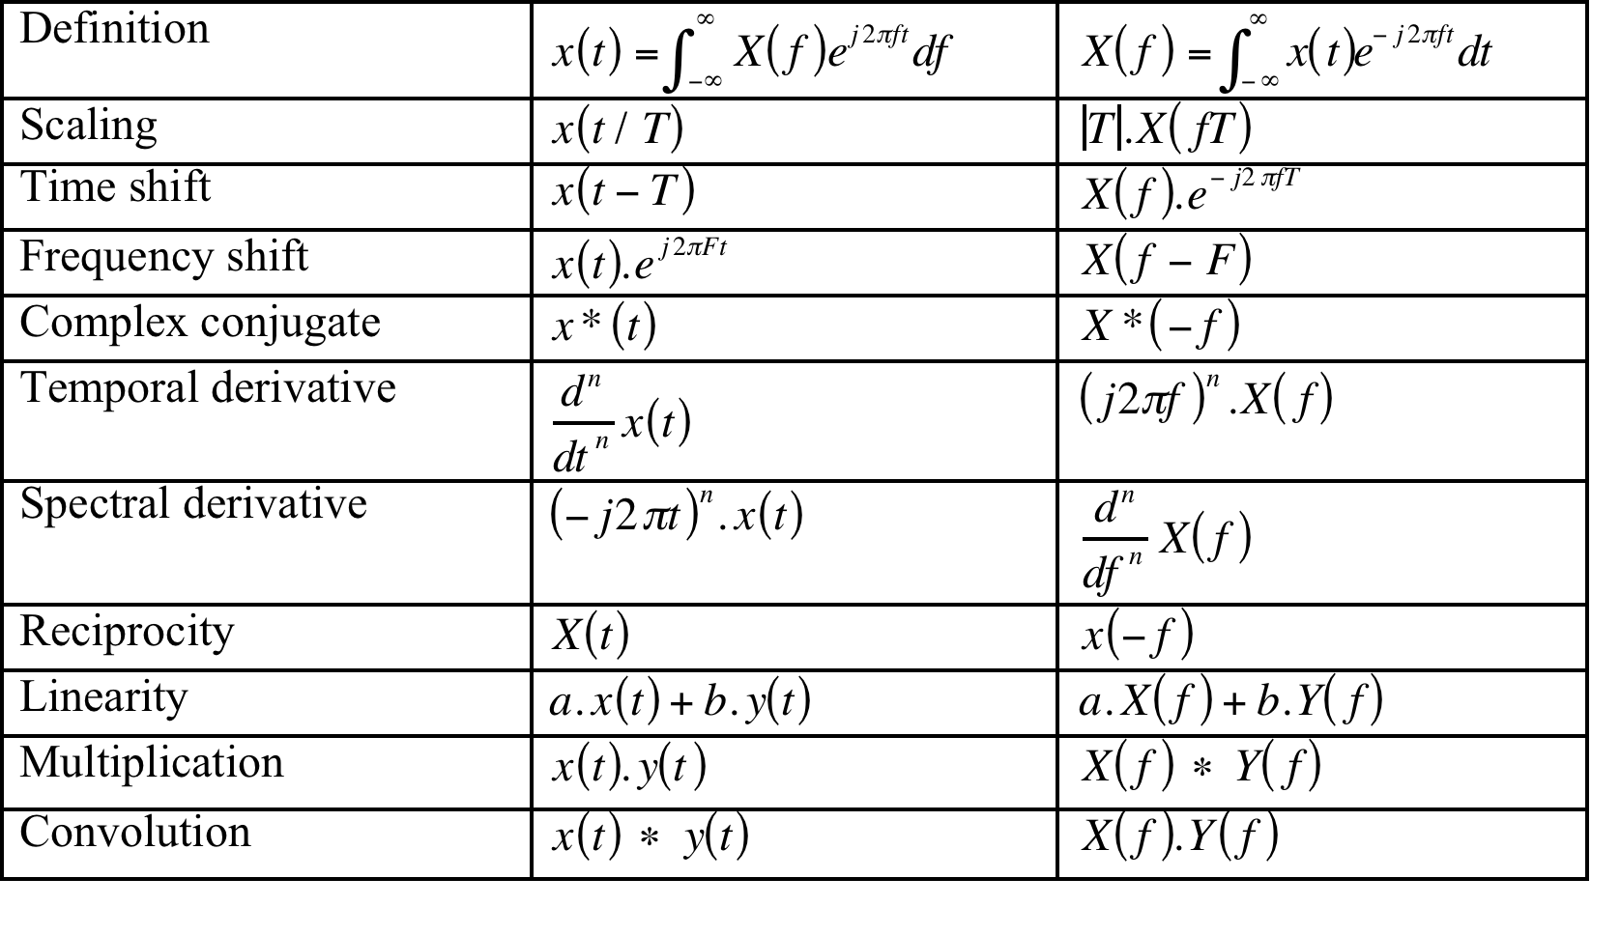
Fourier ‘Rules’

