Slide 1
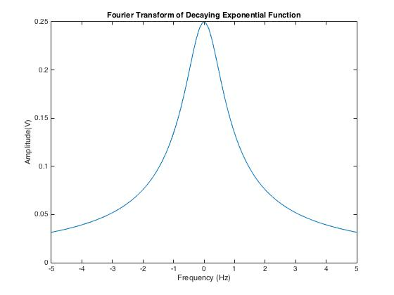
a=4

Slide 2
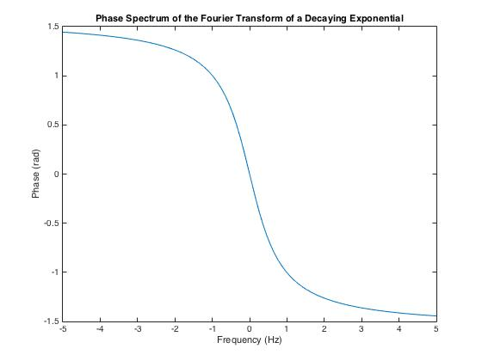

Slide 3
MATLAB Code
f=linspace(-5,5);
v=abs(1./(a+(i.*pi.*f*2)));
phase=angle(1./(a+(i.*pi.*f*2)));
figure(1)
plot(f,v)
figure(2)
plot(f,phase)

Slide 4
Summary of key points so far
Fourier Series looked at periodic signals
Fourier Transforms extend this to non-periodic signals
The Fourier Series showed what sinusoids made up the signal in the Time Domain.
The Fourier Transform gives an equation of the signal in the Frequency Domain.
The Fourier Transform goes from the time domain to frequency domain
The Inverse Fourier Transform goes from frequency domain to the time domain.

Slide 5
Summary of key points so far
We denote a signal in the time domain with a small letter i.e. x(t), v(t), y(t), h(t) etc.
We denote a signal in the frequency domain with a capital letter, i.e. X(f), V(F), Y(F), H(F) etc.
x(t) forms a Fourier Transform pair with X(f)

Slide 6
Recap – Fourier Transform
Fourier Transform
Inverse Fourier Transform

Slide 7
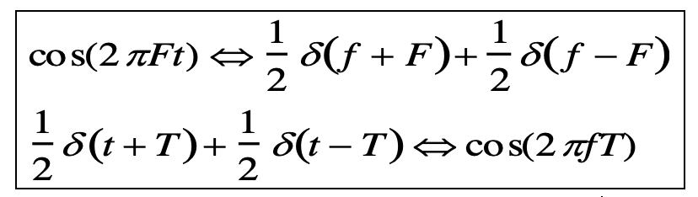
Fourier Pairs - Cosine
t
f
-F
F
t
f
-T
T

Slide 8
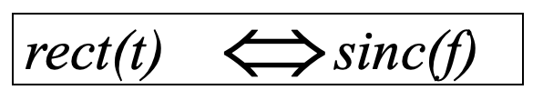
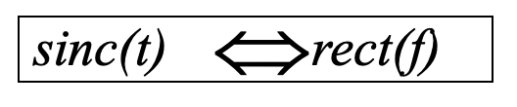
Fourier Pairs - Rectangle
t
f
t
f

Slide 9
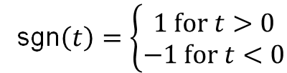
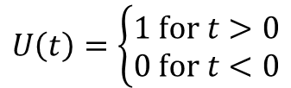
Other signal shapes you should know
Unit Step
$$U\left(t\right)=\left\{\begin{aligned}1 \text{for} t>0 \\ 0 \text{for} t<0\end{aligned}\right.$$
1
0
t
Signum
sgn$\left(t\right)=\left\{\begin{aligned}1 \text{for} t>0 \\ −1 \text{for} t<0\end{aligned}\right.$
1
0
t
-1

