Slide 1
Scaling

Slide 2
Dilation
What is the Fourier Transform of g(at)
1
g(t)
t
-1/2 1/2
1
g(at)
t
-1/2a 1/2a

Slide 3
Dilation

Slide 4
Dilation

Slide 5
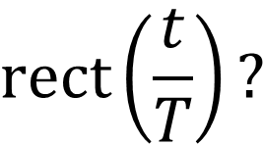

Dilation of a function
$$\text{rect}(t)$$
$$\text{rect}\left(\frac{t}{T}\right)?$$

Slide 6
Dilation

Slide 7
Dilation or Shifting property

Slide 8
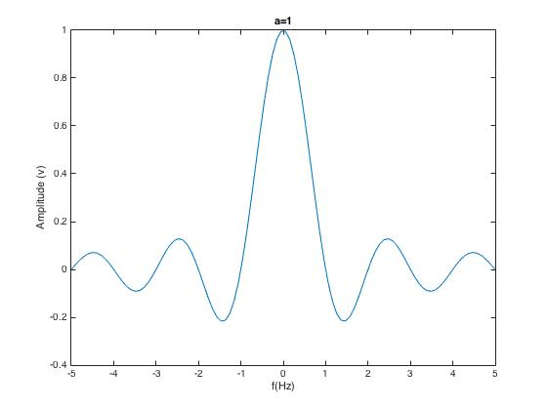

Slide 9
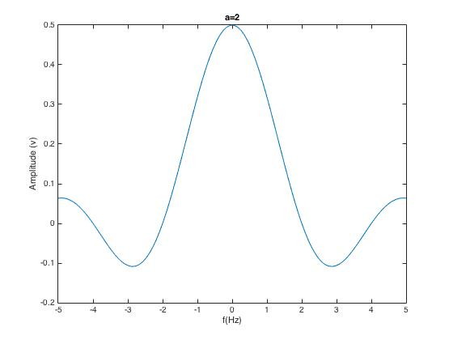

Slide 10
