Slide 1
First – some common functions

Slide 2
Examples

Slide 5
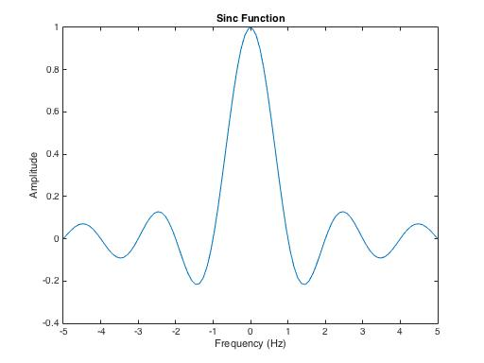
Sinc Spectrum

