Slide 1
Wireline Systems
Dr Cyril Renaud
c.renaud@ucl.ac.uk

Slide 2
Overview
The ‘Copper’ Channel
Twisted Pair
Coax
Wireline Systems
ISDN
xDSL
Ethernet
DOCSIS
Powerline Communications

Slide 3
Twisted pair copper connections
The characteristics of the connection is very variable
Important characteristics include:
attenuation
phase response
characteristic impedance
crosstalk
noise
Need an understanding of these in order to appreciate the limitations of the access network and how we may overcome some of these limitations

Slide 4
Unshielded Twisted Pair UTP
Plastic Outer (Insulator)
Shielded Twisted Pair STP
Metallic Shield
Plastic Outer (Insulator)

Slide 5
Attenuation
Attenuation is a function of frequency due to the “skin-effect”
0.32 mm Cu
10
Attenuation (dB/km)
0.9 mm Cu
1.0
0.1
1
10
100
1000
Frequency (kHz)

Slide 6
Phase response
The phase response of twisted copper is fairly linear beyond about 10 kHz
At around 200 kHz, a cable contributes about 360º/km of phase offset
The variation between different cable diameters is very small
A non-linear phase response - corresponding to a non-flat group delay - would distort digital pulses

Slide 7
Characteristic impedance
A twisted pair copper cable is a transmission line and exhibits behaviour just like any other transmission line
A wave travelling along the line sees an impedance
This is termed the characteristic impedance
1200
800
Impedance (ohms)
0.32 mm Cu
400
0.9 mm Cu
0
1
10
100
Frequency (kHz)

Slide 8
Voice band modems
56 kbit/s over a standard voice connection – at its peak there were over 600 million such connections in the world
V.34 modems achieve 10 bits/Hz of bandwidth by using high level modulation and DSP
Often though they are forced to operate at lower speeds due to inadequate line SNR
Set-up time is also very long
Dial up networking……..
Now mostly consigned to the history books!

Slide 9
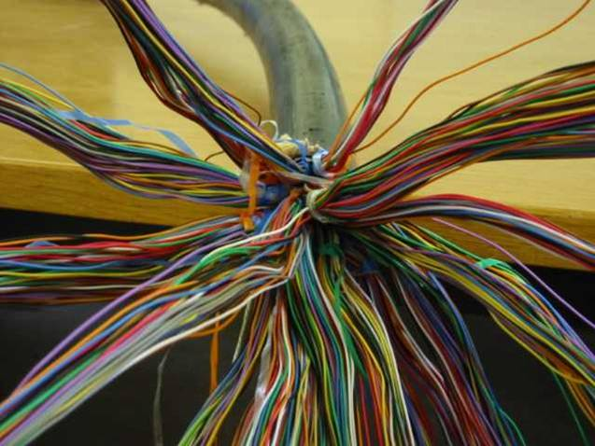
Crosstalk
A telephone cable usually contains hundreds or thousands of wire pairs packed closely together
Due to the electro-magnetic field created when a signal propagates a signal is induced into the nearby wires.
This is reduced by the
twisting by some crosstalk
still remains
This is a primary limiting
factor for high rate
transmission

Slide 10
Near-End Crosstalk
NEXT
Major problem for systems that share the same frequency band upstream and downstream

Slide 11
Far-End Crosstalk
FEXT
Less severe than NEXT as the FEXT noise is attenuated due to the transmission over the cable length

Slide 12
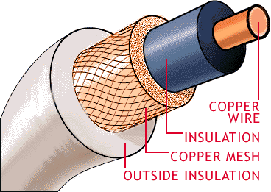
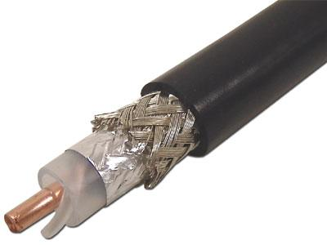
Co-axial Cable

Slide 13
Wireline Systems

Slide 14
ISDN
An ISDN connection provides two 64 kbit/s bearer (B) channels and one 16 kbit/s data (D) channel
Some extra overhead pushes the raw data rate at the customer interface (U-interface) to 192 kbit/s
ISDN uses a 2B1Q (2 data bits are mapped to 4-levels) signal format
This limits the spectrum to about 120 kHz and can typically be supported over an access connection of about 5 km

Slide 15
Primary rate ISDN access
30 B channels and a 64 kbit/s D channel can be provided at 2.048 Mbit/s in a frame of 125 μs duration
TS0 is used for synchronisation and TS16 provides the D channel
The customer is provided with half width 3V pulses on a twisted copper pair coded with HDB3 (or 2.37V pulses on a 75 Ω coaxial cable)
Data is sent in both directions simultaneously using echo-cancelled hybrid (ECH) transmission, and adaptive equalisation

Slide 16
xDSL technologies
Basic digital subscriber line configuration is to have 2 modems
one at the customer end and the other in the network
xDSL allows a subscriber line to support both POTS and high speed data
Variants include:
HDSL - high data rate DSL
SDSL - single line DSL
RADSL - rate adaptive DSL
ADSL - asymmetric DSL
VDSL - very high rate DSL

Slide 17
ADSL over POTS Reference Model
Central Office
Customer Premises
PSTN
Switch
up to 8 Mbit/s
ATU-C
ATU-R
Network
twisted pair
splitter
splitter
DSLAM
up to 640 kbit/s
CPE
DSLAM - Digital Subscriber Line Access Multiplexer
Spectrum allocation
POTS
DOWN
UP
Frequency
4 kHz
32 kHz
1.1 MHz
POTS

Slide 18
DMT Technology
power
spectrum
tone spacing
(4.3 kHz)
max 3 dB variation
POTS
frequency
32 kHz
1.1 MHz
4 kHz
spectrum used
for upstream data
spectrum used
for downstream data
Total bandwidth = 1.1 MHz = 255 Tones
Each tone is QAM modulated and individually optimised with respect to the noise in the channel
Tones may be switched off if the noise is too high

Slide 19
ADSL key advantages
No cable deployment
Low installation cost: no civil engineering works are required
Fast connection of new users
Per-user basis introduction capability
Investment nearly proportional to service demand
Second virtual line
line available for telephone calls even when surfing
Always on Connection
LAN like
resources used only when data are really transmitted
High peak bitrate
Bitrate scalability from 100 kbit up to 8 Mbit/s

Slide 20
ADSL Local Loop Impairments
The performance
of ADSL is
distance dependent
Attenuation
Cross Talk
Unbalanced loops
Noise
Gauge mismatches
Loading coils
Bridged Taps

Slide 21


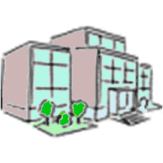
Loop Qualification
Basic Qualification
Insulation resistance
Continuity
Capacitance
Map Analysis
Estimation of the insertion loss using maps
Field Testing
Actual on site testing
Truck roll
2km
4km
6km
8km
http://www.broadbandspeedchecker.co.uk/

Slide 22
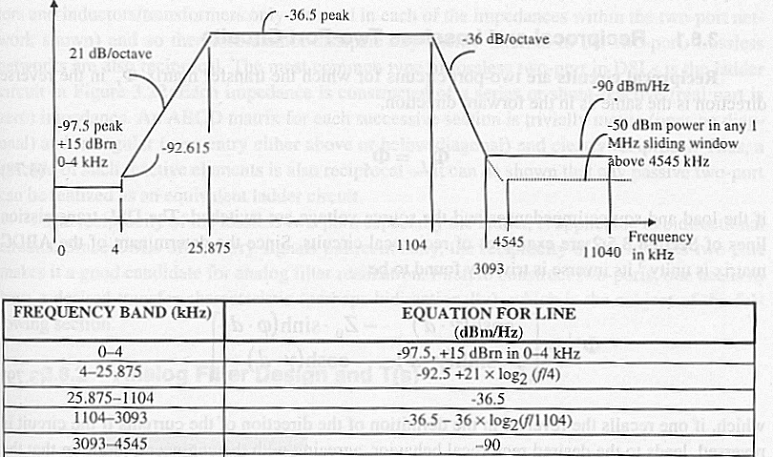
Emissions from DSL
Emissions from wires carrying DSL have become of increased importance as a number of radio bands overlap the transmission spectrum.

Slide 23
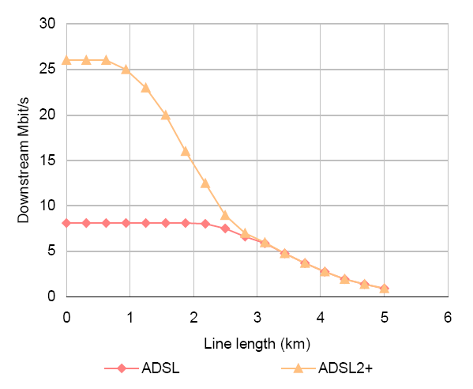
ADSL Reach
Source: Analysys, IEEE

Slide 24
ADSL summary
Utilises the legacy copper access network - a major benefit to incumbent telcos
No major upgrades required to the POTS switches
Opens up new revenue streams
Low fixed costs (ADSL rack in exchange etc) but relatively high marginal costs (ADSL modems can cost around $100/pair)
Allows incremental deployment
Very capital efficient in that service is only provided to those who need it
Still not providing true triple play

Slide 25
VDSL
Broadband services could do with a higher data transfer rate than ADSL can support
The same principles as ADSL (clever DSP) can be applied to address this by limiting the reach of the system
VDSL supports data rates to over 50 Mbit/s to the customer thereby enabling support of these very broadband services
The shorter reach of VDSL though means that data must be carried from the exchange to a point close to the customer (see later)
VDSL Cabinet
PCP
New Fibre Feed
Exchange
Existing E-side Cables
Existing D-side Cables
Bit rate (Mbit/s) | Reach | Suitability
13 | 1.5 km | FTTCab
26 | 1.0 km | FTTC/FTTB
52 | 300 m | FTTB

Slide 26
Ethernet
Ethernet is a family of frame-based computer networking technologies for local area networks (LANs).
Multiple media options
Twister Pair Copper
Coax
Optical Fibre
Standards for 10Mbit/s, 100Mbit/s (Fast), 1Gbit/s (GE) and recently 10Gbit/s (10GE or XGE).

Slide 27
Ethernet over twisted pair
Referred to as xBASE-T (where x is 10,100, 1000)
The cables usually used are four-pair twisted pair cable.
Speed (Mbit/s) | Distance (m) | Standard /Year
10 | 100 | 10BASE-T 1990 | Four wire (two pair), Cat3 or Cat5, Manchester Coding
100 | 100 | 100BASE-T 1995 | 4B5B coding, Cat5 Cabling using two pair
1000 | 100 | 1000BASE-T 1999 | PAM-5 Coding, recommended Cat5e using four pairs
10000 | 100 | 10GBASE-T 2006 | Shielded or unshielded Cat6, PAM-16

Slide 28
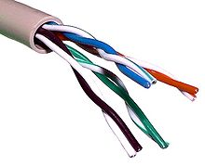
Cable Types
All contain four twister pairs
Category 3
Frequencies to 16MHz
Category 5
Characteristics defined up to 100MHz
Category 5e
Characteristics defined up to 100MHz
Category 6
Performance up to 250MHz

Slide 29
CATV
Originally developed to distribute video to residential communities
Offerings typically include a basic package, a premium package and a pay per view package
The network was designed around a one way broadcast network where filters and scrambling where used to provide conditional access to different customers
Impulse pay per view made use of a telco return channel

Slide 30
Hybrid Fibre Coax Network
Headend
OLT
Optical / Electrical Equipment
Amplifiers
fibre
OLT
coax
OLT – Optical Line Termination equipment

Slide 31
CATV Network
There are six main parts to an HFC network
The headend (Signal reception, origination and modulation point)
The fibre distribution part (transport from the headend to the remote distribution area)
The main coaxial distribution (tree) cable
Distribution coaxial (branch) cable including distribution taps
The drop cable to the home and in house wiring
Customer premises equipment

Slide 32
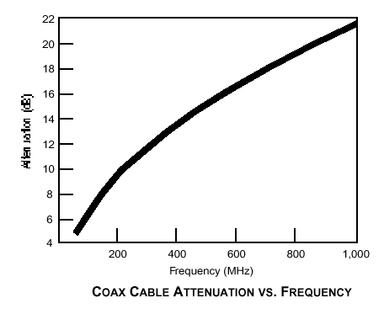
CATV
The most important characteristic of Hybrid Coax networks (HFC) is their ability to allow a customer to use his TV directly for all unscrambled channels
The characteristic impedance of coaxial cable used in CATV is 75 ohms
The well known principles of transmission line theory apply fully to CATV technology
Coaxial cable attenuation is a function
Diameter
Temperature
Dielectric construction
Frequency
Requires equalisation in amplifiers

Slide 33
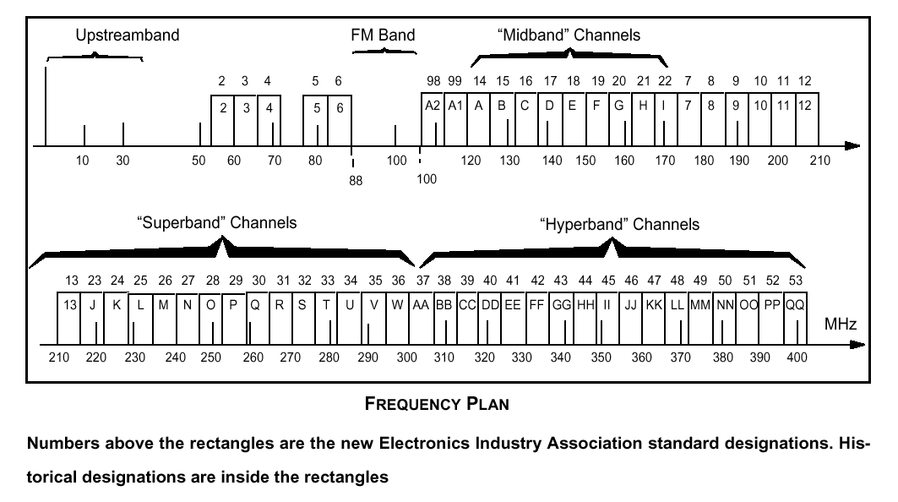
A typical CATV Frequency Plan
*Note that channels are not consecutive
**The cable converter has a high quality broadband tuner and output circuitry that puts the desired channel on a low
Band channel not occupied in the local off the air spectrum (Typically 2,3,4). The TV or VCR is tuned to this channel
And behaves like a monitor

Slide 34
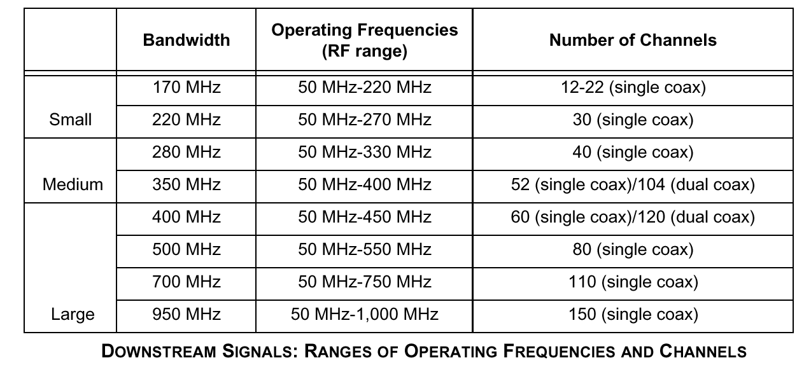
CATV channel carrying capacity

Slide 35
CATV Network
The fibre part transports the signal to the neighbourhood using Sub carrier multiplexing techniques. This part terminates in an Optical Network Unit
A coaxial tree branch distribution system then feeds the neighbourhood. Line extenders are required every approx. 300m. depending on the bandwidth of the system
Since the distribution portion of the plant is operated at higher power levels, non linear effects become important. The maximum number of amplifiers that can be placed in cascade is therefore limited by the build up of noise and distortion
Non linear distortion is measured by the Composite Triple Beat parameter, which is a measure of the interference generated by all the carriers beating together.

Slide 36
CATV signal quality
The principal picture impairments can be divided in to two categories:-
Non coherent noise arising from random noise such as thermal noise. This gives rise to a snowy picture
Coherent noise arising from
the ingress of video signals in to the cable network,
reflections of the signal from transmission line discontinuities
Cross modulation of the video giving rise to beats (horizontal lines moving through the picture)
An experienced cable network designer must balance noise, non linear distortions and cost to find an optimum solution.
Starting at the home the objective is to deliver at least 0dBm to the TV. A weaker signal produces snowy pictures and a stronger one overloads the TV tuner resulting in cross modulation of the channels

Slide 37
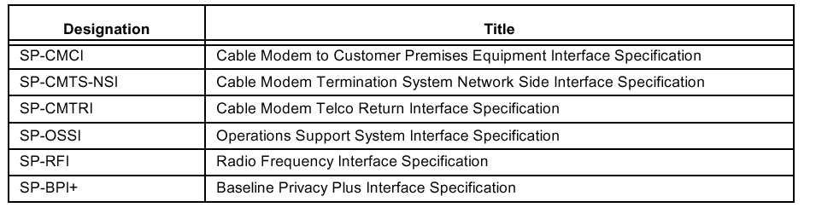
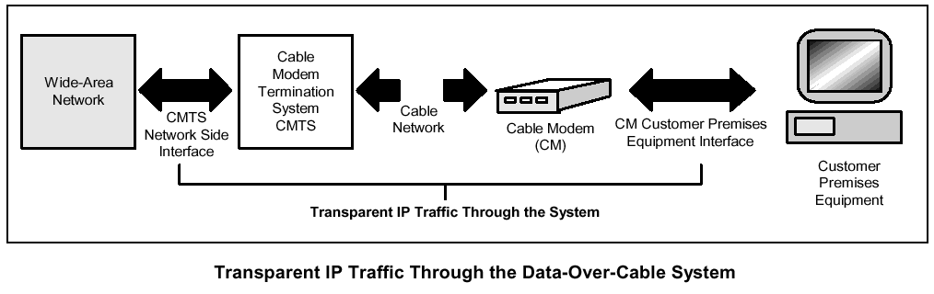
DOCSIS 1.0
Data Over Cable Service Interface Specifications (DOCSIS) DOCSIS 1.0 completed in March 1997 – A family of specifications
The main objective is to provide a transparent high speed link to the Internet. It requires that the HFC network is two way

Slide 38
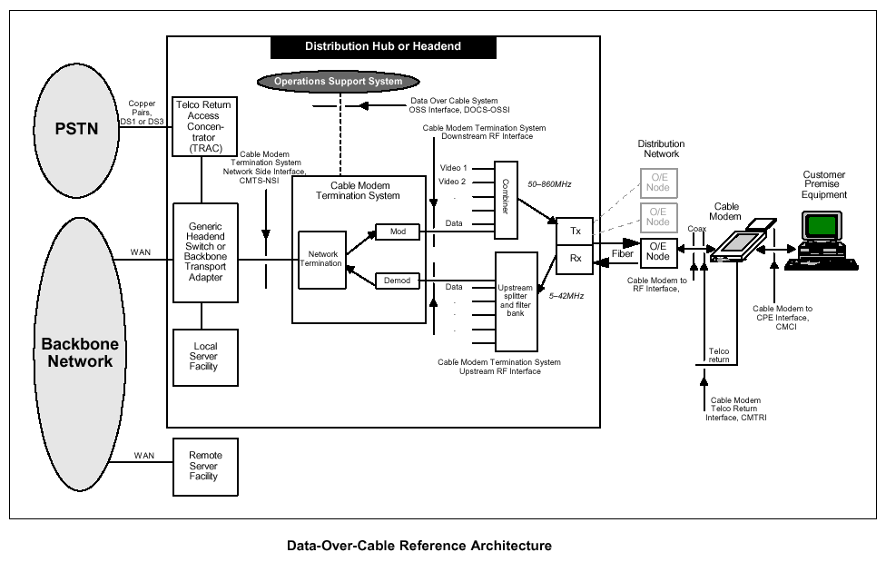
DOCSIS

Slide 39
DOCSIS 1.1 & 2.0
Data Over Cable Service Interface Specifications (DOCSIS) DOCSIS 1.1 was completed in March 1999
Enhanced DOCSIS 1.0 services by addressing :-
Quality of Service
IP multicast
Security
Operational Support
DOCSIS 1.1 included methods to guarantee QOS to different services going through the same cable modem or on the same RF channels
Packet Classification
Service Flows – which define specific guarantees and limits of types of traffic
Dynamic service assignment – allows the system to dynamically create and delete service flows
DOCSIS 2.0 increased the upstream of DOCSIS 1.1 x3 and improved the robustness against interference by the use of A-TDMA and S-CDMA

Slide 40
EuroDOCSIS
The DOCSIS specification has been adapted for use on the networks of European CATV operators. This adapted European version has been called EuroDOCSIS.
The main differences are in
The modulation format (where ITU-T J.83 Annex A is used)
A different frequency split to separate the upstream and the downstream directions
Different Management Information Bases (MIBs)

Slide 41
DOCSIS Protocol Stack
Internet Protocol (IP)
Logical Link Control (LLC)
Data Link Encryption
Data Link
Layer
MAC
MPEG-2 Transport
(Downstream Only)
Physical
Physical Media Dependent Layer (PMD)

Slide 42
DOCSIS Protocol Stack
The upstream PMD sublayer uses a FDMA/TDMA burst access mechanism. Two modulation formats are used QPSK and 16QAM with 5 symbol rates. The lowest symbol rate is 160ksymbols/s and the highest 2.56Msymbols/s. Reed Solomon FEC correct burst errors.
The downstream transmission format is based on the ITU-T J.83 Annex B standard for digital video transmission on cable systems. It uses a 6MHz, 64/256 QAM modulation format. A concatenated coding scheme is also used.
The MPEG-2 transport sublayer is used to provide a common platform for the transfer of video and data on the HFC network
The MAC layer is essential for DOCSIS operation on the shared HFC network. On the downstream the cable modems listen to all the traffic flow from the CMTS and accept messages targeted to them.
In the upstream direction a FDMA/TDMA Multiple access scheme is implemented. A cable modem first requests bandwidth authorisation from the CMTS, listens to the downstream bandwidth allocation message and then transmits if allowed to do so.

Slide 43
DOCSIS 3.0 Features
MAC Layer
Downstream Channel Bonding
Upstream Channel Bonding
Network Layer
IPv6 support
IP Multicast (IGMPv3/MLDv2, SSM, QoS)
Security
Certificate Revocation Management
Runtime SW / Config validation
Enhanced Traffic Encryption (AES)
Certificate Convergence
Early Authentication & Encryption
TFTP Proxy
Network Management
Diagnostic Log (Flaplist)
Extension of Internet Protocol Data Records (IPDR) usage
Capacity management
Enhanced signal quality monitoring
Physical Layer
Switch-able 5-42 MHz, 5-65 MHz, or 5-85 MHz US band
S-CDMA active code selection with new Logical channel
Commercial Services
T1/E1 Circuit Emulation support

Slide 44
Downstream Bonding Service Drivers
Packet bonding of a minimum of 4 channels
Delivers in excess of 150 Mbps
Seamless migration from DOCSIS 1.x/2.0
IP Video over DOCSIS(VDOC)
High definition Video to multiple devices
High BW Internet streaming
Video conferencing
TelePresence
Commercial service
High BW data services
Bonded T1
High BW Ethernet/L2VPN service

Slide 45
DOCSIS 3.0 Channel Bonding
DOCSIS 3.0 is the next generation of the DOCSIS standard
152 Mbps
Logical Channel Bonding Technology
38 Mbps
38 Mbps
38 Mbps
38 Mbps
6 MHz
6 MHz
6 MHz
6 MHz
DOCSIS 2.0 is limited to single channel’s capacity
DOCSIS 3.0 employs packet bonding across multiple channels
Initially will bond 4 channels
8 channel-capable silicon coming soon
Upstream bonding in 2010
Increased speeds 100Mbps+
Notes:
45

Slide 46
Further Developments
Traffic “Grooming”
MPEG-4
Broadcast to narrowcast QAM injection
Reduce broadcast domains to smaller DOCSIS & video service groups
Ultimately a complete Unicast lineup on a per node basis
Analog reclamation for more digital spectrum
More QAM channels for Digital Broadcast, VoD, Switched Digital Video (SDV) and DOCSIS
Use every channel available
Manage the channel lineup, fill in the gaps, mitigate noise to enable all spectrum
1GHz upgrade
Make new spectrum for new CPE above 860 MHz

Slide 47
1 GHz Upgrade
Network Impact
<= 750 MHz of BW may not be enough
Node splitting & SDV alone do not solve HFC BW problem
1 GHz BW upgrade required
1GHz Network Benefits
Value added capacity
60 analog 6 MHz chs gained
Minimal cost per home passed cost to implement
Electronic-only drop-ins in most cases
1 GHz is a cost-effective tool to increase broadcast and narrowcast BW

Slide 48
Why DOCSIS 3.0
DOCSIS 3.0 - channel bonding for higher capacity
Enable faster HSD service
MxN mac domains now
Enable video over IP solutions
M-CMTS (Modular Cable Modem Termination System)
Lower cost downstream PHY
De-couple DS and US ports
I-CMTS (Integrated Cable Modem Termination System)
Allows higher capacity in same box
Same wiring
Notes:
New technologies are being pursued to address the DS bottleneck conundrum.
DOCSIS 3.0 uses a channel bonding technique to achieve higher capacity links, enable faster high speed data (HSD) service, and provide M x N MAC domains to enable video over IP solutions.
The idea of multiple grants per request or outstanding requests with DOCSIS 3.0 is also a good idea for US speed, but still doesn't fix the CPU issue on the CM.
The modular CMTS (M-CMTS) architecture is promoted to achieve better DOCSIS economics, lower cost DS PHY, and de-couple DS and US ports. One day we may see fiber optic nodes with DOCSIS physical layer chips embedded so we can use ingress cancellation at the node, digital links from the node back to the headend without the need to amplify, and no more laser clipping. Of course, this means all traffic needs to be DOCSIS-based on the US!
The integrated-CMTS idea is a way to use “off-the-shelf” external QAM boxes and the existing CMTS just for US connectivity. This allows return on invest and no “fork-lift” upgrades of the CMST chassis and/or limited cabling changes.

Slide 49
DOCSIS 3.0/M-CMTS:Remarks
Promises ten times BW at fraction of cost
Introduce new High Speed Data service of 50 to 75 Mbps
Widespread deployment of DS Bonding in 2008
Backward compatible with existing DOCSIS standards
Allows migration of existing customers to higher tier and DOCSIS 3.0 capability
Allows more BW for legacy DOCSIS 2.0 CM
Allows for a phased deployment
IPV6, US bonding, and other features will follow

Slide 50
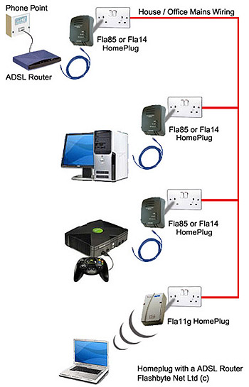
Powerline Communications
The electrical distribution lines can be used to distribute data
A number of systems such as HomePlug allow users to set up LANs over their existing in-home wiring
Broadband delivery over powerlines is also possible

Slide 51
Broadband over Powerline
Variations in the way that power is transported between countries (predominantly EU vs US) has led to a lack of standardisation
Widespread concerns over interference with radio

Slide 52
IEEE P1901
Draft released in Jan 2010, Release Sept 2010
Two different PHY layers, one based on OFDM modulation (following HomePlug) and another based on Wavelet modulation
Uses forward error correction based on convolutional turbo codes

Slide 53
Conclusions
Still a lot of work for copper to do
For low cost networking copper still dominates
Price of the copper itself has risen sharply in recent years, making fibre more attractive in some installs

