Slide 1
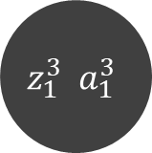

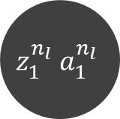

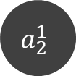

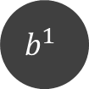



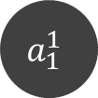


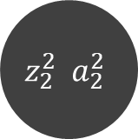


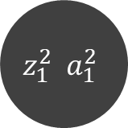
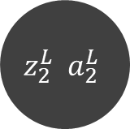

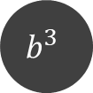
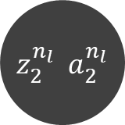

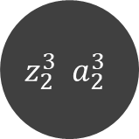
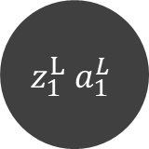


$$W^{2}$$
$$W^{1}$$
$$z_{1}^{2} a_{1}^{2}$$
$$z_{1}^{3} a_{1}^{3}$$
$$z_{1}^{L} a_{1}^{L}$$
$$W^{n_{l}−1}$$
…
$$a_{1}^{1}$$
$$x_{1}^{(i)}=$$
$$z_{1}^{n_{l}} a_{1}^{n_{l}}$$
$$a_{2}^{1}$$
$$z_{2}^{2} a_{2}^{2}$$
$$z_{2}^{3} a_{2}^{3}$$
$$z_{2}^{L} a_{2}^{L}$$
$$x_{2}^{(i)}=$$
…
$$z_{2}^{n_{l}} a_{2}^{n_{l}}$$
…
…
…
…
…
…
$$x_{m}^{(i)}=$$
$$a_{m}^{1}$$
…
$$b^{1}$$
$$b^{1}$$
$$b^{3}$$
…
$$b^{L}$$
$$L=1$$
$$L=2$$
$$L=3$$
$$L=n_{l}−1$$
$$L=n_{l}$$
input layer
output layer

