Slide 1
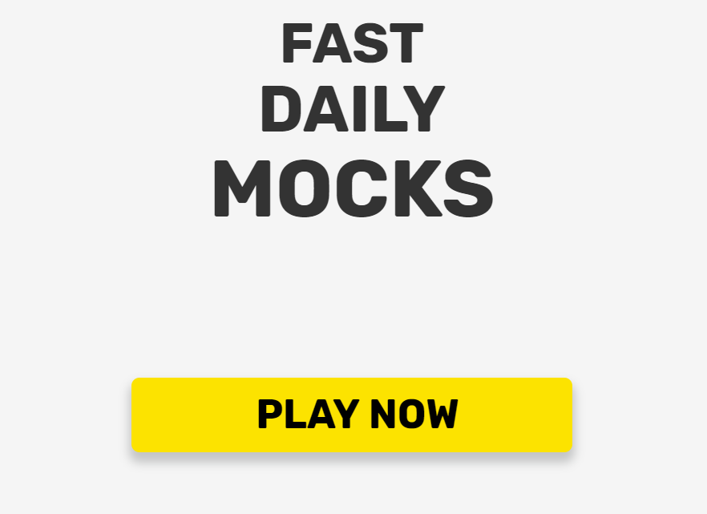

Slide 2







Erick Sieben
Fred Jin
Sean Zhang
Luis Pardo
Jie He
Parham Amani

Slide 3

Agenda
Introduction to Fast Daily Mocks
Sprint 1 Features
Sprint 2 Features
Project Management
Development Roadmap
Tools and Technology
Demonstration
Challenges Faced
Future Enhancements
Questions

Slide 4
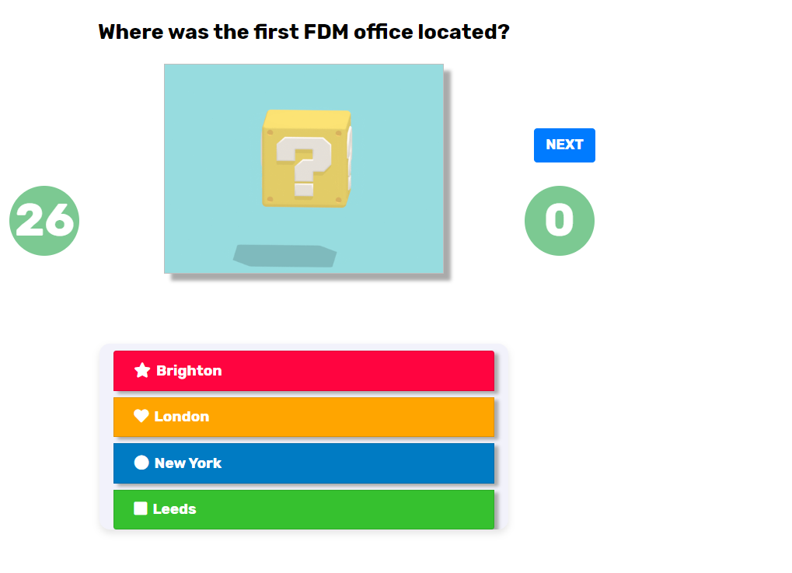
What is Fast Daily Mocks ?
A Real-Time Multi Player Quiz-Game Application

Slide 5
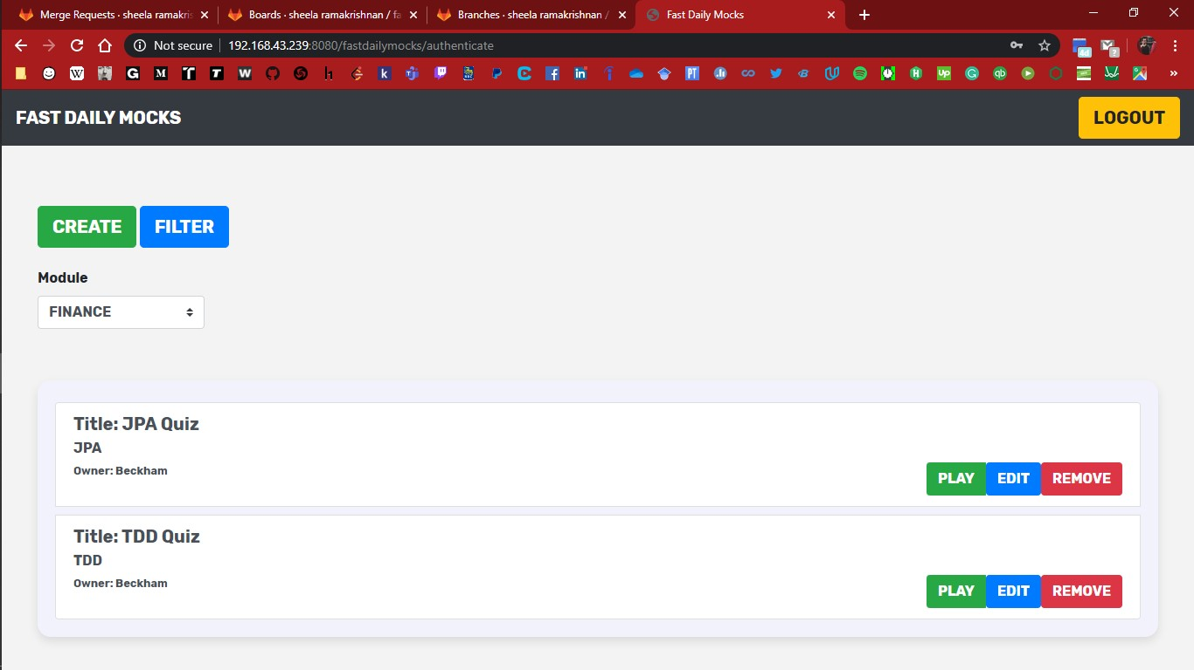
First Iteration
Backbone – Web Socket Implementation
Authentication
Quiz Creation
Game Play
Admin portal to manage users
Report Generation - UI
Notes:
BackBone – WebSocket implementation
Authentication(security)
Quiz Creation
Game Play
Admin portal to manage users
Report Generation - UI

Slide 6
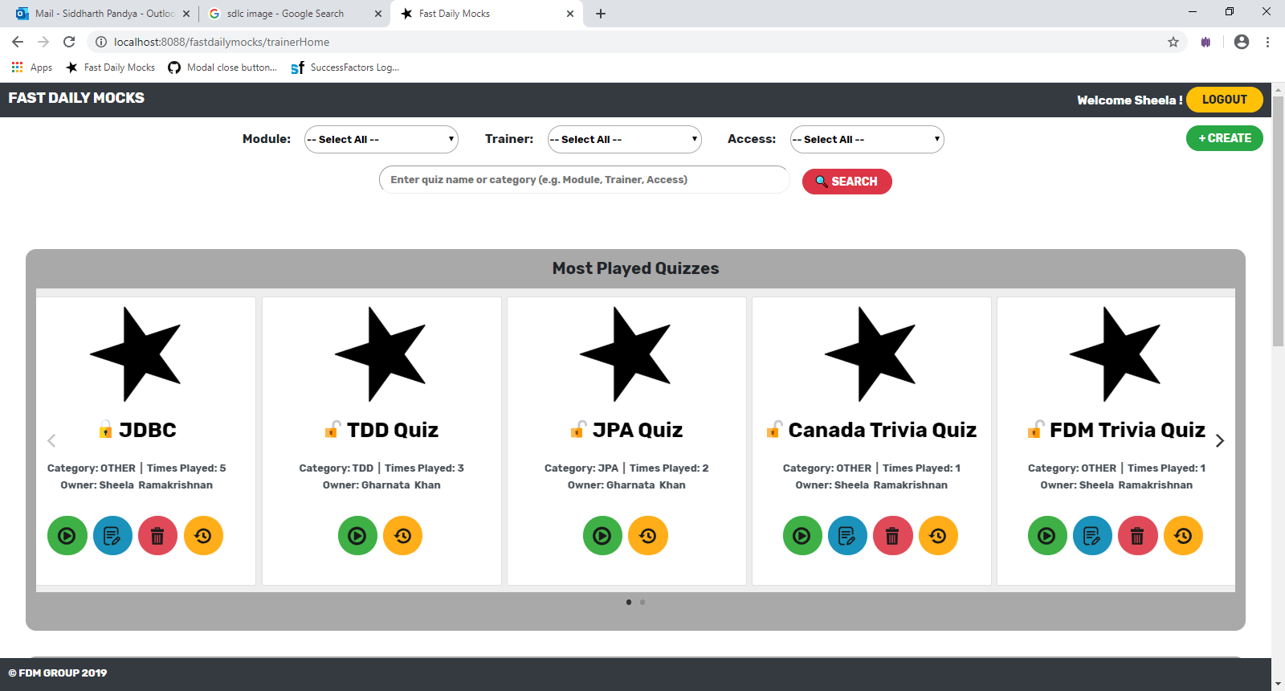

Second Iteration
Image upload
Quiz, question, and choice editing
Download report
Question bank
Sharing quizzes
Security and User Experience
Notes:
Search based onmore categories
Trainer can now terminate quiz in the middle of game

Slide 7
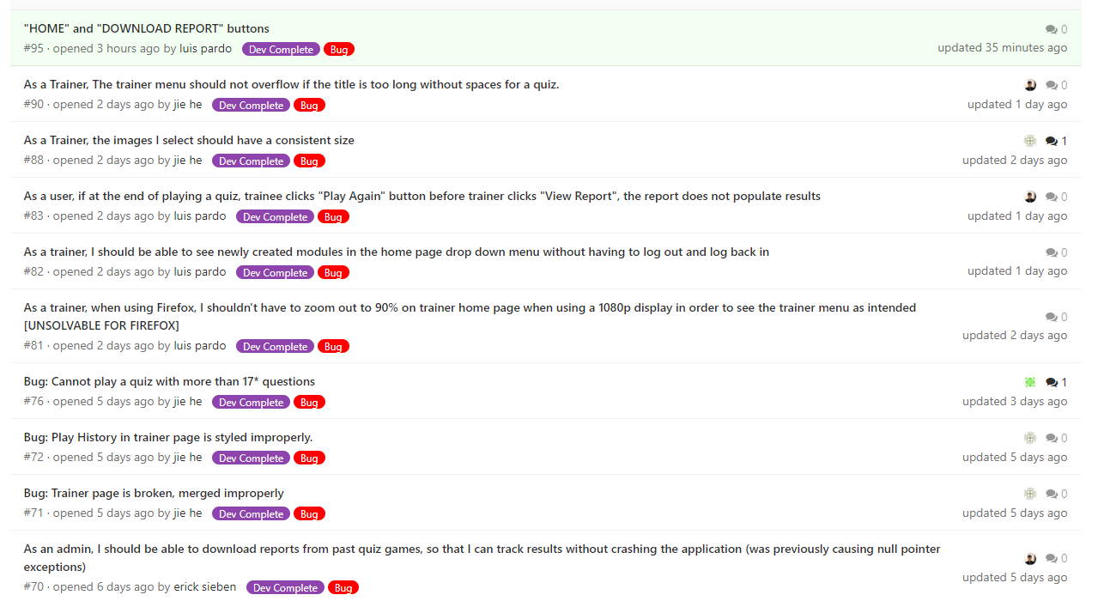
Bugs
Authorization
Dead Code
Consistent Image Size
Code Refactoring

Slide 8
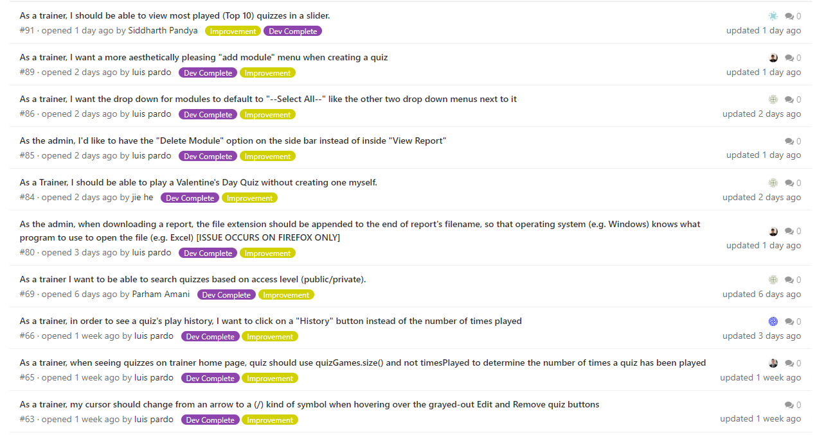
Improvement
More Responsive UI
Quiz Carousel
Quiz Review
Delete Quiz Confirmation

Slide 9
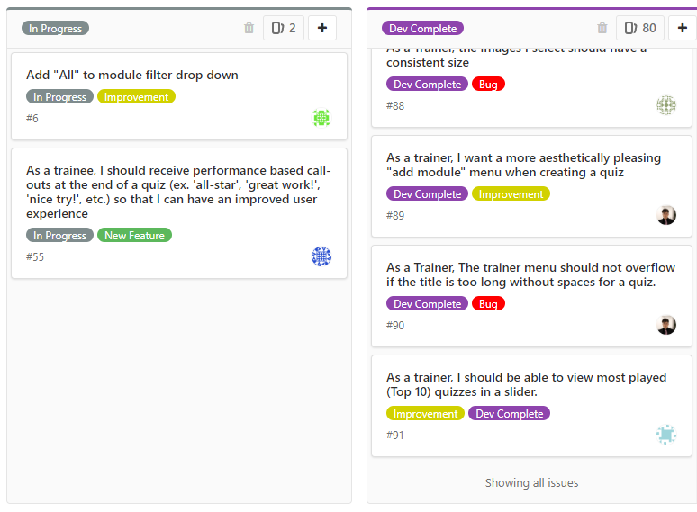
Project Management
Requirements and Backlog
Coordination with APM team
Gathered and presented requirements
Assembled backlog
Oversaw priority assignment
GitLab Issue Tracking and Source Control
Backlog managed using Gitlab
Create and track issues, features, and improvements
Branch and merge features for parallel development

Slide 10
Development Roadmap
Development and Testing
14-Nov-2019 to 29-Jan-2020
Brainstorming and Ideation
1–Nov–2019 to 10–Nov-2019
Product Delivery
30-Jan-2020 to 31-Jan-2020
Sprint Planning
11-Nov-2019 to 13-Nov-2019

Slide 11

BACK END
TESTING
Java
Spring MVC Framework
Spring Boot
JPA
Oracle DB
Servlets
Hibernate
Web Socket
JUnit
Tools and Technology
PROJECT MANAGEMENT
FRONT END
HTML
CSS
JavaScript / JQuery
Bootstrap V4.3.1
Flickity
Agile Environment -Scrum
GitLab

Slide 12
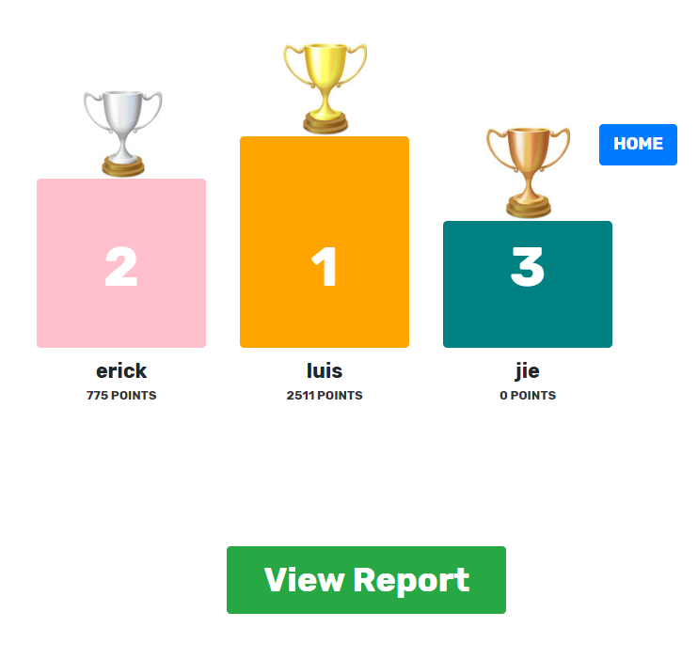
Demo

Slide 13
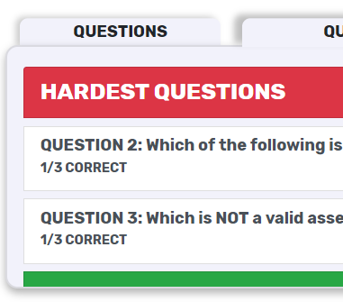
Challenges
Unfamiliar technologies
Minimal documentation
Team management
Code conflicts and refactoring

Slide 14

Future Enhancement
Video, Audio & Code Block
Quiz Rating
Quiz Favorite
User Management
Stream Management
Image Preview
Notes:
Search based onmore categories
Trainer can now terminate quiz in the middle of game

Slide 15
Thank You

Slide 16
