Slide 1
EE542-Lab 03-Project Report Network Measurement
Presenter: Boyang Xiao
USC id: 3326-7302-74
Email: boyangxi@usc.edu

Slide 2
Index
Exploring Bandwidth and Throughput
Bandwidth, Delay, and Loss
Secure copy

Slide 3
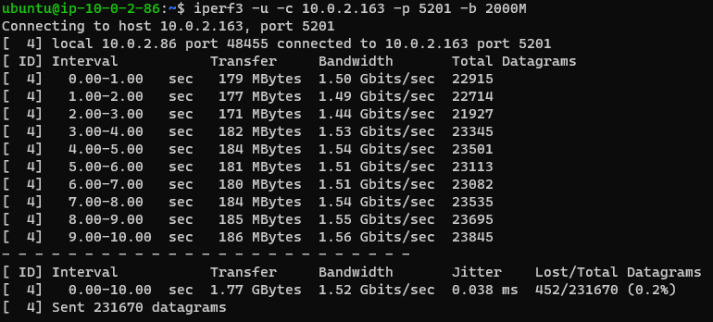
Exploring Bandwidth and Throughput
1. Measuring TCP & UDP throughput using iPerf3
UDP testing results:
The bandwidth should be 1.42 Gbits/sec for UDP.

Slide 4
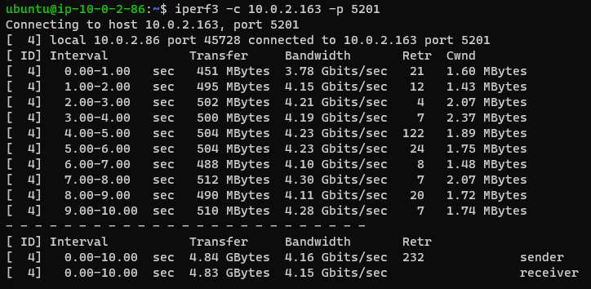
Exploring Bandwidth and Throughput
1. Measuring TCP & UDP throughput using iPerf3
TCP testing results:
The bandwidth should be 4.16 Gbits/sec for TCP.

Slide 5
Exploring Bandwidth and Throughput
2. Measuring TCP & UDP throughput with Latency on Router VM
Conclusions:
Latency will not affect UDP’s bandwidth or jitter
Latency will make UDP’s datagram loss increase more and more faster
Protocol Type | Latency(ms) | Bandwidth | Jitter | Datagram Loss
UDP | 10 | 1.36 Gbits/sec | 0.032 ms | 0.1%
 | 50 | 1.25 Gbits/sec | 0.030 ms | 5.5%
 | 200 | 1.46 Gbits/sec | 0.029 ms | 81%
 | 500 | 1.32 Gbits/sec | 0.032 ms | 91%

Slide 6
Exploring Bandwidth and Throughput
2. Measuring TCP & UDP throughput with Latency on Router VM
Conclusions:
Higher latency will make TCP’s throughput grow lower
When latency is higher than some point, the throughputs as a sender/as a receiver will become different from one single node.
Protocol Type | Latency(ms) | Throughput-sender | Throughput-receiver
TCP | 10 | 999 Mbits/sec | 999 Mbits/sec
 | 50 | 101 Mbits/sec | 101 Mbits/sec
 | 200 | 9.71 Mbits/sec | 7.77 Mbits/sec
 | 500 | 1.80 Mbits/sec | 1.02 Mbits/sec

Slide 7
Exploring Bandwidth and Throughput
3. Measuring TCP & UDP throughput with Ethernet link limit on Router VM
Protocol Type | Ethernet link limit | Throughput-sender | Throughput-receiver | Datagram Loss(UDP)
UDP | 10Mbps | 1.37 Gbits/sec | NULL | 99%
 | 100Mbps | 1.40 Gbits/sec | NULL | 93%
 | 1000Mbps | 1.51 Gbits/sec | NULL | 35%
TCP | 10Mbps | 10.3 Mbits/sec | 9.97 Mbits/sec | NULL
 | 100Mbps | 99.4 Mbits/sec | 99.0 Mbits/sec | NULL
 | 1000Mbps | 966 Mbits/sec | 964 Mbits/sec | NULL
Conclusions:
Ethernet link limit can affect both UDP and TCP transferring.
For TCP, it can directly make TCP throughput the same as the link limit, because TCP will make sure every datagram is ACK-ed and the throughput can be only the link limit
For UDP, the whole throughput does not change too much with various link limit, but the limit affect the datagram loss, because not all datagrams can be delivered with a link limit on the router.

Slide 8
Exploring Bandwidth and Throughput
4. Measuring TCP & UDP throughput when changing the window sizes on Client and Server
Experiment results:
For TCP:
Changing the window sizes does not affect the results when there are latency on the Router
Changing the window sizes does not affect the results when there are link rate limits on the Router
For UDP:
Changing the window sizes does not affect the results when there are latency on the Router
Changing the window sizes does not affect the results when there are link rate limits on the Router

Slide 9
Exploring Bandwidth and Throughput
5. Measuring TCP throughput with different window sizes
Router link rate limit scenarios:
Router Link Latency | Window size | Throughput-sender | Throughput-receiver
10 ms | 64 Kbytes | 1.12 Gbits/sec | 1.12 Gbits/sec
 | 128 Kbytes | 1.12 Gbits/sec | 1.12 Gbits/sec
 | 256 Kbytes | 1.12 Gbits/sec | 1.12 Gbits/sec
100ms | 64 Kbytes | 105 Mbits/sec | 104 Mbits/sec
 | 128 Kbytes | 107 Mbits/sec | 107 Mbits/sec
 | 256 Kbytes | 105 Mbits/sec | 104 Mbits/sec
500ms | 64 Kbytes | 7.30 Mbits/sec | 6.41 Mbits/sec
 | 128 Kbytes | 2.01 Mbits/sec | 0.92 Mbits/sec
 | 256 Kbytes | 4.85 Mbits/sec | 3.22 Mbits/sec

Slide 10
Exploring Bandwidth and Throughput
5. Measuring TCP throughput with different window sizes
Router link latency scenarios:
Link rate limit | Window size | Throughput-sender | Throughput-receiver
10Mbps | 64 Kbytes | 10.4 Mbits/sec | 9.98 Mbits/sec
 | 128 Kbytes | 10.7 Mbits/sec | 9.96 Mbits/sec
 | 256 Kbytes | 10.7 Mbits/sec | 9.97 Mbits/sec
100Mbps | 64 Kbytes | 99.4 Mbits/sec | 99.0 Mbits/sec
 | 128 Kbytes | 99.2 Mbits/sec | 99.8 Mbits/sec
 | 256 Kbytes | 99.4 Mbits/sec | 99.0 Mbits/sec
1000Mbps | 64 Kbytes | 965 Mbits/sec | 963 Mbits/sec
 | 128 Kbytes | 966 Mbits/sec | 964 Mbits/sec
 | 256 Kbytes | 957 Mbits/sec | 956 Mbits/sec

Slide 11
Exploring Bandwidth and Throughput
5. Measuring TCP throughput with different window sizes
Conclusions:
In the internet latency and rate limit scenarios, changing the window sizes seems do help to the TCP throughput
When the latency is very large, the throughput can be unstable under different window sizes
If the link is at 100Mbit/s and 25ms of delay, the window size should be 128 Kbytes to maintain a highest throughput. But my experiments tell me that it cannot get a full 100Mbit/s throughput (actually only 99.2Mbit/s), because there is latency on the link and the ethernet connections are not stable.

Slide 12
Bandwidth, Delay, and Loss
1. Using ping to test RTT between machines
2. Measuring the bandwidth-delay product for this link
Router latency | RTT between Server and Client
0 ms | 0.774 ms
25 ms | 50.972 ms
Protocol Type | Router latency | Bandwidth | RTT | bandwidth-delay product
UDP | 25 ms | 1.42 Gbits/sec | 50.972 ms | 74.11 Mbits/sec
TCP | 25 ms | 4.16 Gbits/sec | 50.972 ms | 217.13 Mbits/sec

Slide 13
Bandwidth, Delay, and Loss
3. If you left the send/receive windows at their default values, would this link perform well?
From the experiments above, the send/receive window sizes do not affect the link performance that much, so this link will not perform well.
4. Can we scale the send/receive windows to see the effect of a bandwidth-delay product/TCP window size mismatch?
This does not make sense, because we should decrease the window sizes to see the difference but not scale it.

Slide 14
Bandwidth, Delay, and Loss
5&6. Set the send/receive window values to something too small and measure the TCP throughput
If we use a very small window size, with larger link latency, the TCP throughput can even grown higher. From the iPerf3 log printed on the terminal, we can find that the TCP will adjust the window size to maintain a highest speed even if the network kernel buffer sizes have been set to a very small value.
Router link latency | Window size | Throughput-sender | Throughput-receiver
1 ms | 10 Kbytes | 958 Mbits/sec | 956 Mbits/sec
5 ms | 10 Kbytes | 962 Mbits/sec | 960 Mbits/sec
25 ms | 10 Kbytes | 970 Mbits/sec | 970 Mbits/sec

Slide 15
Bandwidth, Delay, and Loss
7. Measuring networks with link losses
From the experiments above, we can see that when we set a certain value of link loss on the Router side, the iPerf3 testing can get the same results from the Client and Server VM sides. Therefore we can validate the link loss setting is valid.
Router link Loss | iPerf3 testing results – UDP datagram loss
0% | 0.081%
0.1% | 0.42%
5% | 5.2%

Slide 16
Secure Copy
Preparation works
Set the Router link bandwidth to be 100Mbps
Test the RTT between Client and Server: 0.798 ms
Test the bandwidth delay product between Client and Server: 81.22 Kbits
Explain what we have done in Step 3 & 4
We create a folder called test/
We copy the file /dev/urandom to the file ./filesystem.bin
We make file system on ./filesystem.bin
We use loop mode to mount on the file ./filesystem.bin
We make all the files in the test/ folder have all permissions type

Slide 17
Secure Copy
Step 7&8: Throughput of the file transferring: 50.3MB/s
Step 9: Increase the link delay up to 25ms and measure the file transferring throughput:
RTT (tested using ping) : 50.901 ms
File transferring throughput: 28.1MB/s
Improvement: If we use smaller window sizes, throughput can be improved:
Window size: 10KBytes; Throughput: 31.9MB/s
Window size: 10KBytes; Throughput: 34.1MB/s

Slide 18
Secure Copy
Step 10: Does scp seem to have some sort of built-in limitation? Can you guess what it is? Hint: scp uses the SSH protocol to transfer data.
SCP can only be operated on one thread but not on multi-thread simultaneously. This is because scp is built on ssh, and ssh can only use one port-22 and it can handle only one connection each time.

Slide 19
Secure Copy
Step 11 Measuring file transferring throughput under link losses
With increasing link losses(from 0.1% to 10%), file transferring throughput grows lower.
The descending trend of throughput is not linear, but it experiences a rapid decreasing when the router link loss is between 1% to 5%. This might be because TCP connections are very sensitive during this period due to its ACK mechanisms and sliding windows mechanisms. Before this period, data loss can be ignored, and after this period, the throughput has already been low. So this period it drops very fast.

Slide 20
Secure Copy
Step 12 Estimate (or measure) the delay and loss from Los Angeles to Switzerland. If you had a physicist for a colleague, and he wanted to download some data from the new atom smasher at CERN, would you expect him to come to you for help? Can you help him? If so, how?
From the ping results from this website, the delay between LA and Zurich can be 156.87ms ,and data loss datum cannot be found
If this physicist asked me for help, I would configure his computer and set the TCP buffer size to be little as 10-50 Kbytes. This should help him to obtain a higher throughput and higher network rate.

Slide 21
Thanks for listening!
Presenter: Boyang Xiao
USC id: 3326-7302-74
Email: boyangxi@usc.edu

