Slide 1
Physics-Informed
Neural Networks versus
Classical Least Squares
LOGO
LOGO
BULACAN STATE UNIVERSITY
College of Science · BS Mathematics (Computer Science)
S
Susceptible
MCS 306 · FINAL COURSE OUTPUT
β
I
Infected
for Estimating Dengue Transmission Parameters: A Case Study of Bulacan, Philippines (1994–2010)
γ
R
Recovered
PRESENTED BY
Romar S. Almoguez · Sean Arkin C. Dela Cruz
Osyris Benedict P. Fajardo · Jian Kyle C. Hornales
Notes:
[Presenter: Jian Kyle C. Hornales · about 20 seconds] Hello! We are Romar Almoguez, Sean Arkin Dela Cruz, Osyris Fajardo and Jian Kyle Hornales, BS Mathematics students from the College of Science of Bulacan State University. Our project compares an AI method, physics-informed neural networks, with classical least squares for estimating how dengue spreads in Bulacan.

Slide 2
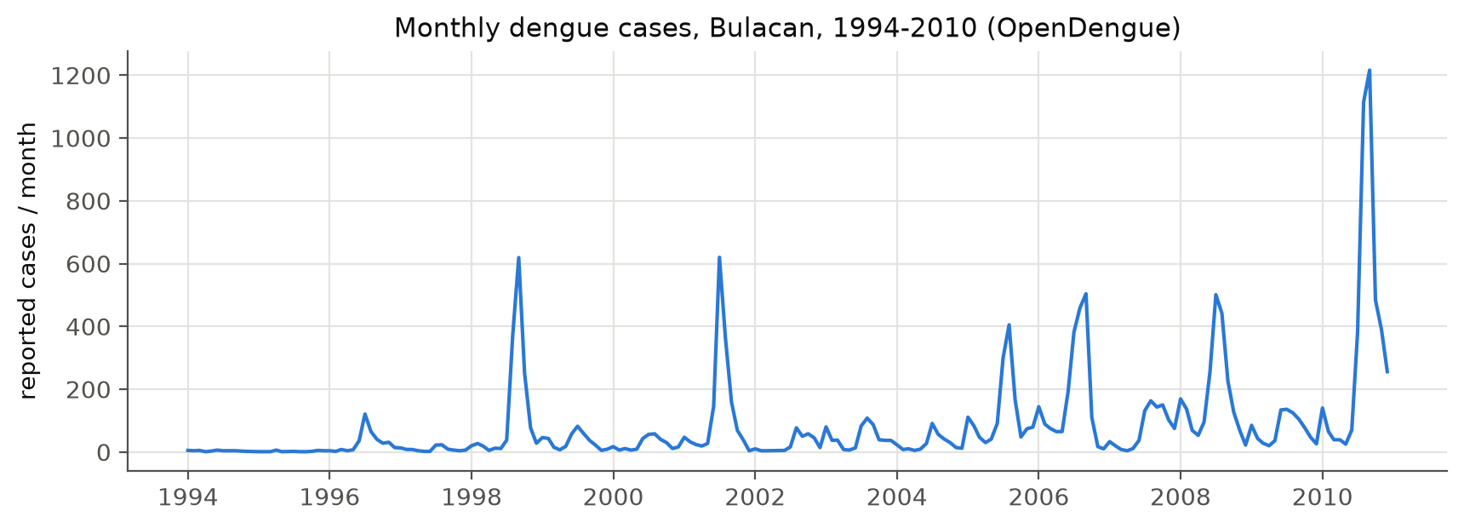
Dengue surges in Bulacan every rainy season
PART 1 · THE PROBLEM
Presented by Jian Kyle C. Hornales
1,216
cases in September 2010, the highest month in the 17-year record
6
Monthly reported dengue cases, Bulacan, 1994–2010. Source: OpenDengue V1.3 (Project Tycho data).
The question: how fast does dengue spread (β), and how long do people stay infectious (1/γ)?
outbreak seasons we model: 1998, 2001, 2005, 2006, 2008 and 2010
PINNs vs. Classical Least Squares · Dengue in Bulacan, 1994–2010
MCS 306 · Bulacan State University
Notes:
[Presenter: Jian Kyle C. Hornales · about 25 seconds] Every rainy season, dengue cases in Bulacan climb, and sometimes they explode. This chart shows the monthly reported cases from 1994 to 2010, from the open OpenDengue database. In 2010, more than a thousand cases were reported in August and again in September: 1,216 in September alone. To respond, health workers want to know two things: how fast is dengue spreading, and how long do people stay infectious?

Slide 3
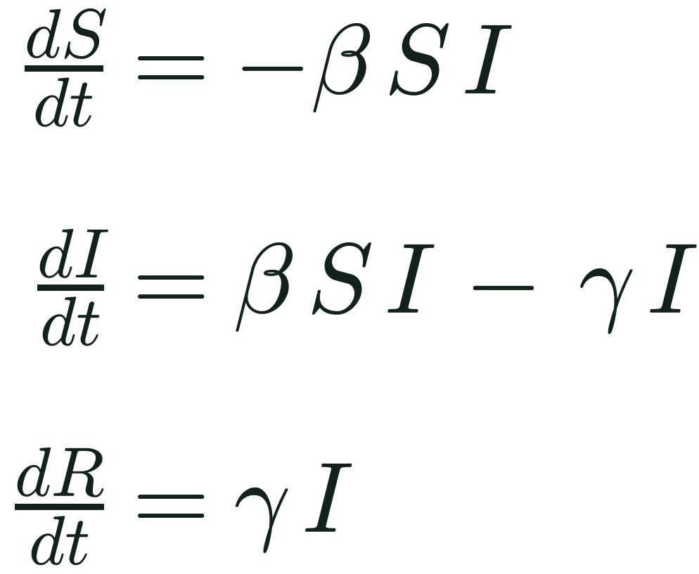
The SIR model: three groups, two unknown rates
PART 1 · THE PROBLEM
Presented by Jian Kyle C. Hornales
S
Susceptible
I
Infected
R
Recovered
The inverse problem
βSI
γI
FORWARD PROBLEM
β, γ
case curve
β transmission rate (per day)
γ recovery rate (per day)
1/γ infectious period (days)
INVERSE PROBLEM · OUR TASK
reported cases
β, γ
Nobody can measure β and γ directly, so we estimate them by working backwards from reported case counts.
We compare two ways to do this: classical least squares and a physics-informed neural network (PINN).
R₀ = β / γ
people infected by one sick person; above 1, the outbreak grows
PINNs vs. Classical Least Squares · Dengue in Bulacan, 1994–2010
MCS 306 · Bulacan State University
Notes:
[Presenter: Jian Kyle C. Hornales · about 35 seconds] Mathematicians answer this with the SIR model. We split the population into Susceptible, Infected and Recovered. Beta is how fast the infection spreads, and gamma is how fast people recover, so one over gamma is how long they stay infectious. Their ratio, R-naught, is how many people one sick person infects; above 1, the outbreak grows. The catch is that nobody can measure beta and gamma directly. We have to work backwards from case counts. That is called an inverse problem, and it is what our project is about.

Slide 4
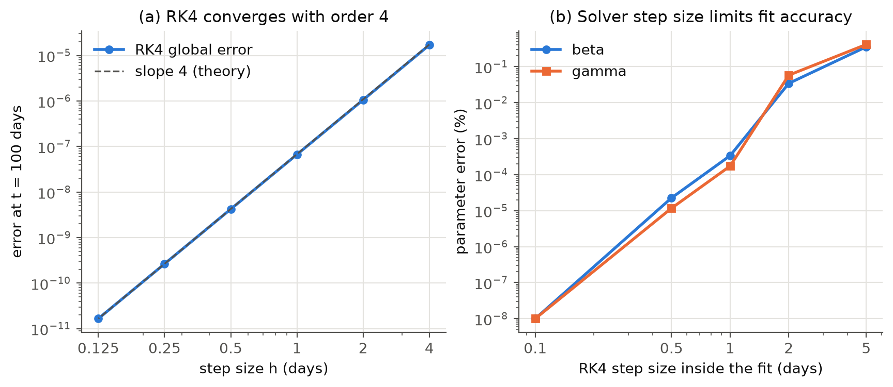
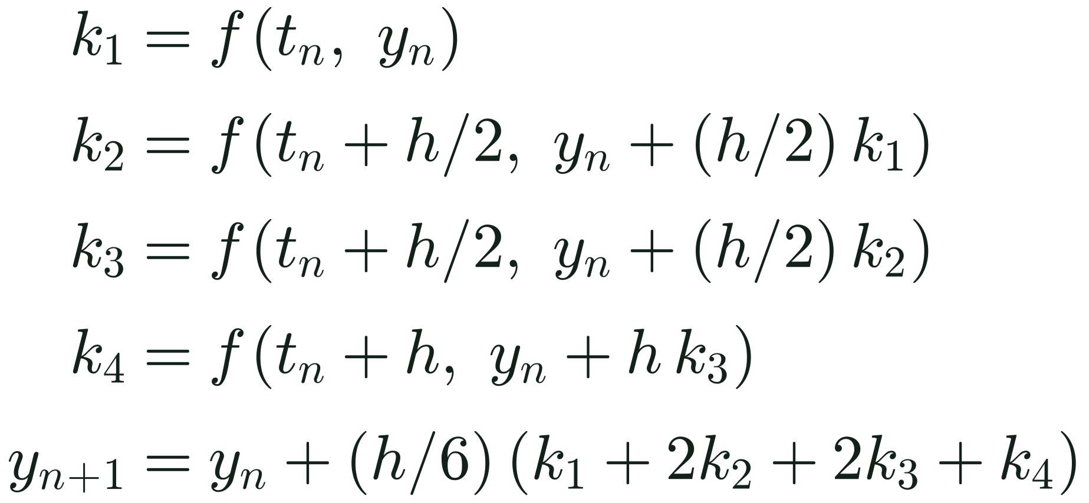
RK4: fourth-order accurate, as theory predicts
PART 2 · SOLVING THE MODEL
Presented by Sean Arkin C. Dela Cruz
One RK4 step of size h
Four slope samples per step, weighted 1 : 2 : 2 : 1
(a) The error at day 100 falls from 1.7 × 10⁻⁵ (h = 4 days) to 1.7 × 10⁻¹¹ (h = 0.125 days).
(b) A coarse 5-day step inside the fit biases β and γ by about 0.4%, so we fit with h = 0.1 day.
3.98–4.01
measured order of accuracy (theory: 4); halving h cuts the error about 16×
PINNs vs. Classical Least Squares · Dengue in Bulacan, 1994–2010
MCS 306 · Bulacan State University
Notes:
[Presenter: Sean Arkin C. Dela Cruz · about 40 seconds] These equations have no pen-and-paper solution, so we step forward in time with the fourth-order Runge–Kutta method, or RK4. Each step samples the slope four times and takes a weighted average. To check our solver, we halved the step size again and again. Theory says the error should shrink sixteen times with every halving; that is fourth-order accuracy. Our measured order is between 3.98 and 4.01, exactly as predicted. The right panel shows that the step size inside the fitting matters too: a coarse five-day step biases the estimates by about 0.4 percent, so we fit with a step of 0.1 day.

Slide 5


Two ways to estimate β and γ from case data
PART 3 · TWO ESTIMATION METHODS
Presented by Sean Arkin C. Dela Cruz
Method 1 · Classical
Method 2 · PINN
RK4 + nonlinear least squares
Physics-informed neural network
Guess β and γ
A neural network maps time t to S, I and R. β and γ are extra trainable parameters, learned together with the network weights.
1
2
Simulate the outbreak with RK4
3
Compare with the observed data
Data term: match the observed data
Physics term: obey the SIR equations (weighted by w_ode)
Initial-condition term: start from the right state
4
Improve the guess (trust-region least squares) and repeat
Cost: under 1 second, at most 7 function evaluations
Cost: thousands of Adam epochs; stops when β, γ change by less than 0.01% per 500 epochs
PINNs vs. Classical Least Squares · Dengue in Bulacan, 1994–2010
MCS 306 · Bulacan State University
Notes:
[Presenter: Sean Arkin C. Dela Cruz · about 40 seconds] We compare two ways to estimate beta and gamma. Method one is classical: guess beta and gamma, simulate with RK4, compare with the data, and let a least-squares algorithm improve the guess. On our test data it finishes in under a second. Method two is the AI approach: a physics-informed neural network, or PINN. A neural network learns the outbreak curve, and beta and gamma are learned at the same time as extra trainable parameters. Its loss has three parts: fit the data, obey the SIR equations, and start from the right initial state. The weight w-ode sets how much the physics counts.

Slide 6
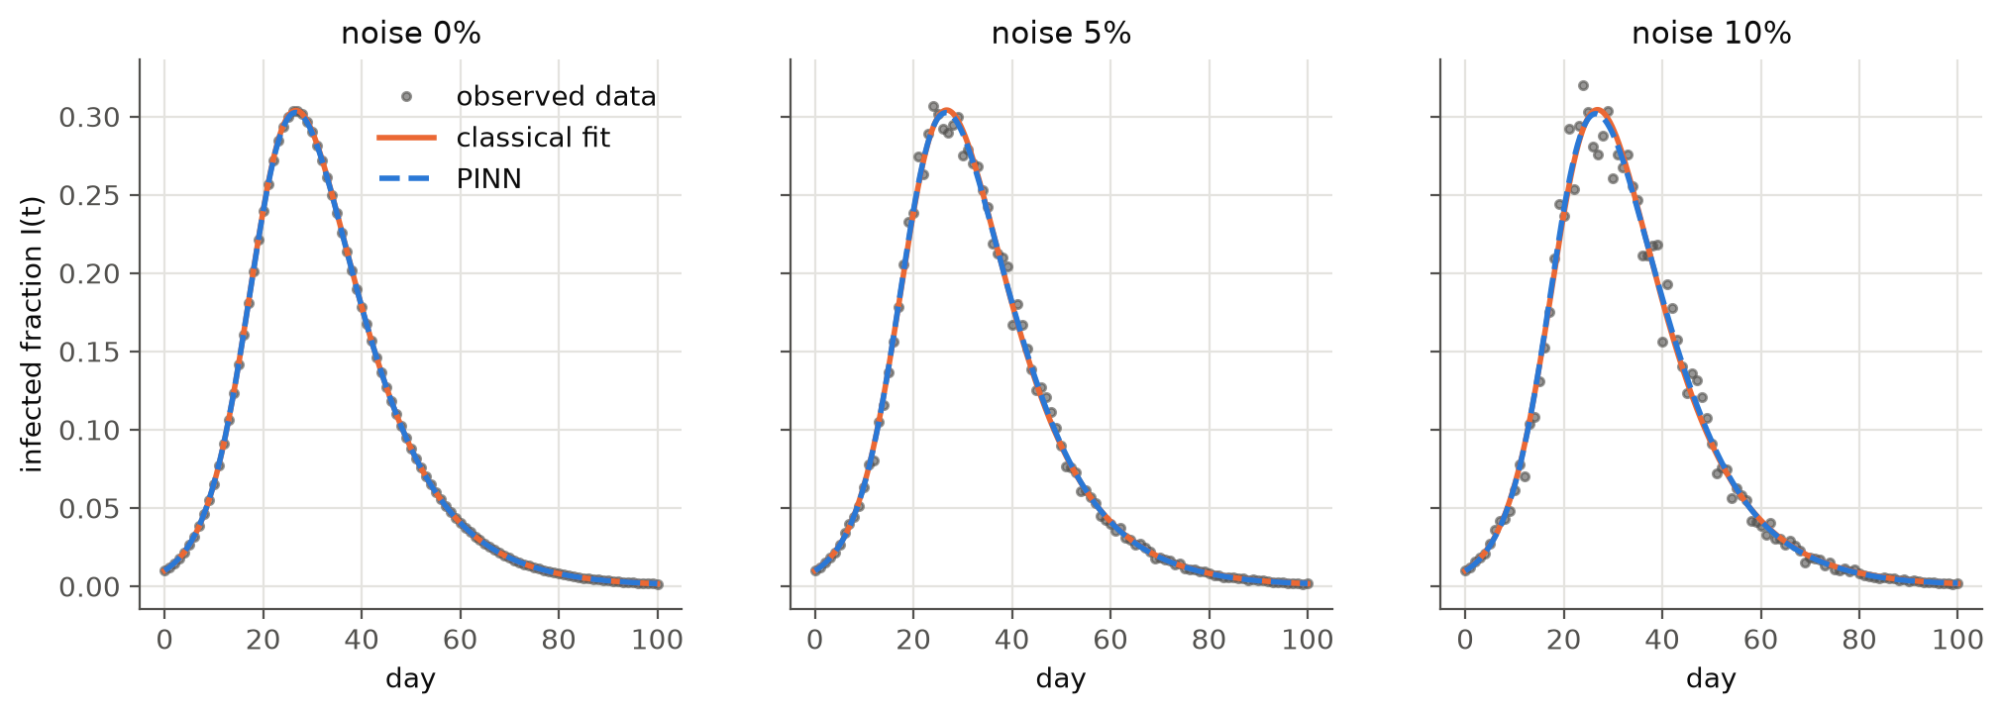
Synthetic test: both methods recover β and γ
PART 4 · RESULTS
Presented by Romar S. Almoguez
< 1.5%
error in β and γ for both methods, even with 10% noise
118×
Synthetic outbreaks with a known answer (β = 0.3, γ = 0.1) and 0%, 5% and 10% noise. The classical fit (orange) and the PINN (blue, dashed) overlap.
CLASSICAL
about 0.5 s · 6–7 function evaluations
PINN
48–73 s · 8,500–13,000 epochs
slower on average: the PINN takes about 60 s per fit, the classical method about 0.5 s
PINNs vs. Classical Least Squares · Dengue in Bulacan, 1994–2010
MCS 306 · Bulacan State University
Notes:
[Presenter: Romar S. Almoguez · about 30 seconds] First, we tested both methods on fake outbreaks where we know the true answer, beta 0.3 and gamma 0.1, with 0, 5 and 10 percent noise. Both methods recover the true values: even at 10 percent noise, every error is below 1.5 percent. But look at the time. The classical method takes about half a second, while the PINN needs thousands of training epochs and about a minute. On average, it is 118 times slower for the same answer.

Slide 7
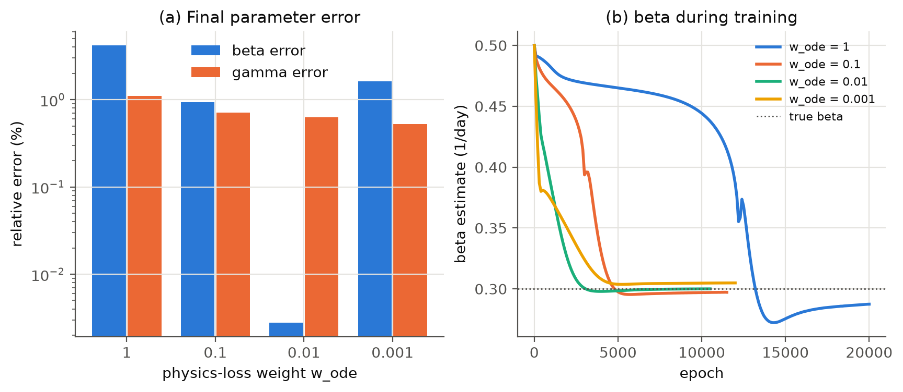
The PINN needs careful tuning of its physics weight
PART 4 · RESULTS
Presented by Romar S. Almoguez
20,000
epochs with w_ode = 1: β stalled for about 12,000 epochs and never converged (4.2% error)
0.01
best w_ode: β error 0.003%, γ error 0.63%, converged in 10,500 epochs
Four physics weights w_ode on synthetic data with 5% noise. (a) Final errors in β and γ. (b) The β estimate during training; the dotted line is the true β = 0.3.
PINNs vs. Classical Least Squares · Dengue in Bulacan, 1994–2010
MCS 306 · Bulacan State University
Notes:
[Presenter: Romar S. Almoguez · about 25 seconds] The PINN is also sensitive to tuning. We trained it with four values of the physics weight. With w-ode equal to 1, beta barely moved for about 12,000 epochs, and training hit the 20,000-epoch limit still 4 percent off. With 0.01, the best value, beta came out almost exact. Choosing this weight is a real tuning problem that the classical method simply does not have.

Slide 8
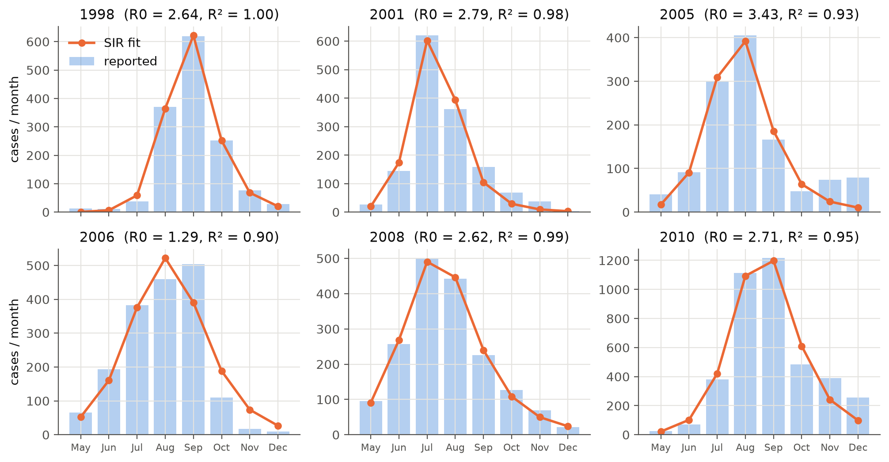
Real data: the SIR model fits six Bulacan seasons
PART 4 · RESULTS
Presented by Romar S. Almoguez
0.903–0.998
R² of the SIR fits across the six seasons
1.3–3.4
range of the basic reproduction number R₀
22–42 days
infectious period 1/γ (2006: at the 7-day bound)
PINNs vs. Classical Least Squares · Dengue in Bulacan, 1994–2010
MCS 306 · Bulacan State University
Notes:
[Presenter: Romar S. Almoguez · about 25 seconds] Then, real data. We fitted the SIR model to six outbreak seasons in Bulacan, from May to December, using monthly case counts. The model follows the curves closely, with R-squared from 0.903 to 0.998, and R-naught between 1.3 and 3.4. One warning: in 2006, the infectious period hit our lower limit of seven days, so we trust that season less.

Slide 9
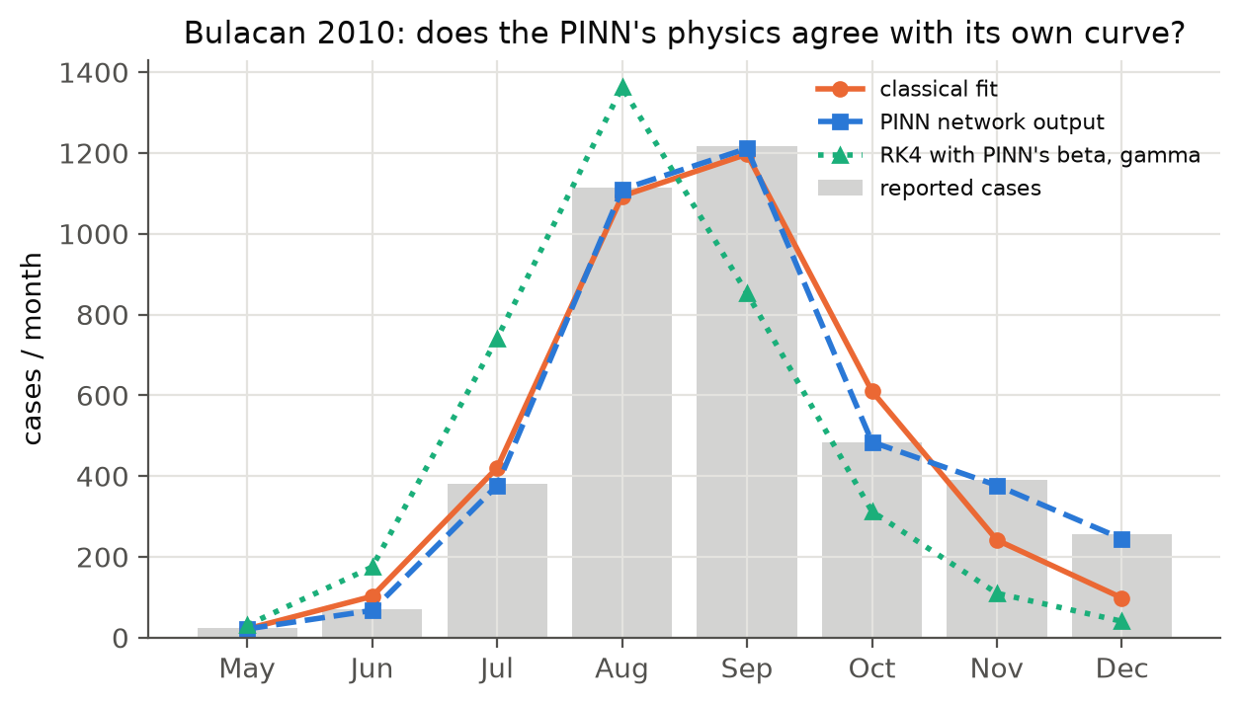
Real data: the PINN fits the curve, not the physics
PART 4 · RESULTS
Presented by Romar S. Almoguez
0.9997
R² of the PINN's own curve for 2010 (8 monthly points)
0.647
R² after re-simulating its learned β and γ with RK4
CLASSICAL FIT, 2010
R² 0.952 · R₀ 2.71 (bootstrap 95% CI 1.29–4.24)
PINNs vs. Classical Least Squares · Dengue in Bulacan, 1994–2010
MCS 306 · Bulacan State University
Notes:
[Presenter: Romar S. Almoguez · about 30 seconds] And the PINN on real data? For 2010, its network curve fits the eight monthly points almost perfectly, with an R-squared of 0.9997. But when we put the beta and gamma it learned back into RK4, we get a different curve, with an R-squared of only 0.647. With only eight data points, the network can bend to fit the data without truly learning the parameters. The classical fit gives R-naught 2.71, with a bootstrap 95 percent interval of 1.29 to 4.24.

Slide 10



What we learned, and where we go next
PART 5 · LIMITATIONS & CONCLUSION
Presented by Osyris Benedict P. Fajardo
Conclusions
Limitations
Next: our thesis
For a small model and sparse data, classical least squares is faster, simpler and more reliable.
PINNs work, but they need more data and careful tuning.
R₀ = β/γ is estimated more reliably than β or γ alone.
SIR ignores mosquitoes, so the fitted infectious period (22 to 42 days) absorbs the mosquito cycle.
Monthly data that end in 2010 give only 8 points per season.
The 2006 fit hits the 7-day bound, and each PINN run used one random seed.
A mosquito–human (vector) model
Weekly case data
Rainfall-driven transmission, where a neural network can earn its place
PINNs vs. Classical Least Squares · Dengue in Bulacan, 1994–2010
MCS 306 · Bulacan State University
Notes:
[Presenter: Osyris Benedict P. Fajardo · about 40 seconds] To wrap up: for a small model and sparse data, the classical method is faster, simpler and more reliable. PINNs work, but they need more data and careful tuning. We also found that R-naught is estimated more reliably than beta and gamma separately. Our study has limits. SIR ignores mosquitoes, so our infectious period of three to six weeks absorbs the mosquito's part of the cycle. Our data are monthly and end in 2010, and the 2006 fit hit a bound. For our thesis, we plan a mosquito–human model with weekly data and rainfall-driven transmission, where a neural network could really earn its place.

Slide 11

Thank you!
LOGO
LOGO
BULACAN STATE UNIVERSITY
College of Science · BS Mathematics (Computer Science)
S
Susceptible
β
Questions and feedback are welcome.
I
Infected
github.com/SeanXxotick/MCS306FCO
γ
Code, data, figures and the full paper
R
Recovered
Romar S. Almoguez · Sean Arkin C. Dela Cruz
Osyris Benedict P. Fajardo · Jian Kyle C. Hornales
Notes:
[Presenter: Osyris Benedict P. Fajardo · about 10 seconds] Thank you for watching! Our code, data, figures and paper are all on GitHub at github.com/SeanXxotick/MCS306FCO.

