Slide 1

ASIC II PROJECT: OpenSparc T1
By David Herbert, Sean Zarycki, Abesh Dhuka

Slide 2
Intro
The goal of the project is to simulate the OpenSparc Floating Point Unit (FPU)
In addition, the following SAED libraries on will be tested for the project
90NM
32NM
45NM

Slide 3
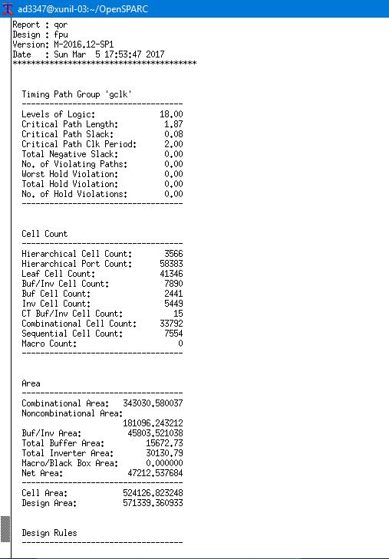
SAED 90NM DC SHELL RESULTS

Slide 4
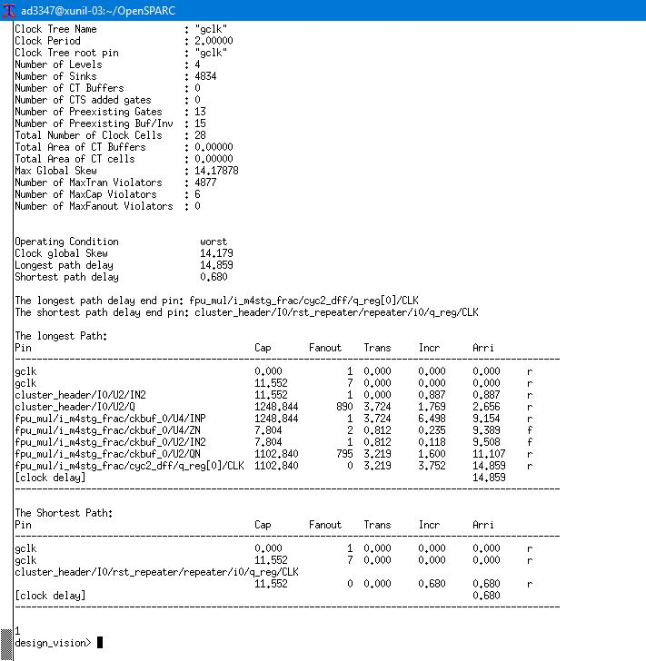
SAED 90NM DC SHELL RESULTS

Slide 5
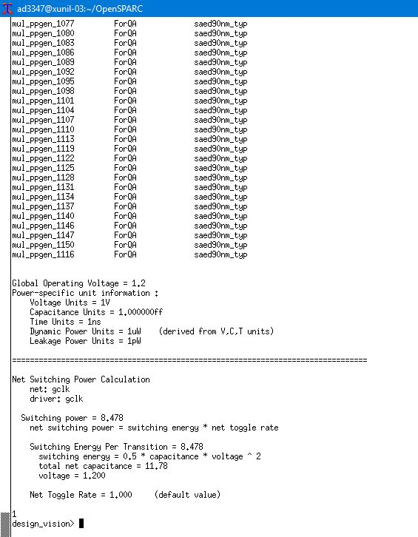
SAED 90NM DC SHELL RESULTS

Slide 6
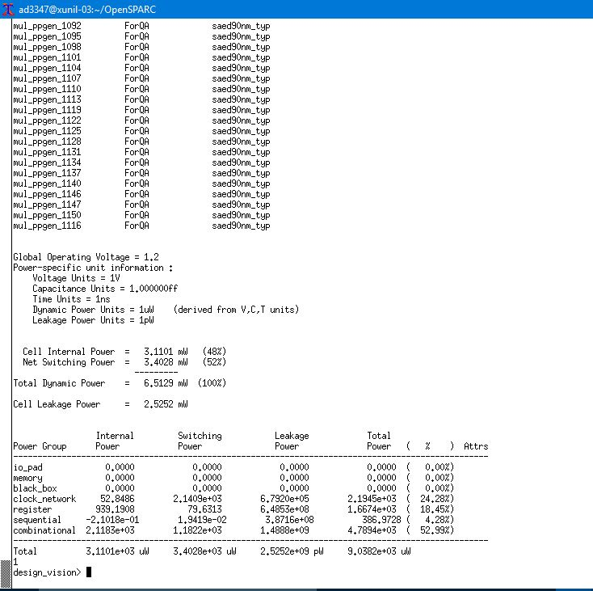
SAED 90NM DC SHELL RESULTS

Slide 7
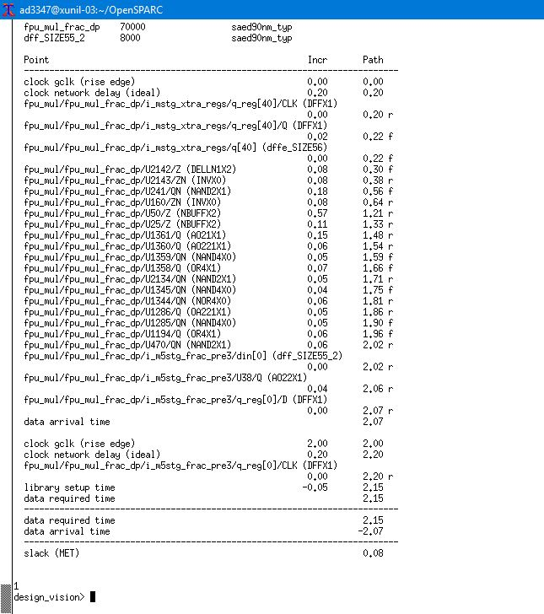
SAED 90NM DC SHELL RESULTS

Slide 8
Other Work That Needs To Be Done
More DC Shell testing
32NM Testing
45NM Testing
ICC Shell
Prime Time Test

