Slide 1
Building an open source potentiostat

Slide 2
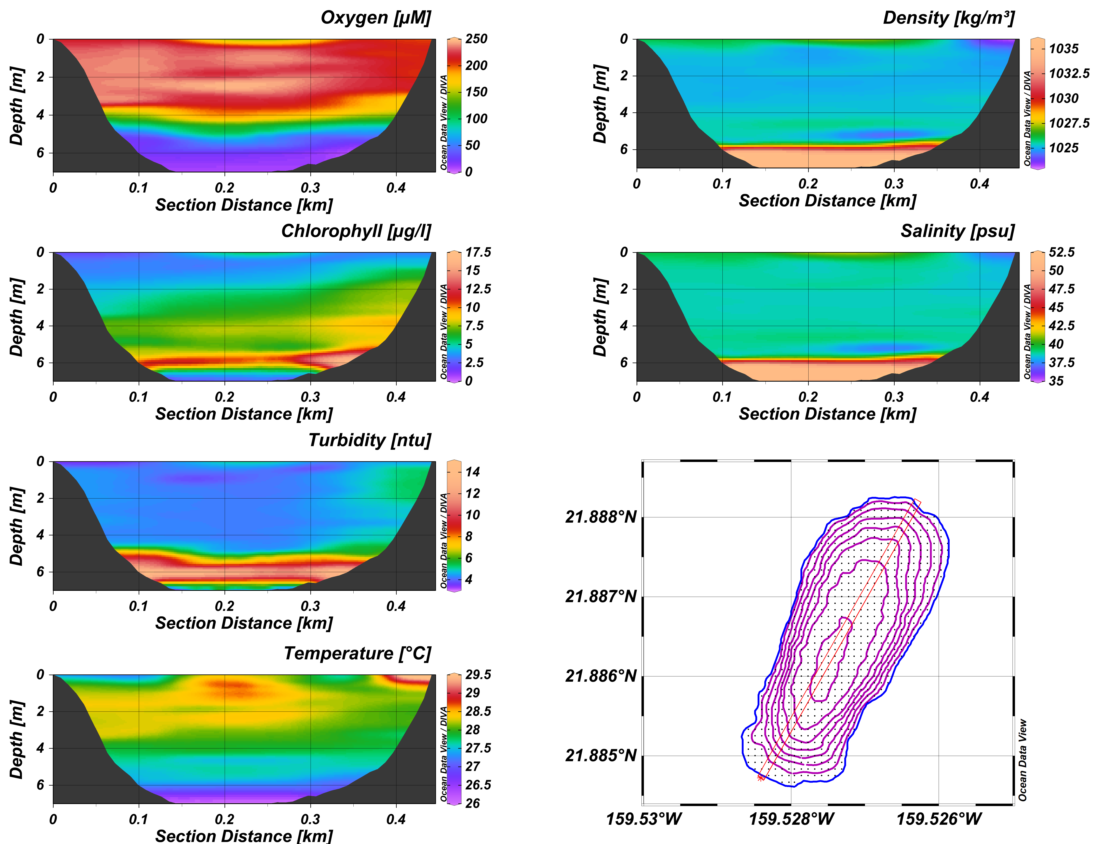
The research objective
Anoxic bottom water layer at Nomilu Fishpond (Kaua’i)
Characterize redox-geochemical cycles
Oxidation partners for oxidation of organic matter
NO3, Mn
Anoxygenic photosynthesis?

Slide 3
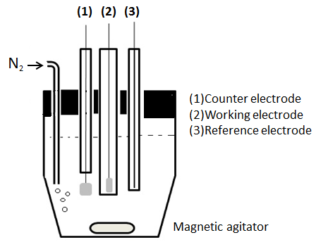
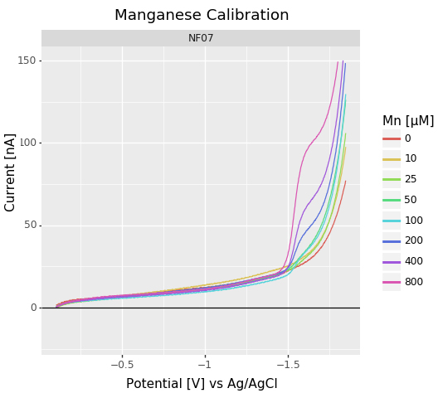
Voltammetry
http://article.sapub.org/10.5923.j.ajee.20140406.07.html
Measuring the current generated by reduction/oxidation of analyte at electrode surface
Analytes: Fe(II), Mn(II), H₂S, O₂ etc
Reaction potential is specific to analyte, peak height relative to concentration
Electrode: Mercury/Gold
Potentiostat: Applies potential to electrode, measures current

Slide 4
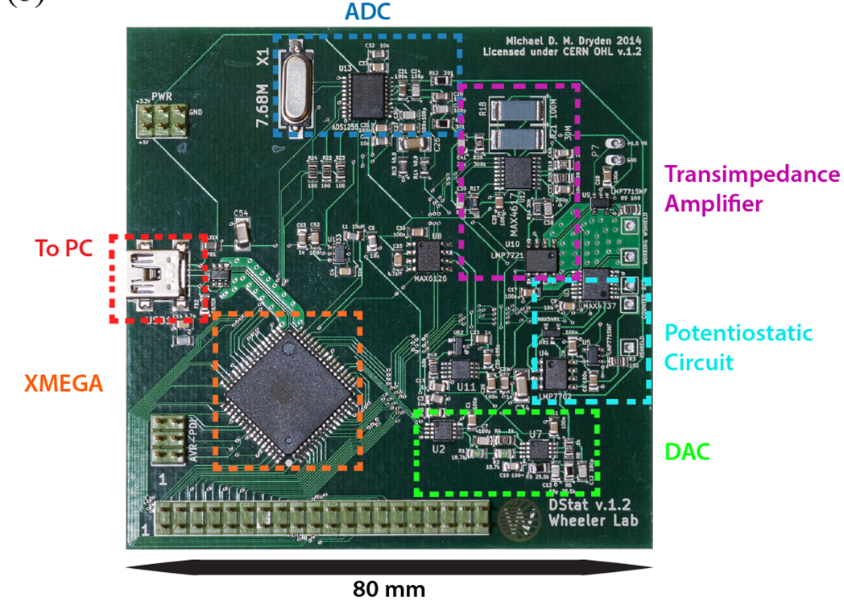
Dstat – open source potentiostat
Dstat
Open source hardware design
Open source (python) software
Cost: ~130 $US for parts
Size: 80x80 mm
Assembly required
Commercially available Potentiostat
Black box
Proprietary software
Cost: thousands
Big box
Comes assembled
Potential Issues:
Sensitivity
Noise
To our knowledge, the Dstat design has successfully been tested with nA current measurements but not with Hg/Au electrodes

