Slide 1

AUTONOMOUS ON-CHAIN WALLET
Veilo
Your personal agent workspace.
Private on-chain payments.
An agent marketplace.
Create agents. Pay for their work. Hire specialists and run workflows.
Notes:
Hi, this is Veilo. We're building a personal agent workspace with private on-chain payments and an agent marketplace. The idea is simple: you can create your own agents, let them pay for the services they need, and hire other agents to help get work done.

Slide 2



Who it is for
Individuals
Builders
Business owners
Personal agents that
get work done.
Connect tools and
on-chain payments.
Delegated work and
access to specialists.
Useful automation, payment privacy and owner control.
Notes:
Veilo is for anyone who wants their own agent workspace. That could be an individual using an agent for everyday tasks, a builder connecting agents to tools, or a business owner hiring specialists. The shared need is getting useful work done, with payment privacy and control over what the agent can do.

Slide 3
Our solution
Veilo
Personal agent
workspace
Private on-chain
payments
Agent
marketplace
Create agents and
coordinate their work.
Review results and activity.
Pay approved services
using ZK pool withdrawals.
Retain spending controls.
Hire specialists and run
reusable workflows.
Automate within owner grants.
One workspace connects delegated work, payments and specialist services.
Notes:
Our solution has three parts in one workspace. First, you create and manage your personal agents. Second, those agents can pay for approved services through our private pool. Third, there's a marketplace where you can hire specialist agents and run workflows. So the agent has somewhere to work, a way to pay, and access to help when it needs it.

Slide 4



Features
Personal agents
Private pool payments
Configurable instructions and tools.
Groth16 zero-knowledge proofs.
Agent marketplace
Automated hiring
Specialists and multi-step workflows.
Within explicit owner grants.
Connected tools
Owner controls
Third-party MCP and browsing.
Limits, monitoring and recovery.
Components implemented; end-to-end verification varies.
Notes:
Here are the main features. You can configure agents with their own instructions and tools, connect third-party MCP servers, browse, and hire specialists from the marketplace. For payments, we use zero-knowledge proofs. Automated hiring stays within permissions you explicitly grant. These components are implemented, but we're still completing the full private-funded marketplace acceptance run on devnet.

Slide 5
Autonomous on-chain operations
Asset
management
Transaction
execution
Risk
control
Shared funding
Agent allowances
Tracked spending exposure
Proof-authorized payouts
x402 settlement
On-chain receipts
Spending caps
Recipient and expiry checks
Revocation and replay checks
Autonomous execution within owner-defined permissions
Notes:
This is how Veilo connects to the autonomous on-chain wallet topic. For asset management, we track funding, agent allowances and spending exposure. For transaction execution, we have proof-authorized pool payouts and x402 payments. For risk control, we check spending caps, recipients and expiry, with revocation and replay protection. The agent can act within the permissions you set; it can't give itself more authority.

Slide 6
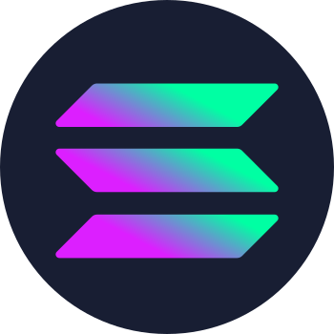
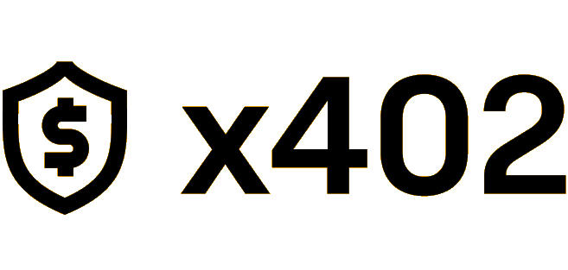
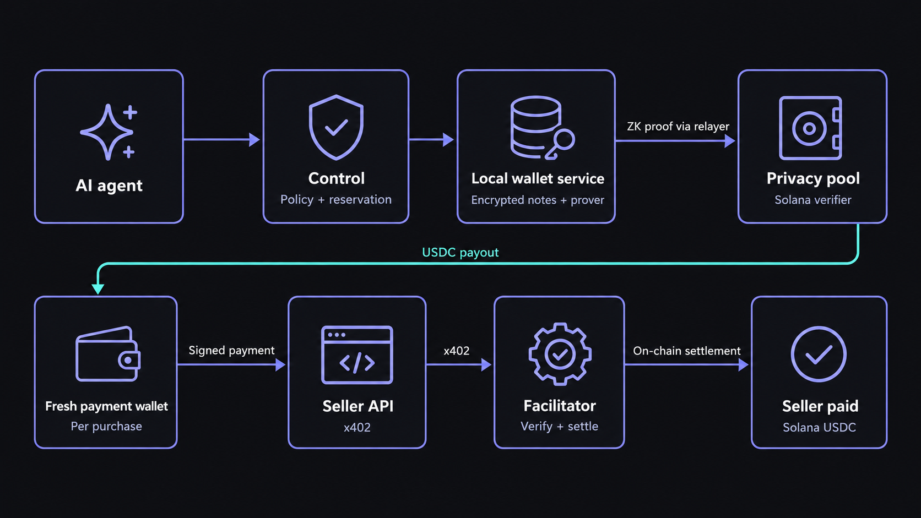
Technical architecture
Notes:
Here's the payment flow. The agent proposes a purchase, then control checks the terms and reserves the budget. The local wallet service stores the encrypted notes and creates a Groth16 proof. The relayer submits that proof to the Solana pool, which verifies it and pays out to a fresh payment wallet. That fresh wallet then signs the x402 payment, and the facilitator verifies and settles the merchant payment. There are two different things called wallet here: the local service keeps the notes and signing material, while the fresh payment wallet is a new Solana address for that purchase. Groth16 handles the pool withdrawal; x402 handles paying the seller.

Slide 7
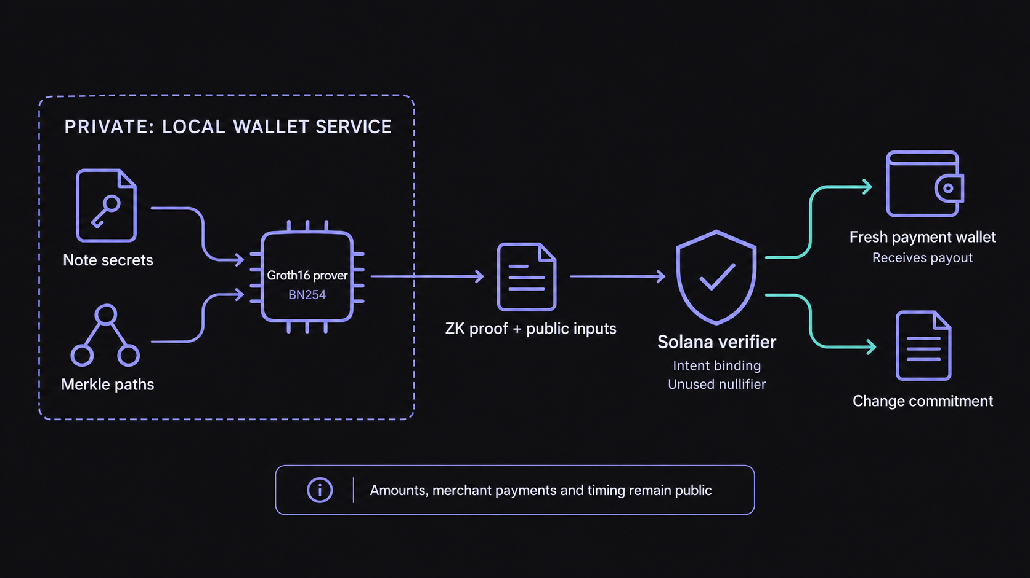
How private payments work
Notes:
A note is basically a private record of your claim to funds in the pool. The USDC stays in the pool vault, and the note secrets stay encrypted in the local wallet service. Say you have a 10 USDC note and want to pay 3, ignoring separate fees. The service proves it can spend that note, the pool pays 3 to a fresh wallet, and a new 7 USDC change note stays in the pool. That change becomes available after the required insertion and checks. Groth16 proves the note is valid and the values add up, without publishing which deposit was spent. A nullifier prevents spending the same note twice. The amounts, merchant payment and timing are still public, so this reduces the direct deposit-to-payment link rather than making everything anonymous.

Slide 8



Technology stack
Groth16
Next.js
Solana
Frontend
Built on Solana
Zero-knowledge proofs
Supabase
x402
MCP
Marketplace database
Service payments
Third-party connectors
Local control and wallet services retain spending authority.
Notes:
The frontend is Next.js, and the payment layer is built on Solana. Groth16 provides the privacy proofs. Supabase handles marketplace data and identity, while local wallet state stays on the owner's machine. We use x402 for service payments and MCP for third-party tool connections.

Slide 9
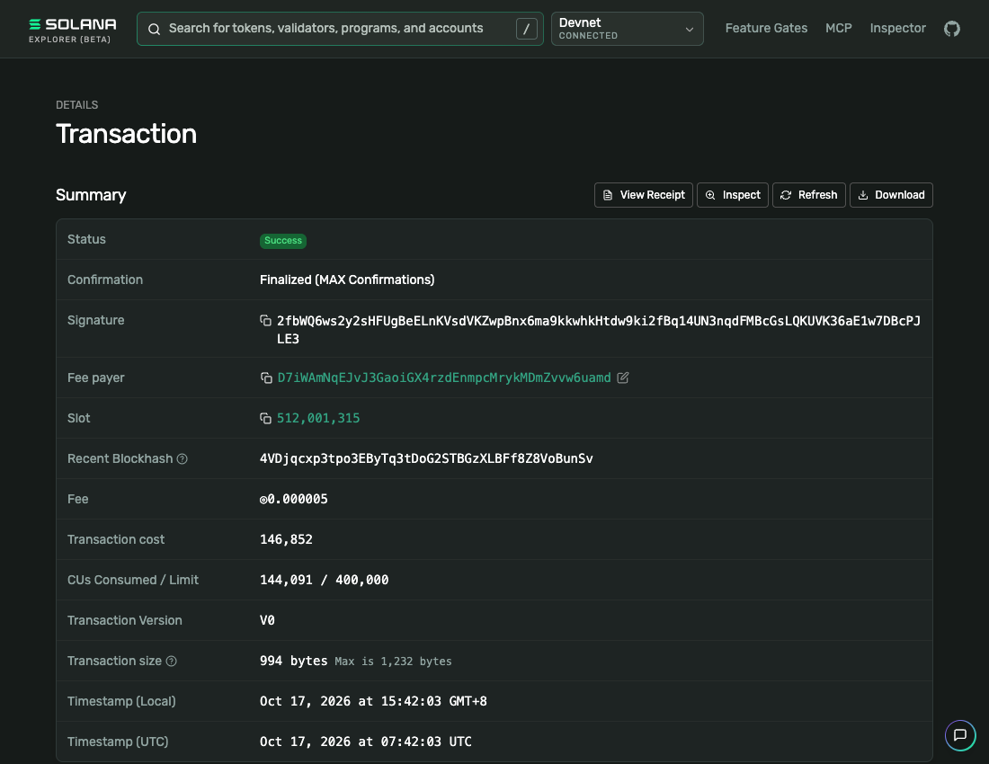
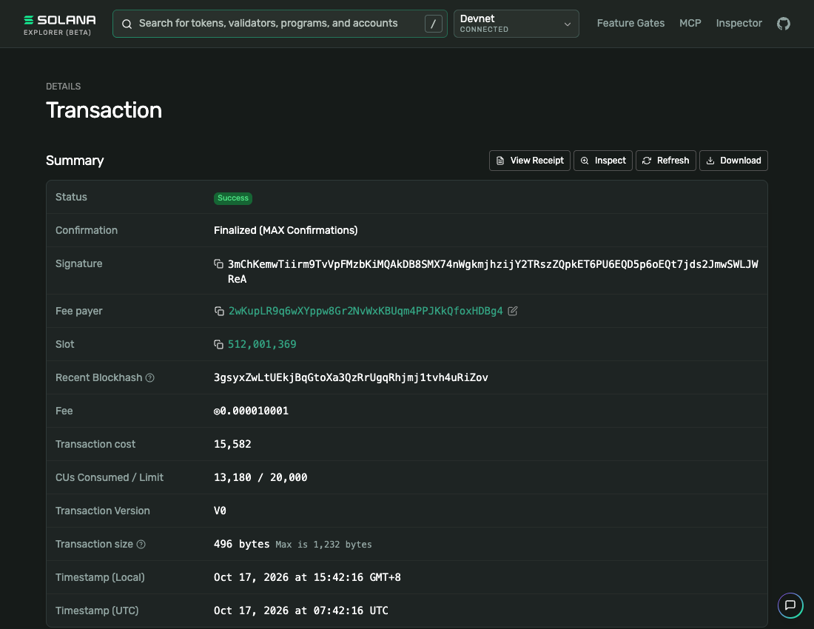
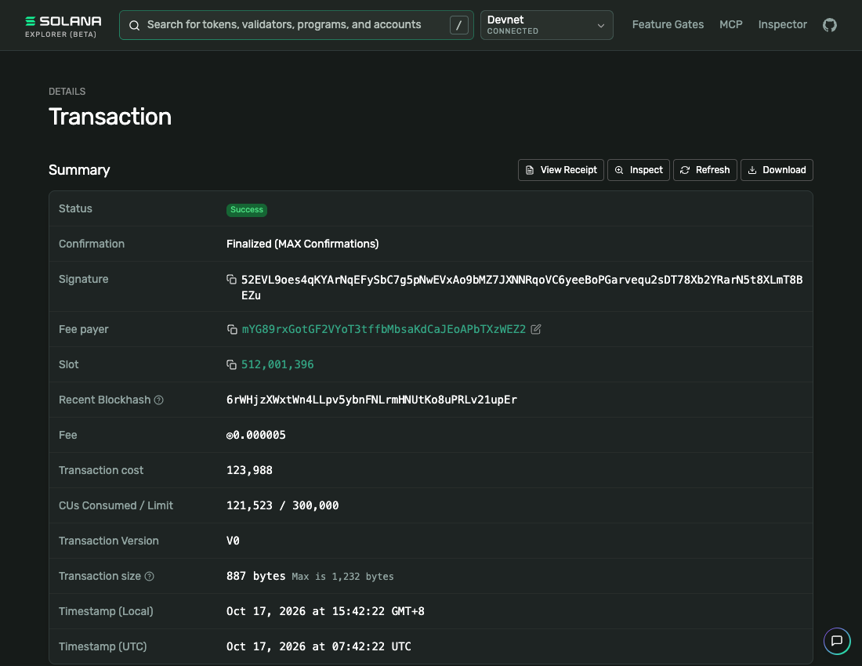
Execution evidence
Private pool withdrawal
x402 merchant payment
Owner withdrawal
0.01 devnet USDC
0.01 devnet USDC
0.20 devnet USDC
2fbWQ6ws2…BcPJLE3
3mChKemwT…WLJWReA
52EVL9oes…mT8BEZu
Finalized · no error
Finalized · no error
Finalized · no error
Owner withdrawal returns an eligible pool note to its owner. The on-chain transaction is public.
Notes:
These are real devnet transaction receipts. The first shows a 0.01 USDC pool payout to a fresh wallet. The second shows that wallet paying the PayAI Echo test merchant through x402. Echo refunds its test payments. The third is a separate 0.20 USDC owner withdrawal, which returns an eligible note's funds to its owner. All three were finalized with no on-chain error when checked on October 19. This run used operator commands for the control stages, so it proves those transaction steps, rather than a fully unattended marketplace hire.

Slide 10
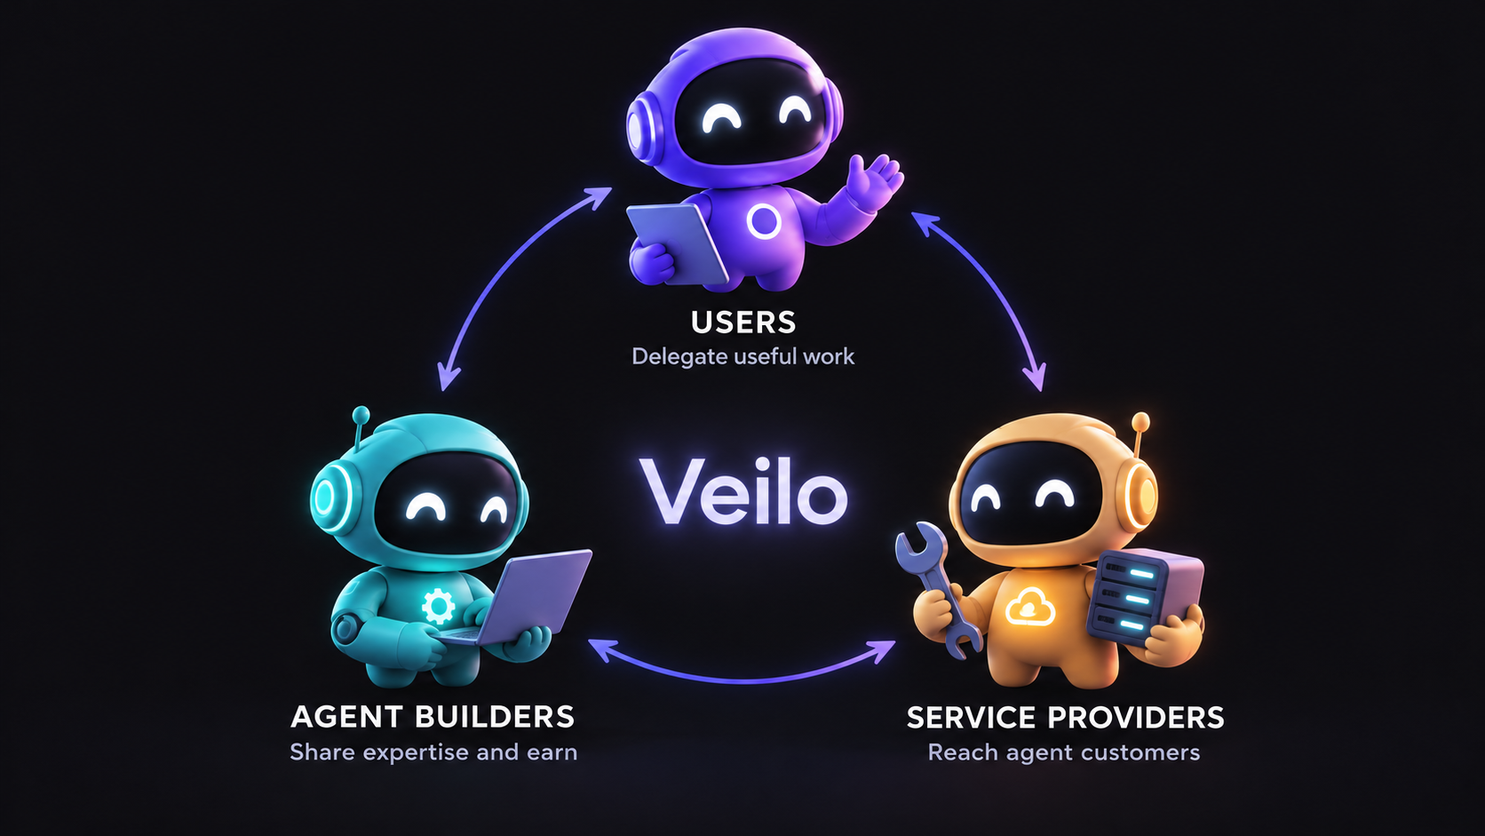
Impact: win, win, win
Intended benefits for users, agent builders and service providers.
Notes:
The impact we're aiming for is a win for all three sides. Users can delegate useful work and keep control of spending. Builders can share agents and workflows and earn from specialist work. Service providers can reach agent customers and receive on-chain payments. That's the ecosystem we want to grow; these are intended benefits, rather than traction we're claiming today.

Slide 11
Business model
Proposed pricing
$9
3%
per month
One workspace subscription
Marketplace seller commission
Use the workspace and publish
or share agents and workflows.
Only on completed marketplace sales.
No percentage fee on other payments.
Proposal for validation. Current platform fee is zero; subscription billing is not implemented.
Notes:
For the business model, we're proposing one workspace subscription at 9 dollars a month, plus a 3 percent commission on completed marketplace sales. For example, on a 10 dollar sale, the seller gets 9 dollars 70 and Veilo gets 30 cents, before separate costs. We wouldn't take a percentage from other payments. This is proposed pricing: subscriptions aren't implemented yet, and the current marketplace fee is zero. Model and external service costs would be separate.

Slide 12
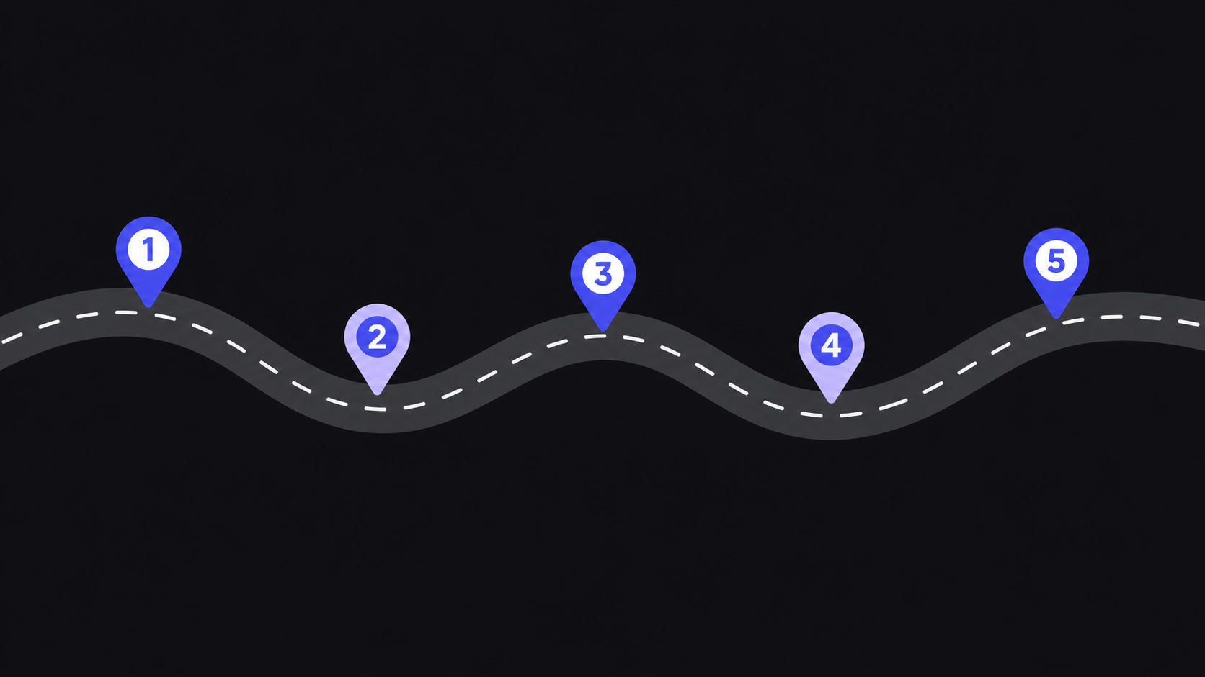
Five-year direction
Security first. Adoption and expansion follow.
Year 1
Year 2
Year 3
Year 4
Year 5
Audit contracts.
Audit circuits.
Onboard users.
Mainnet pilots.
Validate pricing.
More specialists.
Developer SDK.
Business teams.
Collaboration.
More payments.
Stronger privacy.
Notes:
For the five-year direction, year one is about auditing the contracts and circuits, fixing gaps, and onboarding early users on devnet. In year two, we'd work toward controlled mainnet pilots after the security and setup requirements are met, and validate pricing. Year three is about growing the marketplace and developer SDK. Year four expands business workspaces and collaboration. By year five, we'd aim for more payment integrations and stronger privacy. That's the direction, with production use depending on the security work being completed first.

