Slide 1
What Did We Build and Why?
Problem
  Campus tech requests live in a shared inbox and three departmental spreadsheets.
  No named owner, no support-hour SLA clock, and no number the monthly service review can defend.
Customer / user
  Faculty mid-lecture, students locked out of Canvas or eduroam, and CTS agents who triage by scrolling.
Strategic value
  CTS is funded on measurable service quality: one intake path, one queue, one clock, one dashboard.
Working prototype — four interactions, not a platform
  Submit a ticket → SLA target and a tracking number
  Work the queue → search, filter, assign, work notes, audit trail
  Support-hour SLA clock — weekdays 08:00–18:00, not calendar hours
  Dashboard and CSV export for the monthly service review
The prototype works. The question we brought to management is not “can we build it” — it is whether CTS should keep investing, and whether it can execute.
HelpDesk165 · CMPE 165 Project 1 · GO WITH CONDITIONS · 1 / 4
Notes:
TIME: 0:00-1:00 (60 seconds). SPEAKER: [member 1].
Open with the concrete story, not the architecture: a projector dies in BBC 202, the faculty member emails a shared inbox, and nobody owns the request.
Land one sentence on strategy: CTS is funded on service quality, so a queue with a defensible SLA number IS the strategy, not a tool purchase.
Do NOT demo here. The Loom covers the product. Name the four interactions and move on.
Likely question: why not just buy ServiceNow? Answer: that is exactly the decision tree on slide 3, and it loses on EMV.

Slide 2
How Did We Execute?
Team and structure
  Matrix, not projectized — CTS cannot pull a dedicated unit for a year without hollowing out the desk.
  Hybrid, on campus two days a week; classroom tickets need walk-up empathy.
  Lanes are written down: service owner owns requirements, tech lead owns how, PM owns the date and the scope cut.
Leadership
  Facilitative, with a spine. Disagreements go on a decision log within 24 hours, then to the CTS Director.
The conflict that mattered
  Agents wanted a seven-field classroom form. Faculty will not fill that in while forty students wait.
  Neither side won: submit stays 30 seconds, agents complete podium ID and CRN at triage.
Vibe-coding lesson
  We thought the intake form was the project. The SLA clock was the project.
  AI wrote page chrome and seed data well; it froze resolved_at on reopen, and tests caught it.
  Humans made the calls: support hours over calendar hours, and no unqualified GO.
HelpDesk165 · CMPE 165 Project 1 · GO WITH CONDITIONS · 2 / 4
Notes:
TIME: 1:00-2:00 (60 seconds). SPEAKER: [member 2].
This slide is about process management, not code. Spend your words on the conflict and the vibe-coding lesson; the structure bullets are for the reader, not the talk.
The conflict is the strongest 15 seconds in the deck because nobody was declared the winner. Say explicitly that we separated SUBMIT from TRIAGE, which is a negotiation outcome, not a compromise that serves neither side.
For AI: give the one concrete failure. Generated update logic stamped resolved_at when a ticket closed and never cleared it, so a reopened ticket froze the SLA clock and the dashboard under-counted breaches.
Likely question: did AI write the analysis? Answer: it wrote structure; we chose every assumption and the recommendation.

Slide 3
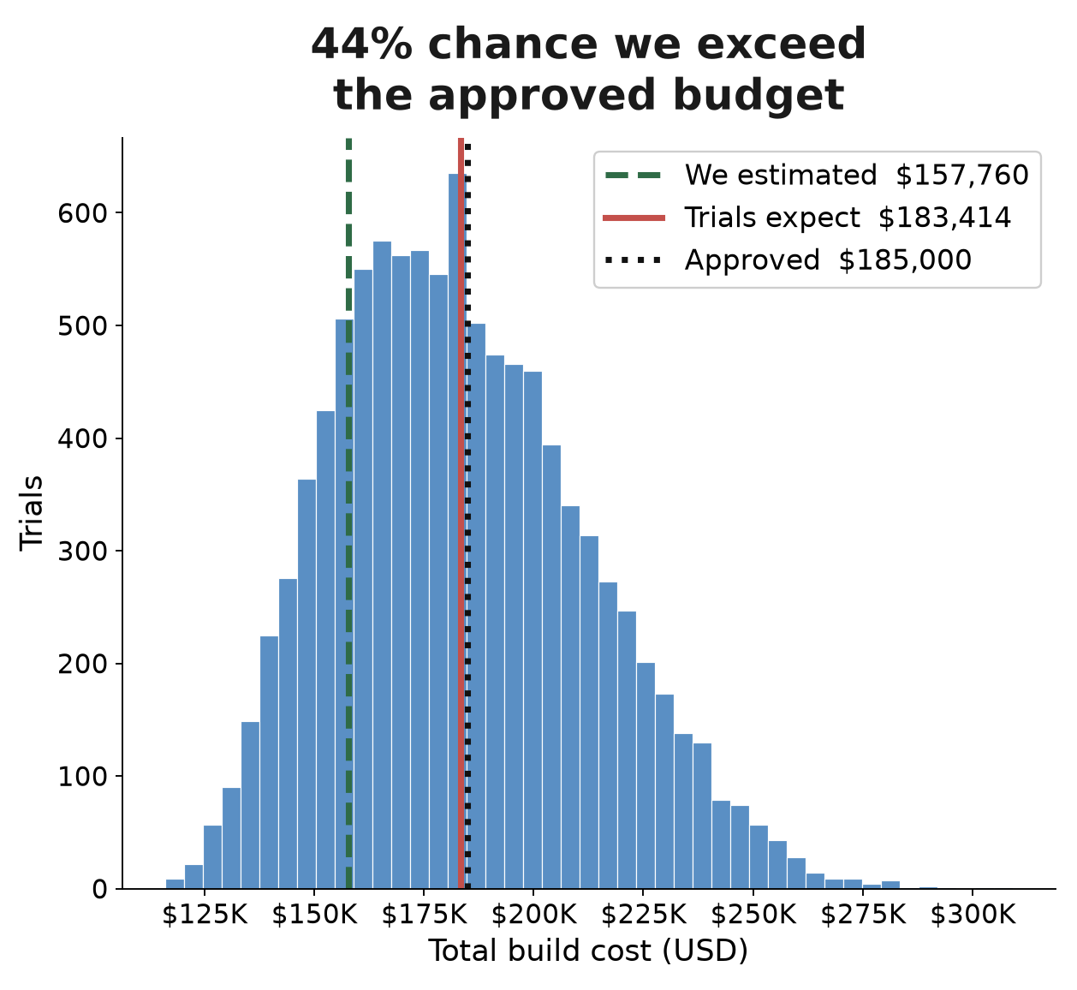
What Could Go Wrong?
Three largest risks, ranked by exposure
  R3 Adoption — $28,500. Inbox culture survives and the labor savings never appear.
  R2 Cost and schedule — $18,900. 44% chance of passing the $185K approval ceiling.
  R5 FERPA — $15,000. Student records sit in ticket bodies with no access control yet.
Decision tree: the pilot wins
  Eight-week paid pilot EMV $98,300, versus build now $85,000 and license ITSM $72,750.
  Pilot downside −$46K; build-now downside −$95K.
Monte Carlo, 10,000 trials
  $179,670 point-estimate NPV → $54,286 expected NPV; P(NPV < 0) = 27.3%.
  Minutes saved and adoption drive NPV — not engineering hours.
Estimate $157,760 · expected $183,414 · approved ceiling $185,000 · P80 $208,011
HelpDesk165 · CMPE 165 Project 1 · GO WITH CONDITIONS · 3 / 4
Notes:
TIME: 2:00-3:00 (60 seconds). SPEAKER: [member 3].
Do not read the risk register. Give the three risks in six words each and spend the rest of the minute on the chart.
The chart is the whole argument: the green dashed line is what we estimated ($157,760), the red line is what 10,000 trials expect ($183,414), and the dotted line is the money we are actually approved to spend ($185,000). The gap between green and red is the planning fallacy with a dollar sign on it.
Say the decision that changes: budget to the P80 of ~$208,000, not to the point estimate.
Then the punchline for slide 4: the two variables that dominate NPV, minutes saved and adoption, are exactly what a cheap pilot measures.

Slide 4
Should We Continue?
GO WITH CONDITIONS
  Not GO — the $179,670 NPV is the mode of our inputs, not the mean. Expected NPV is $54,286.
  Not NO-GO — expected value is still positive, the pilot has the best EMV, and learning costs $46K.
The conditions, written into the funding memo
  Eight-week paid pilot in Classroom Technology and Canvas support; close the shared inbox for those categories. $46K.
  Role-based access control and a booked FERPA review before a single real ticket is accepted.
  Hold capital at the P80 build cost of ~$208K, not the $157,760 point estimate.
  Launch scope frozen at four features. No knowledge base, no chat, no mobile app.
  Stop gate: intake share under 60% at week eight means the full build is not funded.
We are not asking whether the software works. We are asking whether CTS will change how it takes a request — and $46K answers that before $208K is committed.
HelpDesk165 · CMPE 165 Project 1 · GO WITH CONDITIONS · 4 / 4
Notes:
TIME: 3:00-4:00 (60 seconds). SPEAKER: [member 4]. If the team has fewer than four members, split this slide between two speakers so everyone presents.
Say the recommendation in the first three seconds, then justify it. Do not build up to it.
The framing that earns the marks: we are not asking whether the software works, we are asking whether CTS will change how it takes a request. That is a behavior question, and $46,000 answers it before $208,000 is committed.
Close on the stop gate and say plainly that stopping at week eight would be a SUCCESSFUL use of this analysis, not a failed project. The assignment explicitly rewards that conclusion.
HARD STOP at 4:00. If you are over, cut the middle three conditions and keep the pilot and the stop gate.

