Slide 1
MTK Common Platform
Manufacturing Test Kit (MTK GUI)
All-in-one: from design to platform, from net to system
One common platform for all NXP Commercial Boards
ICT → Flash FAT → FCT → Flash OOBE
Developed & deployed by NXP HWS-CC Team — all TE engineers · October 2026

Slide 2
Agenda
10 minutes · 6 topics
1
What is MTK GUI?
Platform overview, main interface & Yaml Build tour
2
Why MTK?
Manual testing vs. LabVIEW / TestStand + PXI vs. MTK
3
Development & Deployment Roadmap
What is done, what is in debug, what comes next
4
Hardware BoM & Investment
≈ $15–19k per station, zero software license fees
5
MTK vs. Traditional Manual Testing
Coverage, precision and new capabilities
6
Summary & Ask
What we need to move to Phase 3 and production rollout

Slide 3
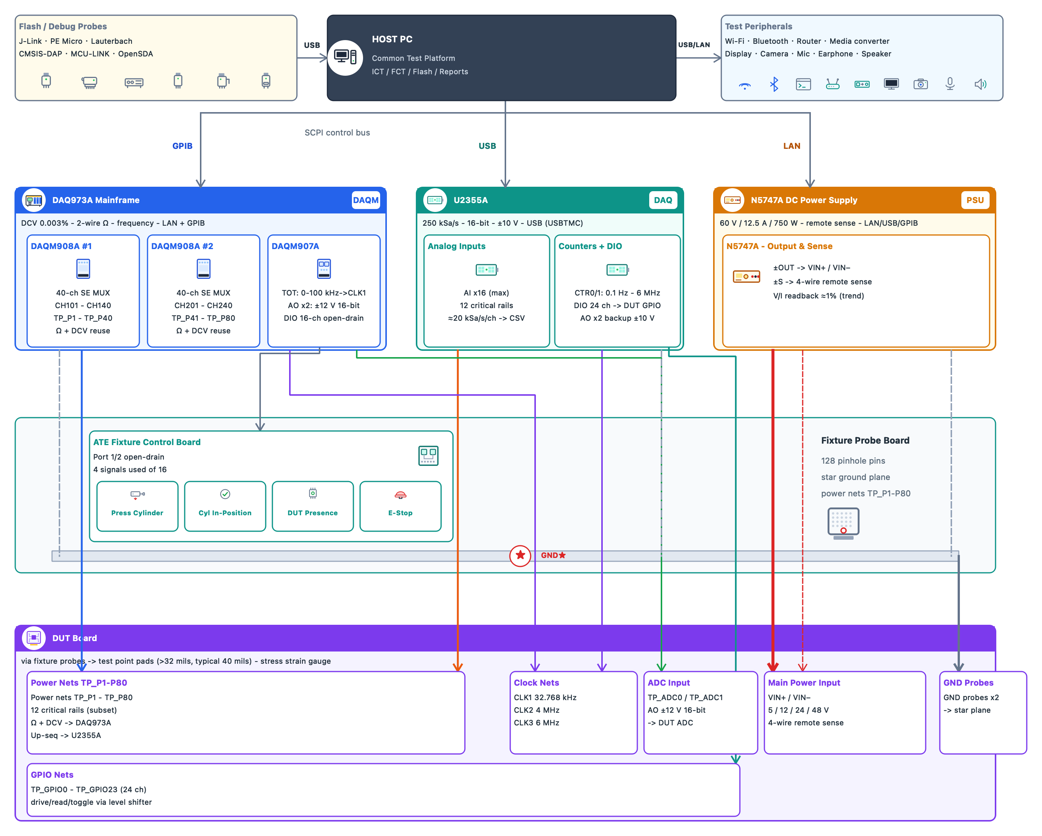
What is MTK GUI?
One PC + one rack = the complete test station. MTK software runs it all — on every NXP commercial board.
1 · Host PC — the brain
One computer runs the MTK software, drives every instrument and produces the reports.
2 · Instruments — measure & power
Digital multimeter, waveform capture and a programmable power supply for the board.
3 · Test peripherals
Wi-Fi router, Bluetooth, display, camera — used to verify the product’s real functions.
4 · Flash / debug probes
Load the firmware into the board (factory-test image, then shipping image).
5 · Test fixture (the bed)
Holds the board; 128 spring-loaded pins touch every test point automatically — no manual probing.
6 · DUT — the product
The board under test, connected to the whole rack through the fixture.
Desktop app — zero setup
Lightweight & universal
One YAML per project
Friendly UI — quick to learn
Supervisor + Operator roles
Takeaway: one operator, one click — MTK orchestrates the entire rack from a single PC.

Slide 4
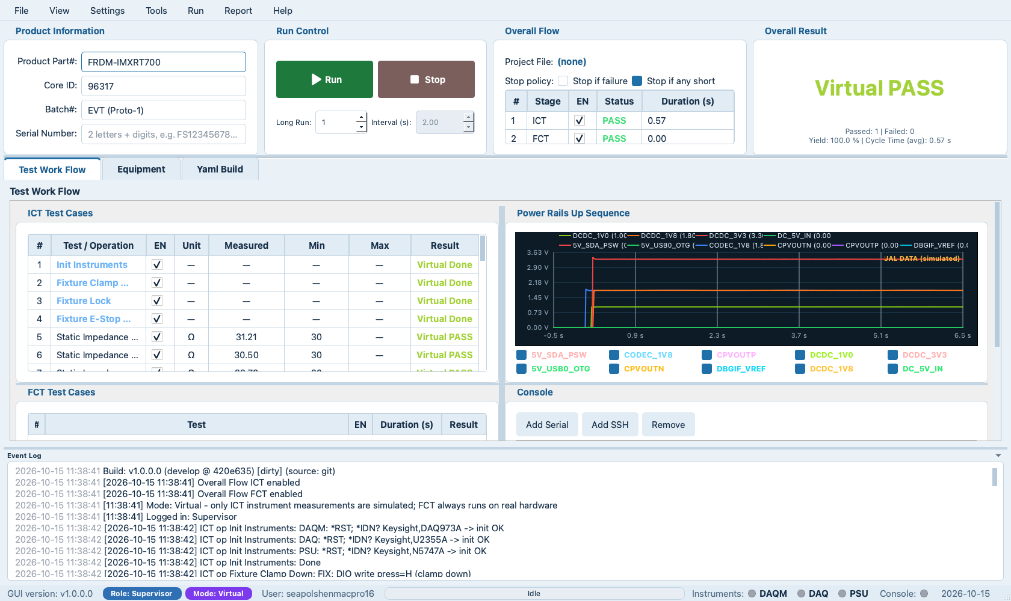
MTK GUI Main Interface
One window runs the whole station — shown here in the Ocean theme (virtual demo run).
2
1 · Product Info & Run Control
Part #, SN, Run / Stop, long-run & interval
1
2 · Overall Flow & Result
Live PASS / FAIL verdict per stage
3
3 · Workflow / Equipment / Yaml Build
Test development & execution in one tool
4
5
4 · ICT / FCT Test Cases & Consoles
Measured vs. limits; serial / SSH consoles
5 · Power Rails Waveform
12-rail ms capture, auto-graded
6
6 · Event Log
ms timestamps, colored verdicts
7 · Status Bar
7
Version, role / mode, progress, LEDs

Slide 5
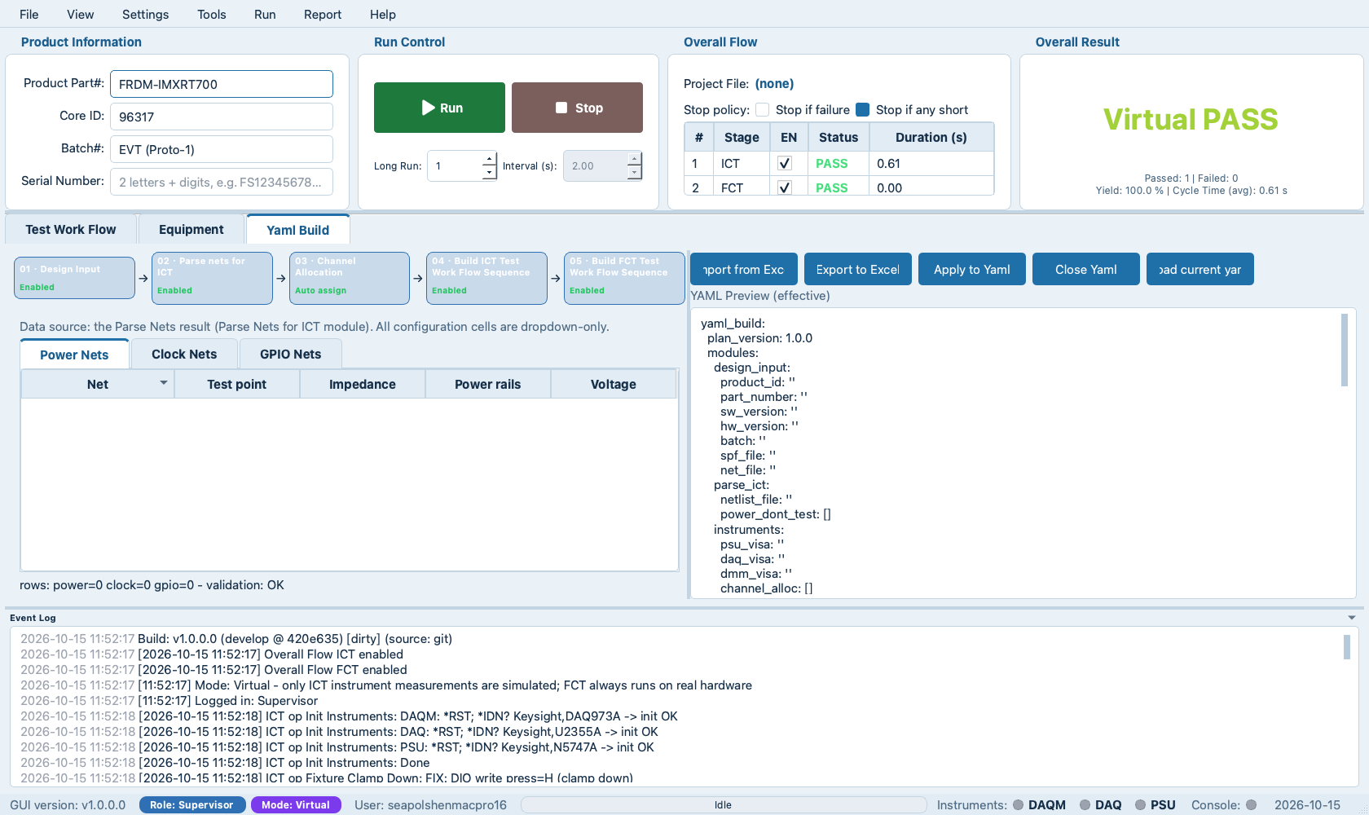
Yaml Build — From Design Files to a Test Plan
Five guided steps turn design inputs into a runnable ICT + FCT project — no manual data entry.
1 · Design Input
Point to netlist / SPF / PDF design files
2 · Parse Nets for ICT
Power nets & test points extracted automatically
1
2
3
4
5
3 · Channel Allocation
Nets auto-mapped to instrument channels
4 / 5 · ICT & FCT Sequences
Test workflows generated, ready to run
Live YAML Preview
Two-way sync with the diagram; Excel import / export

Slide 6
Why MTK?
Same lab instruments — three very different ways to run them.
 | Manual testing (today) | LabVIEW / TestStand + PXI | MTK Common Platform
Test coverage | Depends on the operator — steps get skipped under pressure | High, but every new product needs specialist programming | Full flow built in: ICT → flash → FCT → OOBE, identical on every unit
Speed & efficiency | Slow — one operator fully occupied per board | Fast, but long (expensive) integration per product | One click — fully automated: drives instruments, peripherals & fixture, talks to the DUT console; timing precise to the millisecond
Quality assurance | Human variance; mistakes hard to trace | Repeatable, if configured strictly | Same criteria for every unit; ATE fixture means the operator never hunts for test points or setup — recording & comparison are automatic
Reporting | Hand-written Excel — slow and error-prone | Possible, extra setup per product | Professional CSV / HTML / PDF reports; test data auto-uploaded to SharePoint cloud — zero extra steps, MES-ready
Cost of ownership | Cheap tools, expensive labor | Software licenses + PXI chassis — high $ per station | No license fees; off-the-shelf USB/LAN instruments
Takeaway: Professional automation at a fraction of the cost — built by NXP, for NXP boards.

Slide 7
Development & Deployment Roadmap
FCT proven on a real board · ICT plans ready for 8 board types — real-mode validation is the next gate.
WE ARE HERE
Phase 1 · DONE
Phase 2 · IN DEV & DEBUG
Phase 3 · NEXT
• Foundation infra, architecture, GUI and operating modes
• Test workflow and core logic developed & verified end to end
• FCT full flow on real FRDM-IMX93: acceptance passed, no obvious bugs
• ICT test plans built from design files of 8 different board types — build OK, virtual-mode verified
• Real-mode ICT validation pending — instruments not yet on site
• Run the full flow in real mode — all scenarios, end to end
• Adapt more board types onto one common platform
• Platform performance optimization — higher development & production test efficiency
• Connect to factory cloud server / MES
Current challenges
Instrument rack not yet available on site — real-mode ICT validation is blocked (the Phase-3 gate) · per-product flash-probe integration · Windows packaging & code signing
Takeaway: the core is done and proven — from here it is hardening, rollout and scale.

Slide 8
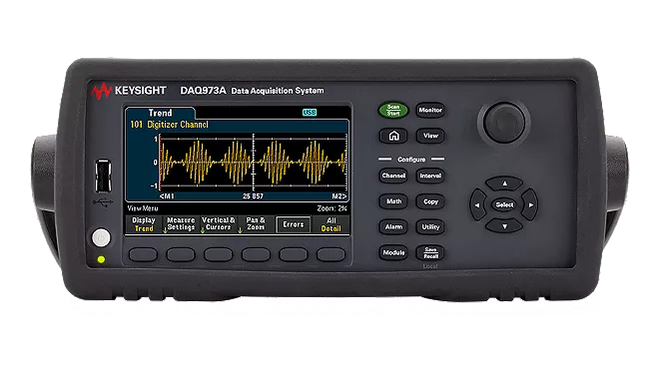
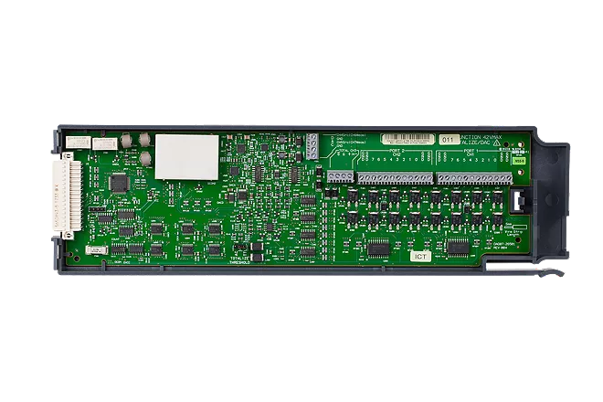
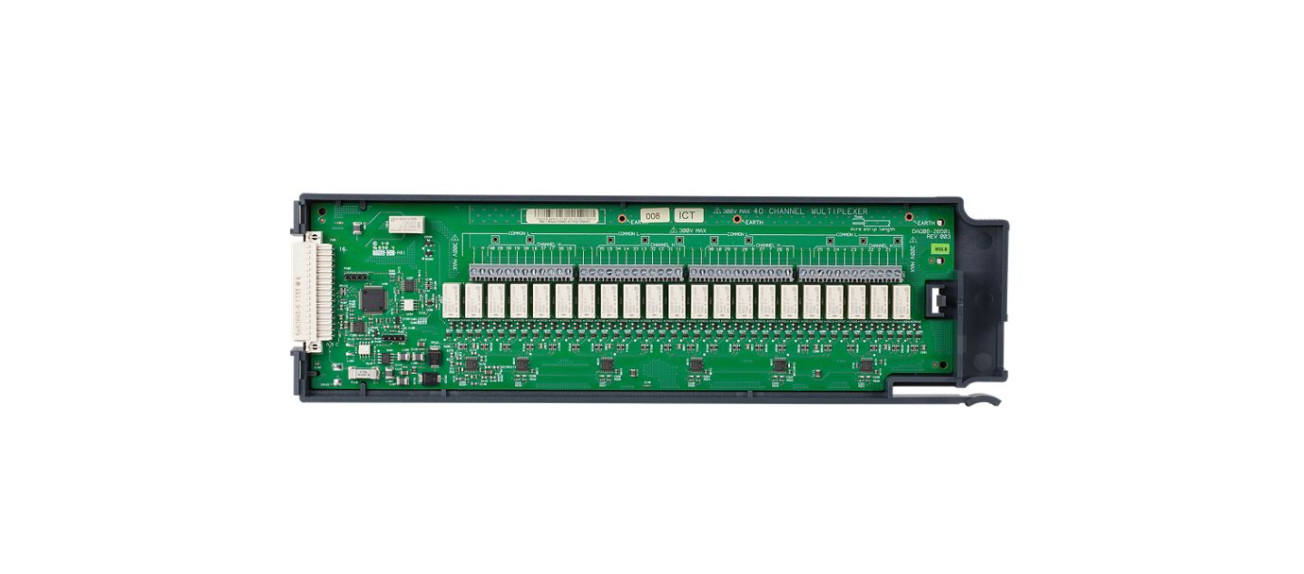
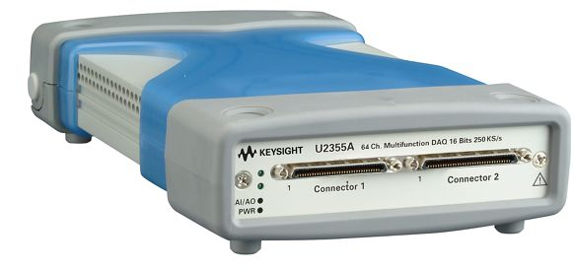
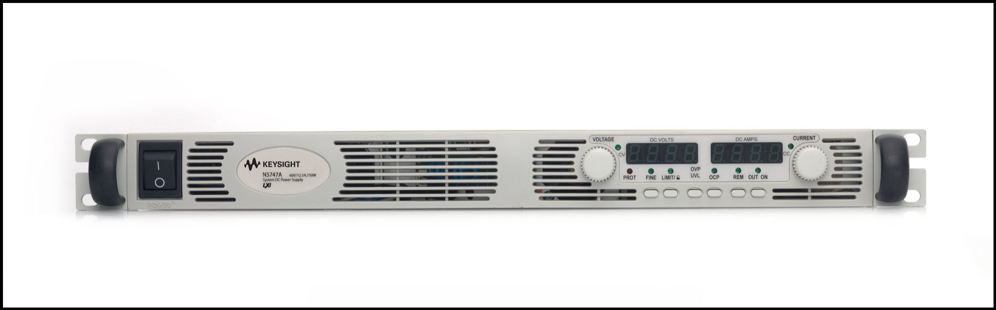
Hardware BoM & Investment
One complete test station — all off-the-shelf instruments, no PXI chassis required.
OPTIONAL
DAQ973A mainframe
DAQM908A × 2
DAQM907A
U2355A †
N5747A PSU (optional)
DMM · 3 slots
40-ch mux each
Fixture IO · AO
Rail capture
Use DUT adapter when provided
$3,569
$1,824
$895
$2,100
$3,902
≈ $15–19k / station
vs. PXI alternative
Typical PXI station: $30–50k+ plus annual software licenses. MTK runs on USB/LAN instruments you may already own.
One-time hardware · $0 software license (in-house)
*Keysight US list prices (Oct 2026) · †U2355A discontinued — reseller price · ~ = estimate

Slide 9
Investment & Deployment Strategy
Per-station total ≈ $15.4–19.3k (PSU optional) — one BoM, two use cases.
Other items | Qty | What it does | Price*
J-Link flash probe | 1 | Firmware flashing (FAT / OOBE) — reusable | ~$500
HOST PC (Windows 11 Pro) | 1 | Runs the MTK desktop app — reusable | ~$1,500
ATE test fixture | 1 | Custom per project — incl. assembly labor | ~$4,000+
Peripherals & cabling | 1 set | Custom per project — incl. assembly labor | ~$1,000+
TOTAL PER STATION |  | PSU optional — DUT adapter first | ≈ $15.4–19.3k
NXP internal — 3 stations
Supplier factories — scale by demand
Romania · Mexico · China — one station each
Used for platform & project development verification
Shared YAML projects & benchmark keep all sites aligned
Suppliers decide station count per order volume
Investment based on our published BoM list
Acceptance runs against our benchmark station
Reusable: instruments & PC · Custom per project: fixture & cabling (incl. assembly labor) · PSU optional (DUT adapter first)

Slide 10
MTK vs. Traditional Manual Testing
Same board — very different test depth.
Impedance & voltage
Clock verification
✗ MANUAL
✗ MANUAL
Handheld DMM, one point at a time — slow and operator-dependent
Oscilloscope eyeballing — “clock exists”, no precision guarantee
✓ MTK
✓ MTK
80 points scanned automatically in seconds, ±0.1% voltage accuracy
Counters measure each clock to spec: 32.768 kHz / 4 MHz / 6 MHz
Power-up sequence waveform
RF function tests
✗ MANUAL
✗ MANUAL
Not possible — scopes offer at most 4 channels
Skipped — far too complex to operate by hand
✓ MTK
✓ MTK
12 power rails captured at ms level; rise, overshoot & ripple auto-graded
Wi-Fi, Bluetooth & GNSS tested automatically with pass/fail verdicts
✗ MANUAL
✓ MTK
Power net & test point selection
Workers study design documents to locate power nets and test points
AI algorithm auto-selects power nets and the best test points
Takeaway: MTK turns today’s spot checks into full-coverage, high-precision, automated testing.

Slide 11
Summary & Ask
One decision unlocks real-mode validation and production rollout.
1
All-in-one, ready to scale
THE ASK
From design to platform, from net to system — one common platform for all NXP Commercial Boards.
▶ Approve the instrument rack
≈ $15.4–19.3k per station (N5747A optional) — unlocks Phase 3: real-mode, full-flow validation.
2
Professional automation, zero license fees
≈ $15–19k one-time per station; no recurring software cost — built by NXP, for NXP boards.
▶ Endorse the pilot rollout
First production-floor station, onboarding more board types with the HWS-CC TE team.
3
Proven, not paperware
FCT accepted on a real board with no obvious bugs; ICT test plans built for 8 board types.
Developed & deployed by NXP HWS-CC Team — all TE engineers · Thank you

