Slide 1
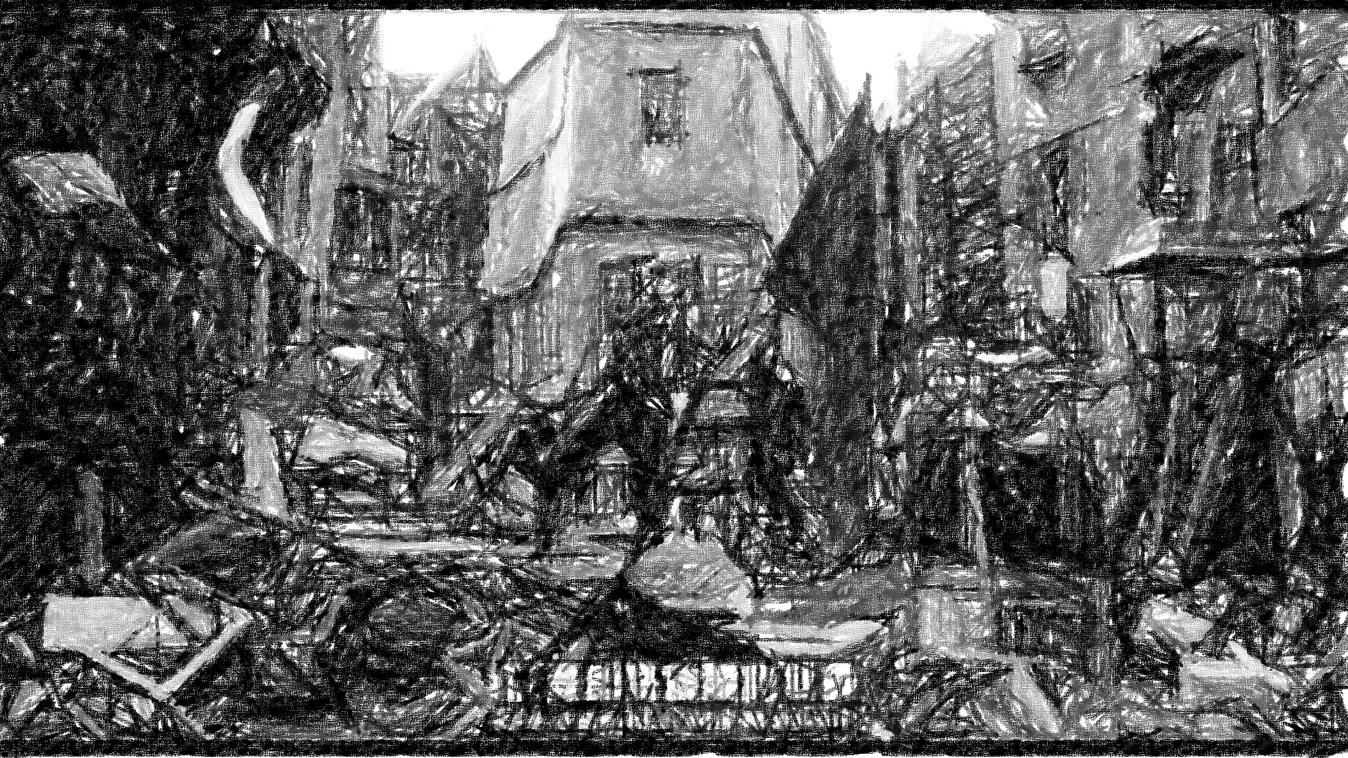
01 TITLE / IDEA
WHAT IF?
An AI-Assisted
Alternate History Short Film
Loki loses focus on the Sacred Timeline.
Four historical worlds begin to change.
Notes:
0:00–0:40 (40 seconds)
Hi everyone. My project is called What If? It is an AI-assisted alternate history short film. The whole film begins with one imagined situation: Loki gets distracted while holding the Sacred Timeline together. The timeline loosens, and things that do not belong to their time appear in four historical worlds. This is my own story premise inspired by Loki, rather than a scene from the series. The four stories belong to one film and share the same cause.
Project premise: user’s revised concept, four historical stories connected by Loki’s distraction. This is a speculative project premise, not a claim about Marvel canon.
Source: user’s proposal and edited presentation. Background concept art: OpenAI imagegen, imagined alternate history.

Slide 2
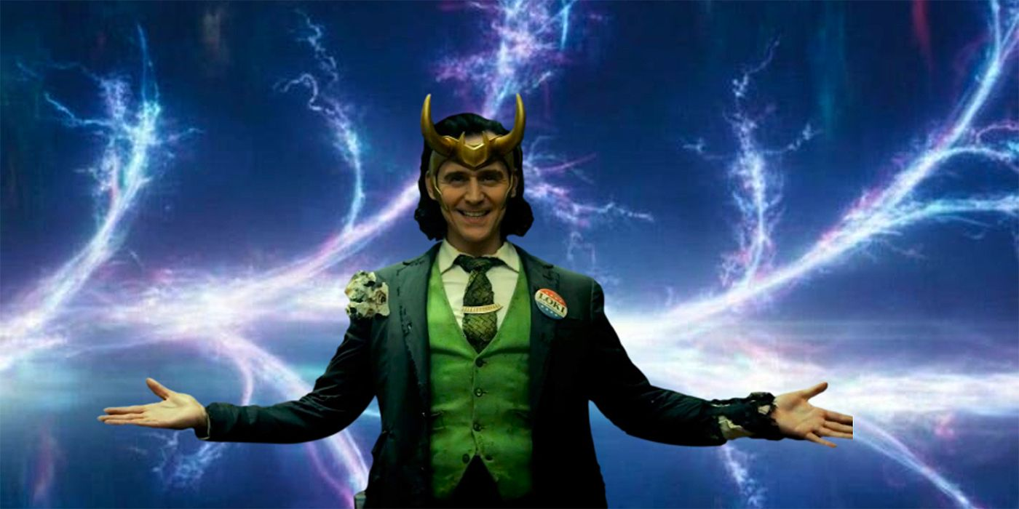
01 TITLE / IDEA
One disruption, four historical branches
Loki loses focus. The Sacred Timeline loosens.
79
1279
1832
1898
Pompeii
Battle of Yamen
June Rebellion
Tan Sitong
Emergency Alert
Future Warship
Iron Man Armor
Powered Armor
Four interwoven stories / ONE 2–4 minute short film
02
Notes:
0:40–1:20 (40 seconds)
The first story is Pompeii in the year 79, where people receive a modern emergency alert. The second is the Battle of Yamen in 1279, where the Southern Song forces encounter a warship from the future. In the third, Enjolras has Iron Man-style armor during the June Rebellion in 1832. The fourth imagines Tan Sitong with powered armor in 1898. These happen in different historical periods, but the same timeline disruption connects them. I want to cut between the four stories, showing their changes unfolding alongside one another. They are all part of the final two-to-four-minute film.
Project premise: user’s revised concept, four historical stories connected by Loki’s distraction. This is a speculative project premise, not a claim about Marvel canon.
Source: user’s proposal and edited presentation. Background concept art: OpenAI imagegen, imagined alternate history.

Slide 3
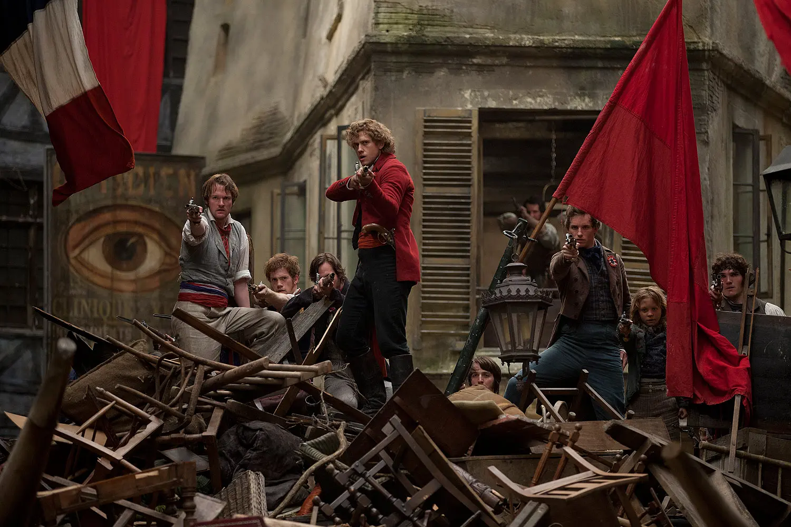
02 MOTIVATION / INTERESTS
Why I want to revisit history
Historical regret
Four chances to imagine a different ending
Anachronism
A technology that does not belong to its time
Would these changes create a better future?
03
Notes:
1:20–2:00 (40 seconds)
I am interested in historical moments whose endings feel impossible to change. When I read about a disaster, a failed rebellion or a lost battle, I wonder what might have happened differently. The four stories let me explore that feeling in different situations. I also like the visual contrast between a historical world and futuristic technology. An emergency alert offers a warning, while a warship or armor offers power. But neither necessarily guarantees a better ending. The film asks what people might do when they suddenly have another chance.
Project premise: user’s revised concept, four historical stories connected by Loki’s distraction. This is a speculative project premise, not a claim about Marvel canon.
Source: user’s proposal and edited presentation. Background concept art: OpenAI imagegen, imagined alternate history.

Slide 4
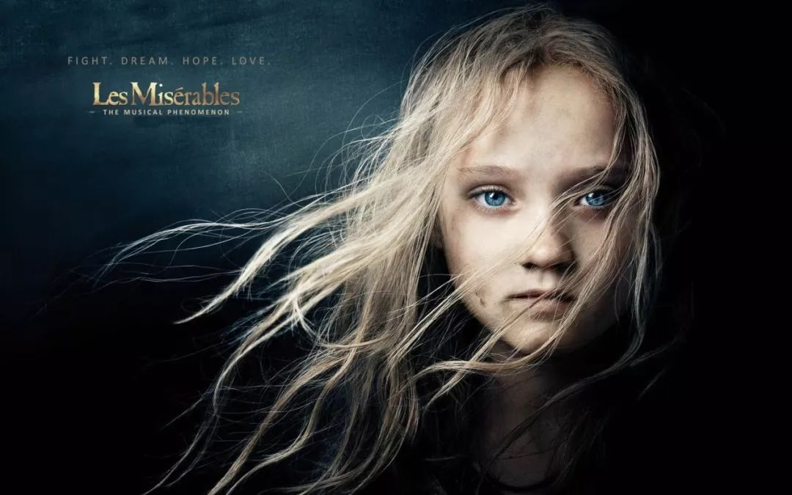
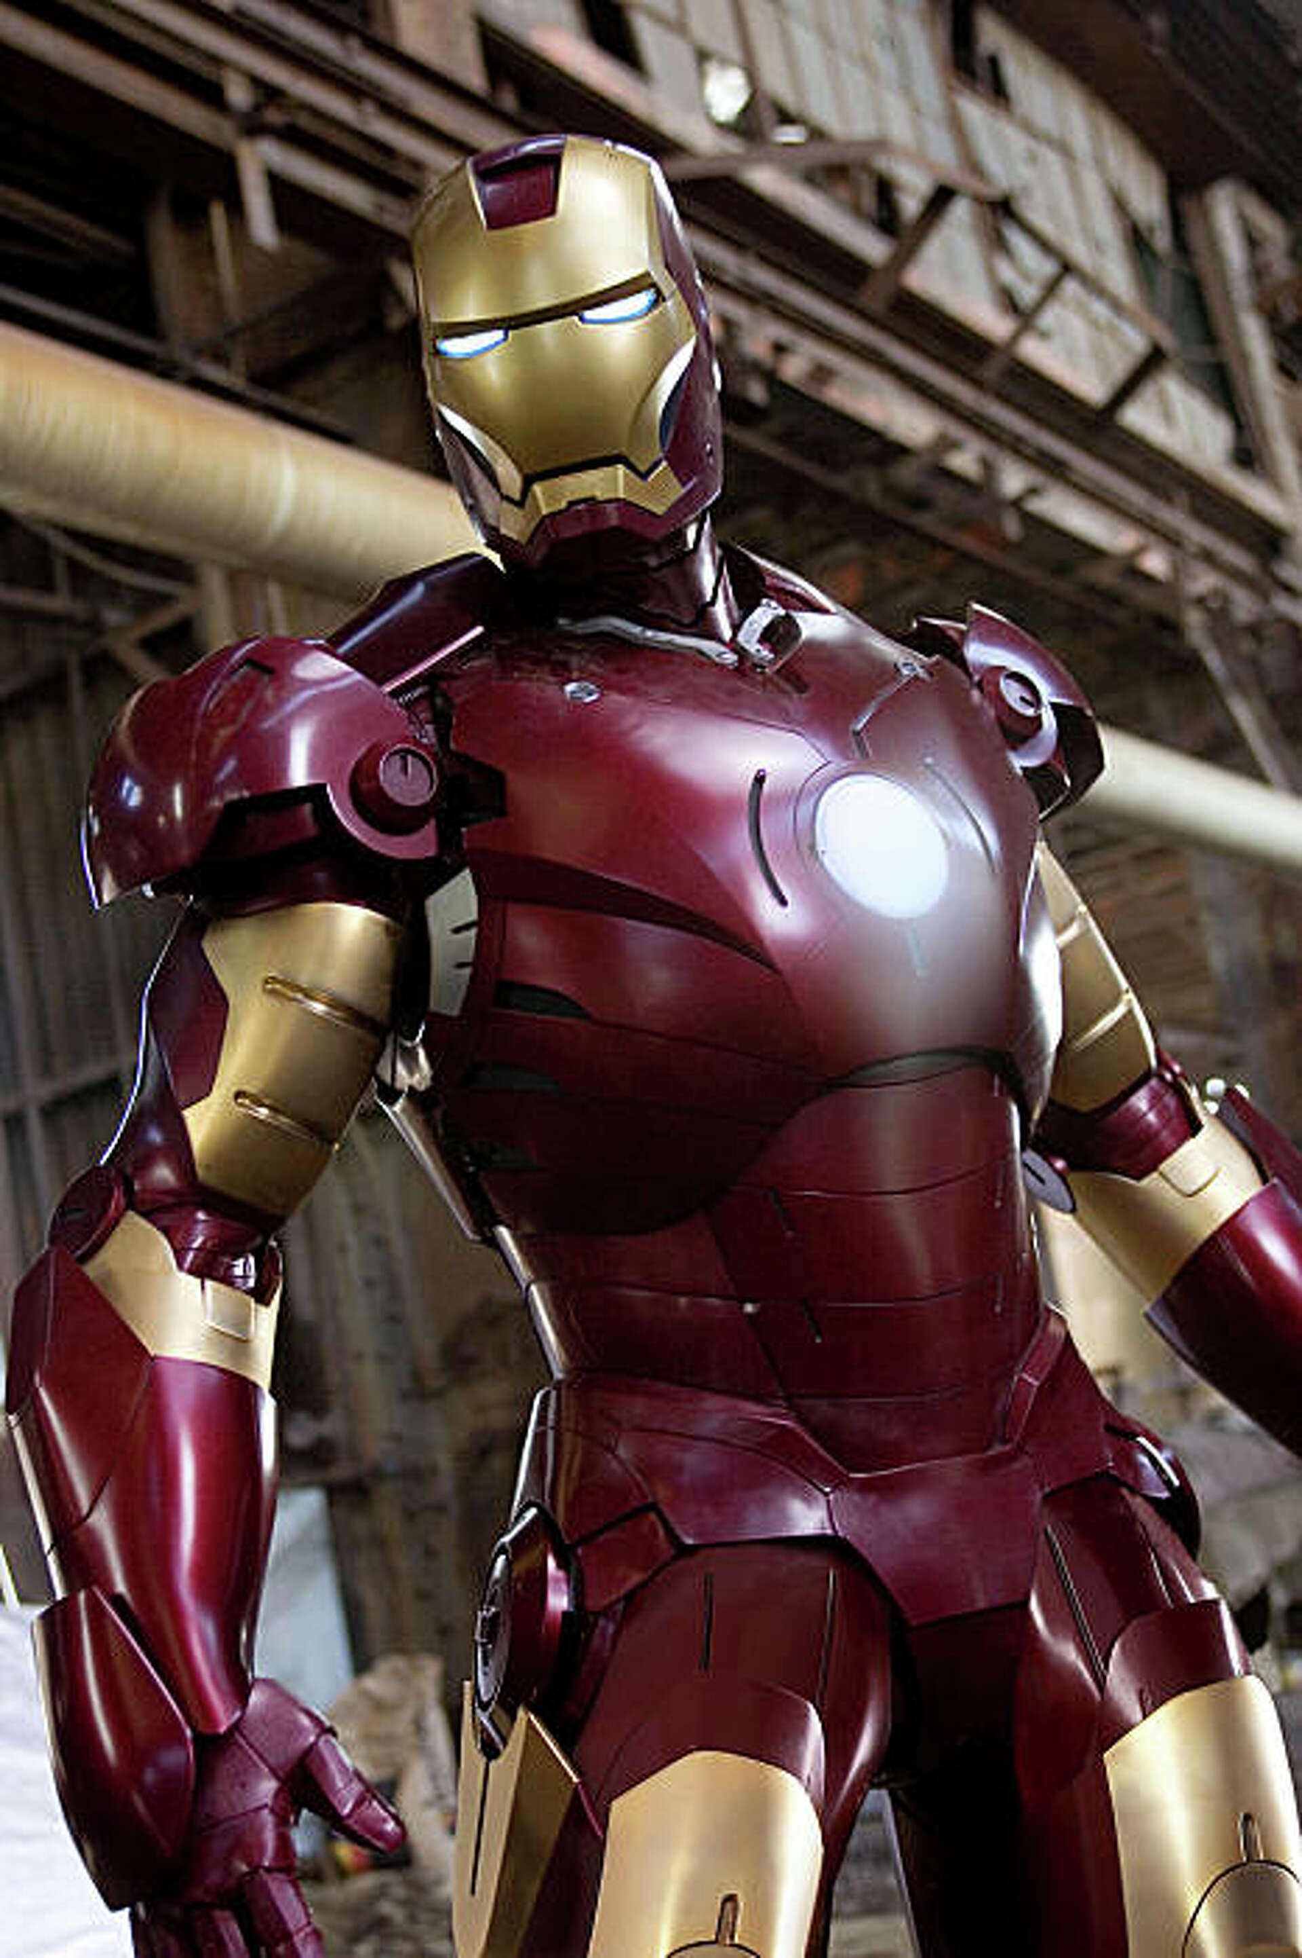
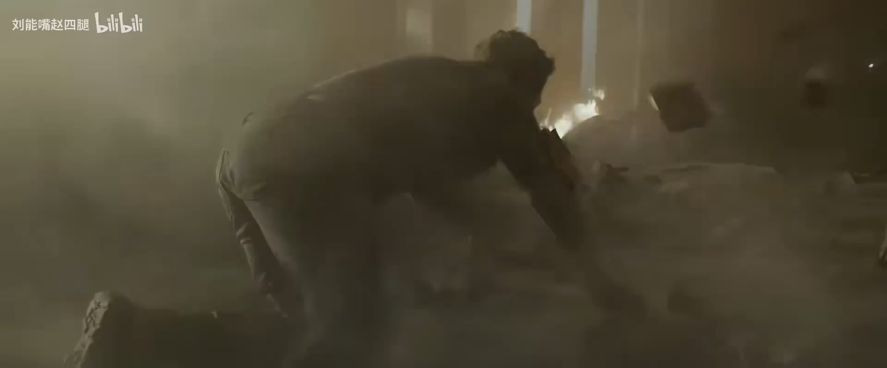
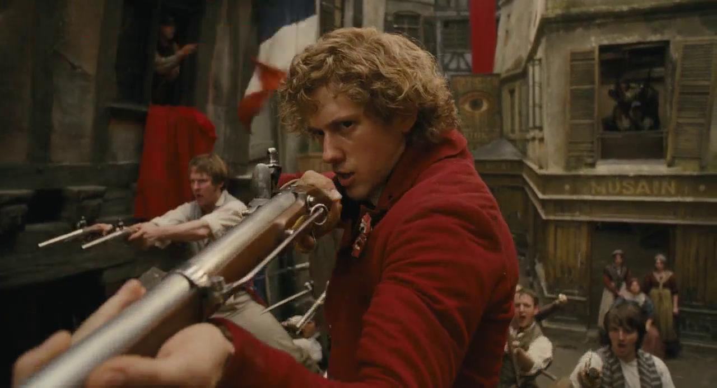
03 INSPIRATION & REFERENCES
The emotional starting point + the impossible object
Les Misérables
Iron Man
Enjolras / barricade / idealism / sacrifice
Futuristic armor / anachronism
04
Notes:
2:00–2:25 (25 seconds)
Les Misérables gives me the emotional starting point: the barricade, idealism and sacrifice. Enjolras is a fictional character, so that part combines historical fiction with alternate history. Iron Man gives me the impossible object and the visual contrast of advanced armor in an old historical world. The film still and the armor image show the two ideas that first came together for me.
Project premise: user’s revised concept, four historical stories connected by Loki’s distraction. This is a speculative project premise, not a claim about Marvel canon.
Image credits:
Les Misérables (2012), film still, Universal Pictures / Working Title. Image accessed via IMDb: https://www.imdb.com/title/tt1707386/characters/nm3117836/
Image URL: https://m.media-amazon.com/images/M/MV5BNWFkM2Q1ZjctODQwNS00NWE2LTlkMmMtYzM2ZmNlOTQzNGM1XkEyXkFqcGc%40._V1_.jpg
Iron Man (2008), promotional still, Marvel Studios. Photographer credit: Zade Rosenthal, as credited by SFGATE. Source: https://www.sfgate.com/entertainment/article/indie-cred-gave-iron-man-filmmaker-his-shot-3217592.php
Image URL: https://s.hdnux.com/photos/10/73/64/2342166/20/1920x0.jpg
Concept and narrative: user’s supplied proposal.

Slide 5
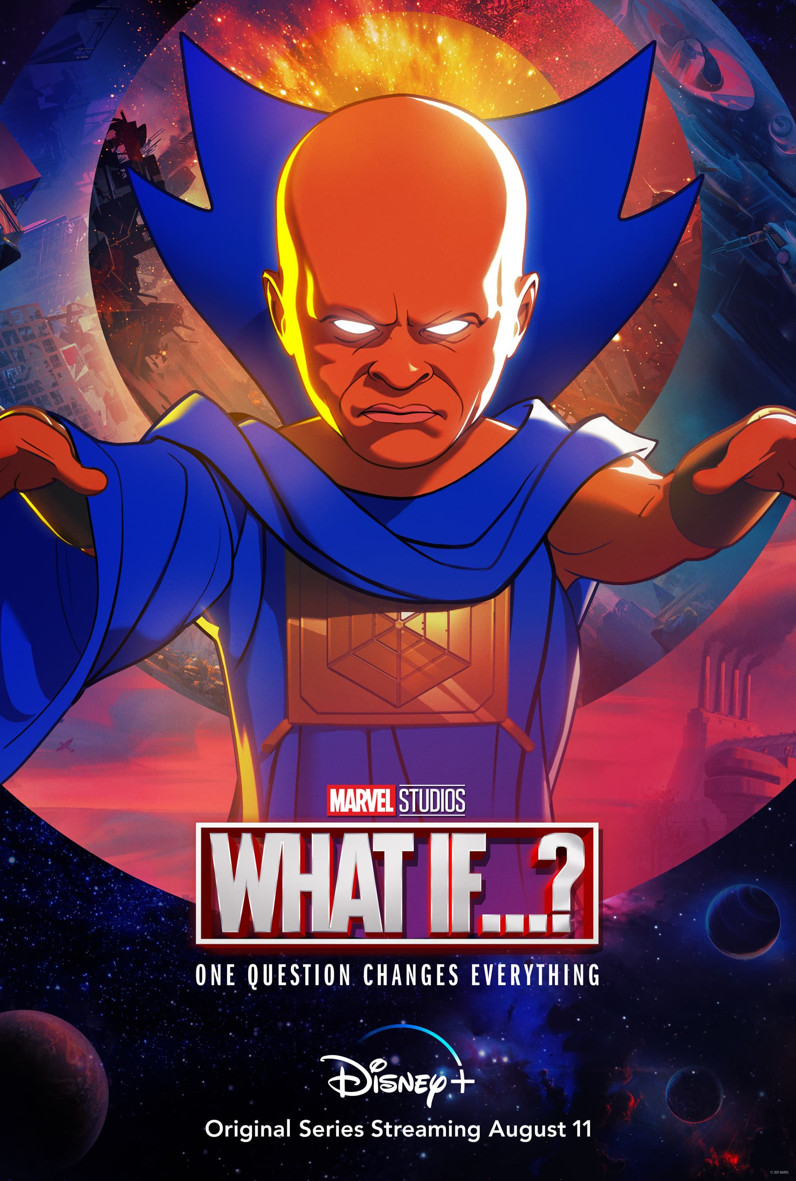
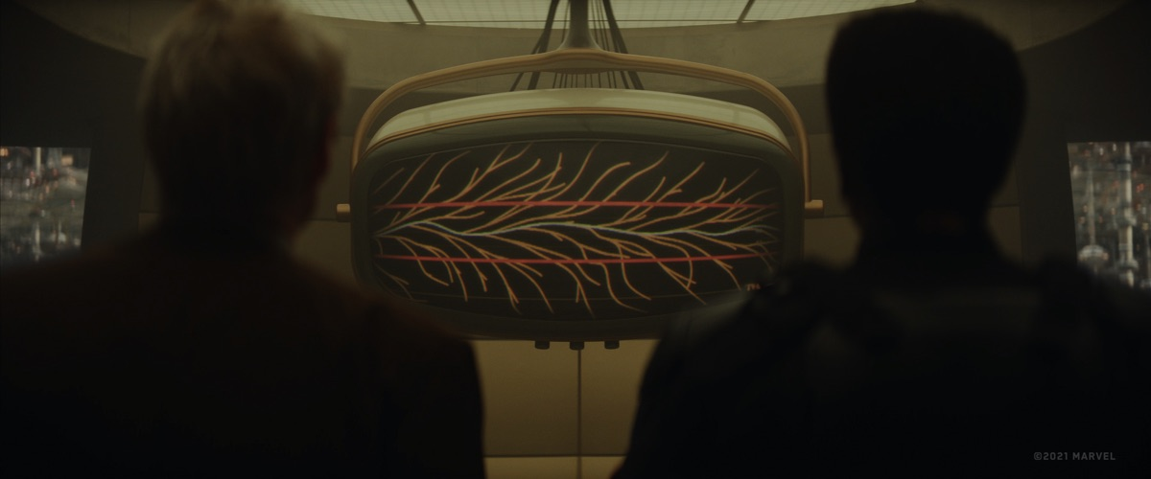
03 INSPIRATION & REFERENCES
Loki connects the four historical branches
Loki / TVA
Marvel’s What If...?
Shared disruption / branching timelines / multiverse
Parallel possibilities
TVA = Time Variance Authority
05
Notes:
2:25–2:55 (30 seconds)
Marvel’s What If...? inspires the question of how one change creates another outcome. Loki gives the project a shared narrative frame, as well as the Sacred Timeline, branching realities and the TVA. In my version, Loki’s distraction triggers all four branches. The TVA timeline screen is a visual reference for the disruption. I want the opening to establish the cause quickly, so most of the film can focus on the four historical situations and the people inside them.
Project premise: user’s revised concept, four historical stories connected by Loki’s distraction. This is a speculative project premise, not a claim about Marvel canon.
Image credits:
Marvel Studios What If...? (2021), official Watcher promotional poster. Copyright Marvel Studios / Disney. Source: https://www.marvel.com/articles/tv-shows/what-if-the-watcher-poster
Image URL: https://cdn.marvel.com/content/2x/online_16.jpg
Loki (2021), TVA timeline screen, Marvel Studios / Disney. Screen graphics: Cantina Creative. Source interview: https://beforesandafters.com/2021/08/10/designing-the-sacred-timeline-in-loki/
Image URL: https://i0.wp.com/beforesandafters.com/wp-content/uploads/2021/08/106_TVA_FINAL_EDIT_LOKI_CANTINA.jpg?fit=1200%2C500&ssl=1
Concept and narrative: user’s supplied proposal.

Slide 6
04 PATHWAY & PLAN
Pathway B
AI-assisted Animation, Film, and Video
2–4 min
Development
Research all four historical worlds
Script + visual development
Storyboard / intercut animatic
Loki framing scene
Four intercut historical stories
Return to the timeline
Production
Short scenes, shared visual style
AI images + short video shots
Editing + sound + compositing + revision
06
Notes:
2:55–3:45 (50 seconds)
I selected Pathway B: AI-assisted Animation, Film, and Video. The film will still be around two to four minutes, so each historical story needs to work as a short visual sequence. I plan a brief Loki opening, four intercut stories and a return to the timeline at the end. I will research all four worlds, write one connected script and build a storyboard or animatic to test the rhythm. The sequence will move through the familiar historical situation, the arrival of the unexpected technology and a response. I will test difficult shots early and use a shared color and sound approach to connect the four worlds.
Project premise: user’s revised concept, four historical stories connected by Loki’s distraction. This is a speculative project premise, not a claim about Marvel canon.
Source: user’s proposal and edited presentation. Background concept art: OpenAI imagegen, imagined alternate history.

Slide 7
05 TOOLS / PRODUCTION / AI ROLES
I plan and edit. AI generates the visuals.
MY ROLE
AI ROLE
Research and historical checks
Four-story script and shot design
Storyboard and art direction
Selection and final decisions
Video editing and sound design
Four historical worlds and costumes
Concept images and visual variations
Image-to-video and motion tests
Optional voice / sound experiments
Provisional tools
ChatGPT / image generator / image-to-video tool / video-to-video tool/ Premier / Jianying
07
Notes:
3:45–4:35 (50 seconds)
My role is to research, write and plan the film. I will decide how the four stories connect, design the shots and edit the material into one sequence. I will also make the sound design and final creative decisions. AI will help generate the historical environments, costumes, concept images and short moving shots. My provisional tools are ChatGPT, an image generator, an image-to-video tool and DaVinci Resolve. I will choose the final generation tools after testing them. Because these are histories that never existed, AI helps me create their images, while I decide what the images mean and how they work together.
Project premise: user’s revised concept, four historical stories connected by Loki’s distraction. This is a speculative project premise, not a claim about Marvel canon.
Source: user’s proposal and edited presentation. Background concept art: OpenAI imagegen, imagined alternate history.

Slide 8
06 QUESTION & CHALLENGE
Three challenges
01
AI tool policies and capabilities
Some scenes may be difficult to generate
Test key shots early and adjust the staging
02
Visual consistency
Consistent faces, costumes and armor across tools
Build a reference sheet for each historical world
03
Limited budget
Video generation costs add up across four stories
Use short shots, stills and a fixed generation budget
08
Notes:
4:35–5:20 (45 seconds)
My first challenge is the policies and capabilities of AI tools. Some scenes may be difficult to generate, so I need to test the key shots early and adjust how I stage them. The second is consistency across different tools. Each world needs a reference sheet for faces, costumes and the futuristic object, as well as checks of historical details. The third is budget. Video generation can become expensive when I am making four stories. I will keep shots short, use still images where they work and set a generation budget before producing the full film.
Project premise: user’s revised concept, four historical stories connected by Loki’s distraction. This is a speculative project premise, not a claim about Marvel canon.
Source: user’s proposal and edited presentation. Background concept art: OpenAI imagegen, imagined alternate history.

Slide 9
06 QUESTION & CHALLENGE
Open question
It’s my first time trying creative video generation so I’m not sure if the time is enough to have this project done within this semester.
And it’s a big money for individual so can the school department help on that? Since we handed in considerable amount of tuition fee.
09
Notes:
5:20–5:45 (25 seconds)
My open question is: Would the film be more meaningful if all four stories change history, or if some still reach their original tragic endings? I have not decided those outcomes yet. Different endings might show that warning, power and technology have different limits. I would like feedback on how the four outcomes can work together, so the film feels like one connected idea.
Project premise: user’s revised concept, four historical stories connected by Loki’s distraction. This is a speculative project premise, not a claim about Marvel canon.
Source: user’s proposal and edited presentation. Background concept art: OpenAI imagegen, imagined alternate history.

